Slide 1
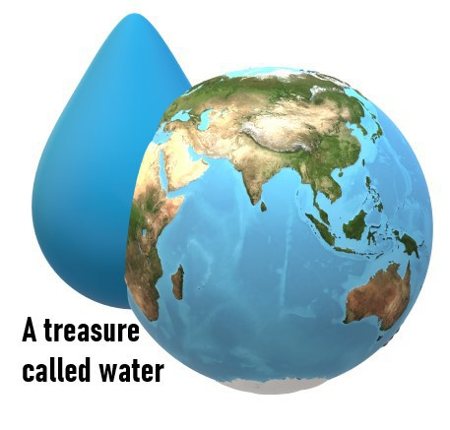
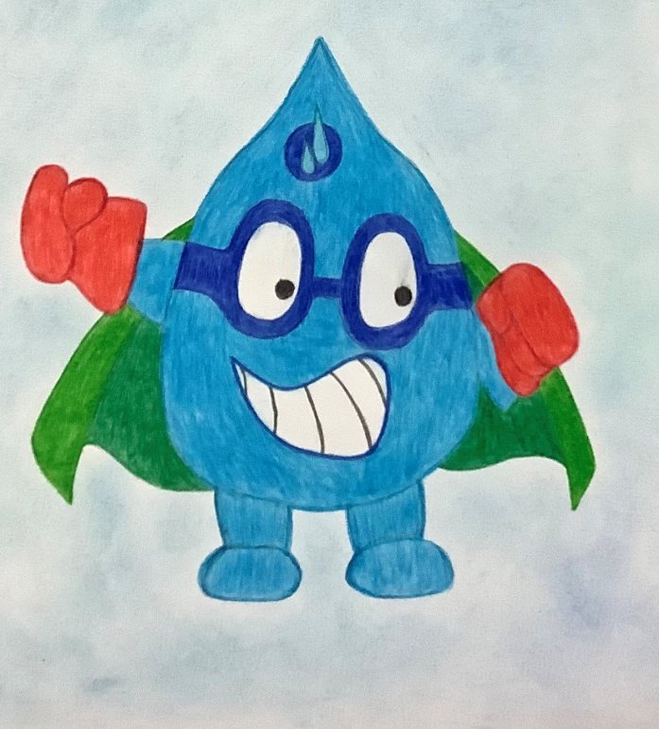
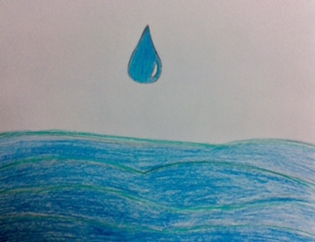
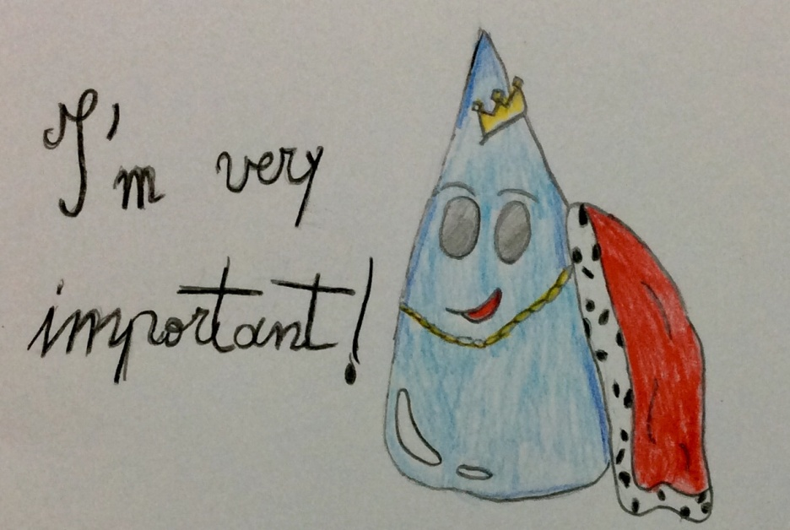
A TREASURE CALLED WATER
MODULE 6- WATER SAFETY PLAN II
SEARCHING FOR CLEAN WATER

Slide 2
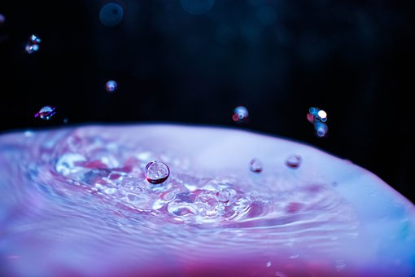
Safe clean water saves lives
Water for all
With access to safe water and hygiene facilities, people can protect themselves from deadly diseases.

Slide 3
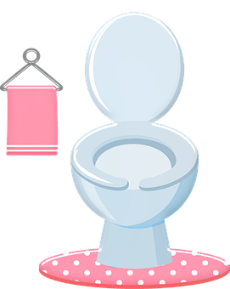
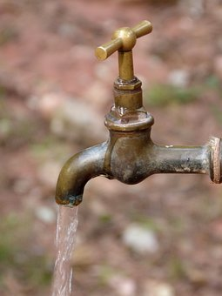
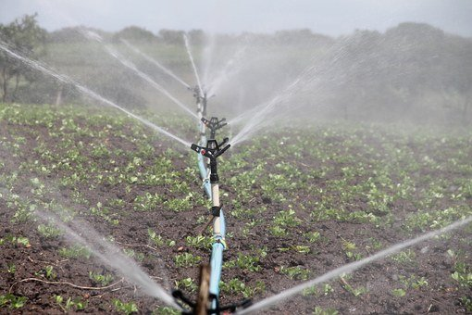
We should help people get safe, clean water
Sharing advice in schools on how to keep clean and stay safe
Installing irrigation systems for farming,
Taps, tanks and toilets

Slide 4
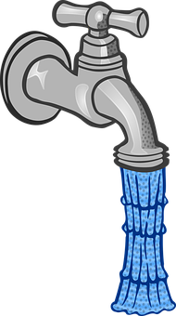
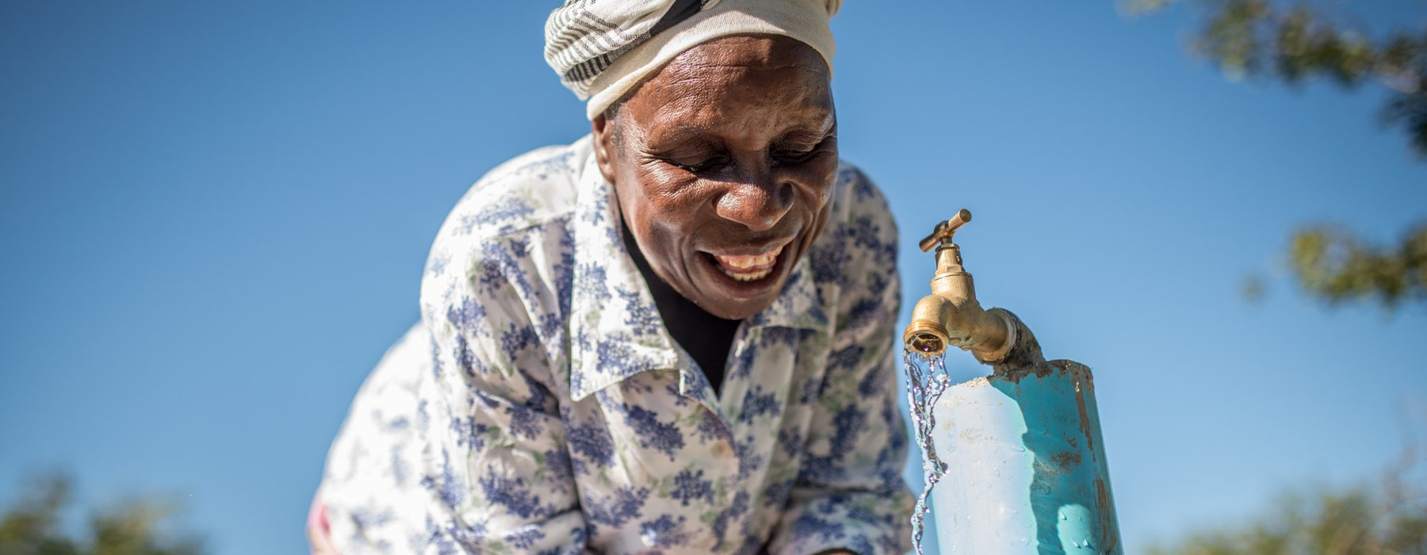
“The first time I got water from the tap I was ecstatic. I do not know how to describe my happiness; it is impossible.”
(Emmely from Zimbabwe. She now has fresh clean water from a tap near her home.)

