Slide 1
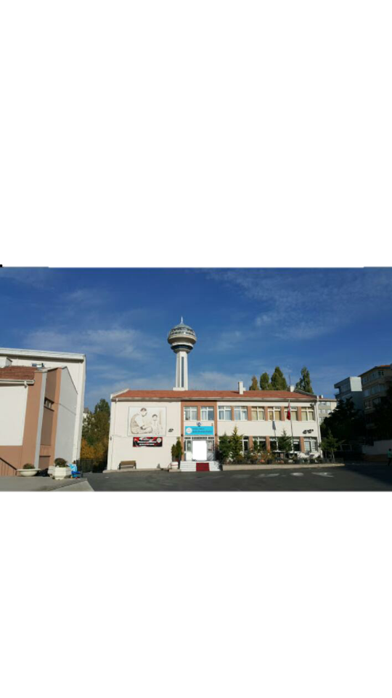
Halide Edip Adıvar Secondary School

Slide 2
Halide Edip Adıvar Middle School
Our school's name is Halide Edip Adıvar middle school. Halide Edip Adıvar is a very important writer. The name of our school’ headmaster is Hikmet Atıcı. Our school always participates in social activities. Our school is also very successful.

Slide 3
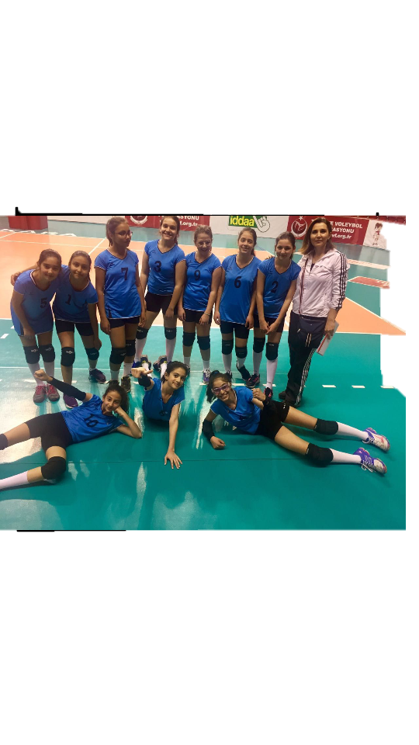
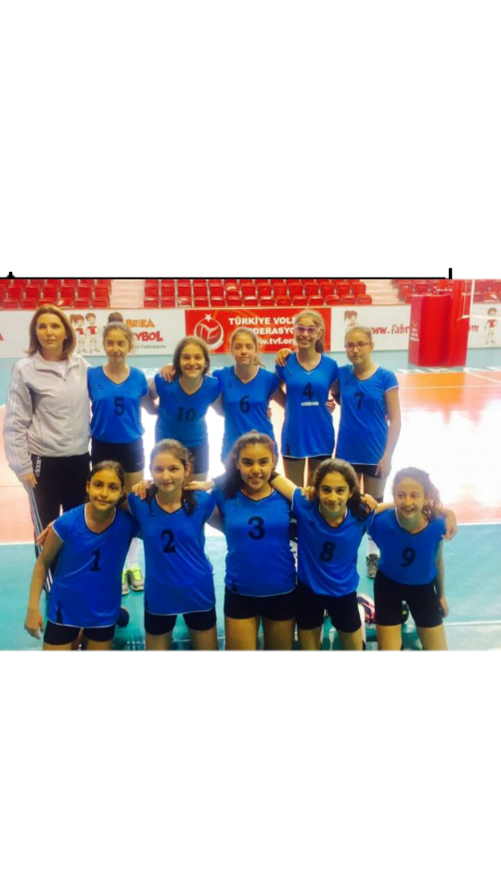
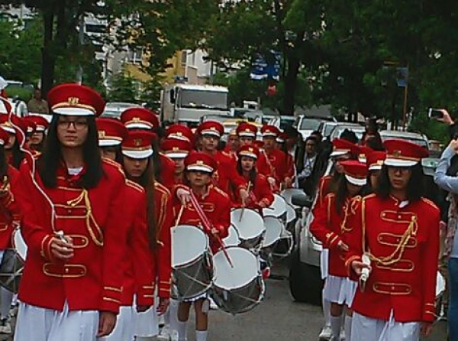
SCHOOL TEAMS
Our school has volleyball team, basketball team, soccer team and band team. Our school has been successful in all of these activities.

Slide 4
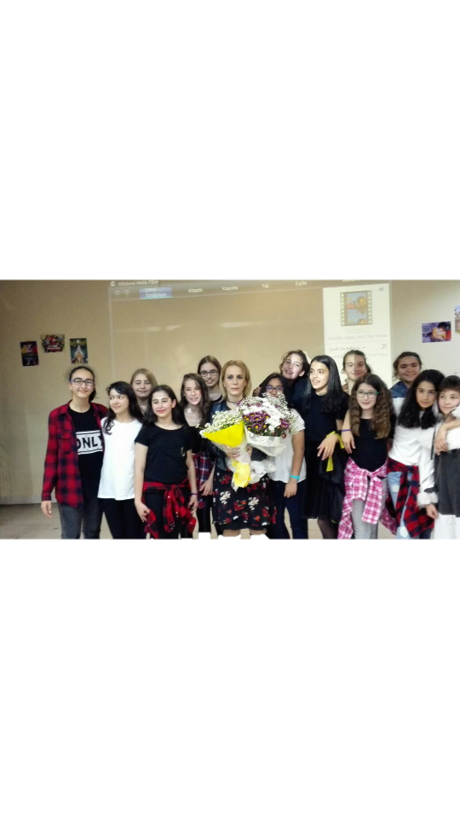
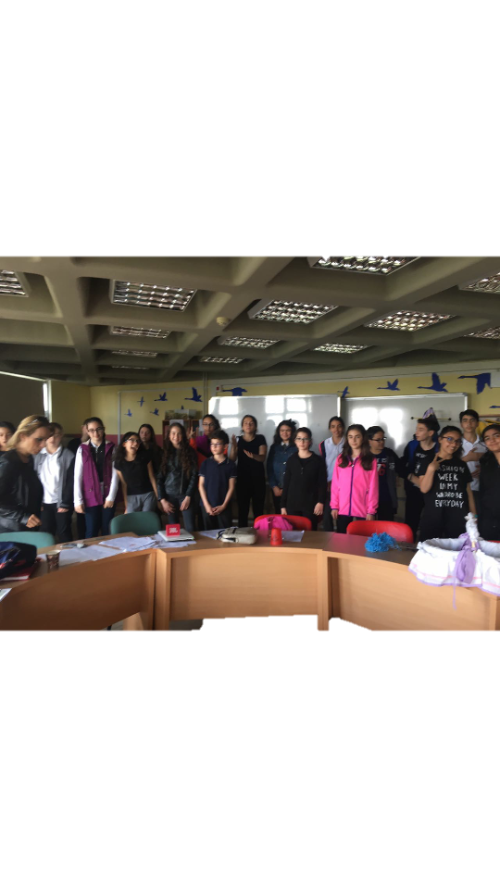
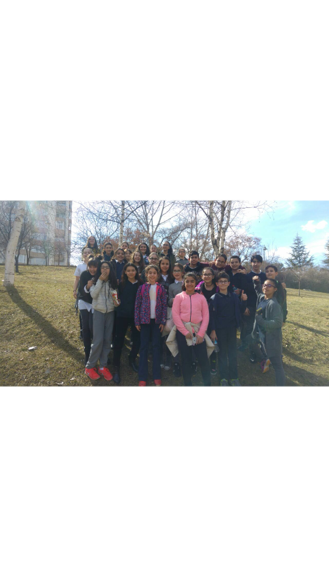
TRAVELS AND PROGRAMS
There are travels and programs organized by our school.

Slide 5
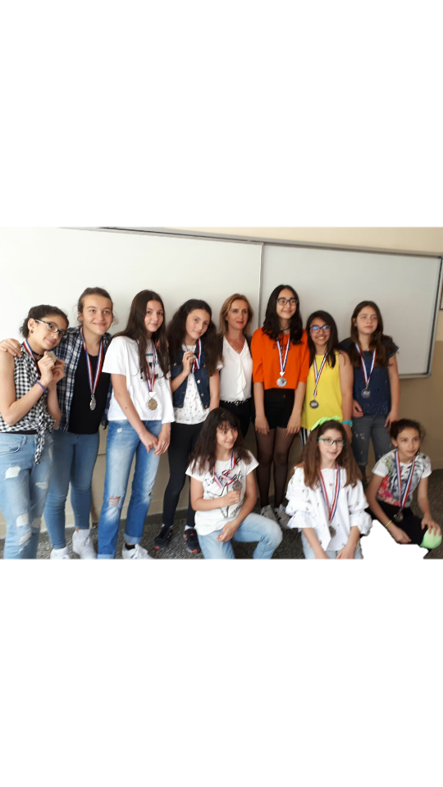
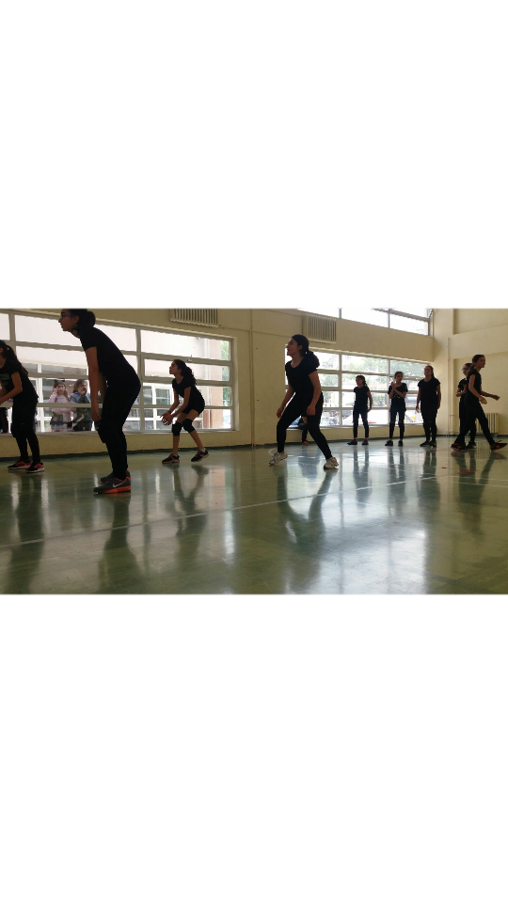
INTERCLASS MATCHES
Physical education teachers organize interclass matches. These are volleyball, basketball and football matches. These matches are entertaining and exciting. As well last year our class was the first .

Slide 6
It is a typical English lesson of our class.

Slide 7
Our subject was love or money

Slide 8
Our school band as usual ın every national day

Slide 9
Here is or library

Slide 10
Thank you for watching

