Slide 1
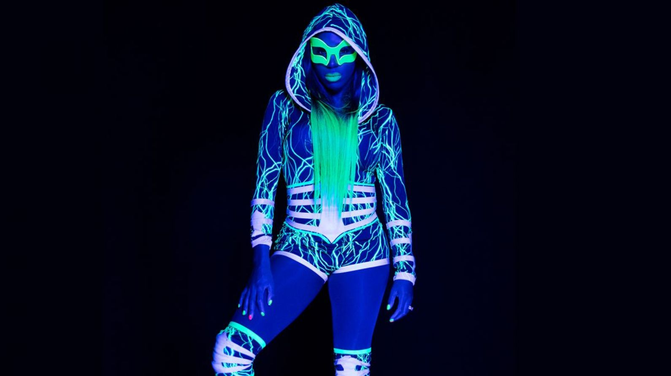
Wwe 2017
I like Naomi

Slide 2
Monster hunter stoires

Slide 3
Pokemon

Slide 4
Congolais

Slide 5
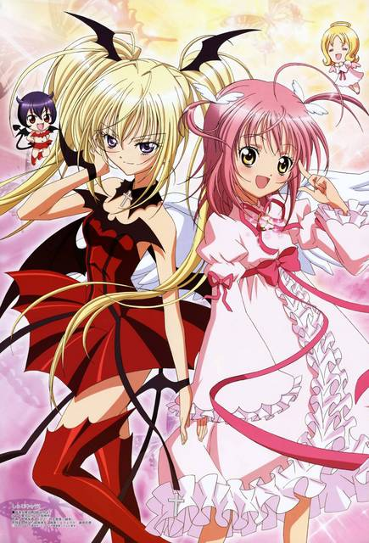
Shugo chara

Slide 6
Camilla Cabello /Sing:Havanna

Slide 7
Dragon ball Super

