Slide 1
My surname is YAYILKAN My name is Bayram-Can i am 12 year old

Slide 2
i live in Creil,France

Slide 3
my nationality is Turkey

Slide 4
i like middle scool

Slide 5
I dont like cold

Slide 6
I speak Turkey

Slide 7
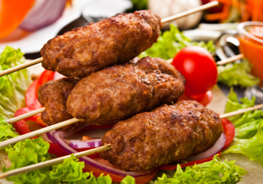
Favourite food kebab

