Slide 1
Ma carte identité Anglais »
My name is Ziaddine Herizi

Slide 2
I am twelve yers old

Slide 3
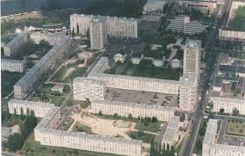
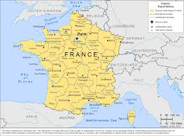
I live in Creil, I com from French

Slide 4
My nationnality is french

Slide 5
my origin is Algerian

Slide 6
I like the playstation 4

Slide 7
I like favorite food banana

Slide 8
I don't like shcool

Slide 9
My favorite subject math

Slide 10
speak Arabies,English and French

