Slide 2
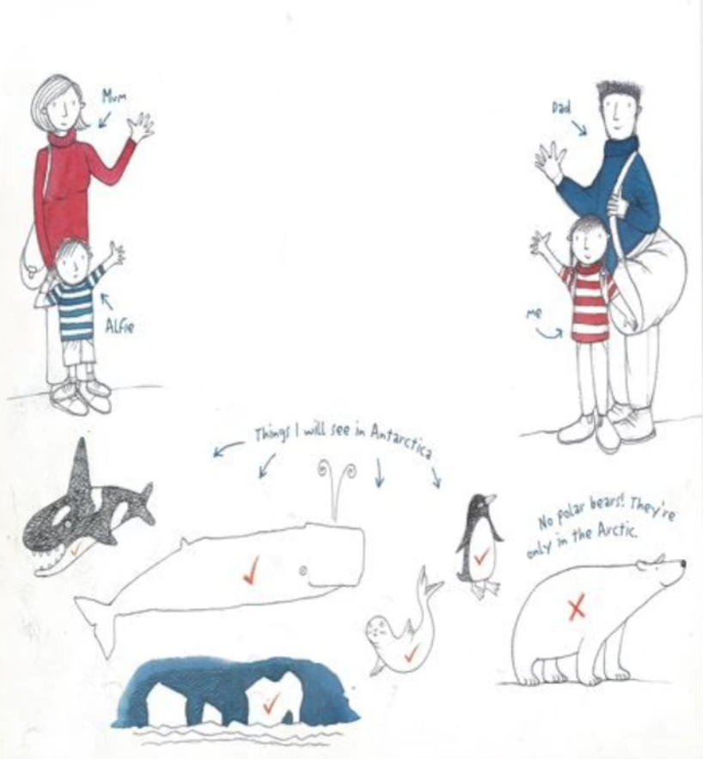
Whohoo I'm going to Antarctica. That's right, me, Sophie Scott. I'm 9 years old and I'm going to Antarctica with my dad. He's the captain of the Aurora Australis. It's an icebreaker a ship that can go through ice. We are delivering people and supplies to Mawson Station. We will be the last visitors there before winter comes and the ocean freezes.
We will be at sea for about a month. It will take nearly two weeks to get there, Then after a week at Mawson it will be time to come home.
I'll see icebergs, penguins, seals and whales. Dad says they might even be blizzards.
I can't wait.

Slide 3
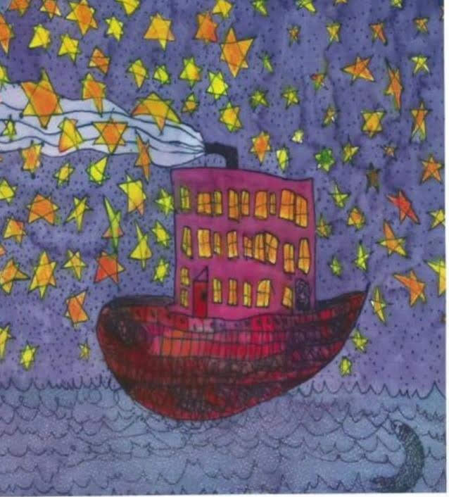
Day 1
Mum was being brave when she hugged me goodbye at the airport, But I could see tears in her eyes. Alfie was sad too so I promised to bring him back some Antarctic ice. When our plane was arriving in Hobart I could see the Aurora Australis in the harbour. She looked tiny from the air, but when I stood beside her (dad says ships are always girls) I could see she was enormous, as long as a soccer ground and five stories high.
Dad carried my bags to our cabin and I unpacked my things. My bunk has a little curtain I can pull across. There's a reading light just above my pillow and it feels like a cubbyhouse. It's nice knowing dad will be just on the other side of the cabin.
I climbed up to the top deck and watched as passengers lugged bags up the gangway, and a big crane swung a net full of cargo onto the ship.
When everything was packed. Dad blew the horn and the ship moved slowly away from the dock. We threw lolly-coloured streamers to the people waving and held on until the streamers snapped and the water between us got wider and wider.

Slide 4
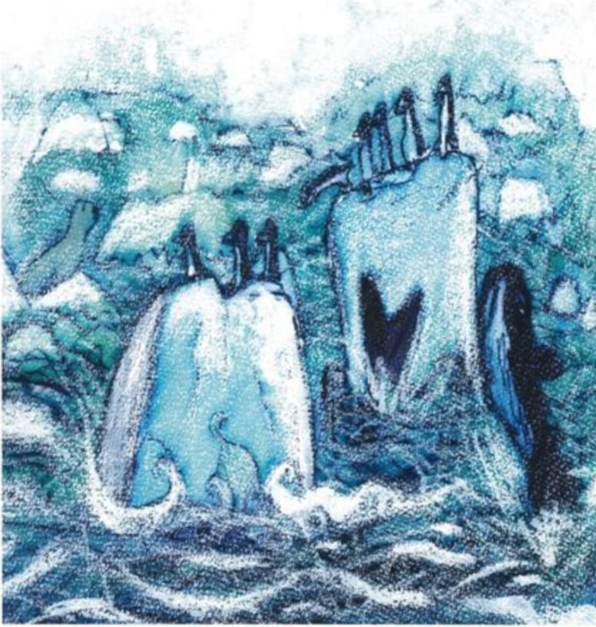
As we left Hobart, a big moon reflected on the water and lights twinkled along the hills. I felt like an astronaut, heading into outer space, a bit scared, but very excited.
Day 2
Last night I felt safe and snug as the ship crashed through the waves. I love my little bunk. I'm still finding my sea legs, but I haven't felt seasick. Dad says, I have the ocean in my veins. I'm very careful when I'm on deck. ‘One hand for the ship and one for yourself’ is what dad says. He means always hang on. It would be terrible to fall overboard.
There are 62 people on the ship(plus me) and I met most of them today. Twenty three are crew members and the rest are the Mawson resupply expedition.
They are
-the voyage leader and his deputy,
-16 people going to stay at Mawson for a year,
-12 visiting scientists,
-six people to drive boats
-two crane operators,
-one artist, mom's friend Sarah.

Slide 5
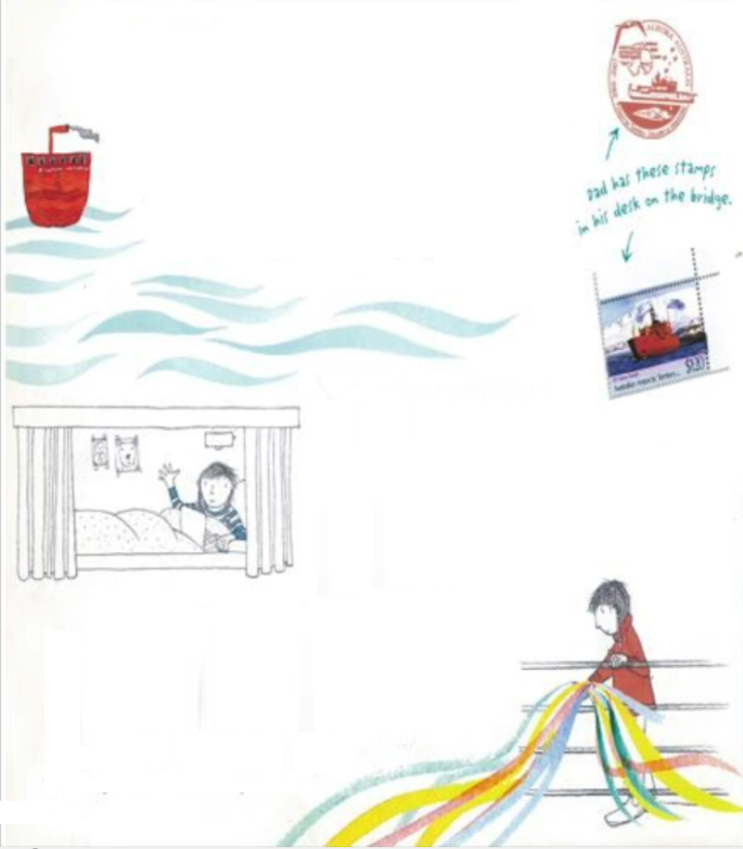
Some things on the ship have special names. My bunk is called a berth, the window is a porthole, the kitchen is the galley and the dining room is the mess. I made a new friend today, Georgie, who is going to Mawson for a year to study penguins. She taught me a dance called the Penguins strut.
This morning we put on our life jackets and all went to the helideck for a muster where we learned about safety and rescue. We climbed into the big orange lifeboats hanging off the side of the ship. Each one fits 70 people and the toilet is a bucket. The food is stale sea biscuits.
I hope we don't ever have to use the lifeboats. Dad says I shouldn't worry. He's been to Antarctica lots of times and never been shipwrecked.

Slide 6
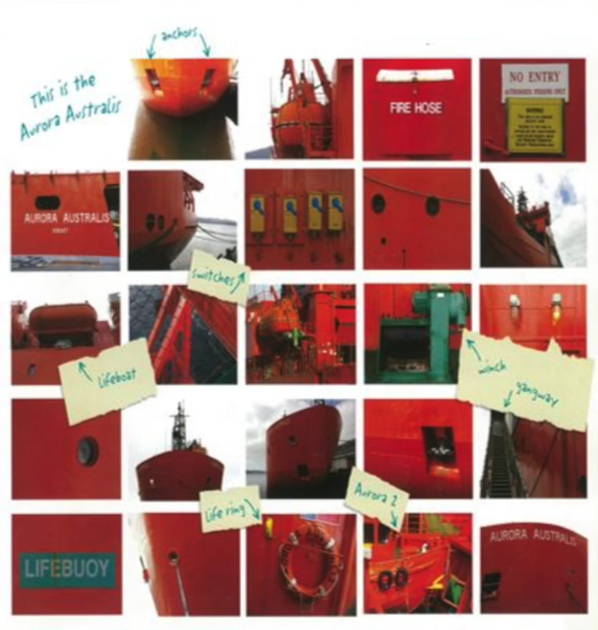
Day 5
I missed a couple of days in my diary because the sea has been so rough. Last night the ship was rocking and rolling like crazy. Anything that's not tied down goes flying and I have to hold on all the time. Sometimes a wave bashes the ship so hard that it feels as though we've hit a rock. The dining-room portholes go underwater every time the ship does a big roll. It's like we're eating inside a washing machine. Hardly anyone came to breakfast this morning because lots of people are seasick.
Mum's friend Sarah has given me a desk in her studio where I can draw and paint. It's a tiny cabin with no windows. Sarah says that being in this room is like being in the belly of a whale because the pipes in the walls moan and groan, like a rumbling tummy. I'm not allowed to go on deck by myself when the sea is this rough, but this afternoon Dad, let me go with Sara to take some photos.
The wind was so strong and cold I could hardly breathe. The ship rolled beneath us like a bucking horse and we watched an albatross sweep over the waves.

Slide 7
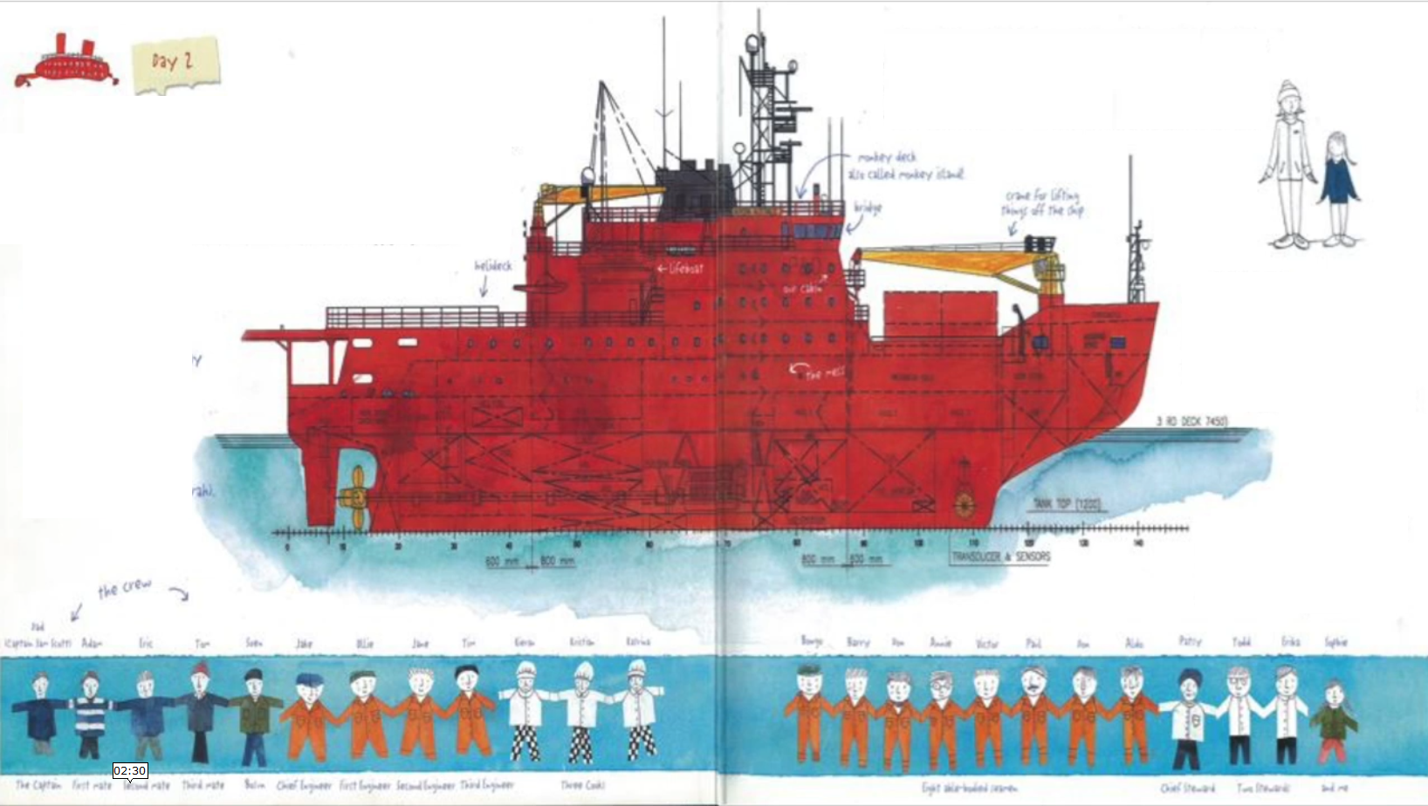
Day 7
When I looked out of my porthole this morning, there were two big icebergs on the horizon. My first icebergs. Dad steered the ship close to one and it was as big as a 15 storey building. It looked like a giant crouching Lion.
We also passed a jade iceberg, and one with a big black stripe. The stripe was rock that had been picked up by the ice when it was part of a glacier grinding slowly over Antarctica.

Slide 8
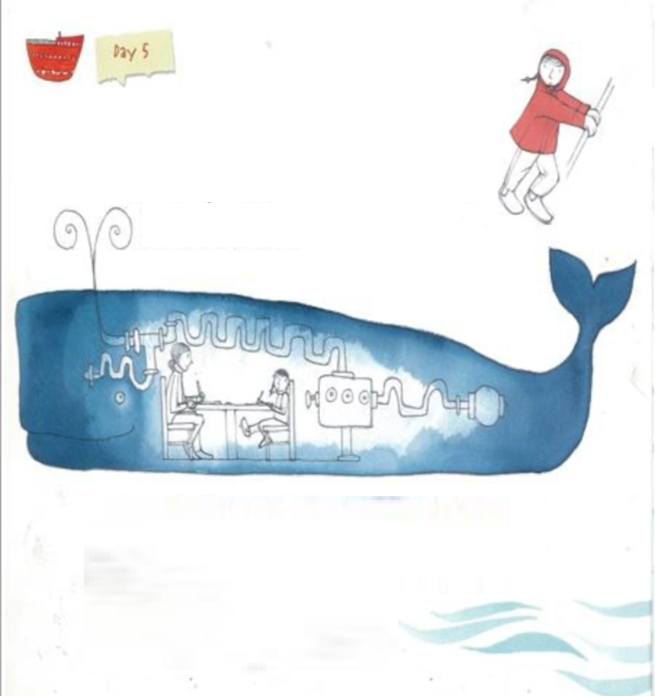
I was toasty today in my special polar clothes. First I put on a thermal top and long johns, thick woolen socks, neck warmer, polar fleece top and pants, freezer suit, insulated snow boots, mittens, beanie, sunglasses and finally a big Gore-Tex jacket. I looked like a Teletubby.
As we head towards Antarctica it feels as though we are entering an icy kingdom and the icebergs are guarding it.
Day 10
Brrrrr. I'm so cold I can hardly type. Last night there was a wild blizzard, and I couldn't sleep. I was sliding up and down in my bed like a yoyo. This morning the decks were covered with ice and snow, and it was too dangerous to go outside. After lunch the storm died down and the ship had to go slowly because the sea was covered with broken-up ice.

Slide 9
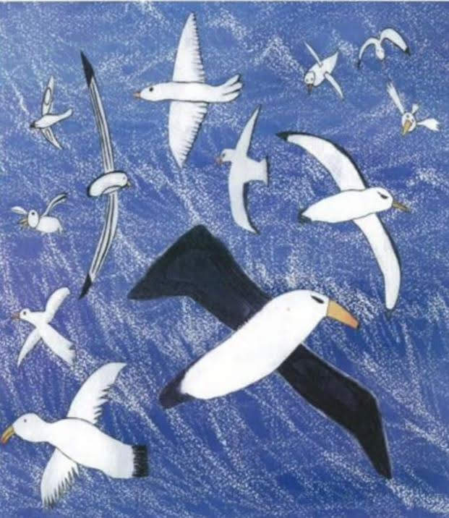
There were loud bongs as icebergs just below the surface bashed into the ship's hull. Adam, the first mate, told me these icebergs are called growlers. I loved looking at the ice cracking as the Aurora pushed through it, and while I was watching a seal poked its head through the ice.
it looked right at me and I waved and shouted, Hello seal! then it was gone.
Georgie said it was a crab-eater seal. They don’t eat crabs, they eat krill. Maybe they should be called krill-eater seals.
I saw my first penguins too. 6 adelies standing on an ice floe. They looked like tiny waiters in dinner suits. The sun didn't set until 10:30, And by the time I came inside, my toes and fingers were frozen.
Day 12
Dad thought we would be at Mawson station this morning, but the sea ice is too thick for us to go any closer. He's worried we'll get stuck if we keep going, so the ship is stopped. We can see the mountain peaks behind Mawson and it's driving everybody crazy that we are so close, but we still can't get there.

Slide 10
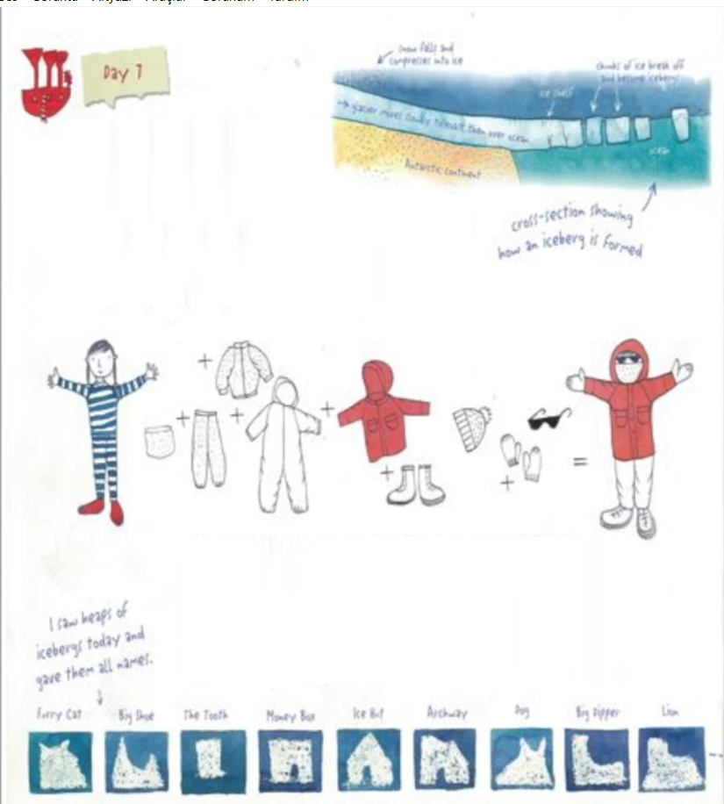
I helped sweep the ice and snow off the helideck so the helicopters can take the visiting scientists ashore. They only have a week to do their work, so they need to start straight away. Georgie went on the helicopter, but Sarah is still on the ship with me. We are keeping our fingers crossed that the ice will clear.
Day 13.
Hoorray! Last night the wind blew so hard it shifted the sea ice, clearing the way for the ship to get to Mawson. I stood on the monkey deck as we went in and the wind was like a freezing hurricane. I couldn't hold my camera steady and I couldn't stand up unless I was sheltering behind someone.

Slide 11
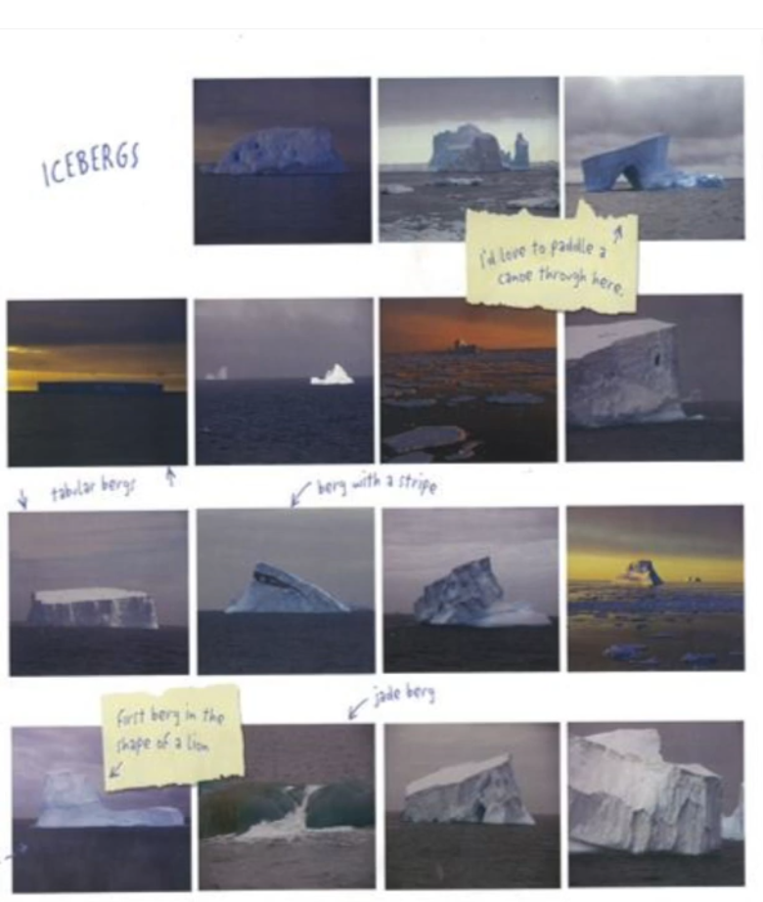
Dad steered the ship into tiny Horseshoe Harbor and parked her like a car. People from Mawson sped out to the ship in rubber boats. They picked up the mooring ropes and took them back to bollards on the rocky shore. Soon the Aurora Australis was tied up safely. I felt very proud when I heard people saying what a great skipper Scotty was.
Day 14
This morning I was so excited about going ashore that I woke up too early and dad made me go back to bed for a while. After breakfast we climbed down a rope ladder to a barge waiting below. It was scary trying to hang on, with the ship moving up and down.
When I stepped on land my smile was so big it felt like my face was going to crack. I was standing on Antarctica.
The ground was rough and rocky with patches of snow. Thick ropes linked all the buildings and Sarah told me this is to stop you getting lost in a blizzard.

Slide 12
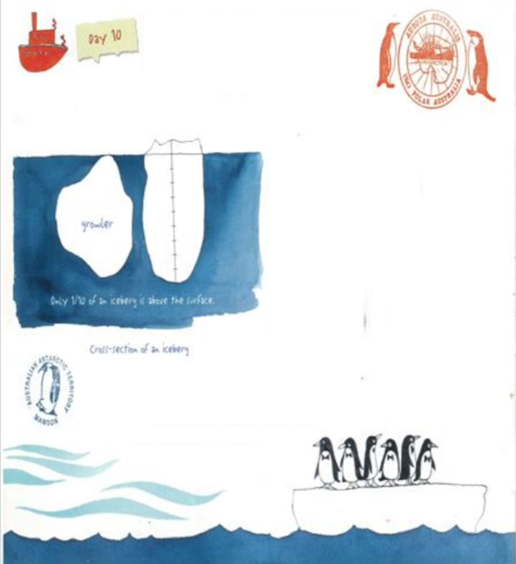
The station leader, Janie, said this happens to lots of people. She welcomed everybody and told us the station rules, then we helped put away supplies. There were huge boxes of toothpaste, toilet paper, soap and shampoo and massive amounts of food, like 5400 eggs in one hundred and sixty five tubs of ice cream.
Later, Georgie took me for a walk and we watch the Weddell seals scratching his whiskers with a flipper. He was groaning and moaning, and I think he had eaten too many fish.
It was good to get back to the ship tonight and show dad my photos. Katrina brought me dinner in bed because I was so tired.
Day 15
When we went to ashore this morning, Sarah and I explored around the station. We had lunch in the red shed, then Geoff, the station doctor, took us for a drive up to the plateau. We went in a hagglund, which is a kind of snowmobile. It was very noisy and bumpy. As we went up the hill, the hagglund couldn't get a grip and kept slipping backwards towards the sea. I was thinking how bad it would be to crash into the freezing water when Geoff finally gunned it to the top and we all cheered.

Slide 13
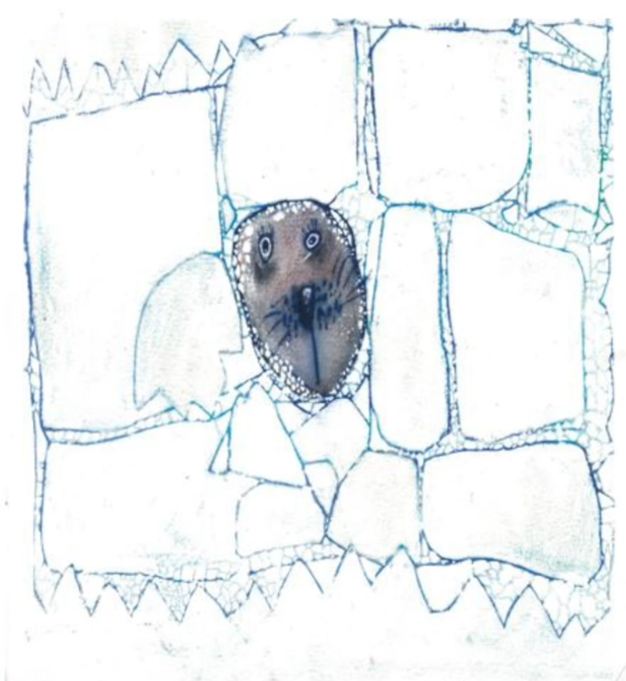
Before we got out, we hooked spiky chains under our boots because the ice was as slippery as glass. I took some photos, but we didn't stay for long because it was so cold. As we bumped back to the station, the sky went dark and hail started bashing against the windscreen. When we got out of the hagglund, it was snowing so heavily we could hardly see. Sarah and I held onto the ropes between the buildings and finally got to the red shed.
When Janie called dad on the radio he told us we would have to stay ashore. The weather was too wild for us to go back to the ship.
It was a blizzard. I was stranded in Antarctica.
Georgie put mattresses on the floor of her room for Sarah and me, and we were like little mice snuggled up together. Just before I went to sleep, Georgie played me a recording of a Weddell seal singing under the ice and it's a lovely song stayed in my head all night.

Slide 14
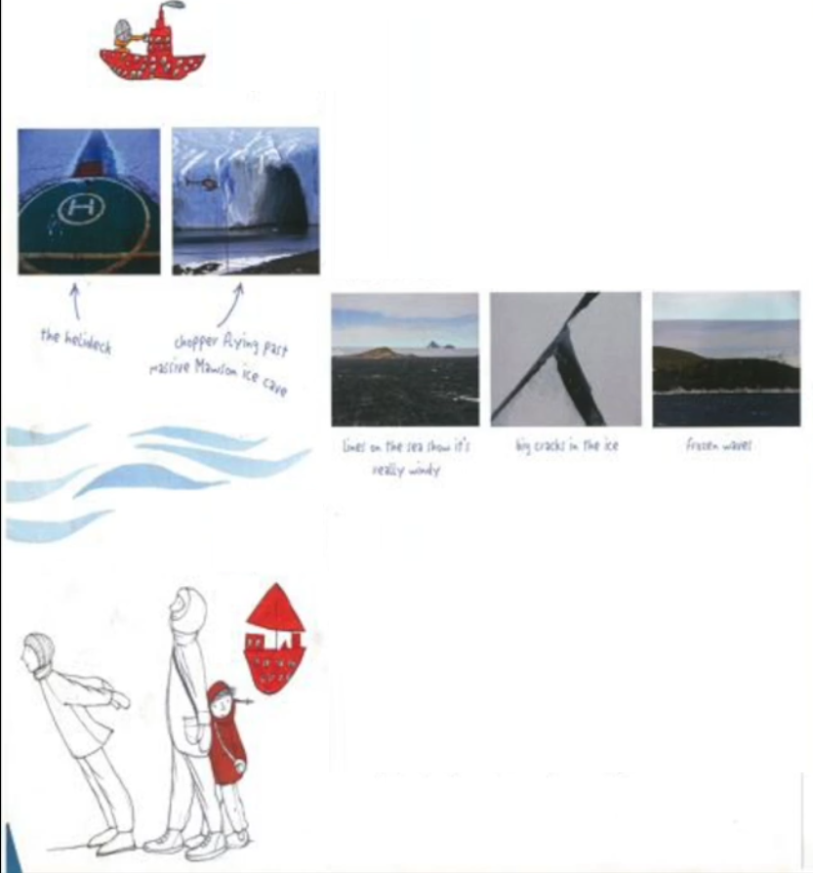
Day 16
This morning the wind was howling and the walls of the red shed shook as though a monster was trying to get in. It was way too dangerous to go outside.
14 people from the ship were stranded ashore and we all helped with jobs. I dried dishes and helped Sarah mop the floor.
Everybody was kind to me, but I felt lonely and worried about dad. I watched the ship swinging from side to side, and it looked as though the ropes would break, for sure.
In the afternoon, the blizzard got so strong that we couldn't even see the Aurora. It was a whiteout.

Slide 15
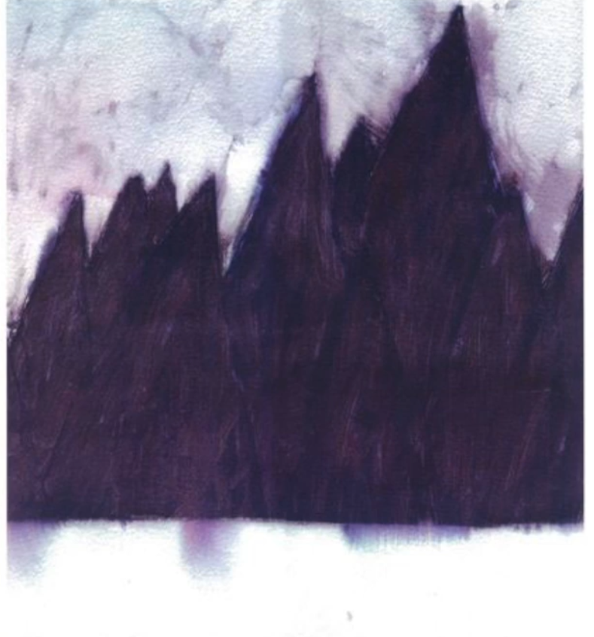
Georgie and Sarah played Polar Scrabble with me, and I think they let me win. After lunch, Janie gave me the phone so I could talk to mum and Alfie. While mum was talking I could hear the magpies singing outside our house.
By dinnertime, the blizzard had died down. It was still too dangerous to go back to the ship, but we were allowed to go outside. When Georgie and I went walking, we had to hold onto each other to stop being blown over. We saw an Adelie penguin, completely covered in ice. Georgie said it wouldn't feel cold because penguin feathers are good insulation.
Day 17
Last night Sarah and Georgie woke me up to show me a surprise. They helped me get dressed, we went outside and they pointed up. A band of light stretched across the sky, shimmering and dancing in front of the stars. It began over the sea and swooped above us in a wide stripe of neon green. It was as though a ghost had zoomed across the sky then disappeared with a flick of its tail.

Slide 16
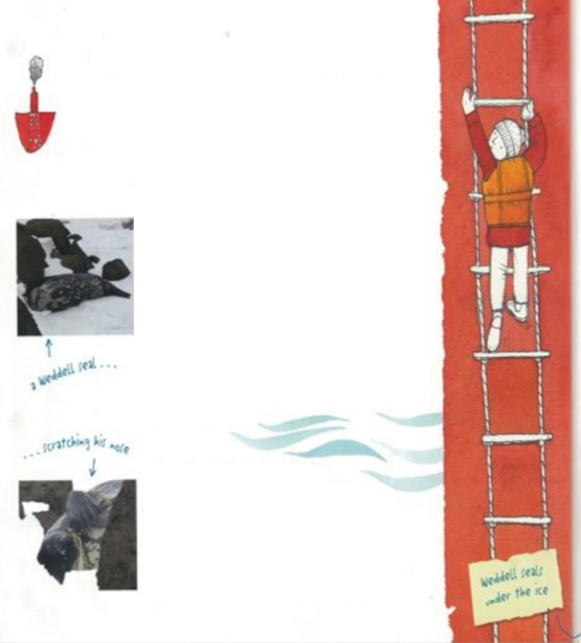
It was an Aurora. They’re caused when particles from the sun crash into the earth's atmosphere above the poles. In the Arctic it's called aurora borealis. In Antarctica Its name is aurora australis, the same as our ship.
I woke up to a sunny day today and a nice surprise because dad arrived while I was having breakfast. It was great to see him and he hugged me until I had to yell for a breath.
I took him to see the penguins and we had a go on the climbing wall. Dad was hopeless, but I could climb like a spider. After that, we went back to the ship.

Slide 17
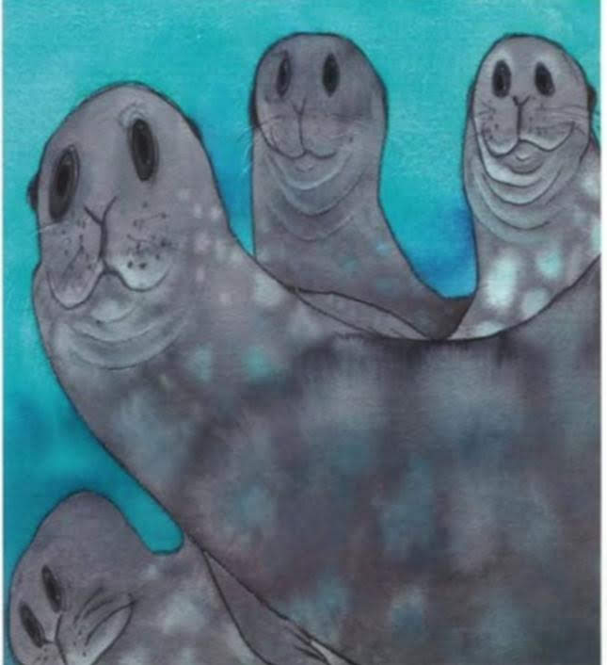
Day 18
We have two more days at Mawson, and when we leave, there will be no more visitors for seven months. Only sixteen people will stay here for winter. That’s when Georgie will ride her quad bike over the sea ice to Auster Rockery. She’ll live on nearby Macey Island in a tiny red apple hut and study the emperor penguins. There are more than 20000 penguins there. That’s a lot of penguins.
Day 19
Goodbye, Mawson. This morning, the helicopters flew out to the ship. We are taking them home with us. I watched the engineers unscrew the rotor blades and stow them in a big box. Then they pushed the choppers into the hangar and tied them down.

Slide 18
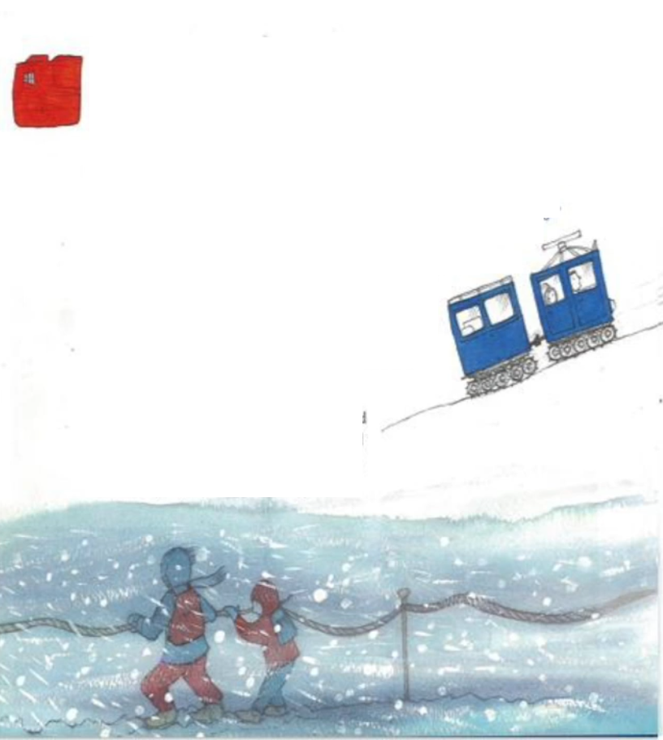
After lunch, I heard the ship's hooter and raced up on deck to wave to Georgie.
Everybody staying at Mawson came down to Horseshoe Harbour to farewell us. They let off pink flares that drifted down through the snowy sky.
The sea was freezing into little pancakes of ice and Dad was anxious to get going. If we weren't quick, we'd be stuck at Mawson for the winter.
We crashed through the ice all afternoon. Some bits were so big that the ship tilted as she slid over them.

Slide 19
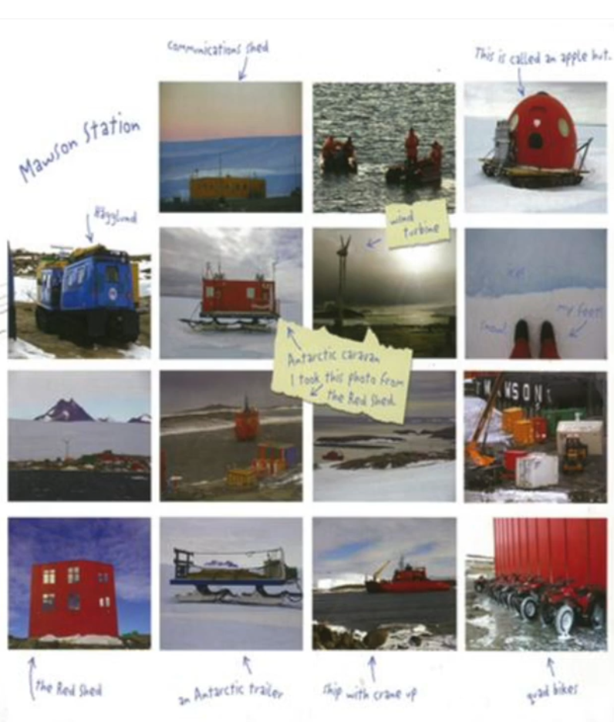
All the people who have been at Mawson are excited to be going home. The visiting scientists have done their work, and I think dad and the crew are happy that we didn't get stuck.
After dinner, we had a King Neptune ceremony to celebrate crossing the Antarctic Circle. We should have had it on the way down, but the weather was too rough. Adam was dressed up as King Neptune and dad was a mermaid. We had to kiss a dead fish.
Day 22
The ice has been so thick. It's taken us three days to get this far. This morning at sunrise, we saw some killer whales beside the ship. Their shiny black bodies stood out against the Golden Sea. Some were putting their heads right out of the water as we went past. This is called spy-hopping.
After lunch, Sarah showed me photos from her polar trips and told me about some of the famous Antarctic explorers.

Slide 20
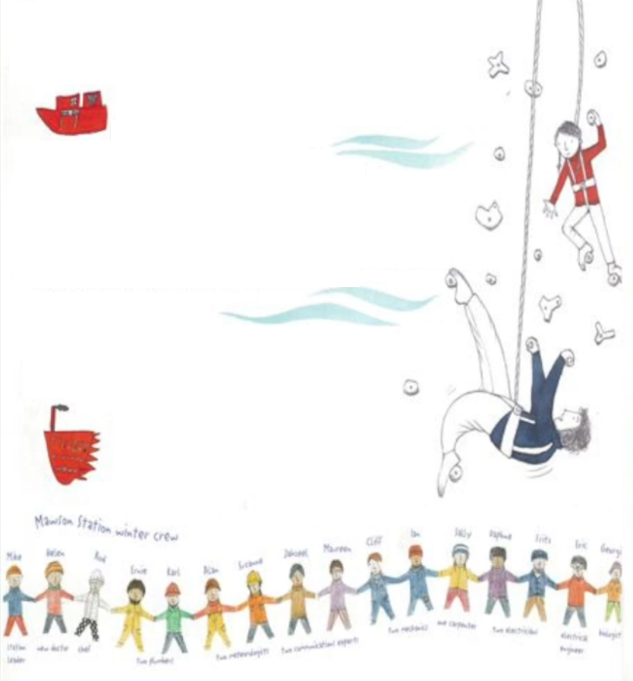
Day 25
We’ve been out of the ice for two days now. This morning the ship stopped to pick up an underwater microphone called an Acoustic Recording Package. The scientists on the ship left it here a year ago to record the ocean noises.
Today the technicians floated it to the surface. Whale experts back home will listen and find out what whales have been saying.
After lunch, it was sunny, even though it was still minus 4 degrees. Sarah and I took photos of the cooks pretending to sunbake in front of an iceberg.
That was our last iceberg. I felt sad that we wouldn't see anymore. When we were in the ice it seemed they would last forever.

Slide 21
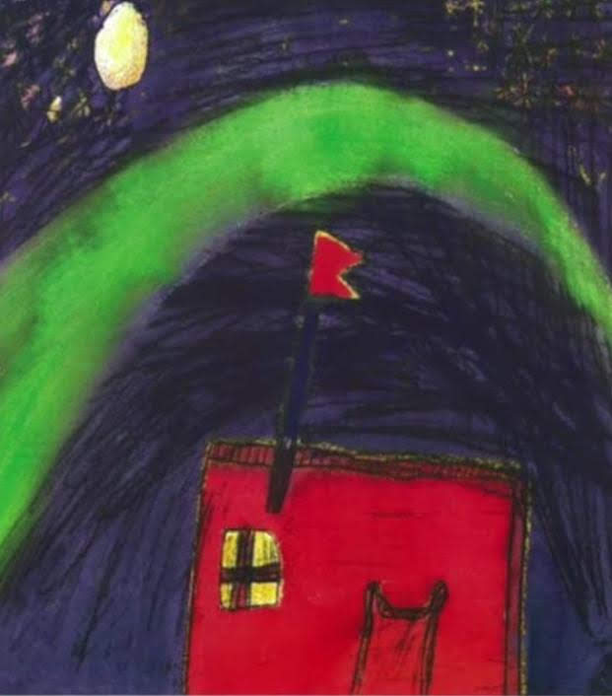
It was dad's birthday today, and I got to carry out the cake on a big silver tray. Tonight the sunset over confused seas. I love that name, it sounds as if the sea can’t figure something out, but it really means that there are waves coming from all directions.
Only four days until we get home. I'm going to miss my little bunk that rocks me to sleep every night.

Slide 22
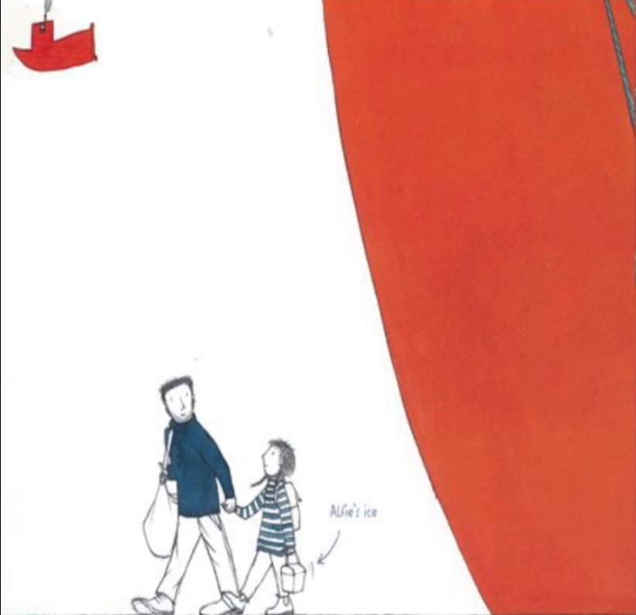
Day 30
When I woke up this morning the ship wasn't moving and when I looked out of my porthole, there was Hobart.
We were tied up to the dock.
After breakfast, we all swapped email addresses and said goodbye. Sarah gave me a beautiful painting of whales and icebergs to take home to Mum. Then everybody walked down the gangway with their bags. The ship felt still and quiet when they were gone.
I packed up my things, peeled my pictures off the wall, then lay on my bunk and waited for dead. Soon he came.
Come on, Sophie of the Antarctic. He said, let's go home.
And so we did.

