Slide 1
FUNDRAISING
KA2 School Education 2017-1-DE03-KA219-035600_6
“Art Ventures in EUROPE –
in search of common roots and perspectives”
Bari – ITALY
1st - 7th April 2019

Slide 3
Fundraising
or fund-raising
is the process of gathering voluntary contributions of money or other resources, by requesting donations from individuals, businesses, charitable foundations, or governmental agencies.

Slide 4
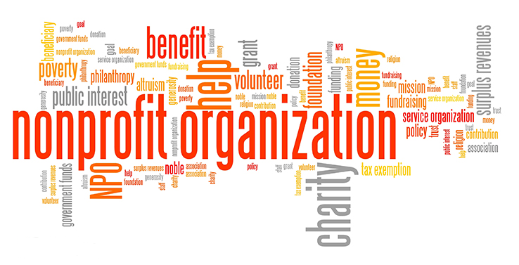
Fundraising typically refers to efforts to gather money for non-profit organizations
It is sometimes used to refer to the identification and solicitation of investors or other sources of capital for for-profit enterprises.

Slide 5
PURPOSE
Organizations raise funds to support capital projects, endowments, or operating expenses of current programs.
Many non-profit organizations solicit funds for a financial endowment, which is a sum of money that is invested to generate an annual return.

Slide 7
Why People Give to Nonprofits
They feel a connection to the organization
Their peers are giving
Someone asks them to
To make a difference
To share their good fortune
For recognition
To ensure the organization’s ability to fulfill its mission in the future
For tax reasons

Slide 8
Why People Do Not Give to Nonprofits
Solicitation is infrequent or poorly communicated
They don’t see how their gift would make a difference
They receive no direct, personalized appeal
They gave an unacknowledged gift in the past
They were not asked to give
The timing wasn’t right
The organization’s mission was not compelling

Slide 9
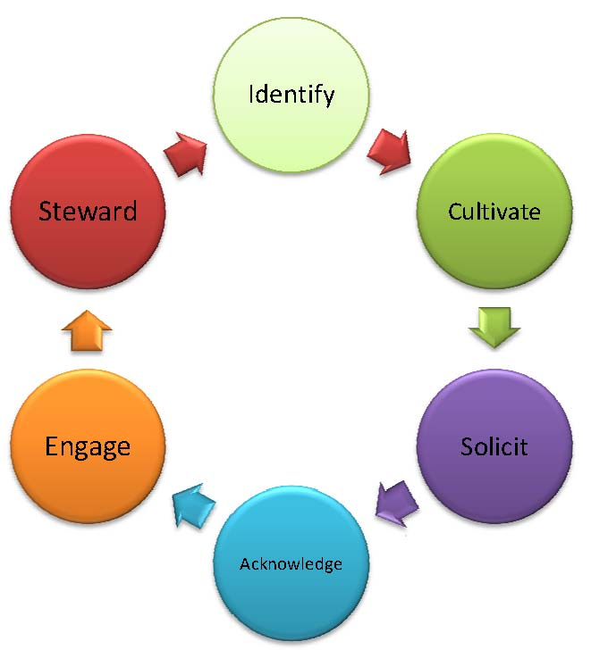
Stages of Fundraising

Slide 10
Stage One: Cultivation
Identifying potential donors (prospects)
Building relationships with prospects
Generating interest in the organization
Showing prospects what the organization is all about – history, programs, finances, etc.
Notes:
Talking Points: The first stage of fundraising is cultivation. This is the time to introduce the organization to prospects and generate interest in giving.

Slide 11
Stage Two: Solicitation
Presenting the organization’s case statement
Participating in one-on-one solicitation
Sending direct mail pieces with personalized notes
Making telephone solicitations
Notes:
Talking Points: Solicitation is asking the prospect for a donation. Solicitation can be as formal as a one-on-one meeting or as informal as a form letter. Remember that larger donations generally require more personalized solicitation approaches.

Slide 12
Stage Three: Stewardship
Thanking donors and letting them know their gift made a difference
Maintaining donor relationships
Thank you letters
Donor recognition activities
Invitations to special events
Updates from the organization
Notes:
Talking Points: An organization’s fundraising responsibilities are not over once it has received a donation from a donor. The final stage of fundraising is stewardship — thanking the donor and maintaining a relationship that keeps the donor connected to the organization. Let the donor know the gift was appreciated and that it made a difference to the organization. Keep major donors involved with the organization through invitations to special events or periodic updates from board members or senior staff members. By maintaining a relationship with previous donors, the organization increases its chance of receiving future gifts from these donors.

Slide 13
methods

Slide 14
Methods
Direct Marketing (direct mail)
Telemarketing (telephone)
Face to Face
Web Marketing especially by dedicated web platforms
Events, sponsor, social investments, and so on….

Slide 15
TO SUCCEED IN FUNDRAISING, YOU MUST KNOW FOUR THINGS:
The mission of the organization
The goals of the organization
How to ask
How to overcome fears

