Slide 1
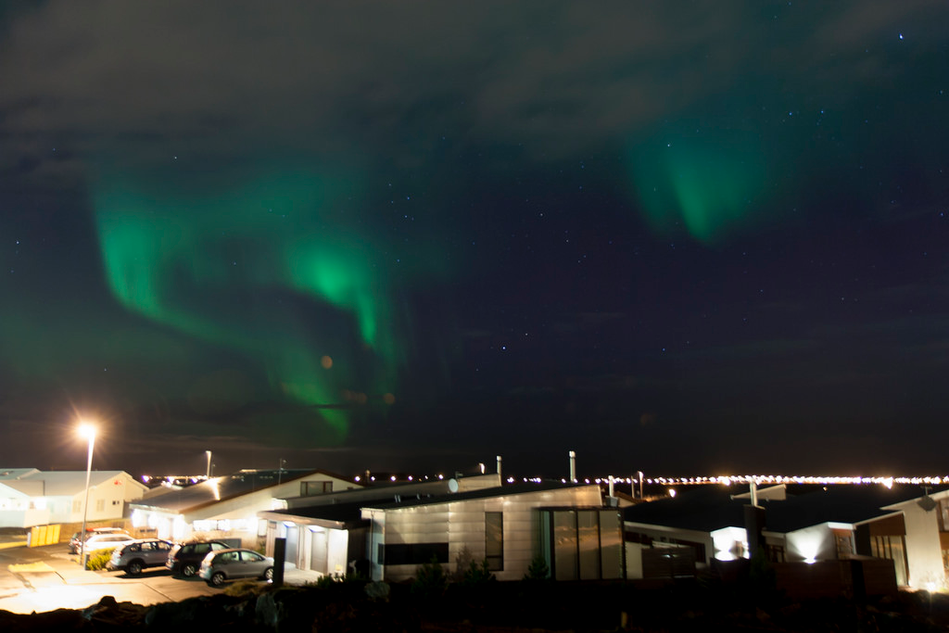
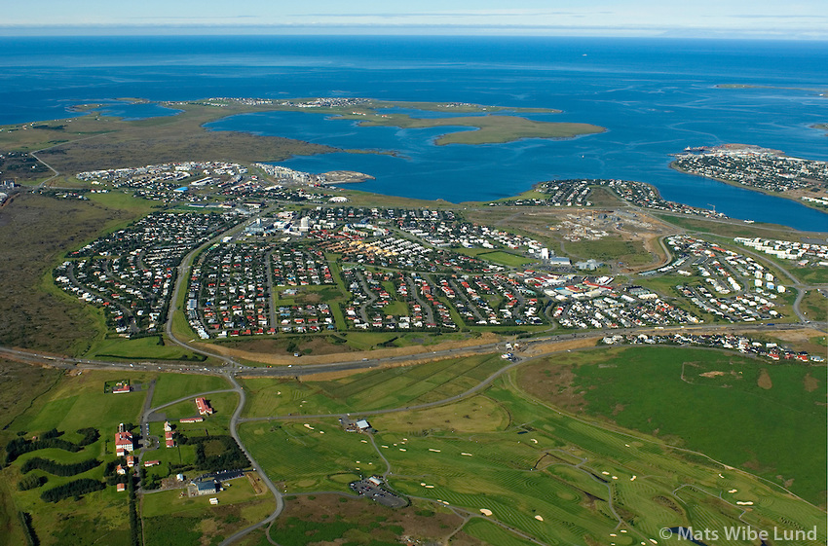
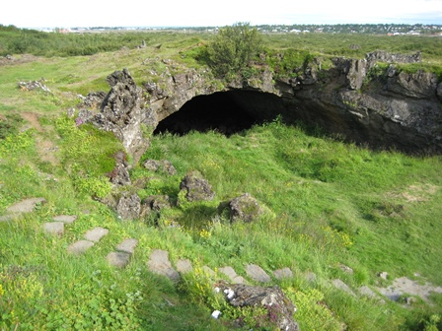
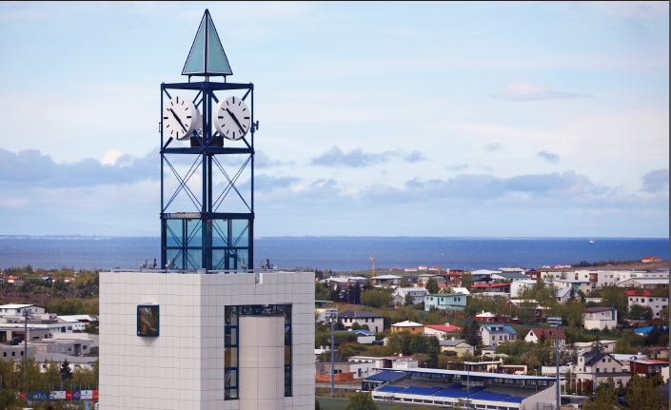
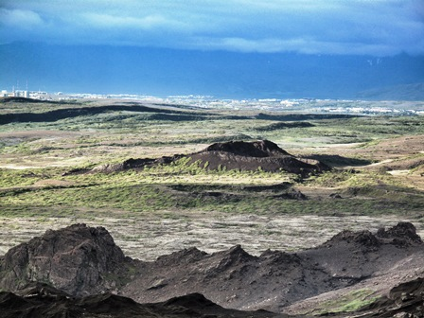
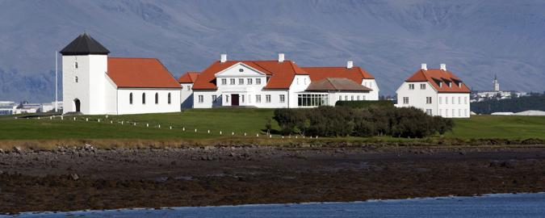
Garðabær
Kristján, Bryndís og Magnús

Slide 2
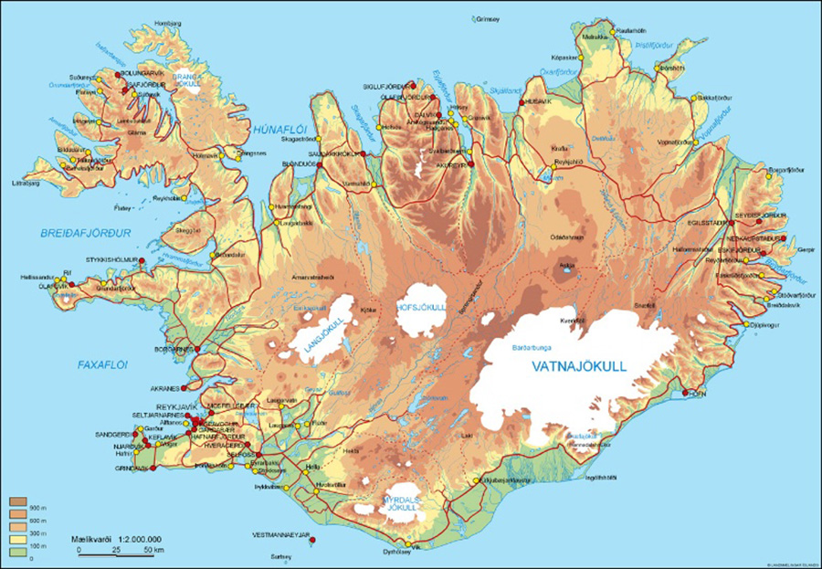
Location
Garðabær
Garðabær is located on the south-west coast of Iceland.
Garðabær is a part of the capital area.

Slide 3
The history of Garðabær
At first Garðabær was called Garðahreppur.
The small village was founded in 1878
Now, Álftanes is also a part of Garðabær.

Slide 4
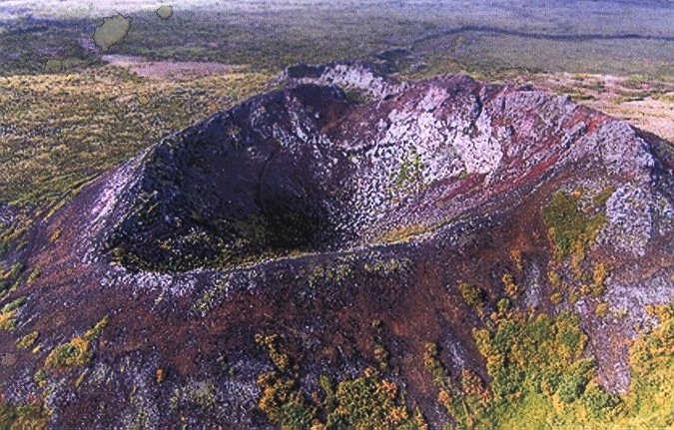
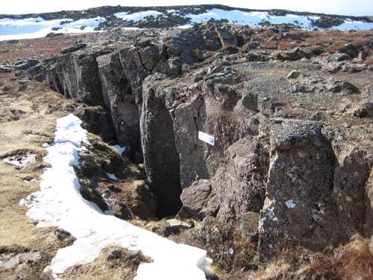
Interesting places in Garðabær
Kringlóttagjá
Vatnsgjá

Slide 5
Facts about Garðabær
Garðabær is one of the richest towns in Iceland .
The only in the capital Ikea in Iceland is located in Garðabær along with Costco.
There are seven schools in Garðabær.
There are about 15.000 people that live in Garðabær.
The president of Iceland lives in Garðabær.
The TV studio for the children´s television programme Lazytown.
Garðabær’s Symbol was made by Erna Ragnarsdóttir.

Slide 6
Population
The population of Garðabær is 15.230 people.
In 2016, 513 people moved to Garðabær .
Since 2006, 5674 people have moved to Garðabær.

Slide 7
Stjarnan
Garðabær’s sport team; Stjarnan (The star).
Stjarnan is a big team and has a lot of sports including gymnastics, handball, football, swimming, volleyball, basketball and weight lifting.

Slide 8
Culture
The jazz feast.
The art day.
The Design art museum.
Krókur.

Slide 9
Business
Garðabær has many local businesses such as:
66°north, https://www.66north.com/
Cintamani, http://cintamani.is/en/store/
Marel, http://marel.com/
Icewear, https://www.icewear.is/

