Slide 1
Alterations of relief in the Canary Islands
Cristina López, Sara García y Lucía Díaz (IES San Juan de la Rambla. 4.º ESO A. Course 2017-18)

Slide 2
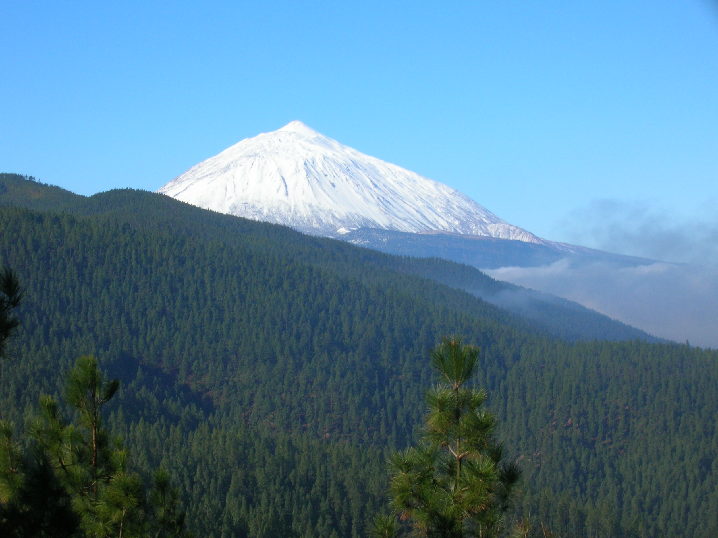
What is the relief?
The relief is formed by everything that protrudes from a flat surface or that modifies it. The concept is often used to refer to the elevations and depressions found on our planet.
The terrestrial relief includes both the shapes that are noticed on the surface and those that involve accidents on the seabed.

Slide 3
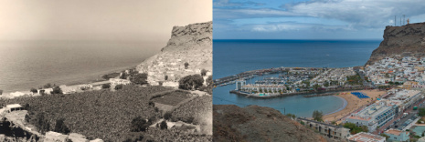
The Canary Islands suffer serious environmental problems,
as the alterations of the landscape and the relief
The alterations of the relief and the landscape are due at present, mainly, to the urban pressure and to the extension of the tourist and transport infrastructures, affecting everything to the coastal areas. These are affected by problems linked to constructive massification, pollution and overexploitation of the territory.
Mogán, Gran Canaria, before and after tourism development.

Slide 4
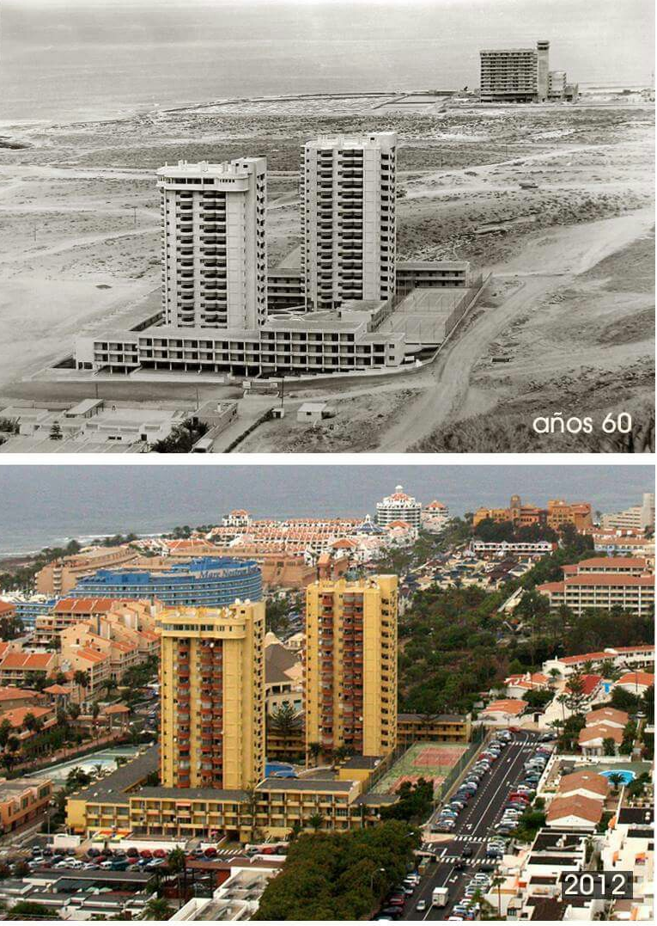
HUMAN ACTIVITY AND LANDSCAPE
If we observe the natural environment of our islands, we can verify that there is a great variety of landscapes. The landscape of a place is the result of several natural factors and, of course, of the action that human beings perform on it.
The factors that condition the landscape of our islands are the following:
Partial view of Los Cristianos in the 60s of the 20th century and today.
1) The relief, formed by numerous volcanic eruptions.
2) The latitude and position of the Islands (climate).
3) The action of the sea.
4) Erosion produced by the wind.
5) Surface water and groundwater.
6) Living beings that are modifying the shape and composition of the relief.

Slide 5
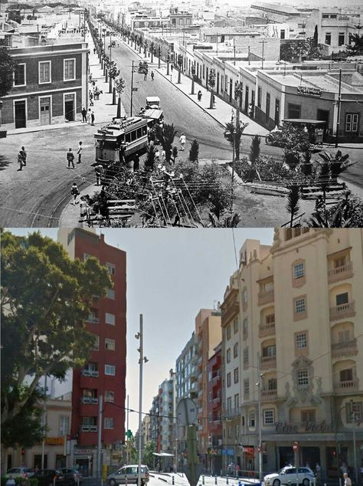
Urban pressure
The urban pressure is determinant in the alteration of the relief and landscape. Canarias has spent less than 80 years from 680,000 to 2,100,000 inhabitants.
In addition to the increase in population, urbanization for tourism has occupied large areas on the coasts and, in the case of residential construction, in recent years has opted for a type of construction that occupies large bags of land (townhouses).
La Rambla de Pulido in Santa Cruz de Tenerife in the 20s of the twentieth century and today.

Slide 6
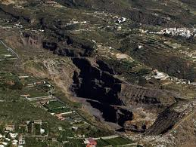
Extraction of aggregates
One of the most frequent alterations of the insular relief is the extraction of aggregates. Traditionally, fertile land was extracted from different areas of the islands and transported to other less fertile ones, creating rendering lands (sorribas) in order to dedicate the arid zones to export crops (bananas and tomatoes).
In recent decades the extraction of aggregates has been associated with construction and there have been serious cases of illegal exploitation.
The illegal exploitation of aggregates quarries in Güímar has produced a very serious environmental. impact.

