Slide 1
SPEAKING EXERCISE
Students will work in pairs. Encourage the use of the vocabulary they have learned in previous exercises. It would be a good idea to give each pair of students a list with all the new words.
When they finish talking in pairs about one of the questions, they can share opinions with the whole group. Then, repeat the same dynamic with all the slides.

Slide 2
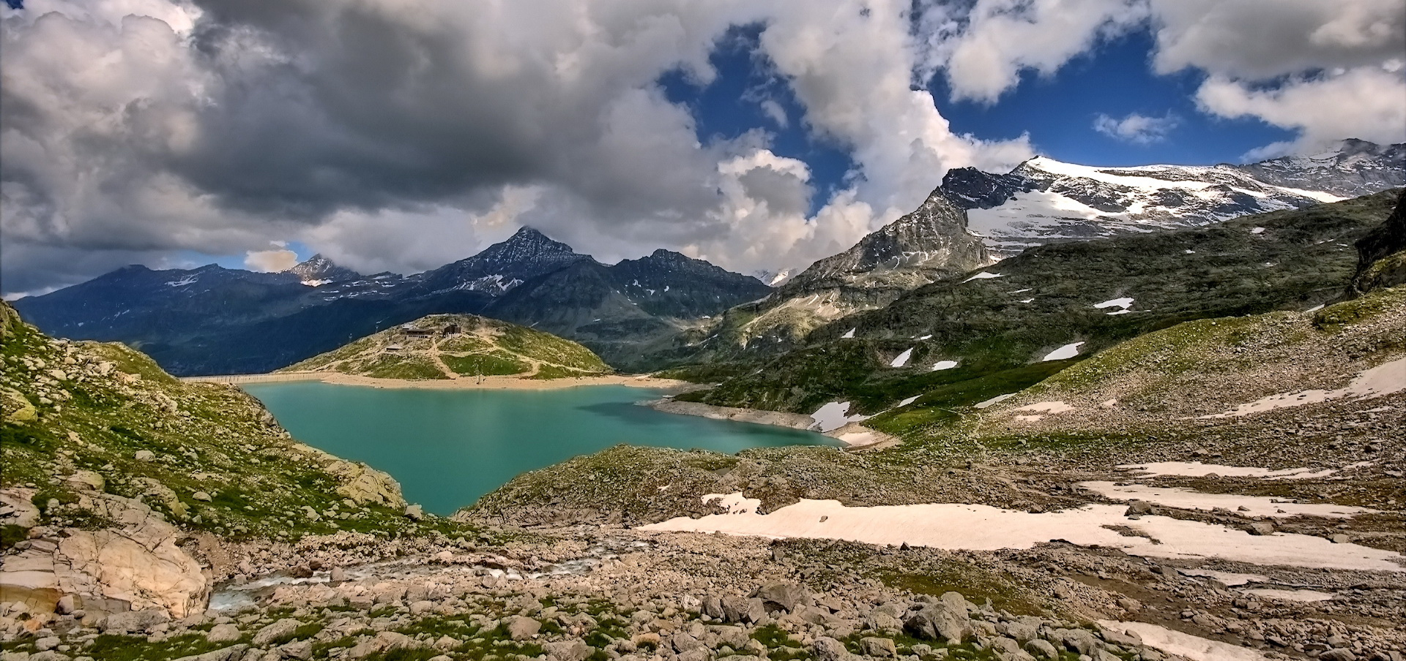
How is the environment around you? Is it clean?

Slide 3
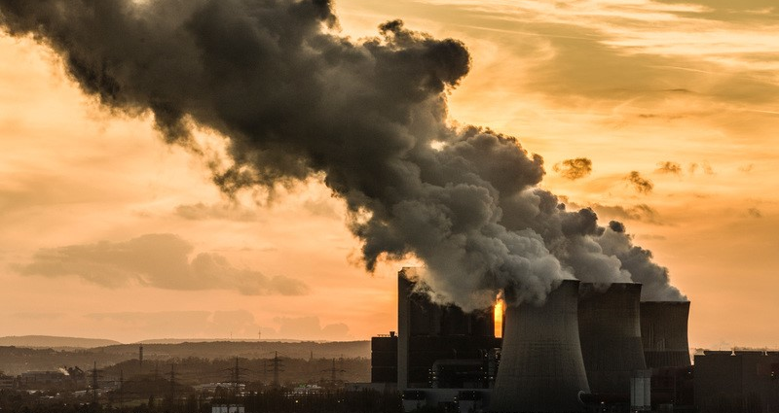
What kind of pollution bothers you most on your daily routine?

Slide 4
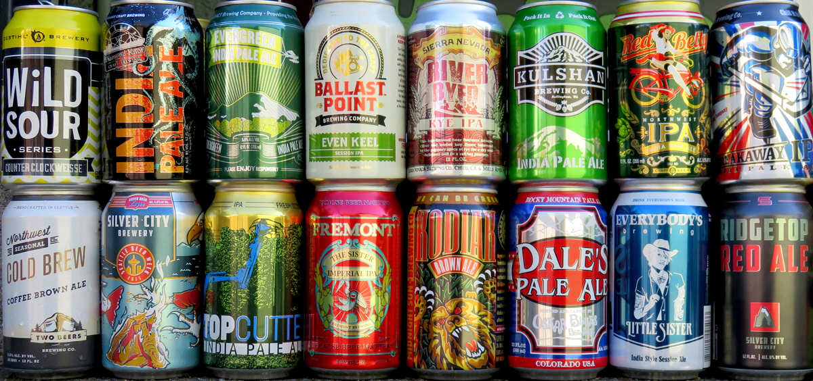
Do you recycle? What kind of things do you recycle?

Slide 5
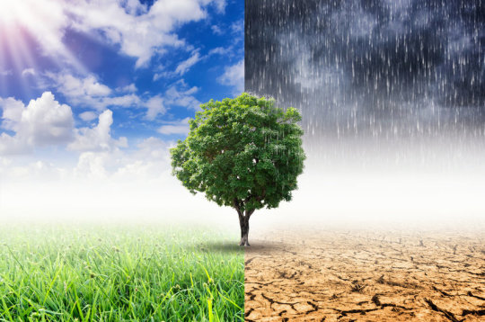
How do you feel when you hear about global warming? Is there hope for the future?

Slide 6
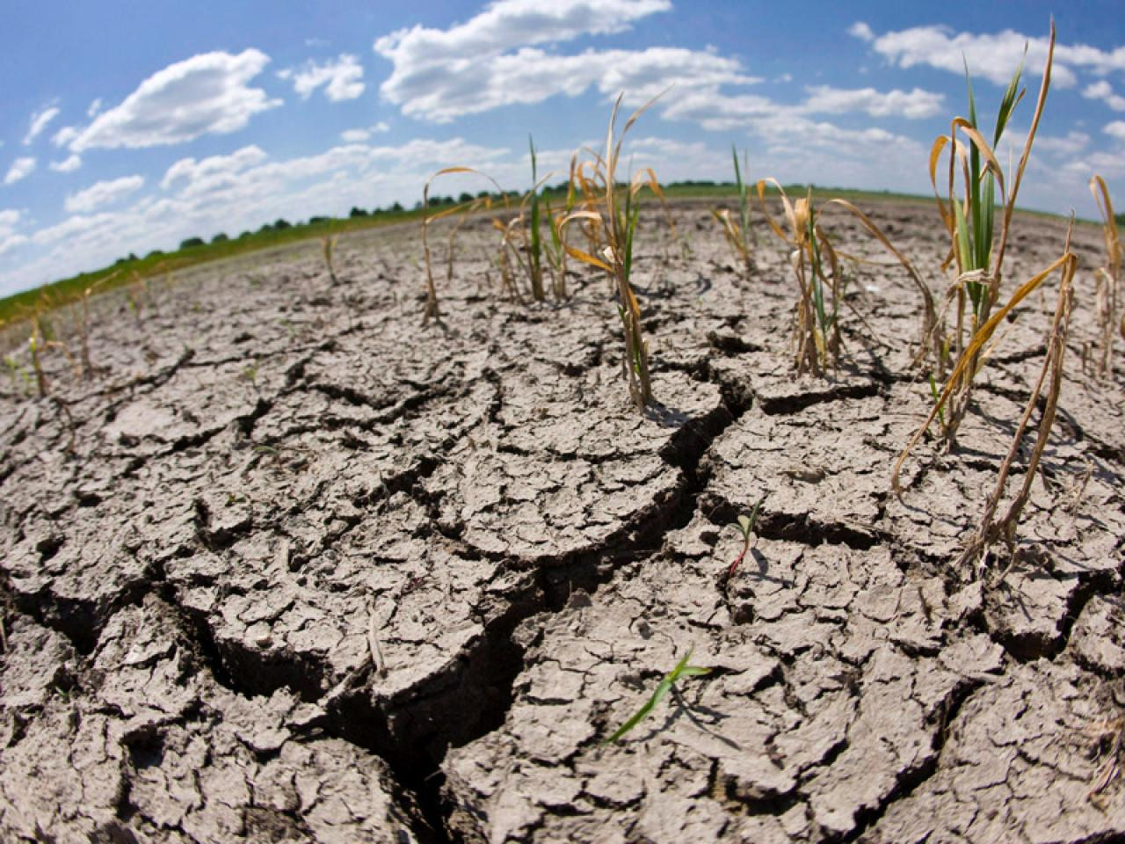
Do you believe human activity contributes to global warming? If so, what should we do about it? If not, what do you think causes global warming?

Slide 7
Which type of energy is the most environmentally friendly? Do you use this type of energy? Why?/Why not?

Slide 8
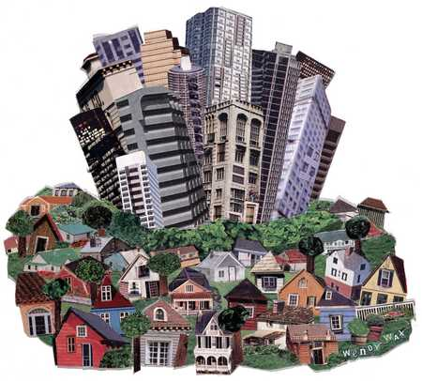
Do you think overpopulation is an important environmental issue? Why/why not?

