Slide 1
The work of climate ambassadors in our school
Pärnu Kuninga Tänava Põhikool

Slide 2
The students who have participated in project mobilities are also the climate ambassadors in our school.
Our climate ambassadors are the 8th grade students:
- Miia Puidet, Juuli Kõrre (Tenerife, Spain)
- Emily Anete Pukk, Henri Kald (Budapest, Hungary)
- Keitlin Kütt, Artur Ormisson, Reigo Raal (Martinique, France)

Slide 3
The task of climate ambassadors on the 1st project year is to talk about the project and its goals and to spread the message of importance of climate friendly lifestyle.
In May, the climate ambassadors visited the 5th and 8th grades of our school. The talked about the climate and nature of their mobility destination country and its environmental problems. They also discussed about global warming and climate change effects. They encouraged the students to discuss about climate change reasons and to suggest the solutions to reduce the effects of global warming.

Slide 4
The working methods:
Presentations by climate ambassadors
Questions to the audience
Discussions with the audience
Working in pairs, filling the table with information
Team and group work to create posters about the main climate issues in project’s partner countries

Slide 5
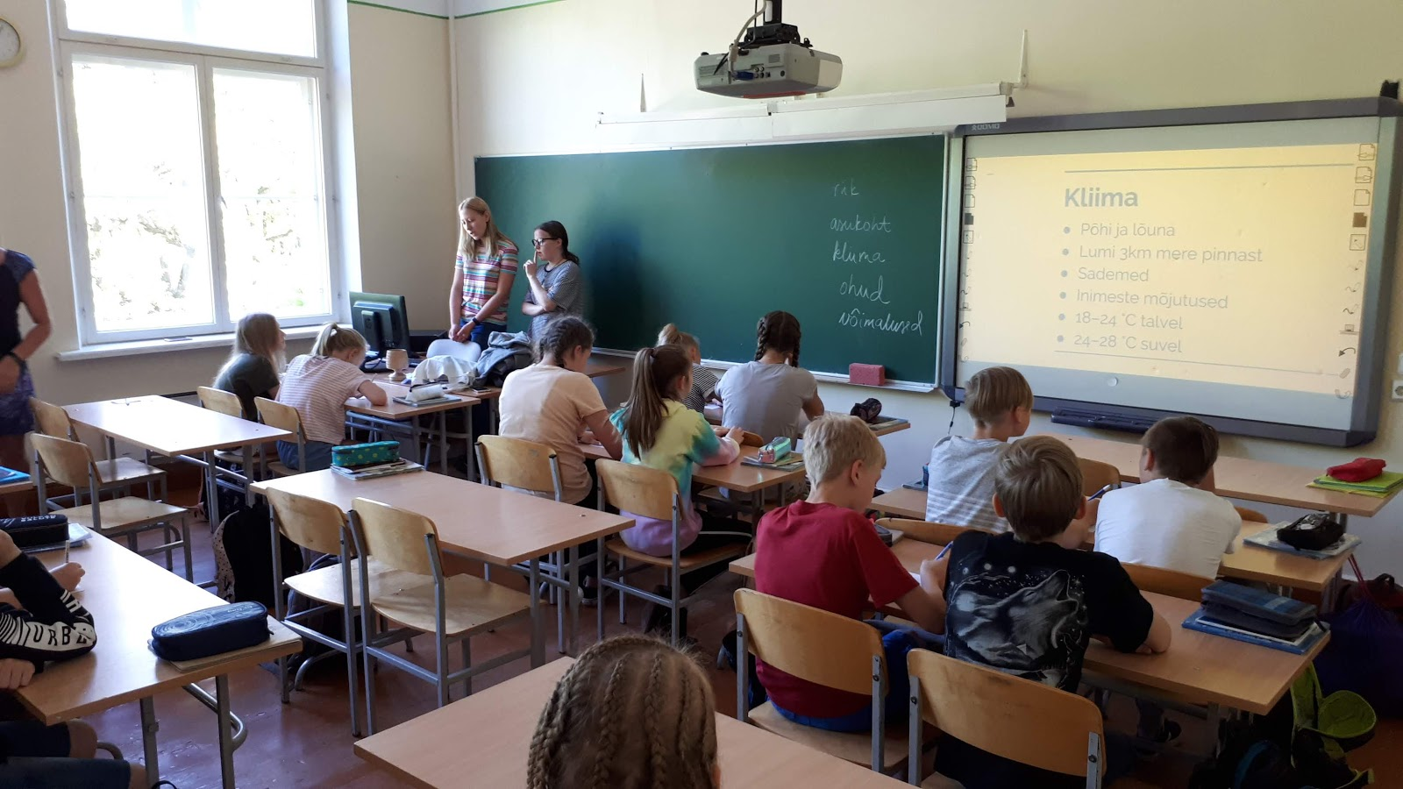

Slide 6
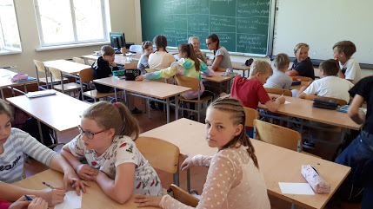

Slide 7
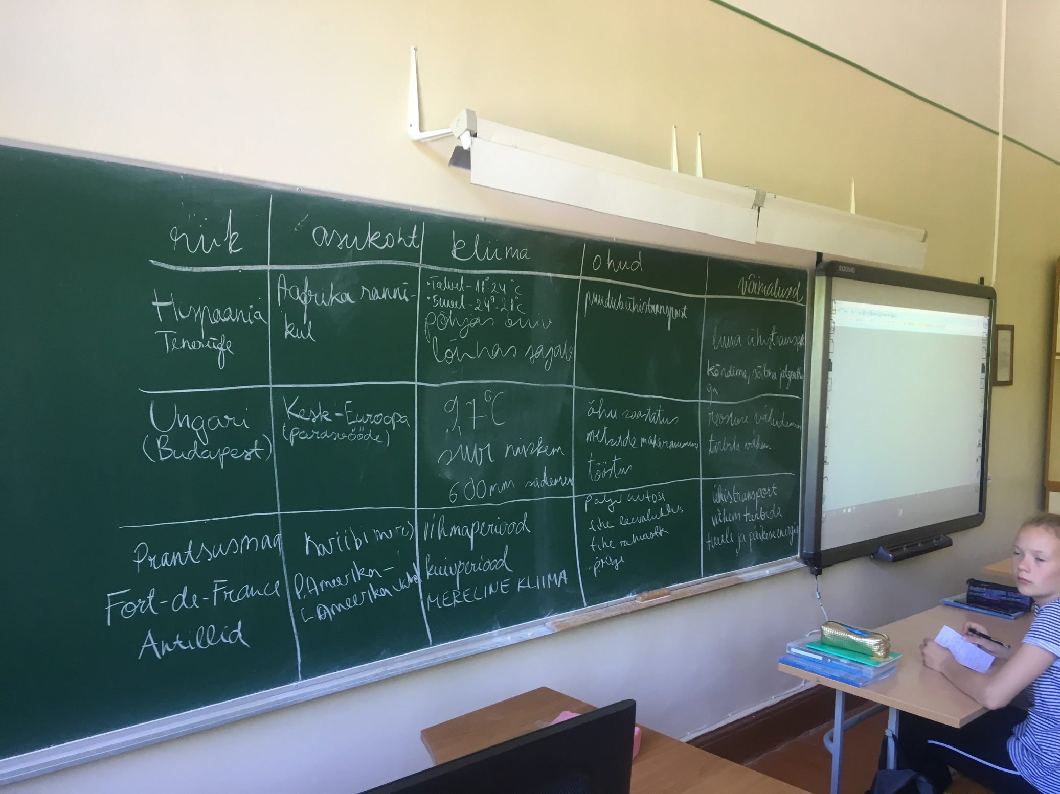

Slide 8
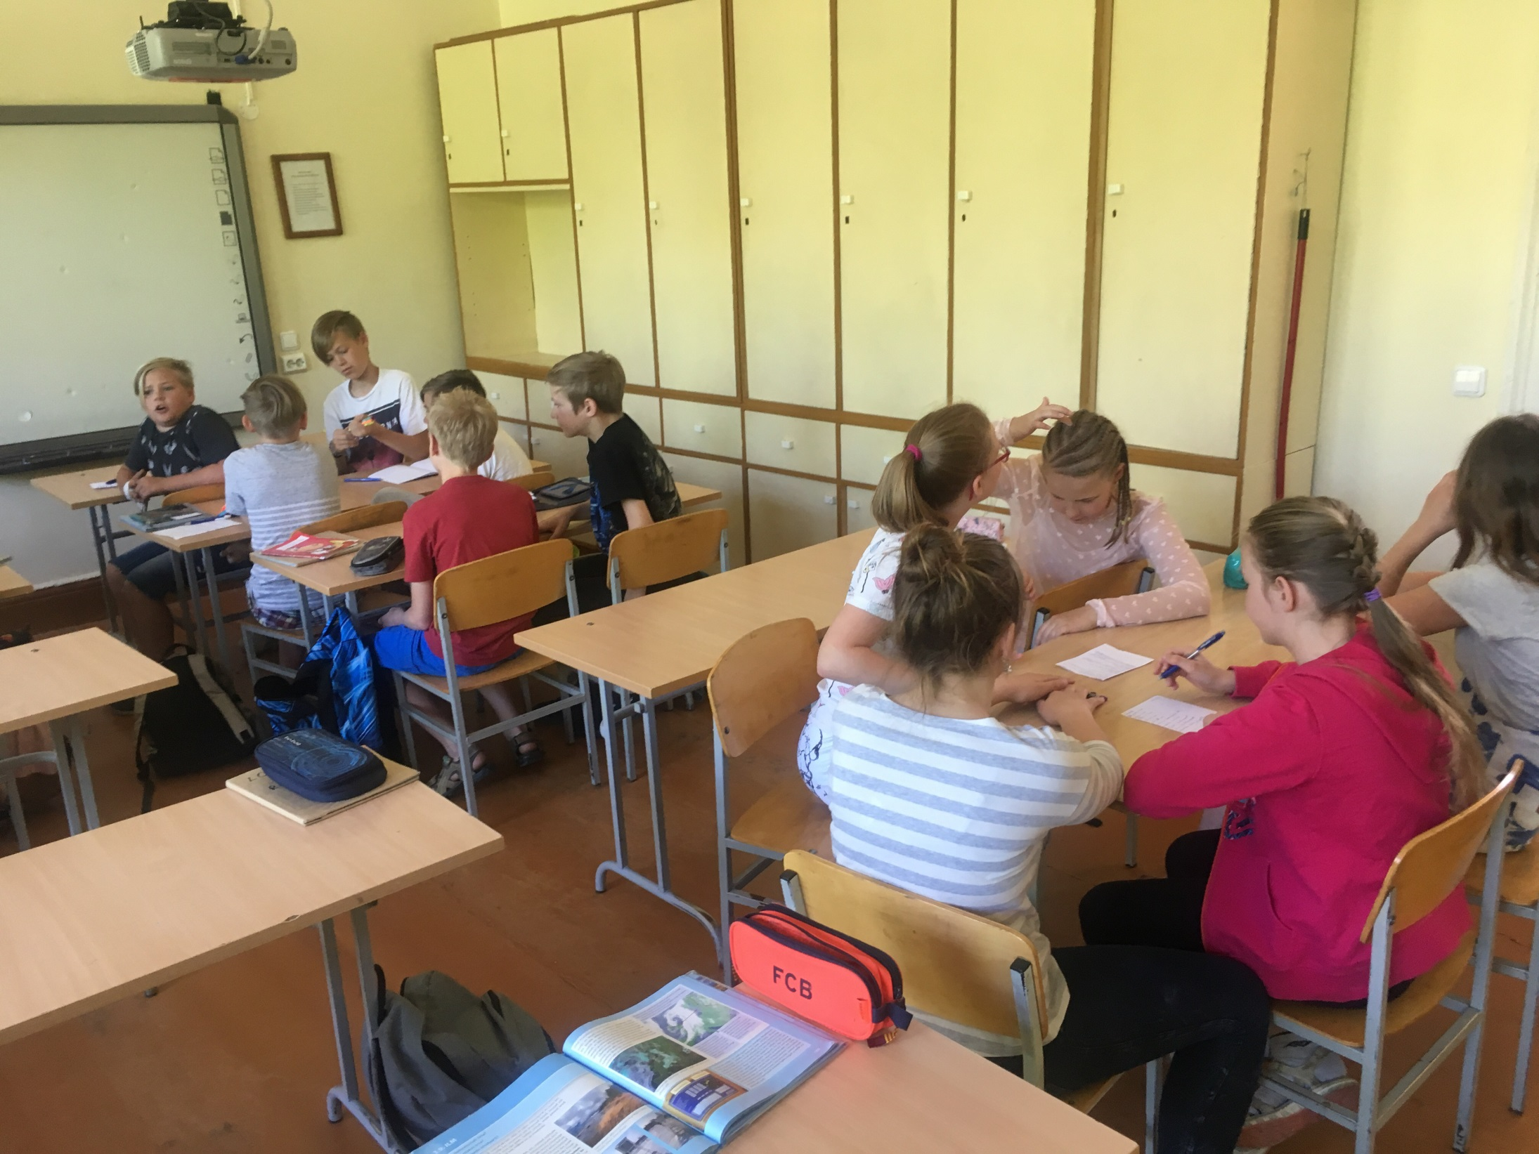

Slide 9
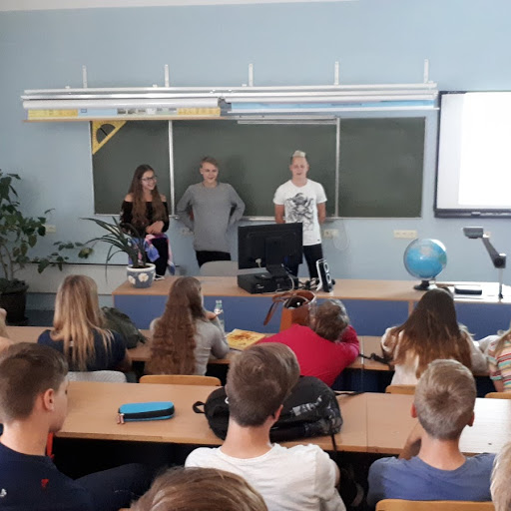

Slide 10
On the 2nd project year, the climate ambassadors will start to make the Energy Puzzle Hunt with the younger students in our school.
Learning for new ideas in Energy Discovery Center in Tallinn on the 1st of June with you
THANK YOU!

