Slide 1
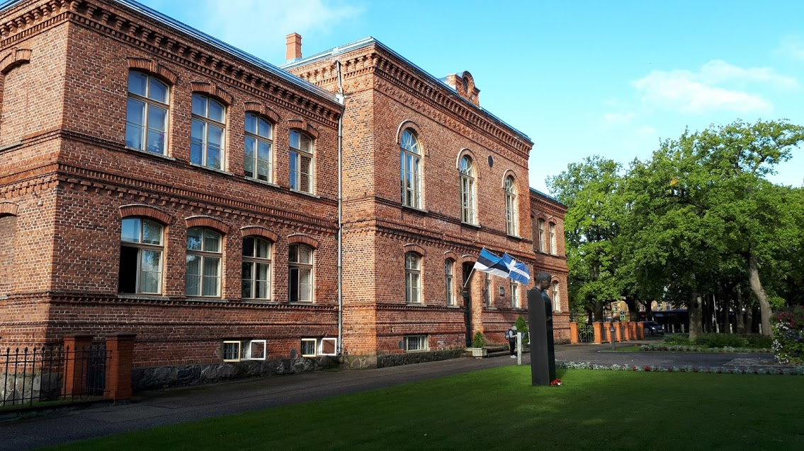
Pärnu Kuninga Street Basic School
In estonian: Pärnu Kuninga Tänava Põhikool

Slide 2
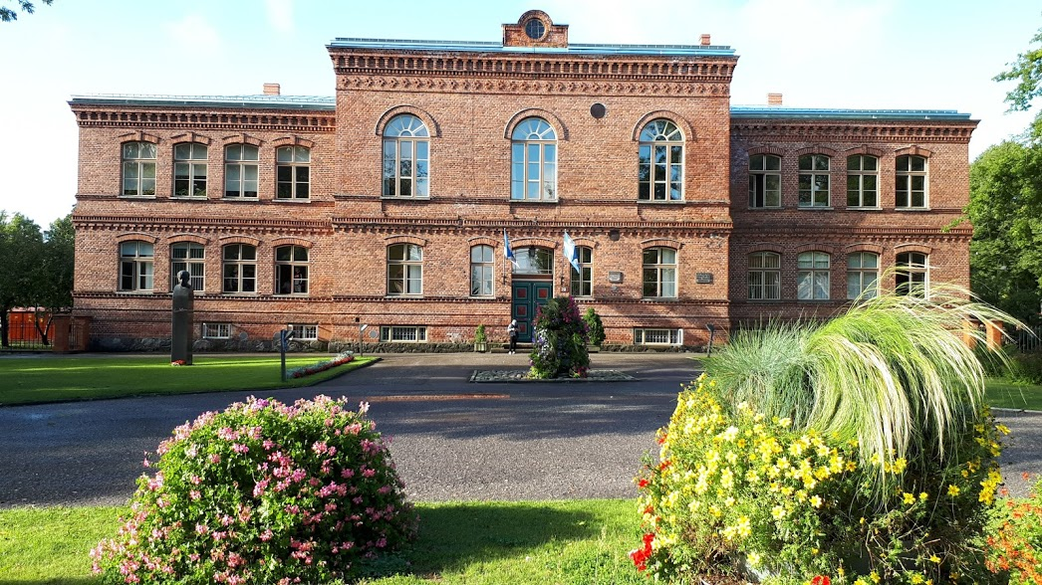
FACTS ABOUT SCHOOL
It is situated in the school building founded in 1875

Slide 3
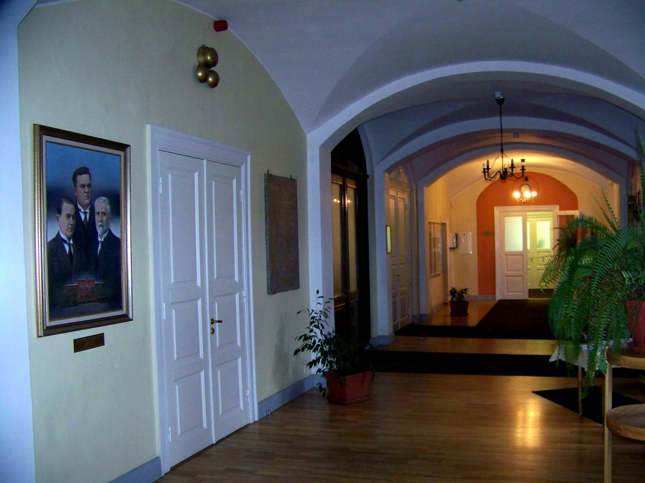
A large number of the first government of the Republic of Estonia, many cultural and music action figures have studied in this building.

Slide 4
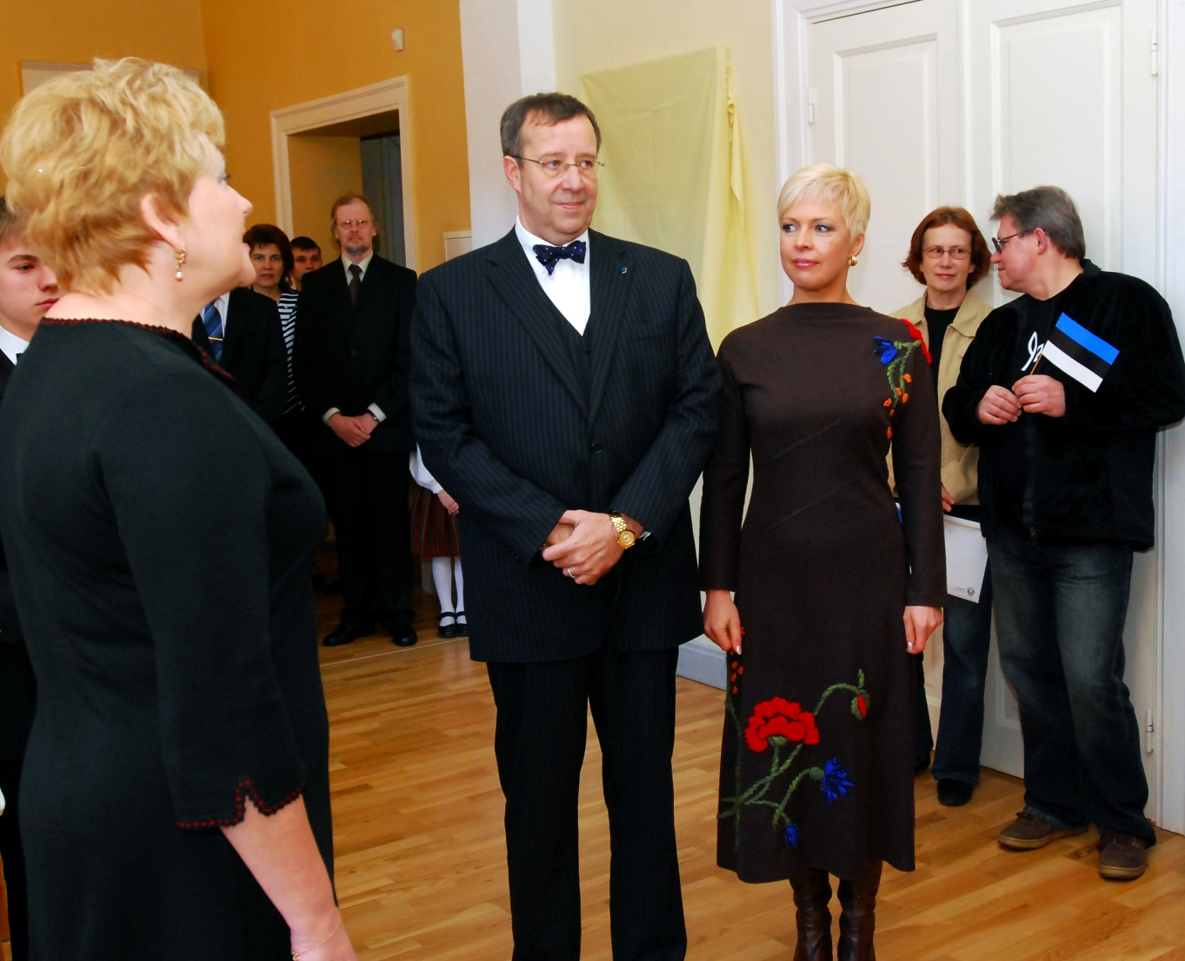
So it is the school with the one of the most honourable history in Estonia.

Slide 5
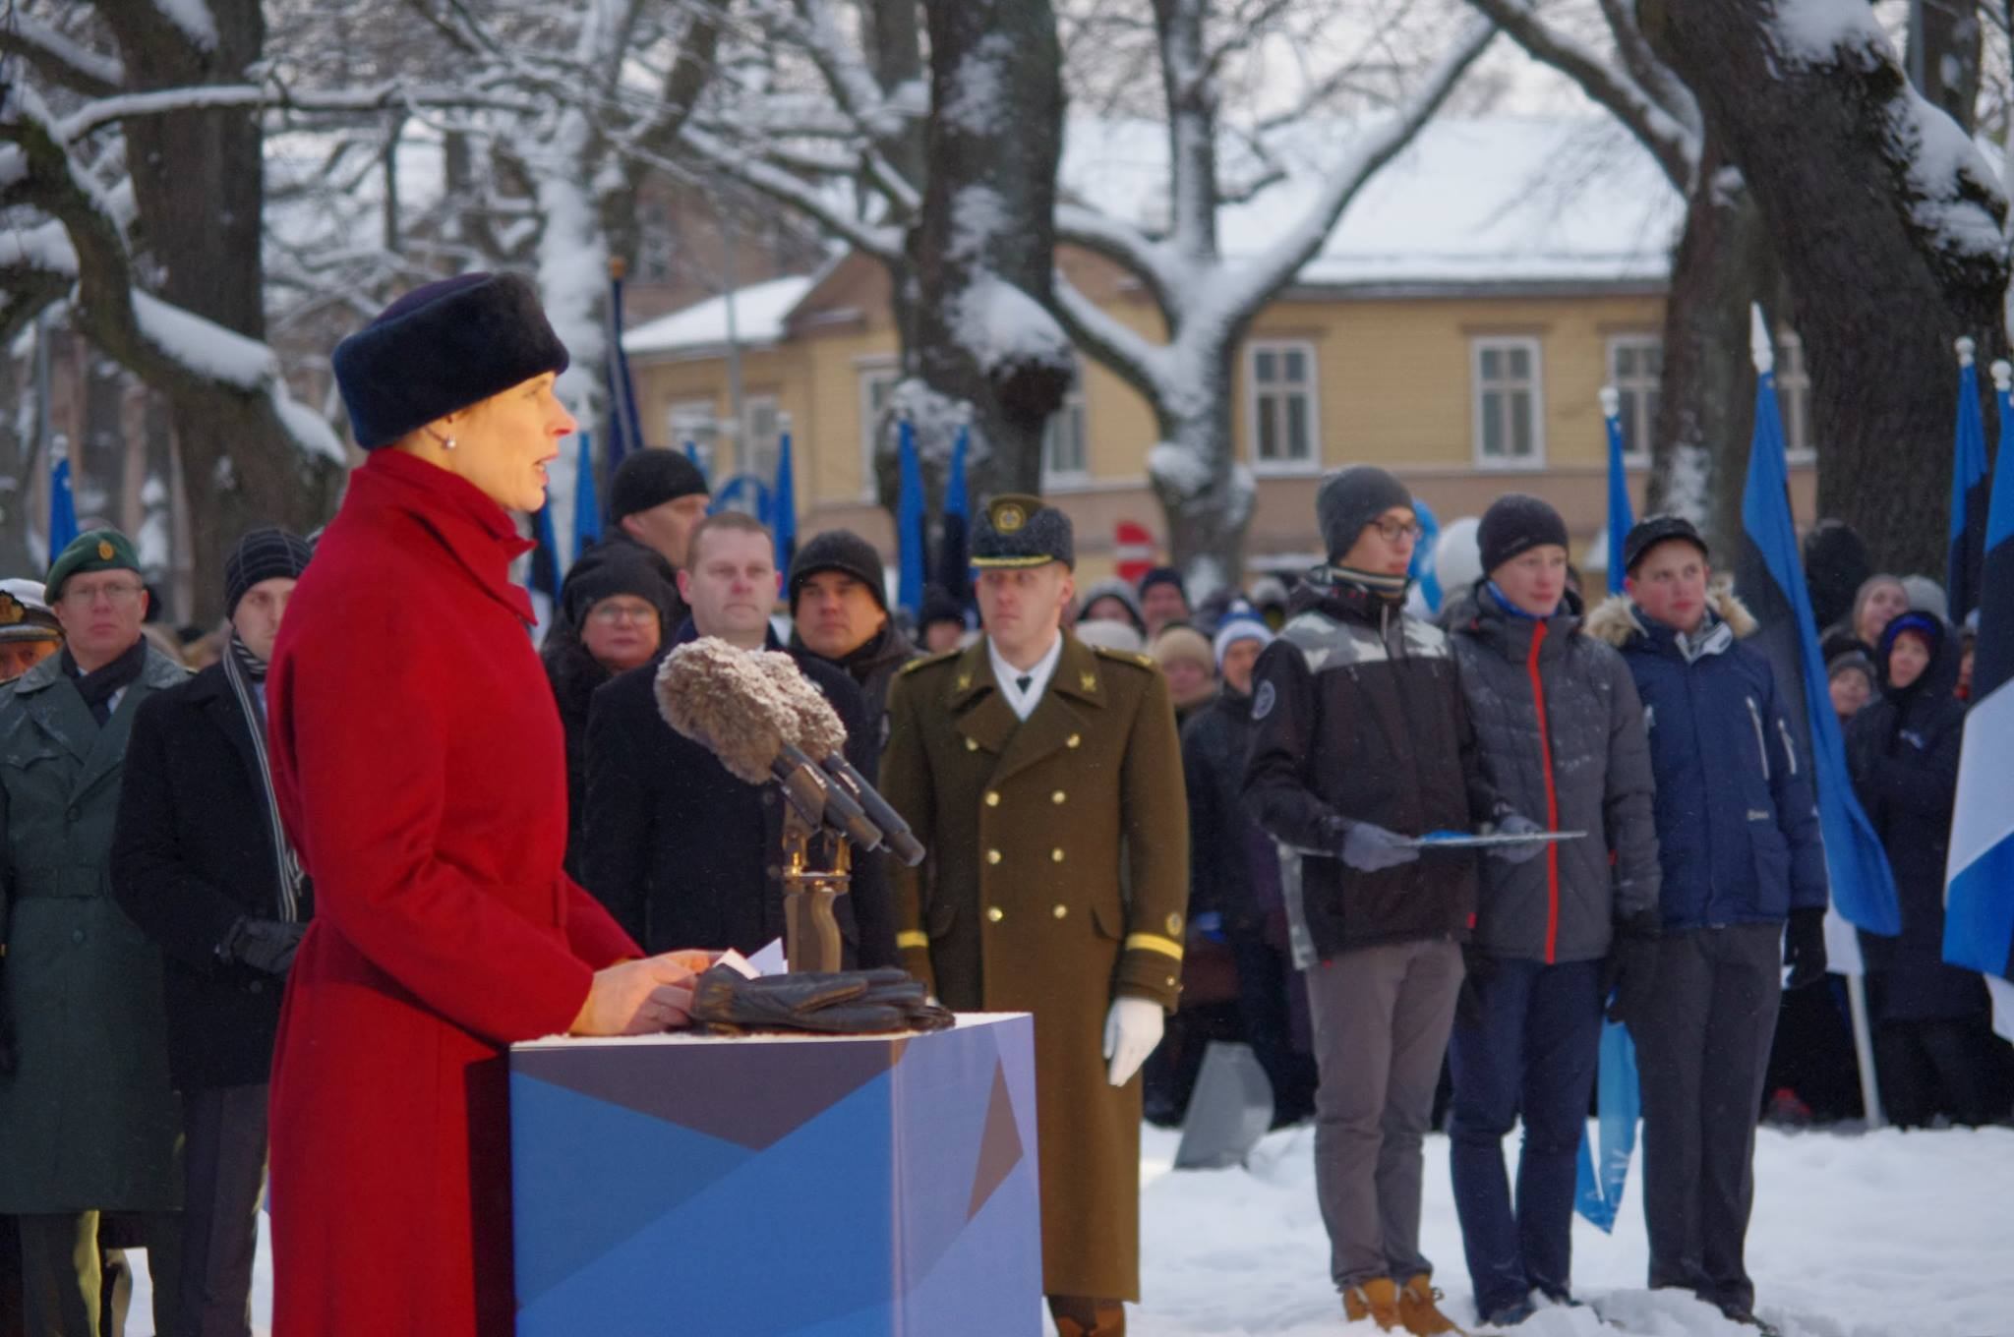
In February 2018, Mrs President Kersti Kaljulaid opened the monument „Ajahetk“ (A Moment of Time) in front of the school builiding (for the 100th anniversary of the Republic of Estonia)

Slide 6
Some numbers in school year 2018-2019:
Students: 526 (in grades 1-9)
62 students among them have a simplified curriculum because of their different special needs, including educational ones
Teachers : 52
(+ teachers and assistants for children with special needs + psychologist + social pedagogue)

Slide 7
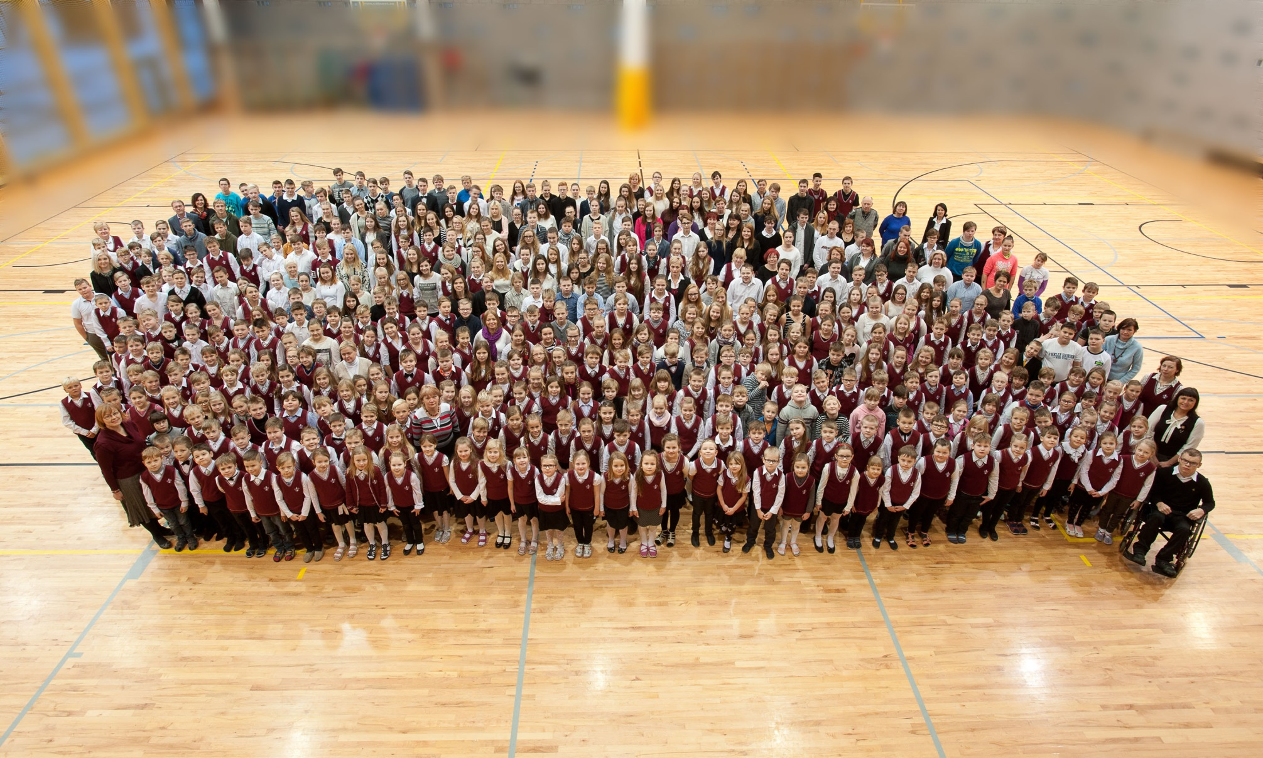
Our school family

Slide 8
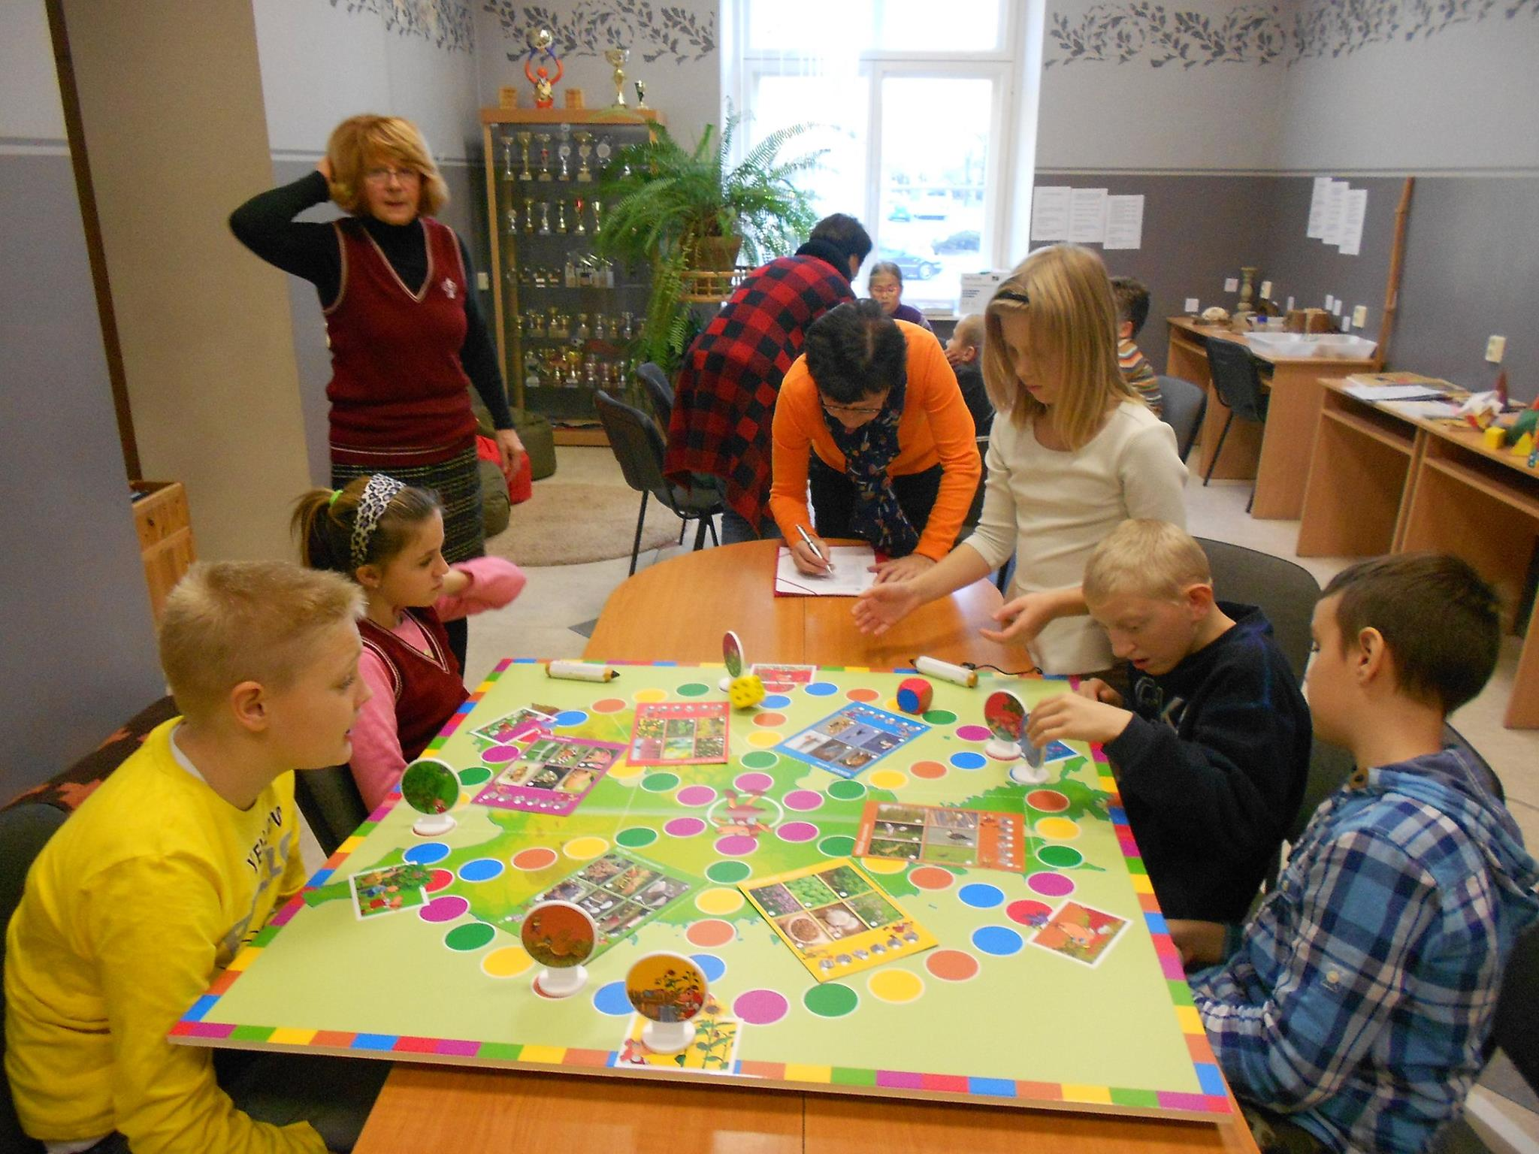
OUR AIMS
Teaching staff aims at being concentrated on all sides of learning and teaching process by...
teaching learning skills

Slide 9
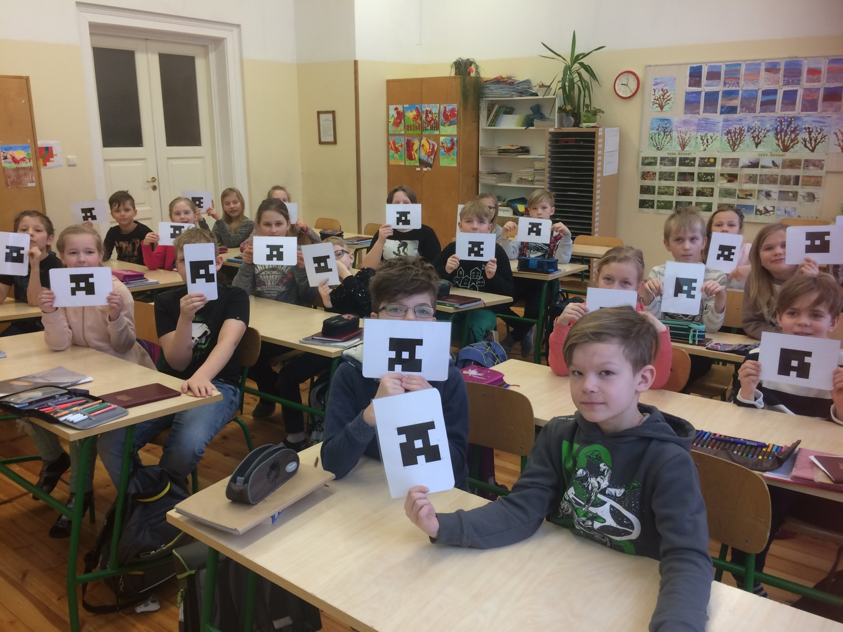
By using modern teaching methods

Slide 10
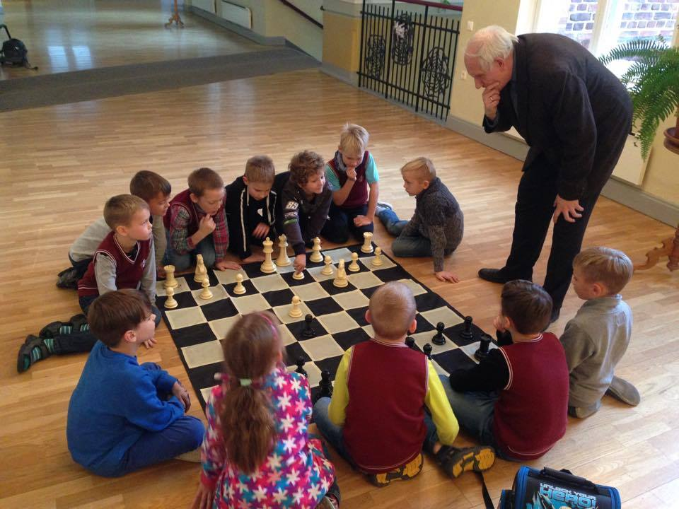
By supporting creative and exploring activities.

Slide 11
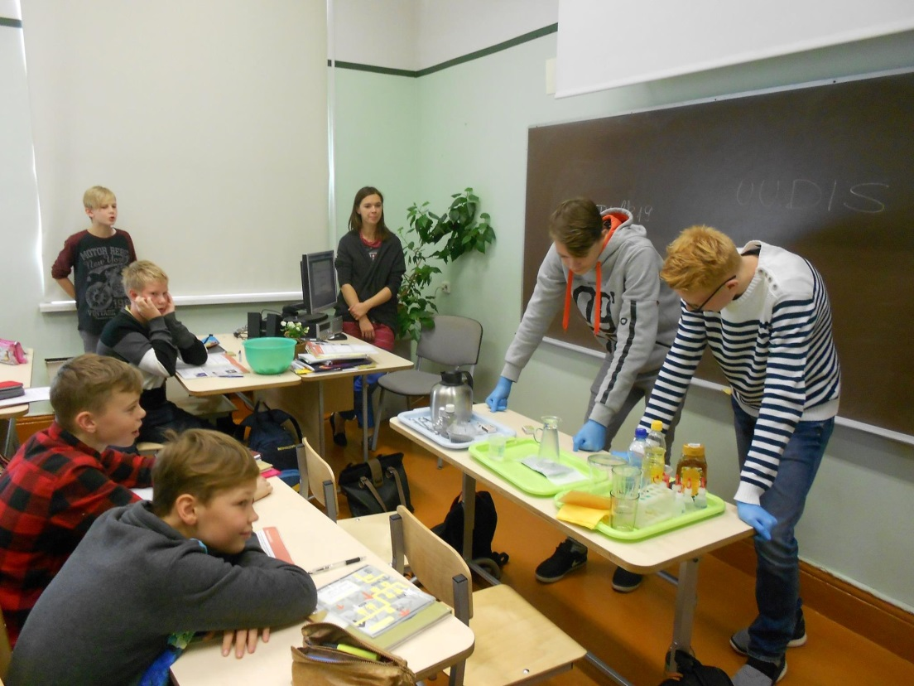
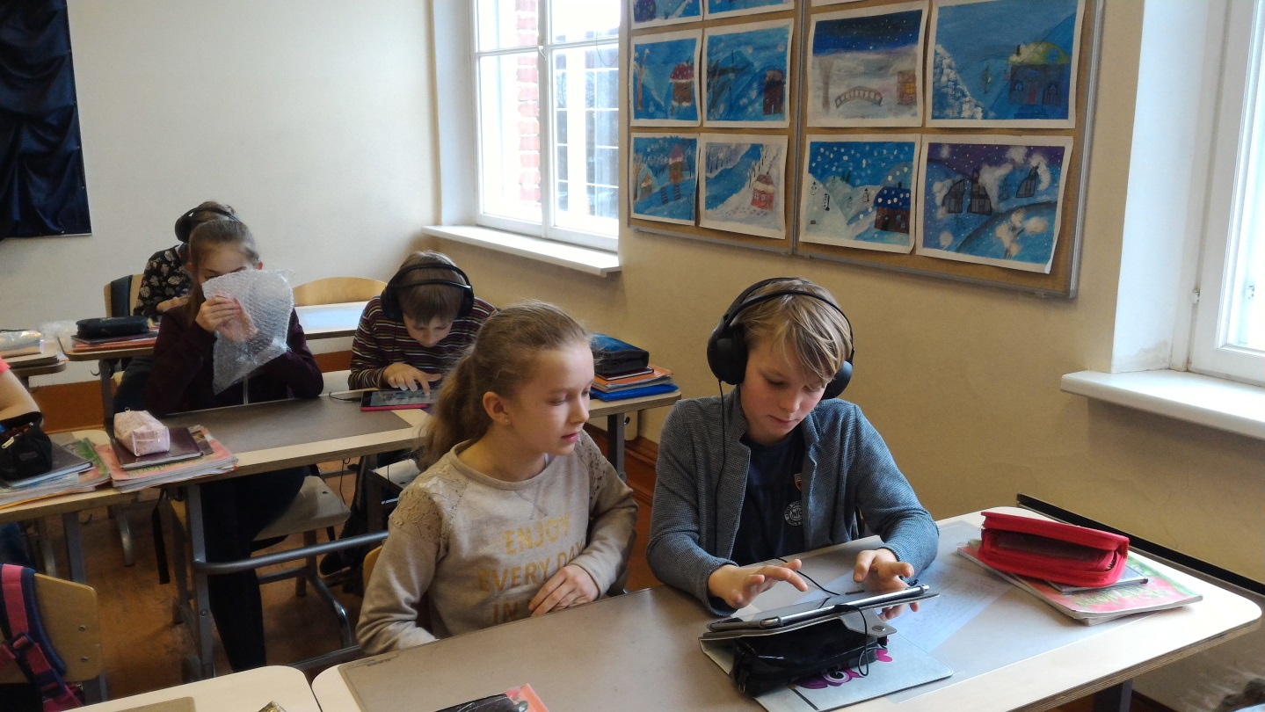
Special attention is paid to teaching natural and exact sciences in modern learning environment and using contemporary tools and methods.

Slide 12
Collaboration is a ValuE!
School values the cooperation in the town of Pärnu, in the region of Pärnu, in Estonia and in Europe.
Partners in Pärnu: Study Counselling Center, Career Counselling Center, The House of Arts, the Science Discovery Center Pernova, other schools
Partners in Estonia: The Center of Enveronmental Investments, the network „Green Schools“, the network „Entrepreneurial Schools“
School has currently 3 Erasmus+ projects:
"CliMates - together for the better"
"Four Cs for the 21st Century - Curiosity, Cooperation, Communication and Creativity"
„Read and write together to travel through the 21st Century Europe"

Slide 13
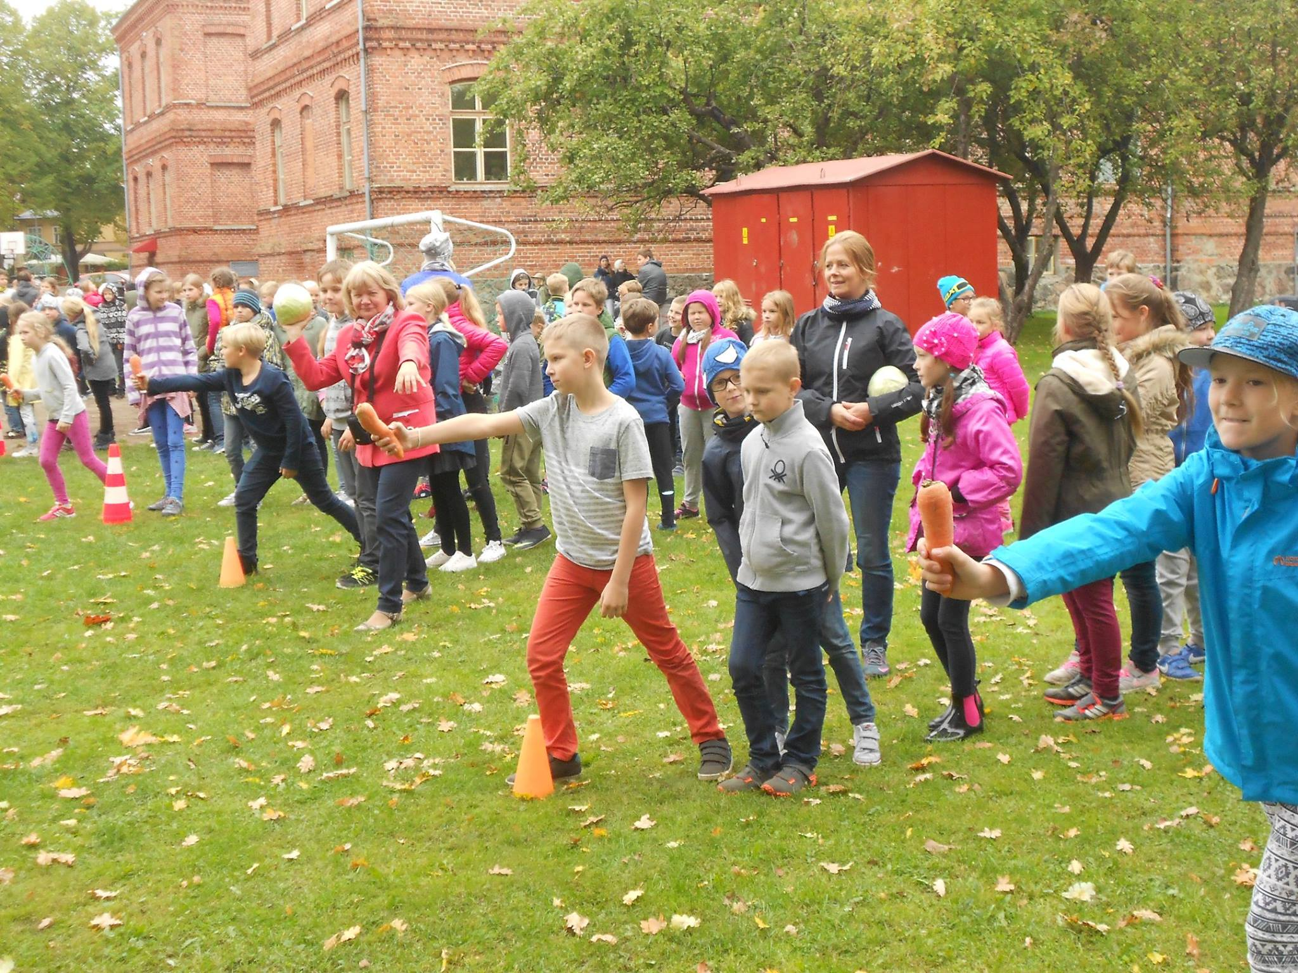
School traditions
Funny sport games in school yard in automn

Slide 14
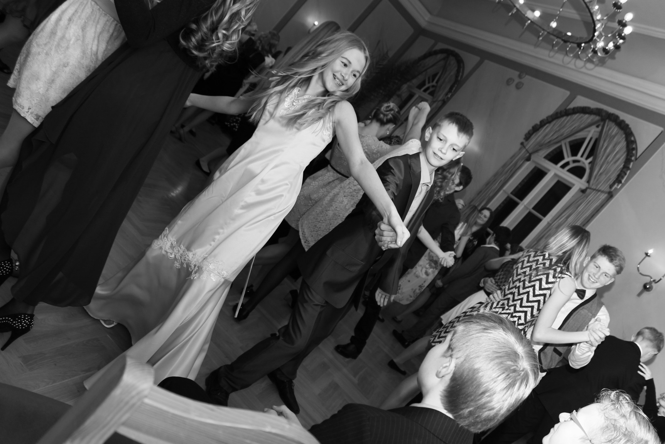
Christmas prom

Slide 15
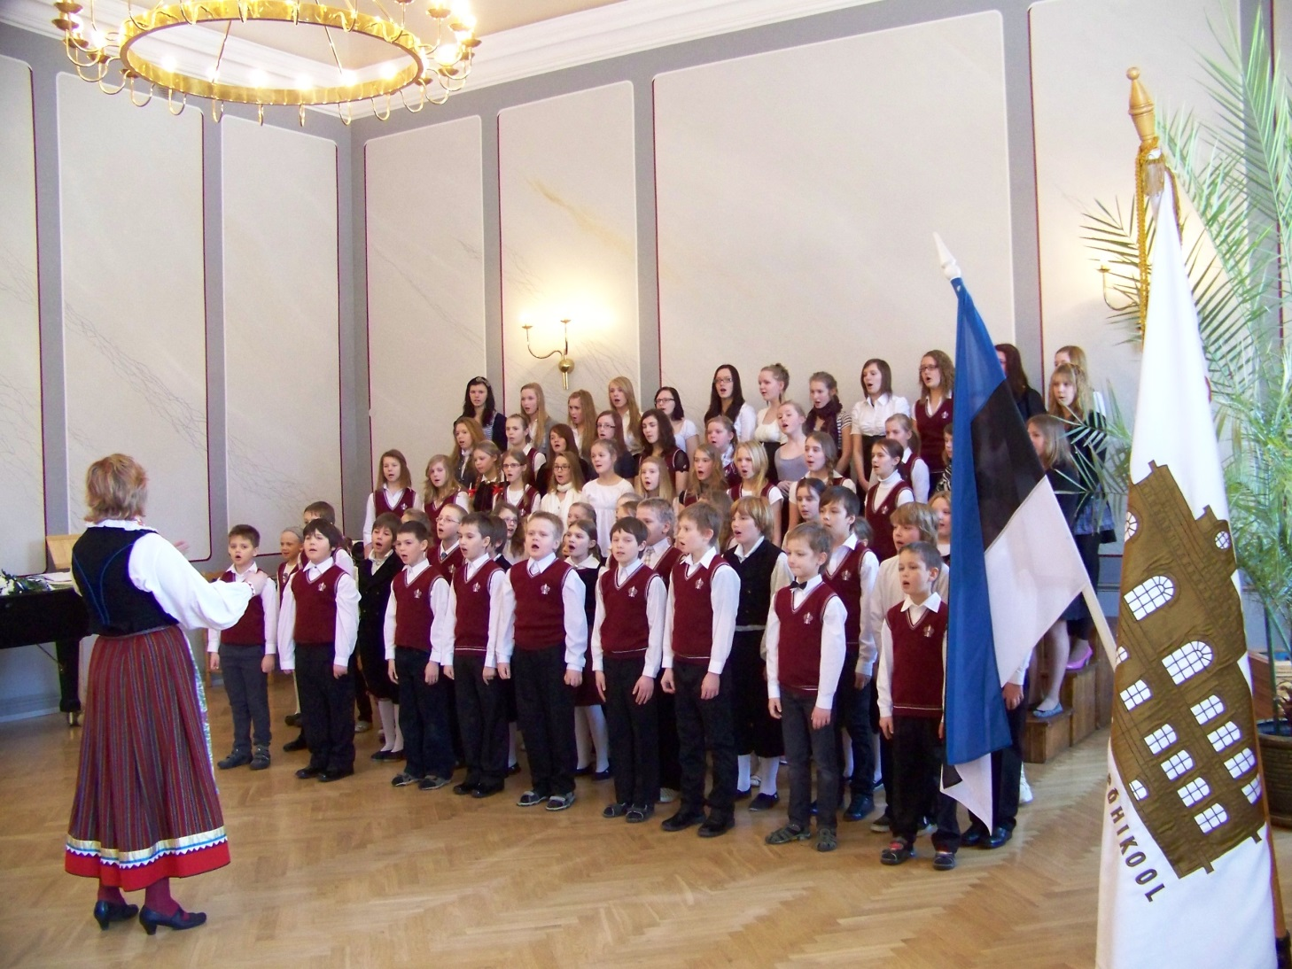
Concerts given by school choirs

Slide 16
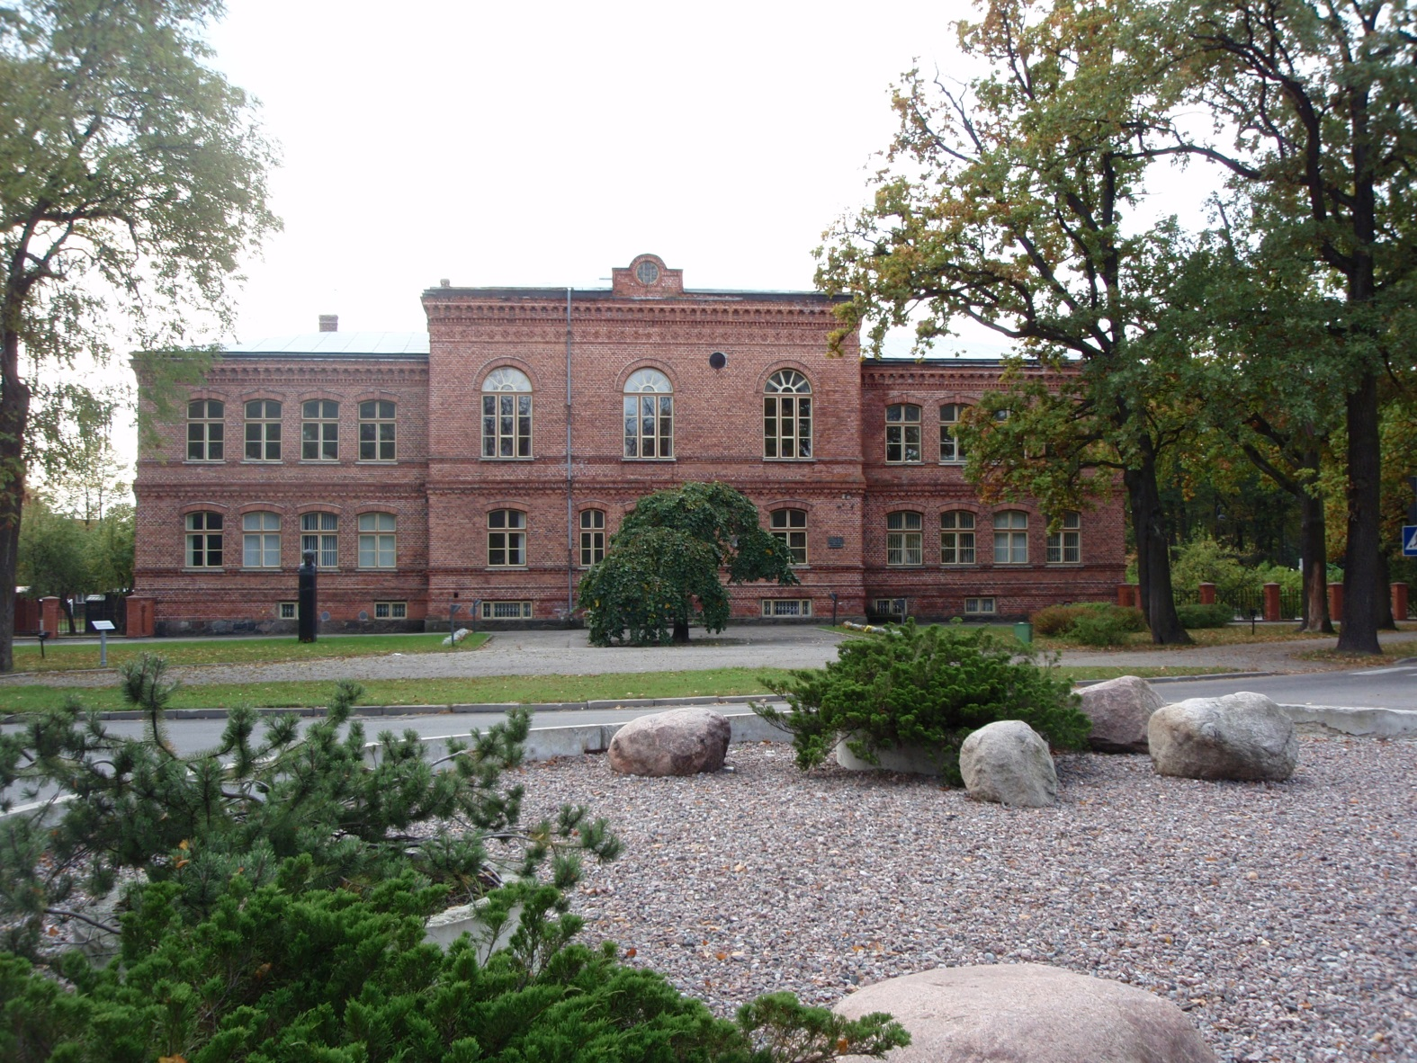
Our HISTORICAL SCHOOL BUILDING

