Slide 1
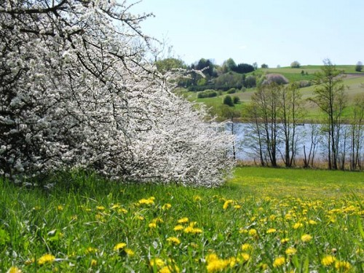
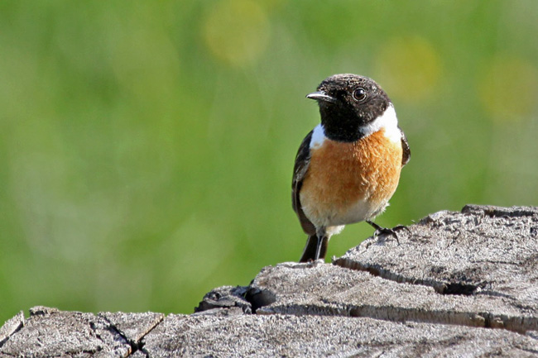
Spring is the time of year that is full of well-being and warmth. This is the season in which nature comes to life, birds are singing and all the people meet up with friends. However, once spring was really a beautiful time of year .

Slide 2
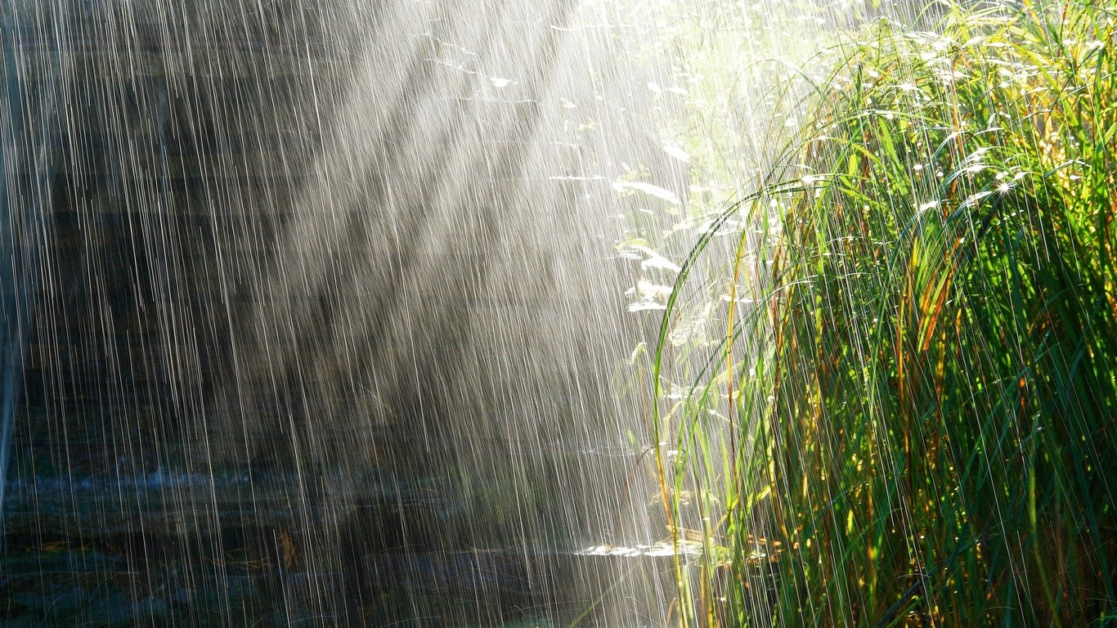
Currently, spring is the season in which it is raining, and there is a very cold weather . Spring now is mainly a very short and almost no one is unimportant. Historically, the winter lasted several months followed by an astronomical spring .

Slide 3
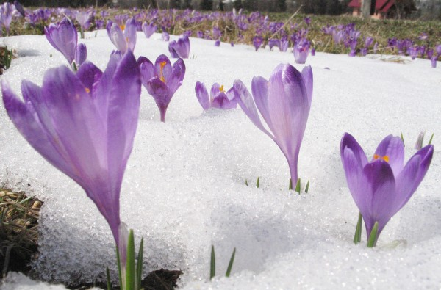
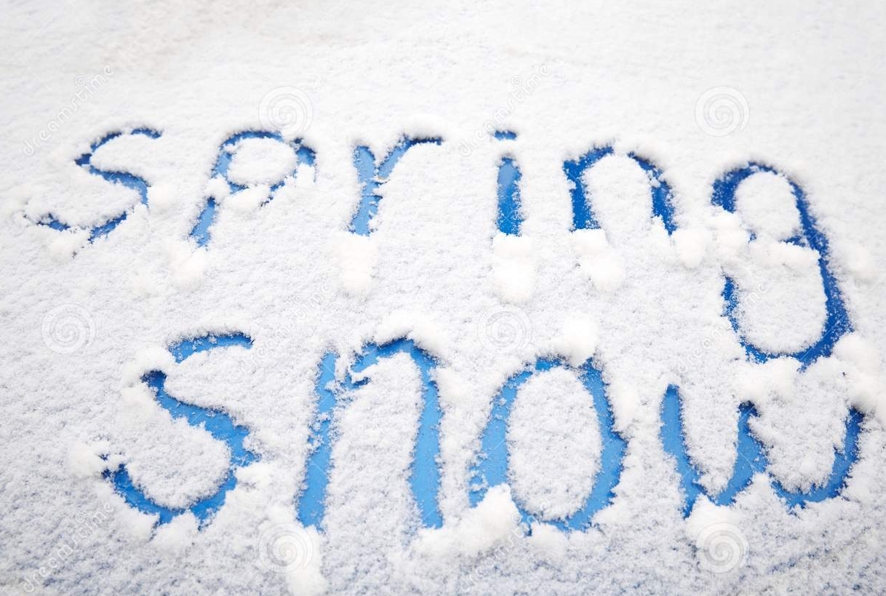
Currently enormous spring mainly snow and temperatures that are close to zero.

