Slide 1
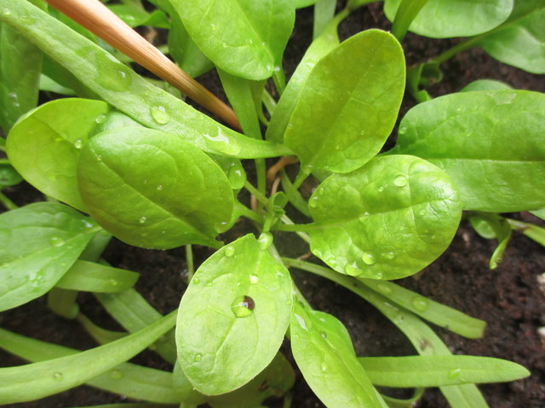

Our school garden
Primary School of Naousa Paros, Greece
Erasmus Program
"Environment Surrounding Us as a Challenge and Responsibility"

Slide 2
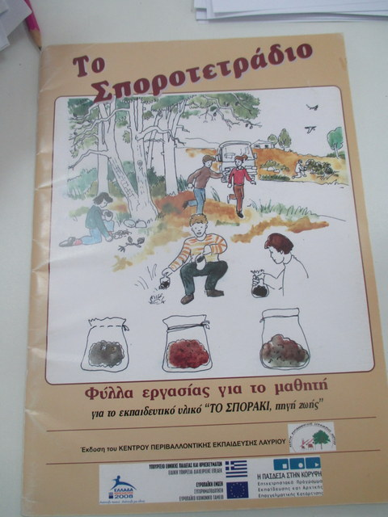
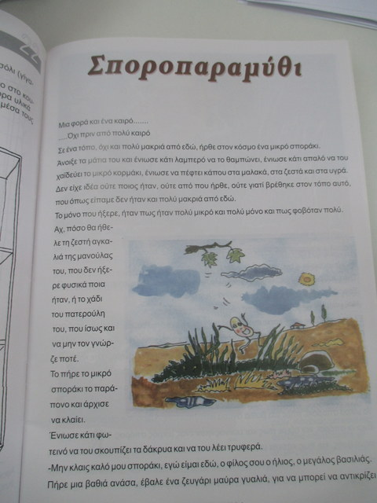
Fairy tale about seeds
We started by reading the “Seed tale” and
filling in our seeds exercise notebook! So much fun!!!

Slide 3
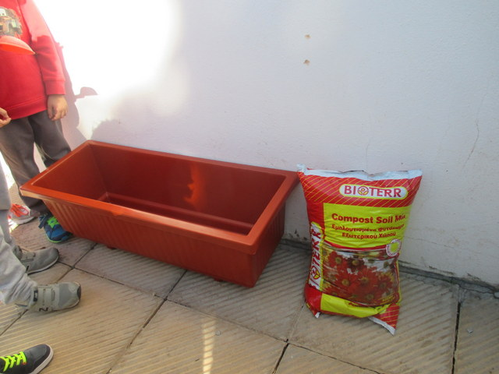
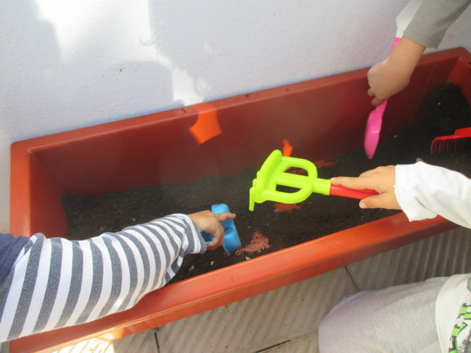
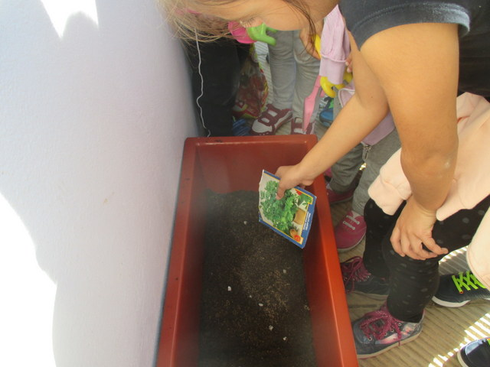
Planting of the seeds I

Slide 4
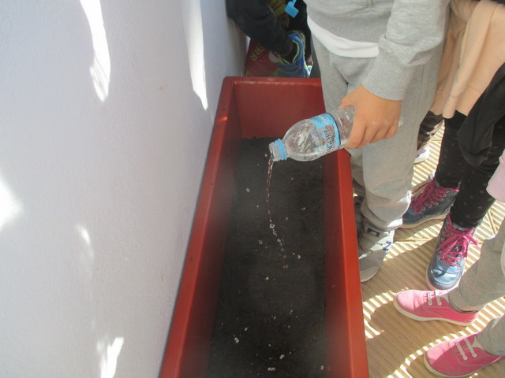
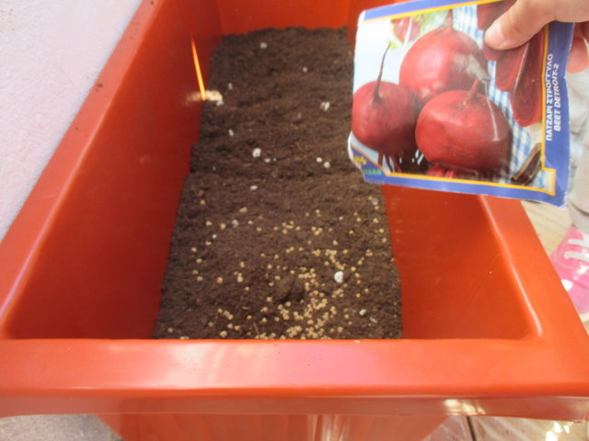
Planting of the seeds II

Slide 5
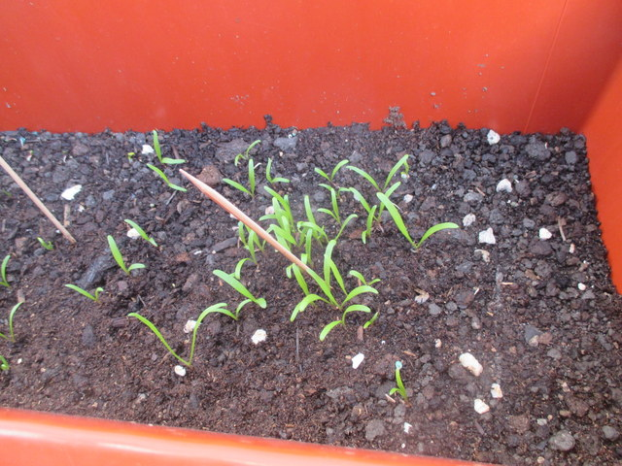
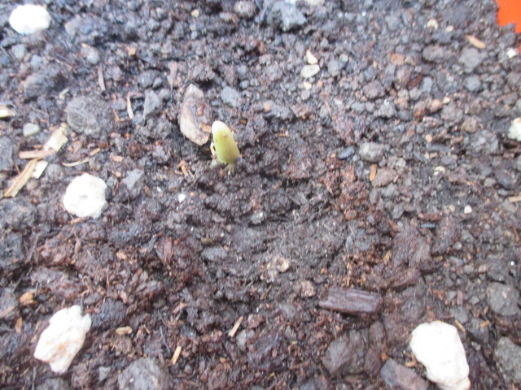
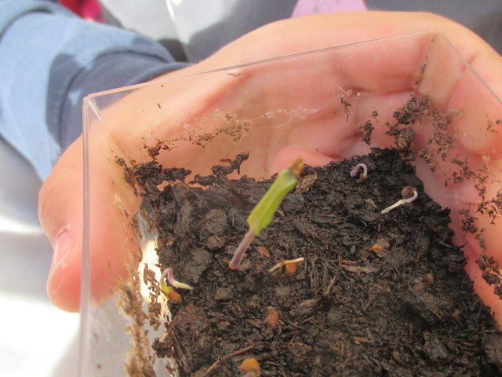
The growing of the seeds

Slide 6
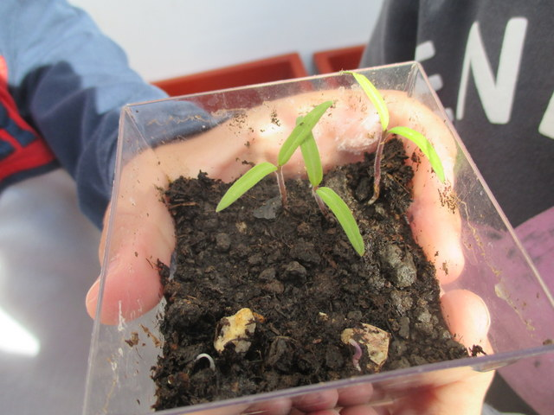
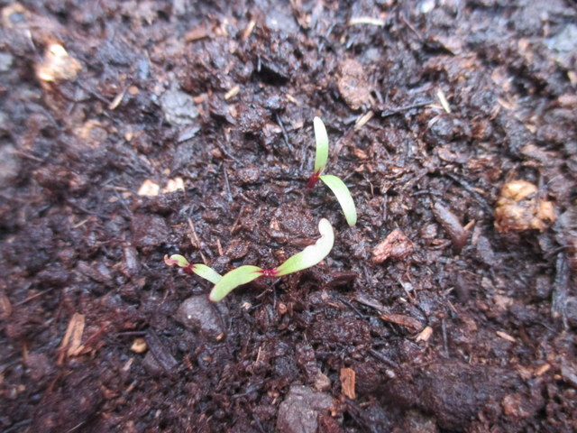
The growing of the seeds

Slide 7
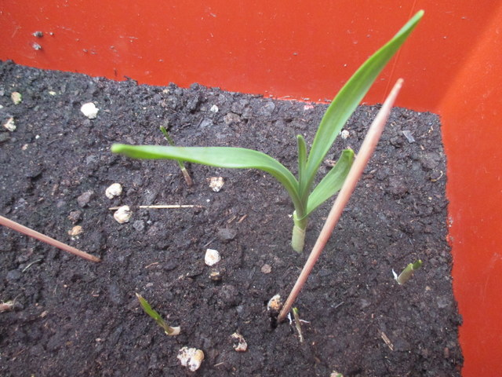
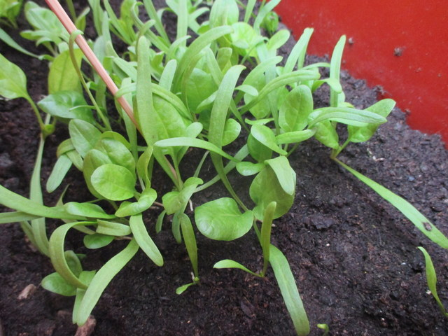
The growing of the spinach

Slide 8
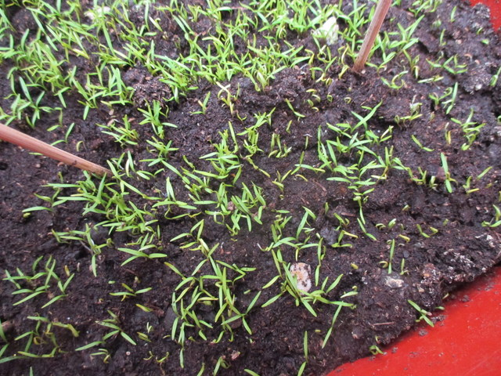
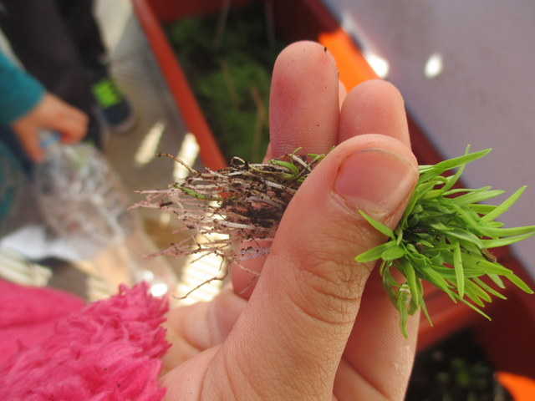
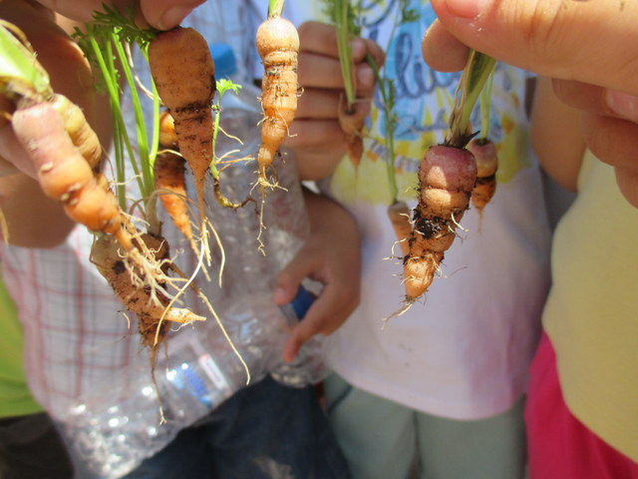
The growing of the carrots

Slide 9
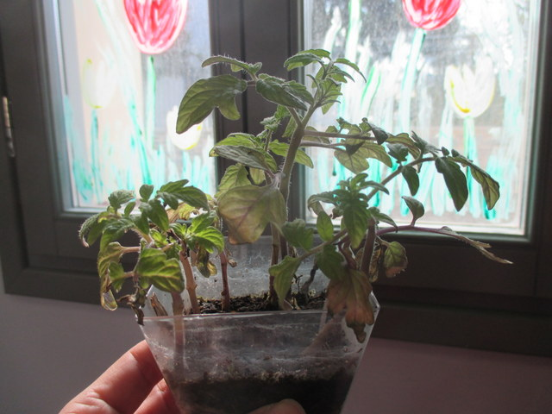
The growing of the tomatoes

Slide 10
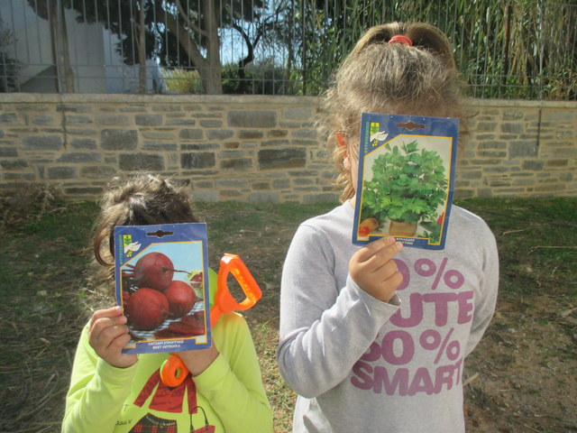
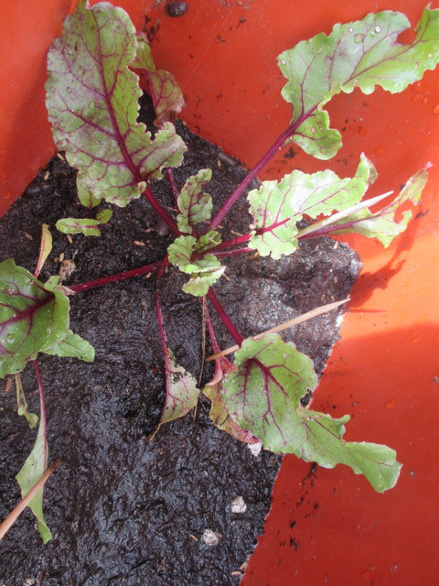
The growing of the beetroots

Slide 11
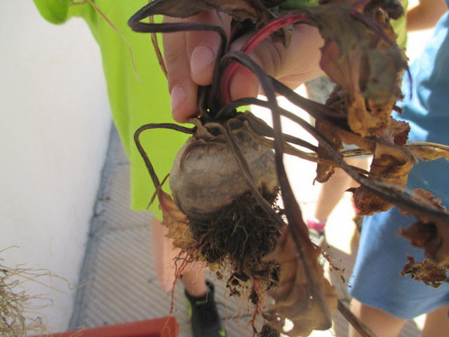
The growing of the beetroots

Slide 12
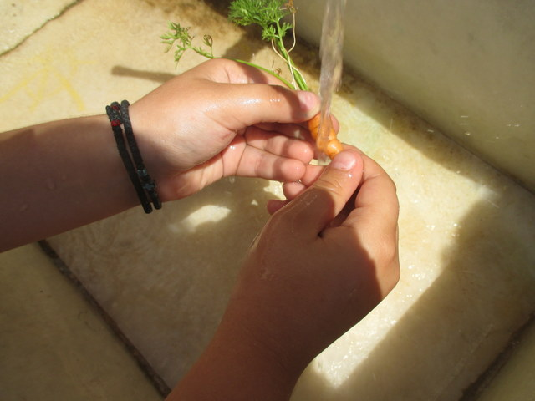
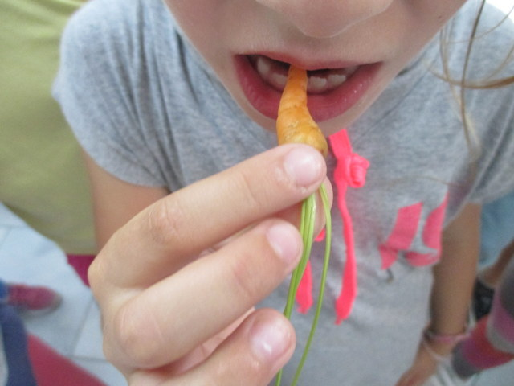
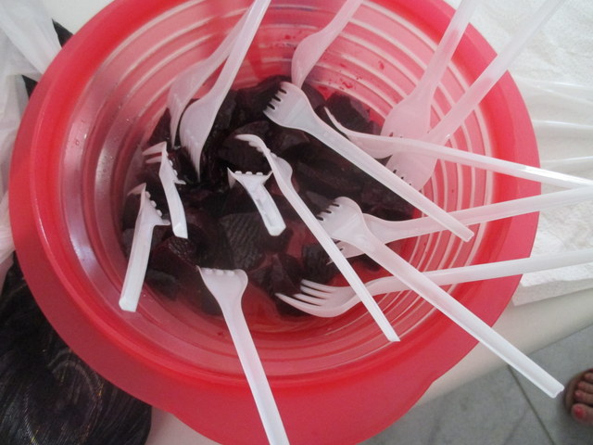
Tasting our vegetables

Slide 13
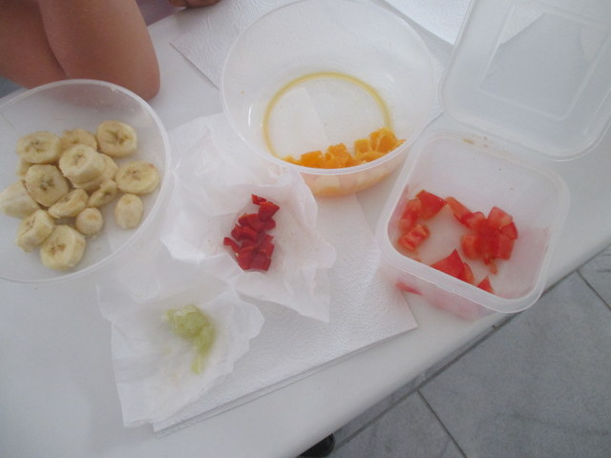
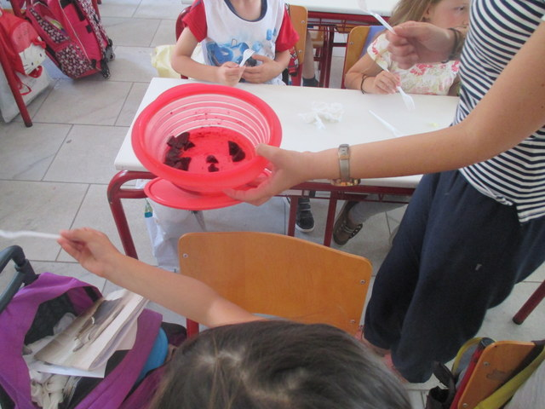
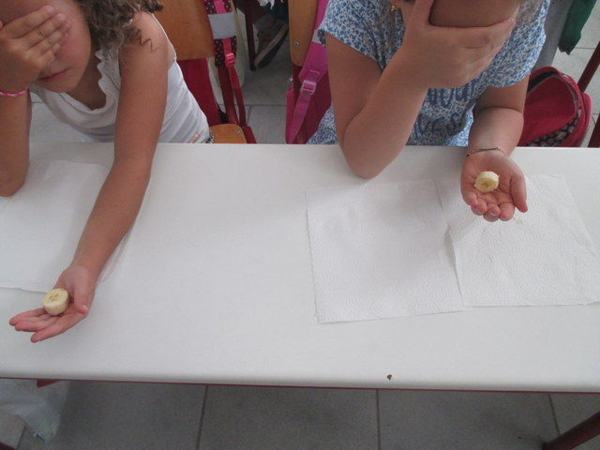
Playing with the sense of taste

Slide 14
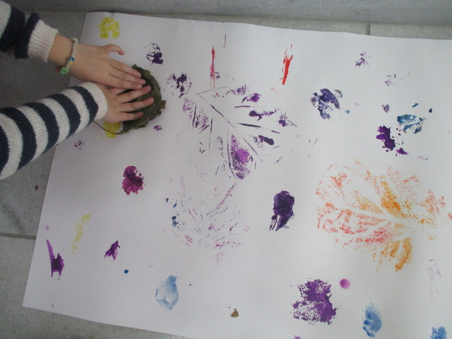
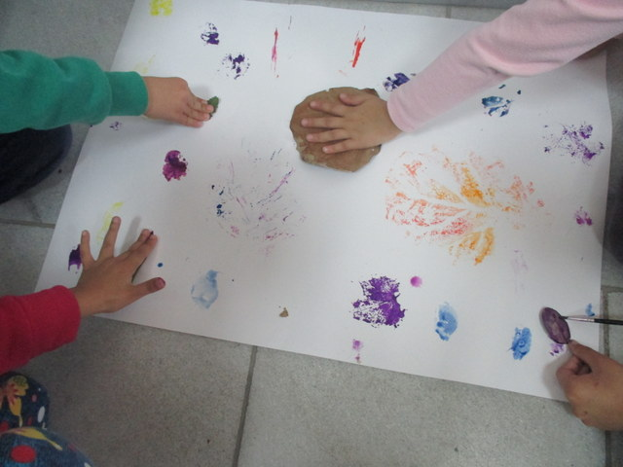
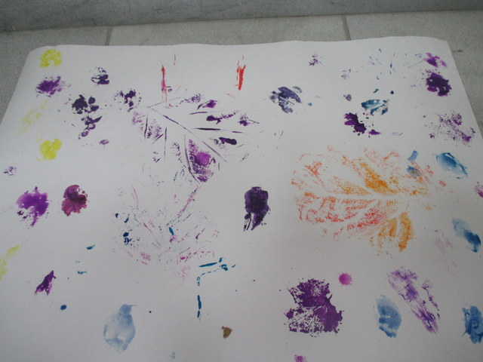
Print making from our vegetables

Slide 15
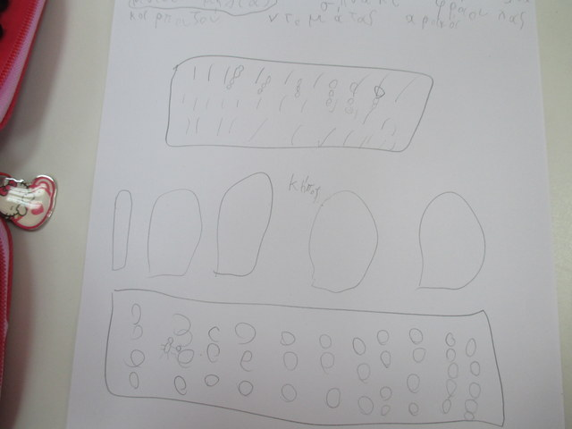
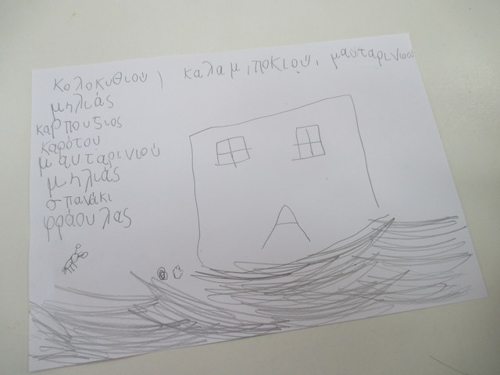
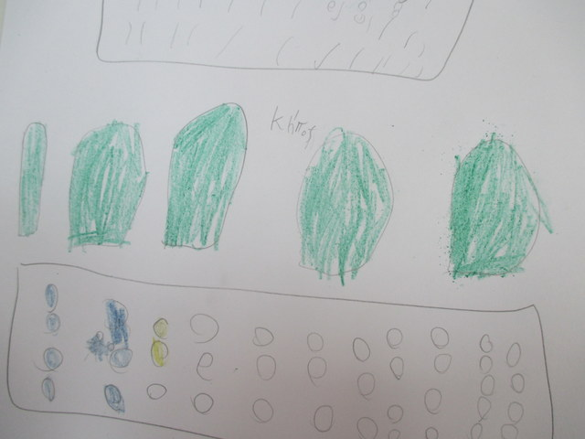
We are ants hunting for seeds…

Slide 16
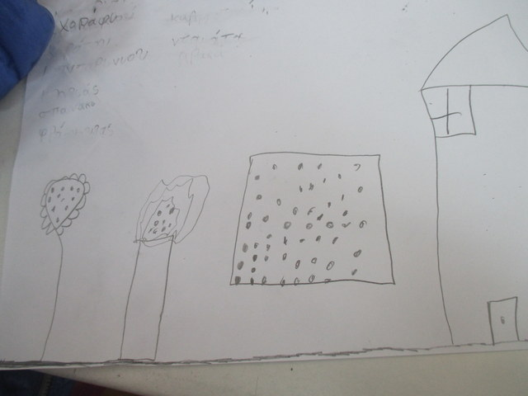
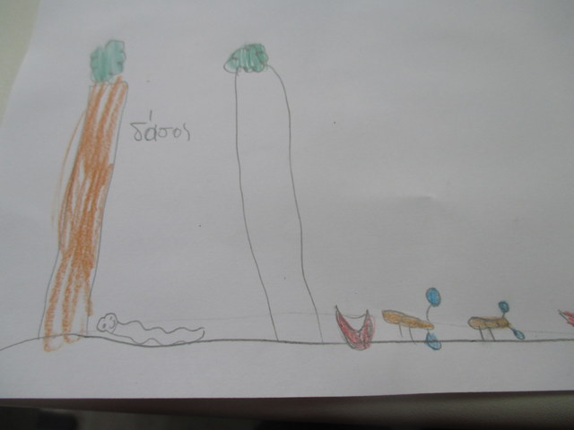
We are ants hunting for seeds…
We created our own fairy tale! We became ants that live in a beautiful forest and are searching for seeds. We drew pictures for our story and did role playing. We loved it!!!

Slide 17
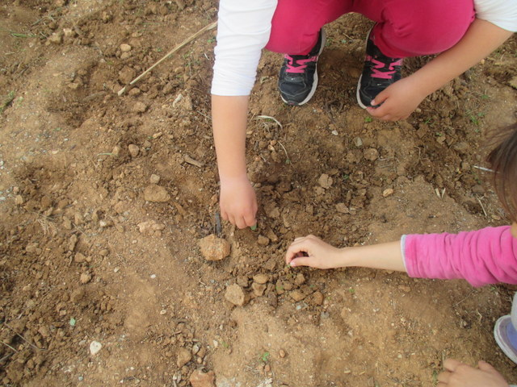
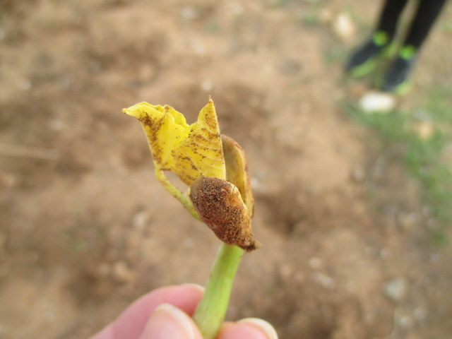
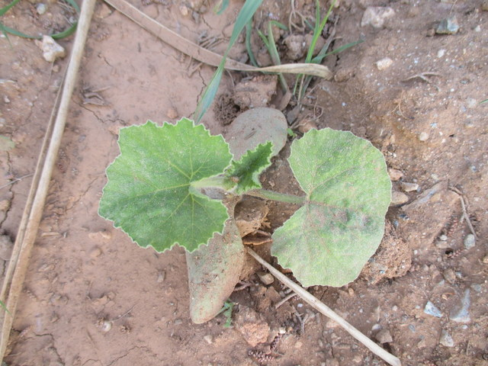
Another cultivation (beans, zucchini)

Slide 18
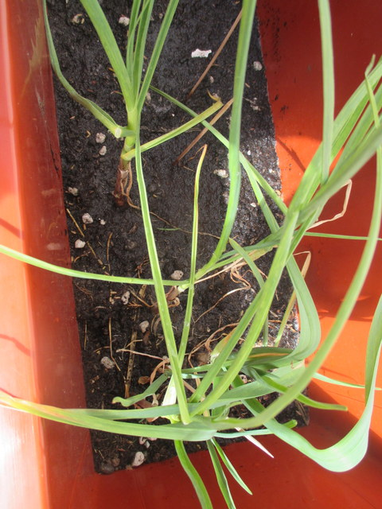
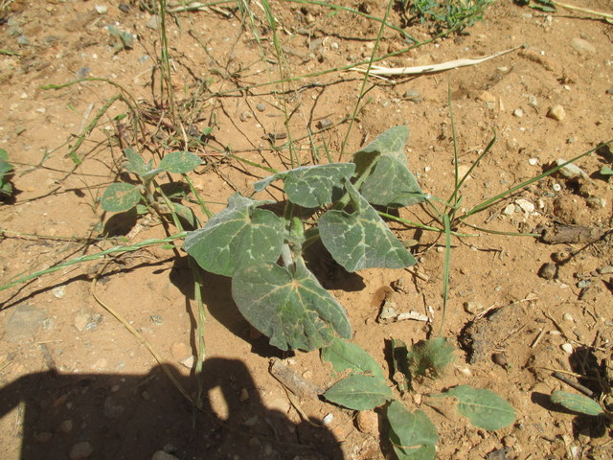
Another cultivation (zucchini, garlic)

Slide 19
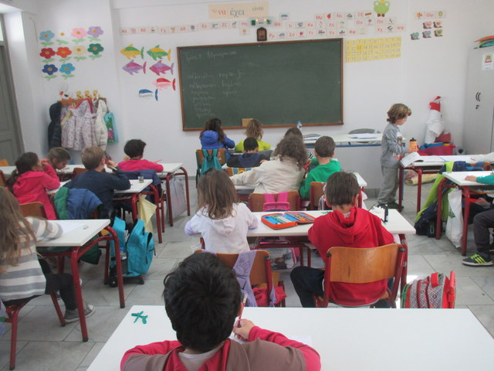
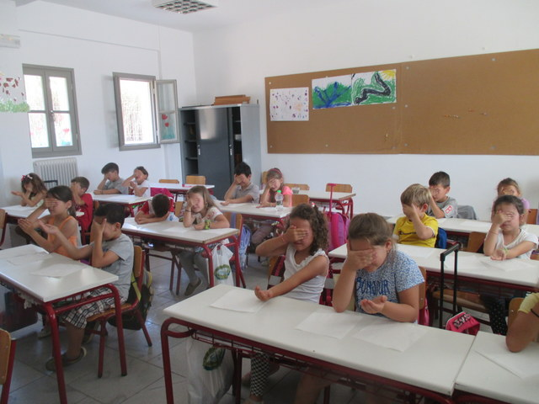
Playing games inspired from our garden!
Find the vegetable or fruit by only tasting it!
Not allowed to see it!

Slide 20
CLASSES A2 AND A3 (1ST grade)
PLANTING LENTILS AND BEANS IN PLASTIC CUPS

Slide 21
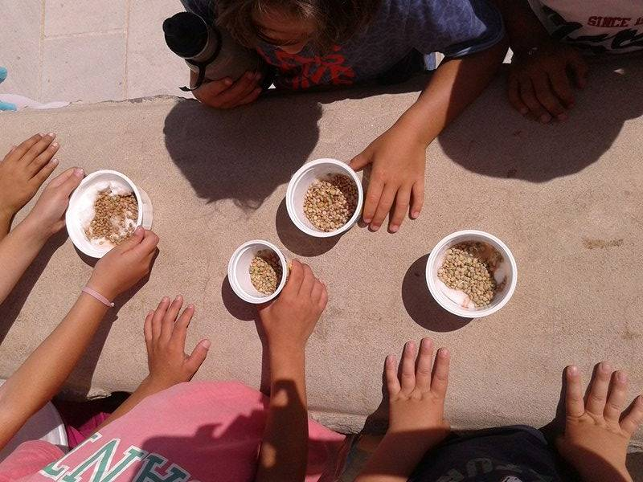
PLANTING LENTILS AND BEANS

Slide 22
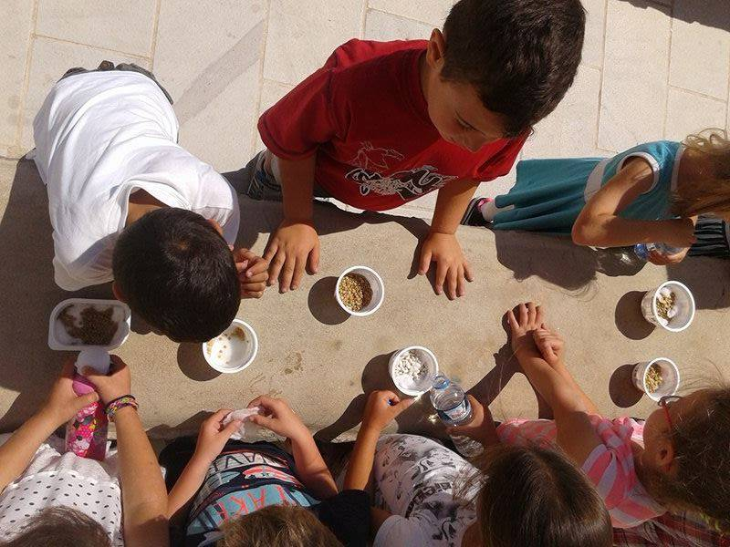
WATERING OF LENTILS AND BEANS BY PUPILS

Slide 23
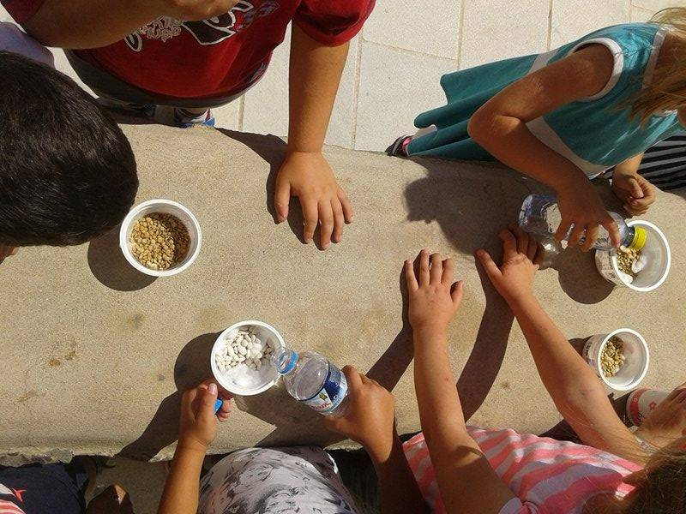

Slide 24
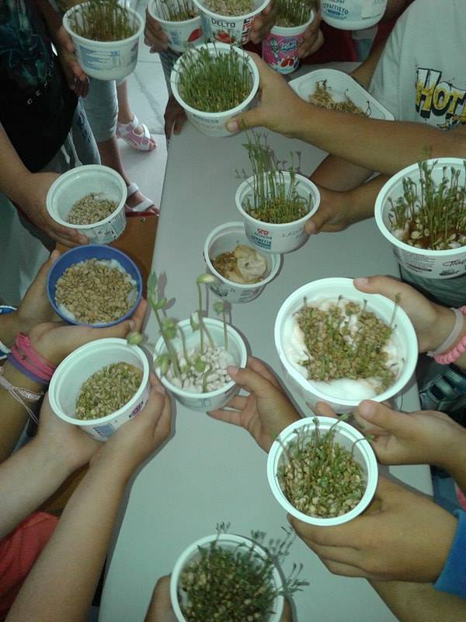
WATCHING THEM GROW UP

Slide 25
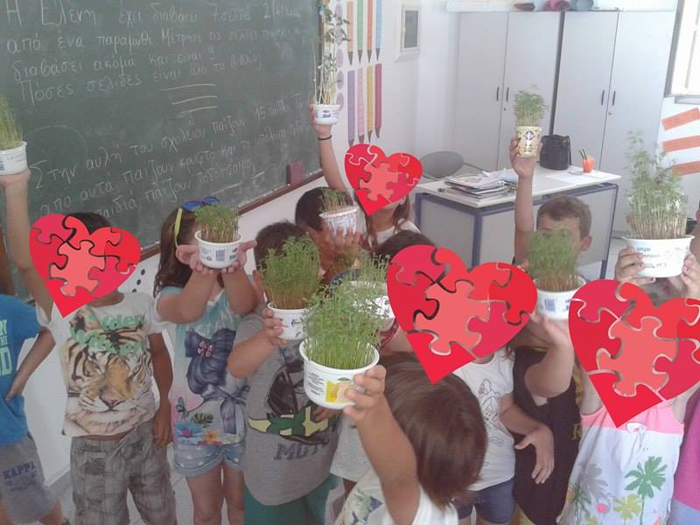
G
A
R
D
E
N
E
R
S
H
A
P
P
Y

Slide 26
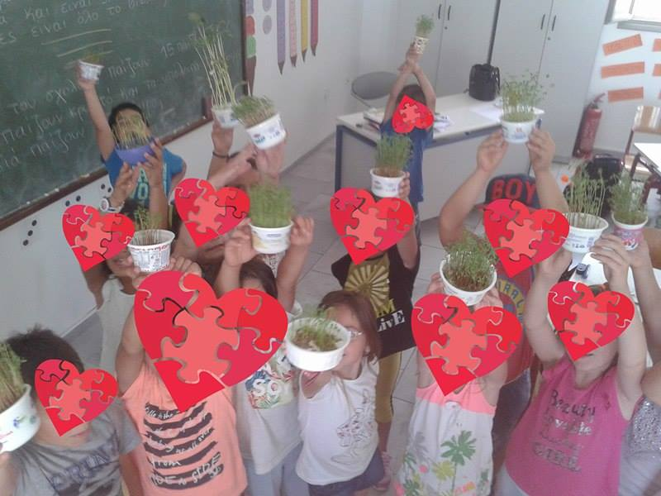

Slide 27
CREDITS
MAIN PROJECT
TEACHER OF A1 CLASS: DIMOU PINELOPI
ICT TEACHER: DETSIOU SOFIA
Teachers of A2 (Trachana E.) & A3 (Kostopoulou E.) classes participated with the smaller project “planting lentils and beans”.

