Slide 1
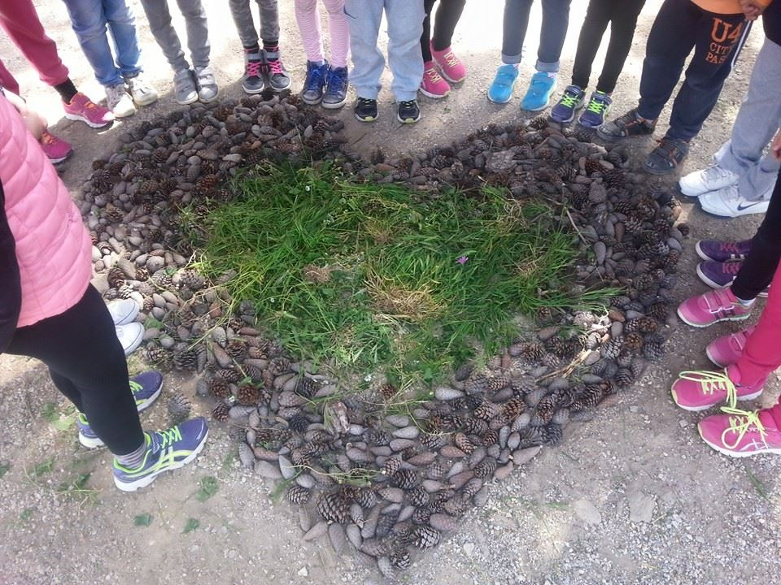
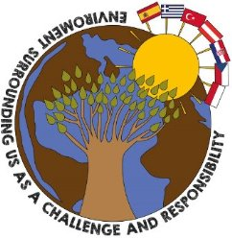
Celebrating Earth Day Primary School of Naousa
Erasmus + project: “Environment Surrounding Us as a Challenge and Responsibility”

Slide 2
Celebration of the Earth Day
Every year on 22th April at Primary School of Naousa we celebrate the Earth Day.
Students learn why it is important to protect our planet. We do a variety of activities like collecting garbage from the beaches near our school, plant trees and plants and do creations inspired from nature like land art.

Slide 3
Collecting garbage from beaches around Naousa

Slide 4
Collecting garbage from Naousa beaches

Slide 5
Collecting garbage from Naousa beaches

Slide 6
Planting trees in cooperation with the Environmental Department of Municipality of Paros

Slide 7
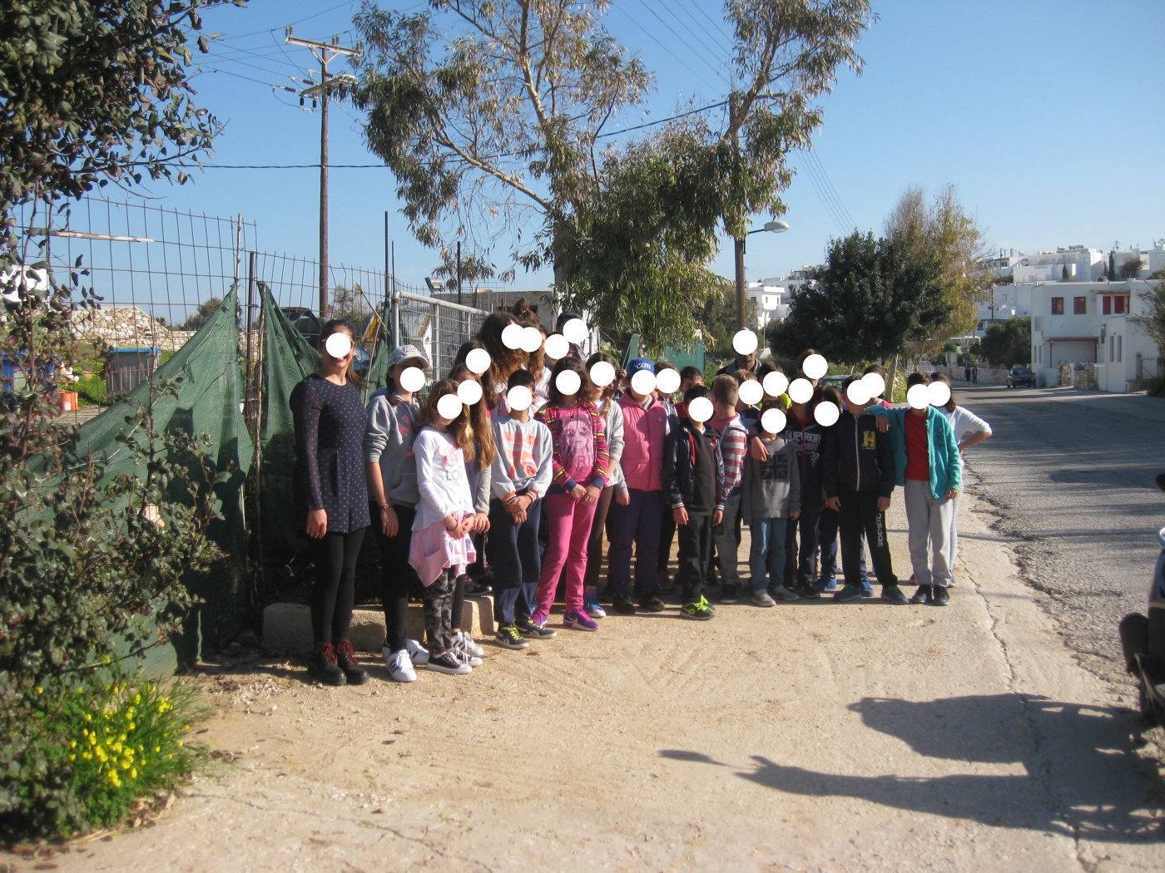
Planting trees

Slide 8
Land art creations to our school garden and yard
Spiral creation
Spiral creation

Slide 9
Land art creations to our school garden and yard

Slide 10
Land art creations to our school garden and yard
We love Earth
We love Earth

Slide 11
Land art creations to our school garden and yard
Heart of the Earth
Heart of the Earth

Slide 12
Land art creations to our school garden and yard

Slide 13
Land art creations to our school garden and yard
Earth is our home
Earth is our home

Slide 14
Land art creations to our school garden and yard
Earth is our home
Earth is our home

Slide 15
Thank you for watching! THE END
Credits:
Class ST2 , Teacher: Elena Antoniou
Classes Α1,Α2, Α3, Β1, Β2, Β3,
Art Director: Chanioti D.
Presentation/Digital editing: Detsiou S.
Sources : Art Textbook for 1st & 2nd Grade
Environmental Studies: 1st & 2nd Grade
Greek Language textbook: 1st &2nd Grade
This project is funded by the European Union
The European Union is not responsible for any uploaded or submitted content. Such content expresses the views of its author(s) only.

