Slide 1
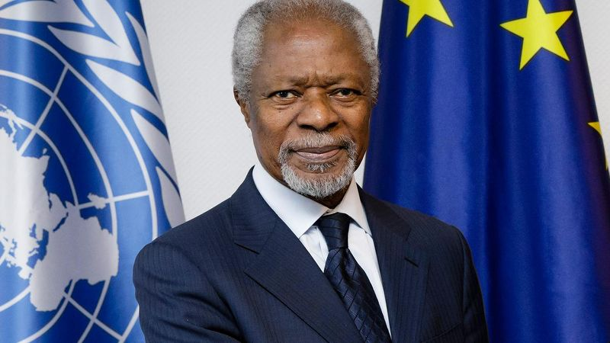
Kofi Annan
Class: a 4-a B School: Secondary N. Iorga Sibiu Authors: Daria Croitoru Eric Bengulescu Ana Bocodi Antonia Barb

Slide 2
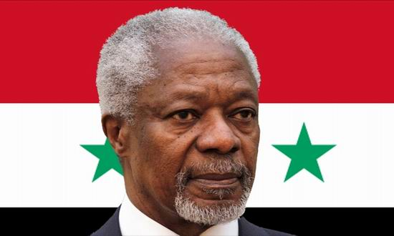
Kofi Annan's family
Kofi Annan was born on April 8, 1938 in Kumasi, Ghana and died on August 18, 2018 in Bern Switzerland at the age of 80. He died of an illness.
He had 3 children with Nane Annan: Kojo Annan, Nina Cronstedt and Ama Annan
His parents were Henry Reginald Annan and Rose Eshun
He had a sister and a brother: Kobina Annan and Efua Atta

Slide 3
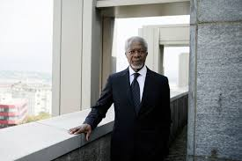
Citizenship, ethnicity and religion
He is a Ghanaian citizen
It is of Ashanti ethnicity
And he is Protestantism

Slide 4
What was Kofi Annan's occupation?
Kofi Annan was the seventh Secretary-General of the United Nations and was the founder and president of the Kofi Annan Foundation.
He was also a Diplomat, Politician and Economist

Slide 5
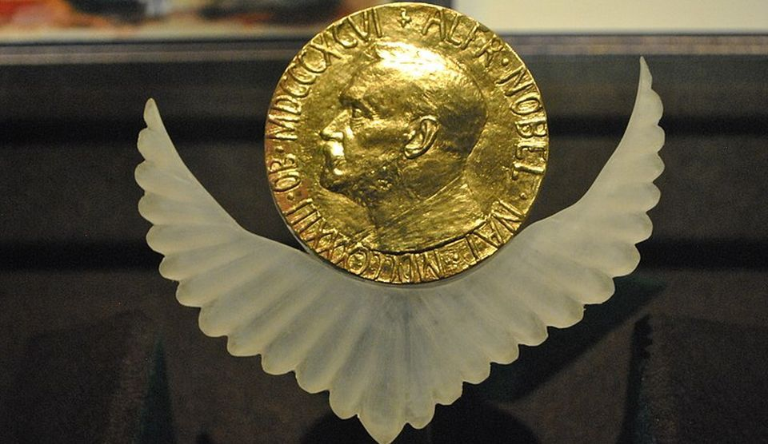
Awards
In 2001, he and the United Nations received the Nobel Peace Prize together. Kofi Annan was praised for being "preeminent in bringing new life to the organization." (Norwegian Nobel Committee, October 2001).

Slide 6
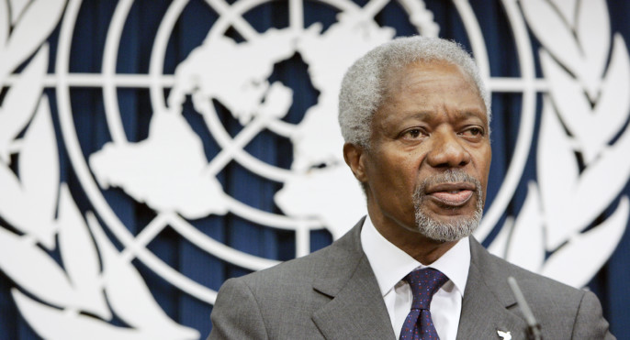
Curiosity
His name Kofi means he was born on a Friday
For 10 years, he was at the forefront of world politics. He continued to work as an ambassador of peace even after leaving the post of UN Secretary General.
His signature is:

