Slide 1
eye

Slide 2
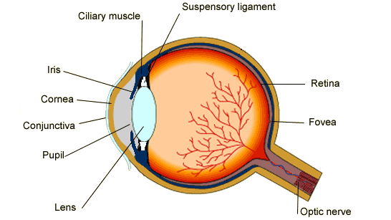
the construction of the eye

