Slide 1
What we learn in history☺
Author : Elvis Bērziņš

Slide 2
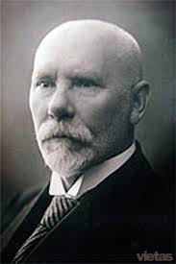
For November!
November is a very important month for Latvia because November 11 is Lāčplēsis Day, but on November 18 is the Latvia‘s birthday!
Latvia was founded on 18 November 1918.
Latvia first president was Jānis Čakste

Slide 3
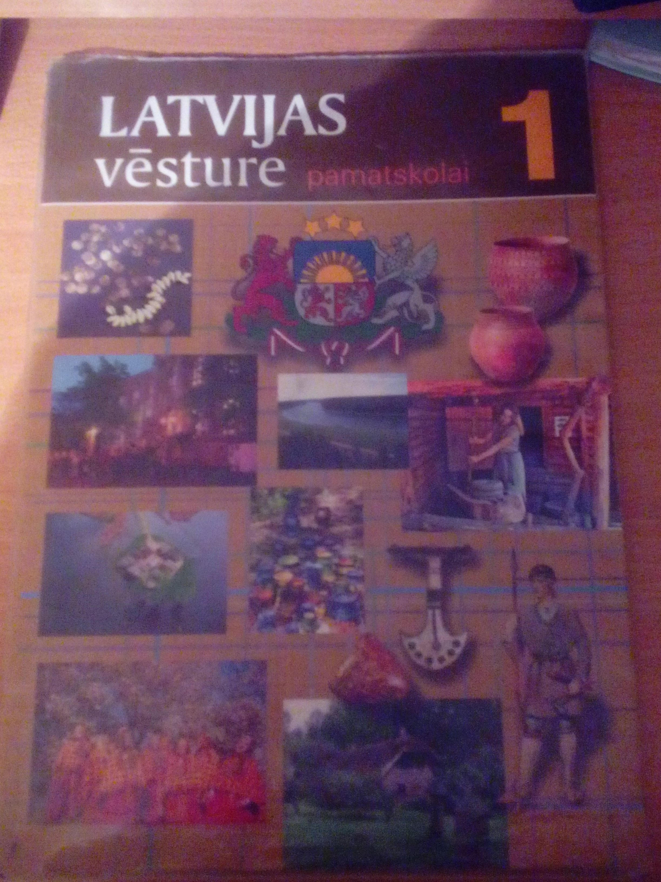
Books we use in history classes !
This book is called “History of Latvia for Primary School 1“

Slide 4
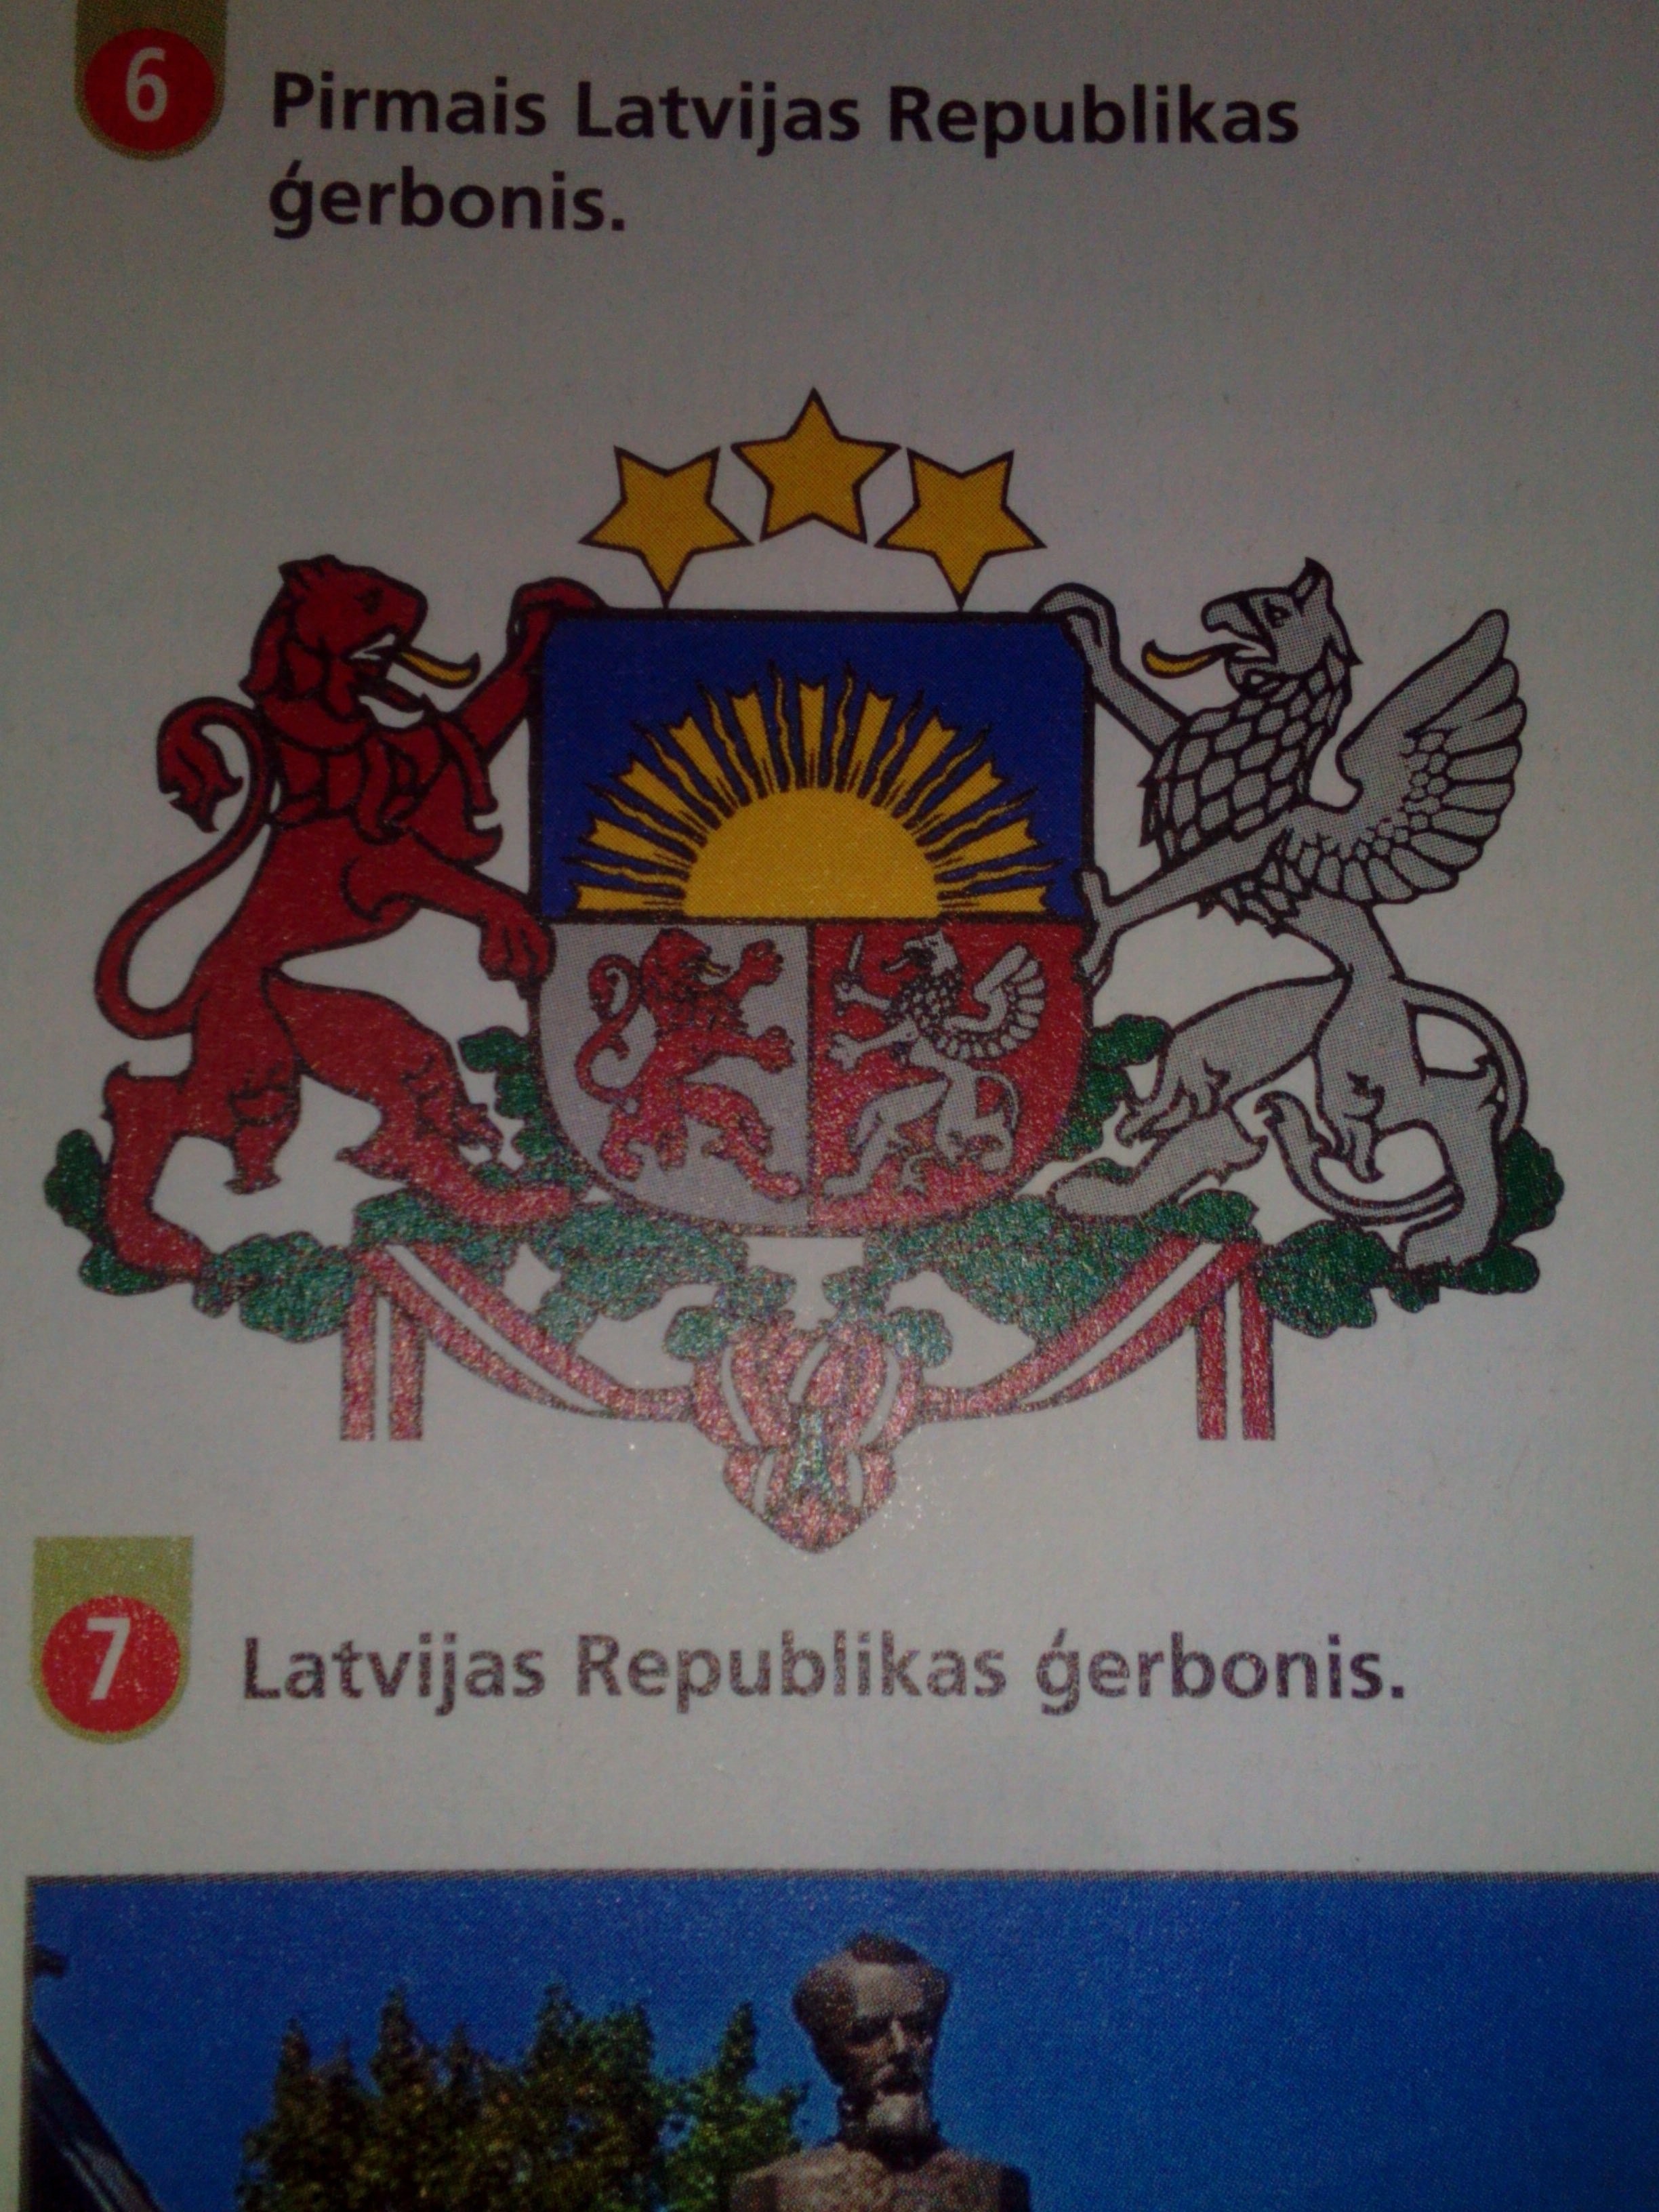
Latvia‘s Coat of Arms
Latvian Coat of Arms the autors of two people Rihards Zariņš and Vilis Krūmiņš
Latvian Coat of Arms was approved in 1921

Slide 5
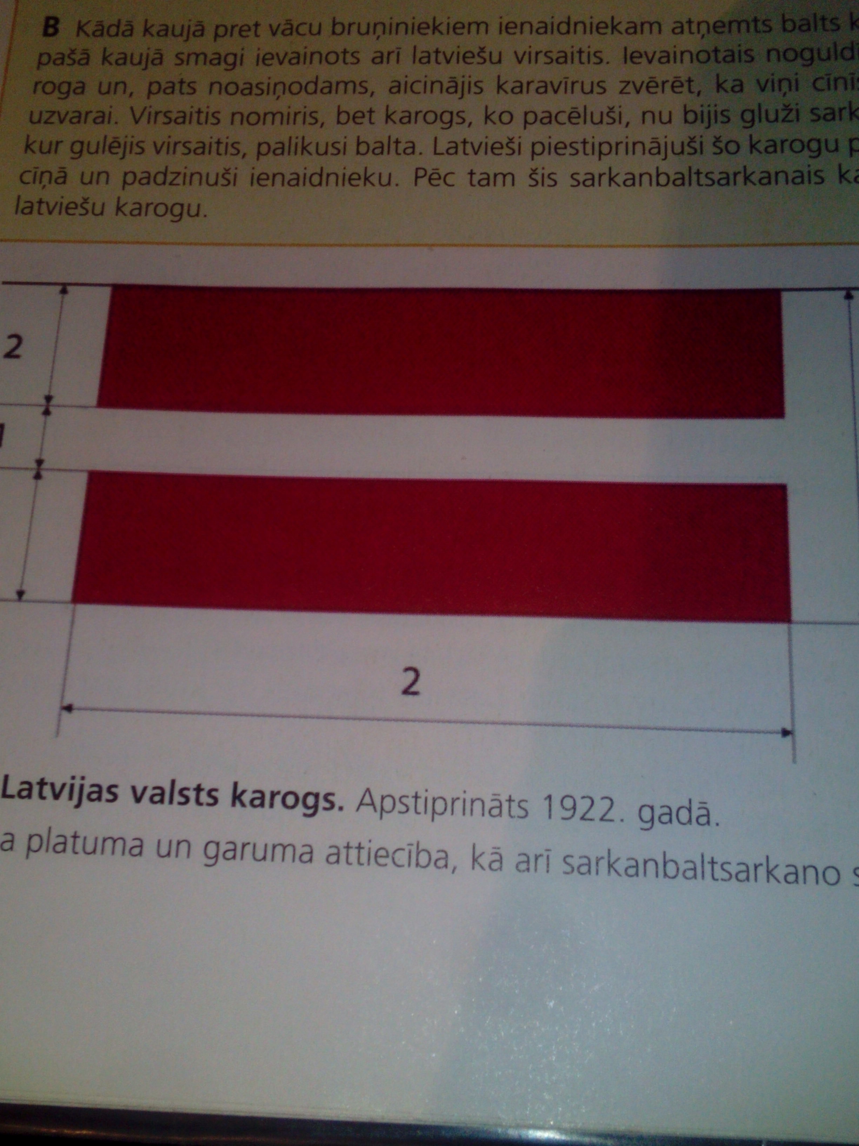
Latvian flag !
Latvian flag was approved in 1922.

Slide 6
That we learn in history!!!

Slide 7
Thank you for your attention !!!

