Slide 1
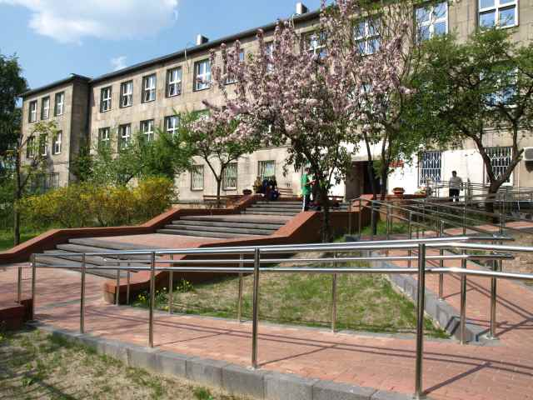
A very short history of the Primary School number114 in Warsaw
Filip Nader class 5a

Slide 2
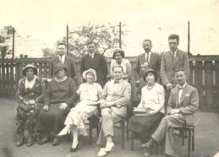
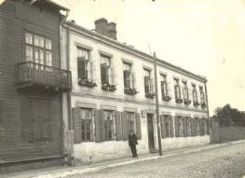
The first students went to this school in 1920. The
students were only girls. The first headteacher
was Mrs Badowska. In the foto you can see the
first teachers who worked in the school. In the second foto you
can see the first buliding of this school- in Piotra
Skargi street.

Slide 3
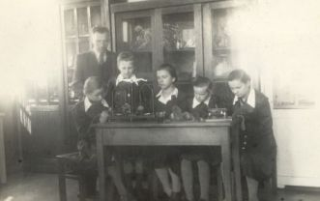
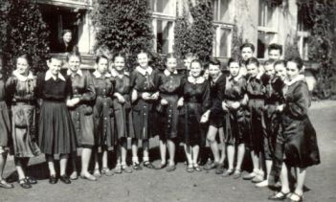
Since 1930 boys and girls have been taught
together in the school. The students wore school
Uniforms. Nowadays we don’t wear uniforms.

Slide 4
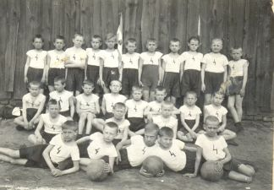
In 1931 PE teachers set up volleyball, basketball
and football school teams. In the picture you can
see the first football team. The students went on
school trips to Puławay, Kazimierz, Częstochowa
and Ojców.

Slide 5
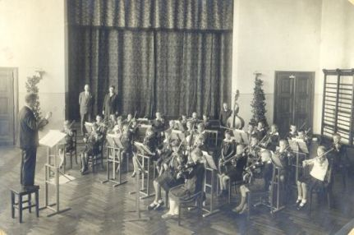
In 1931 two teachers set up a school music band.
The students played musical instruments and sang songs. In 1933 the school music band met the Polish President Ignacy Mościcki. In the foto you can see the president and the students.

Slide 6
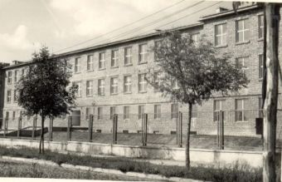
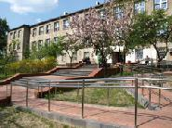
The school changed its location a lot of times. In
1959 the school year started in a new building in
Remiszewska street and we still learn here. In the
pictures you can see the same building.
The first picture is from 1959 and the second picture shows modern times.

Slide 7
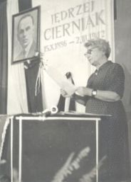
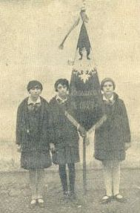
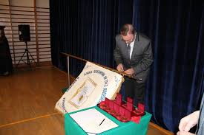
Here you can see the school banner.

Slide 8
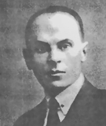
In 1961 the school got the name of Jędrzej Cierniak – a
Polish language teacher. In this pictures you can
see him.

Slide 9
At present the school is one of the best in Warsaw
and I am happy that I can learn here.
☺☺☺☺☺☺☺

Slide 10
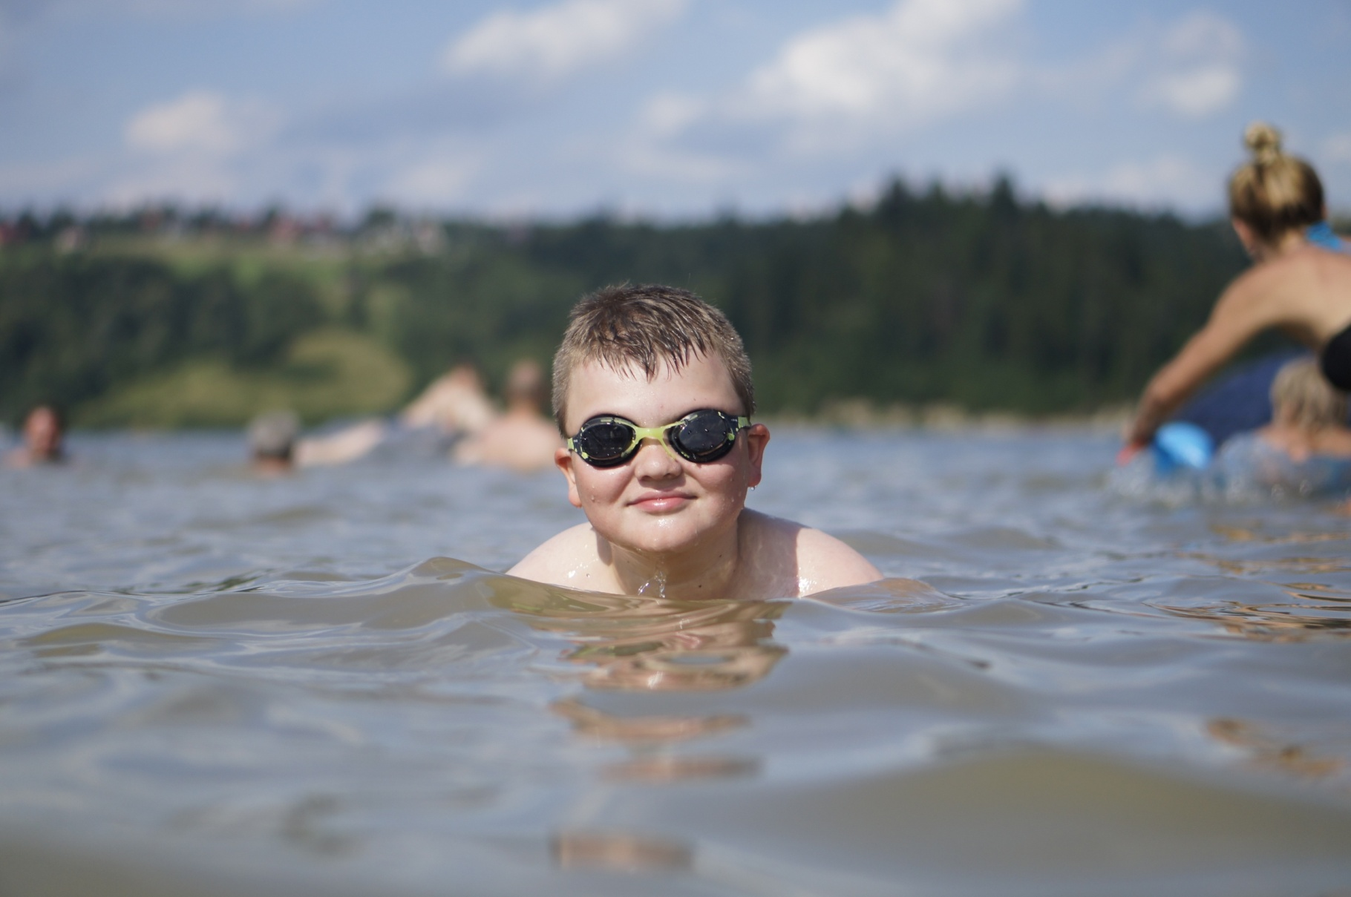
The End
Filip Nader Va

