Slide 1
English lessons in a Polish school
Made by: Krzyś Wrzosek i Bartosz Pięta class Va

Slide 2
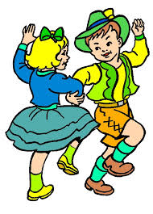
We are learning about a new tense Present Continuous
sit-sitting
run-running
put-putting
chat-chatting
They`re dancing.

Slide 3
We study cocabulary in Insta.ling

Slide 4
We name the subjects:
Math
Polish
English
Technology

Slide 5
We name musical instruments:
Double bass
Keyboard
Saxophone
Piano

Slide 6
Our book’s title is „ Steps in English 2”

Slide 7
Thank you very much
photos: google grafics

