Slide 1
In the course of history we learn about the local history of our city
Just outside the city of Kavala is the archaeological site of Philippi .

Slide 2
The ancient city of Philippi-kavala

Slide 3
The ancient city took its name in 356 b.c. after the father of Alexander the Great, Filippos the II.

Slide 4
The excavations have brought to light ruins from the Hellenistic, Roman, Byzantine and Paleochristian period.

Slide 5
The octagon, the Roman forum, the paleochristian basilicas and parts of the city walls, are some of the most well known.

Slide 6
public buildings, and private houses.

Slide 7
Basilica A

Slide 8
Basilica B

Slide 9
the Roman forum

Slide 10
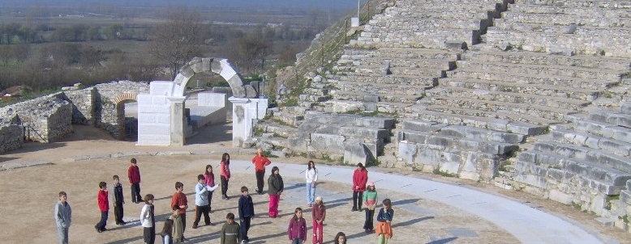
The ancient theatre of Filippi

Slide 11
One of the most important festivals in Greece It takes place every summer on the site of the ancient theatre of Filippi and it hosts various plays and musical performances.

