Slide 1
We make Christmas candles
We used natural materials to decorate them

Slide 2
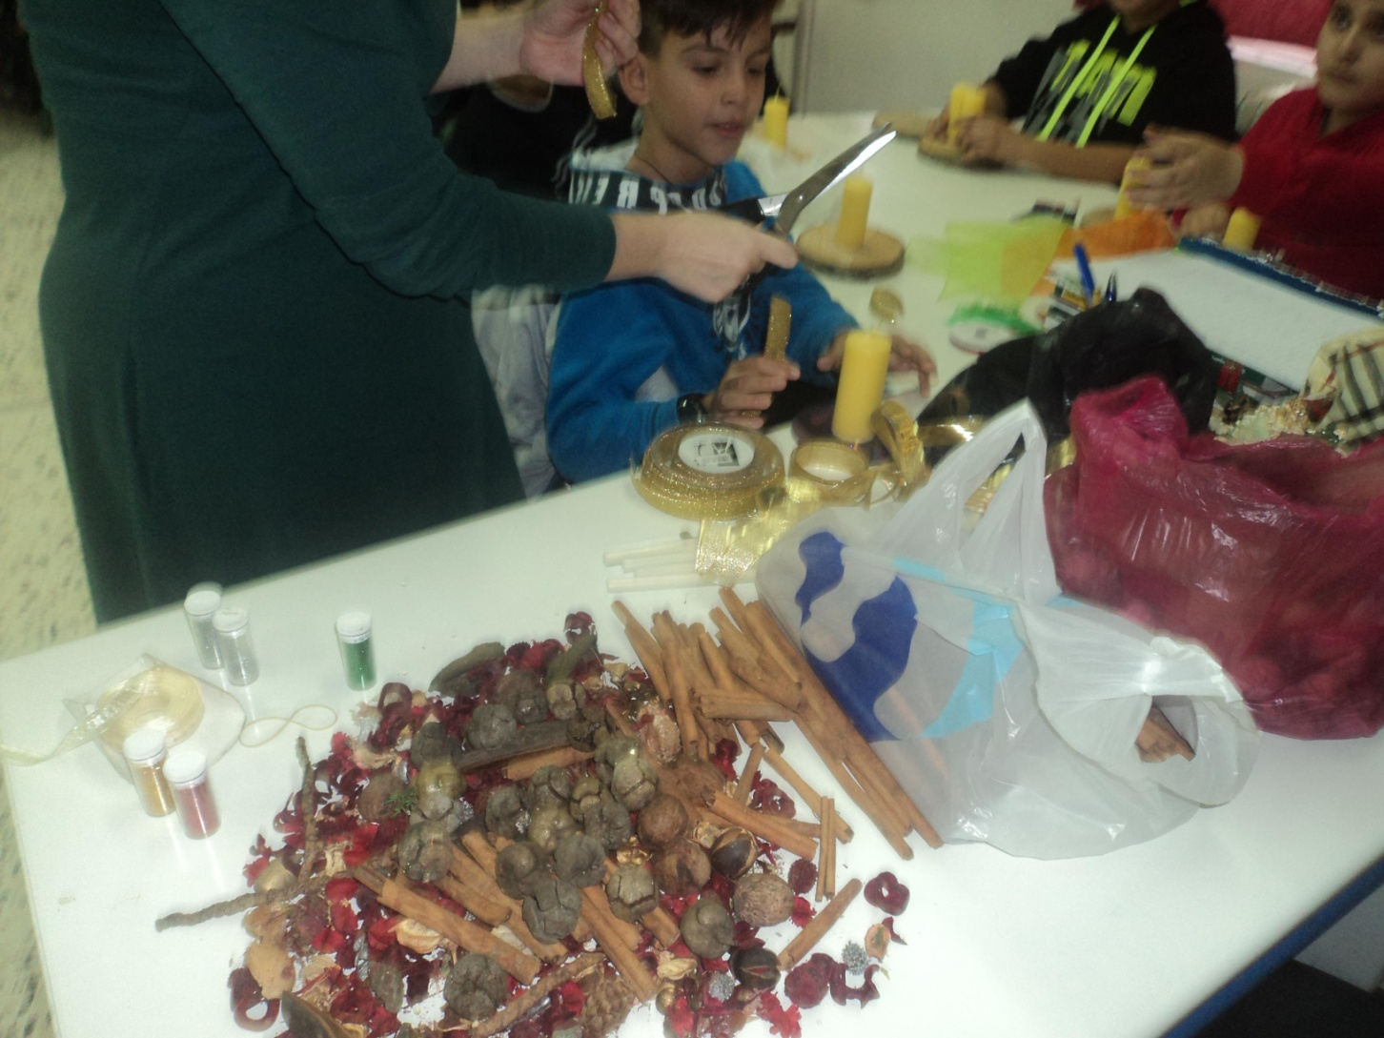
Our materials

Slide 3
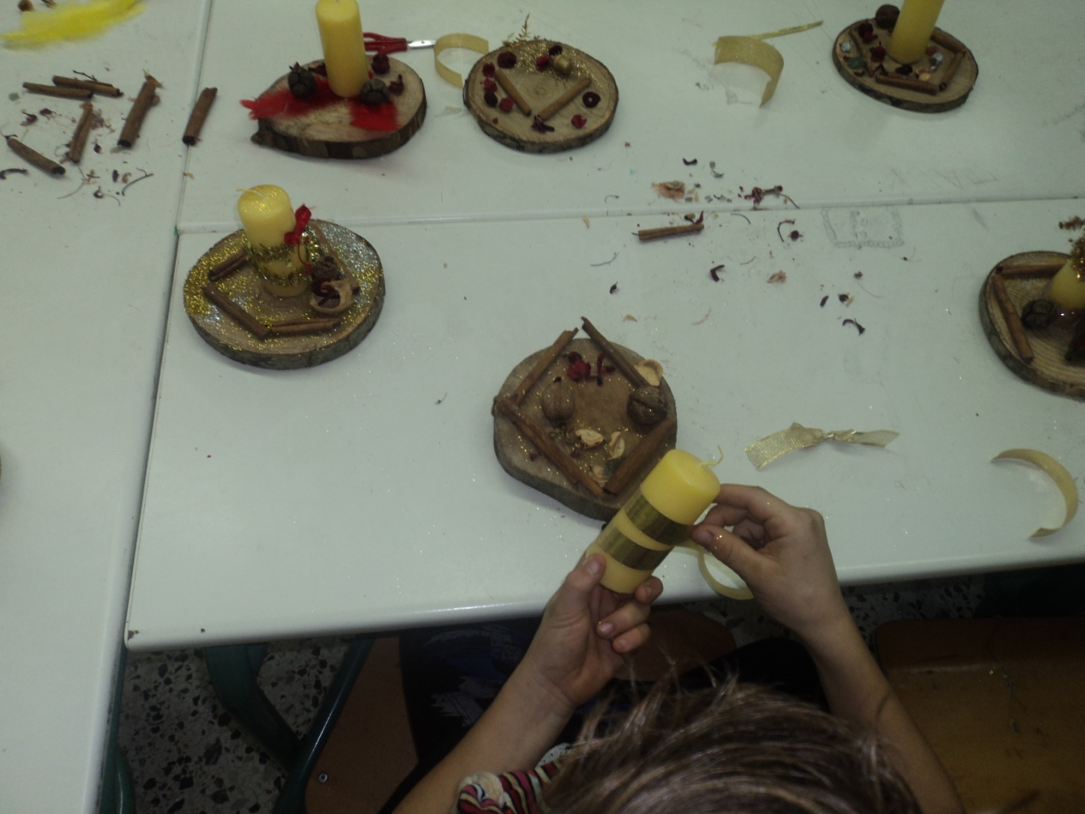
We start the work

Slide 4
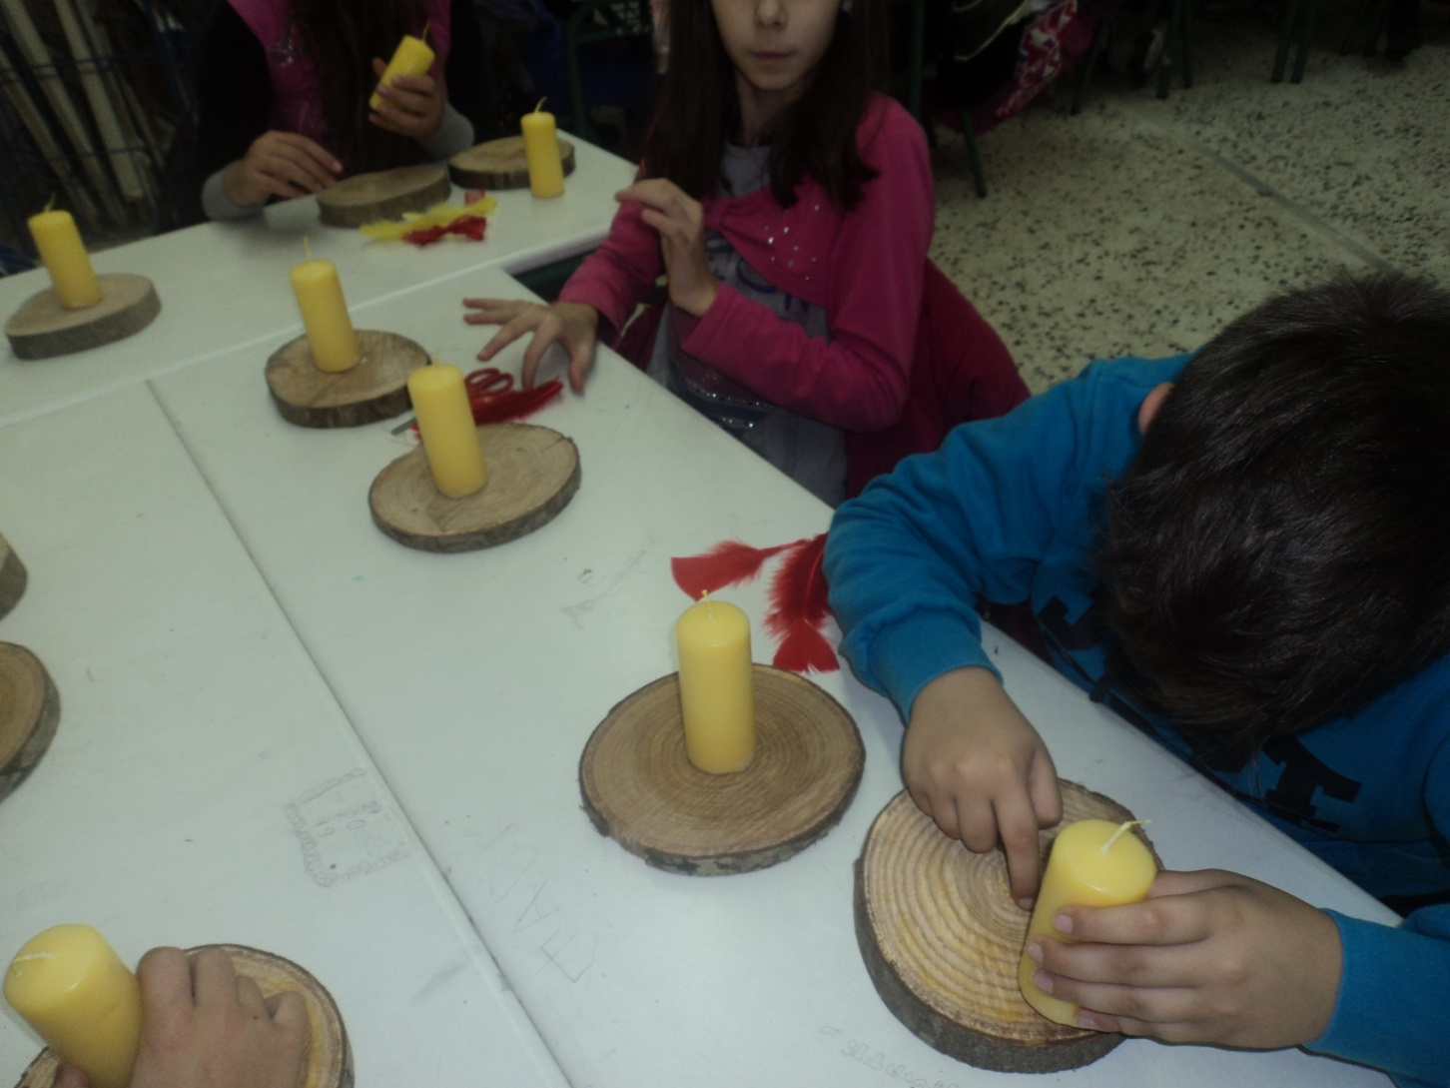
We don’t waste our time!!!

Slide 5
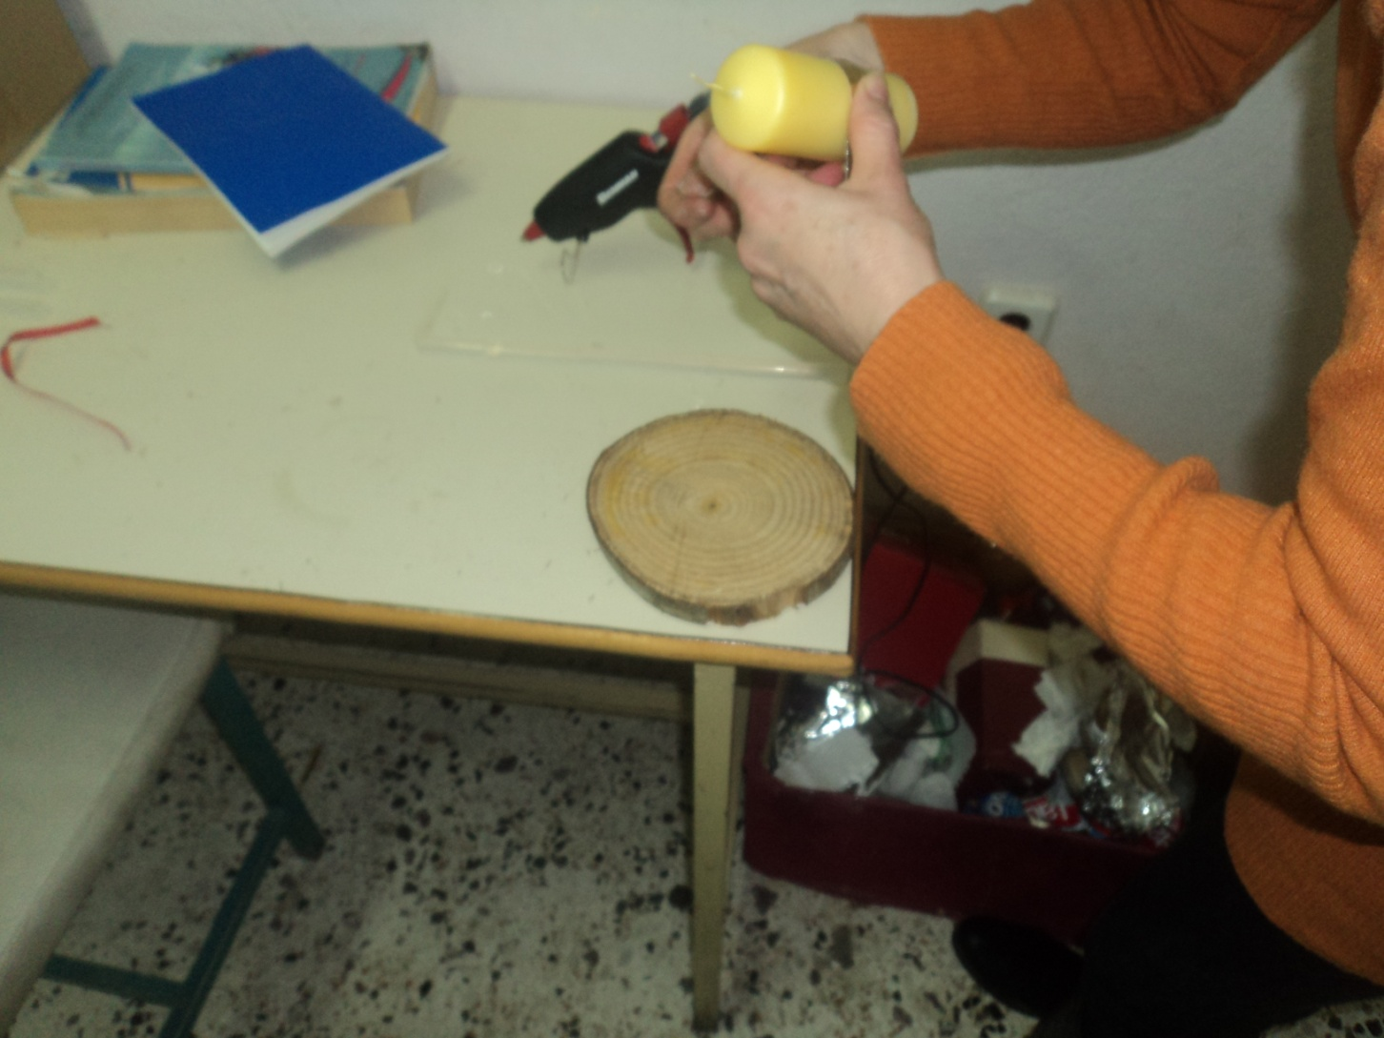
Our candles have a little more work to be ready

Slide 6
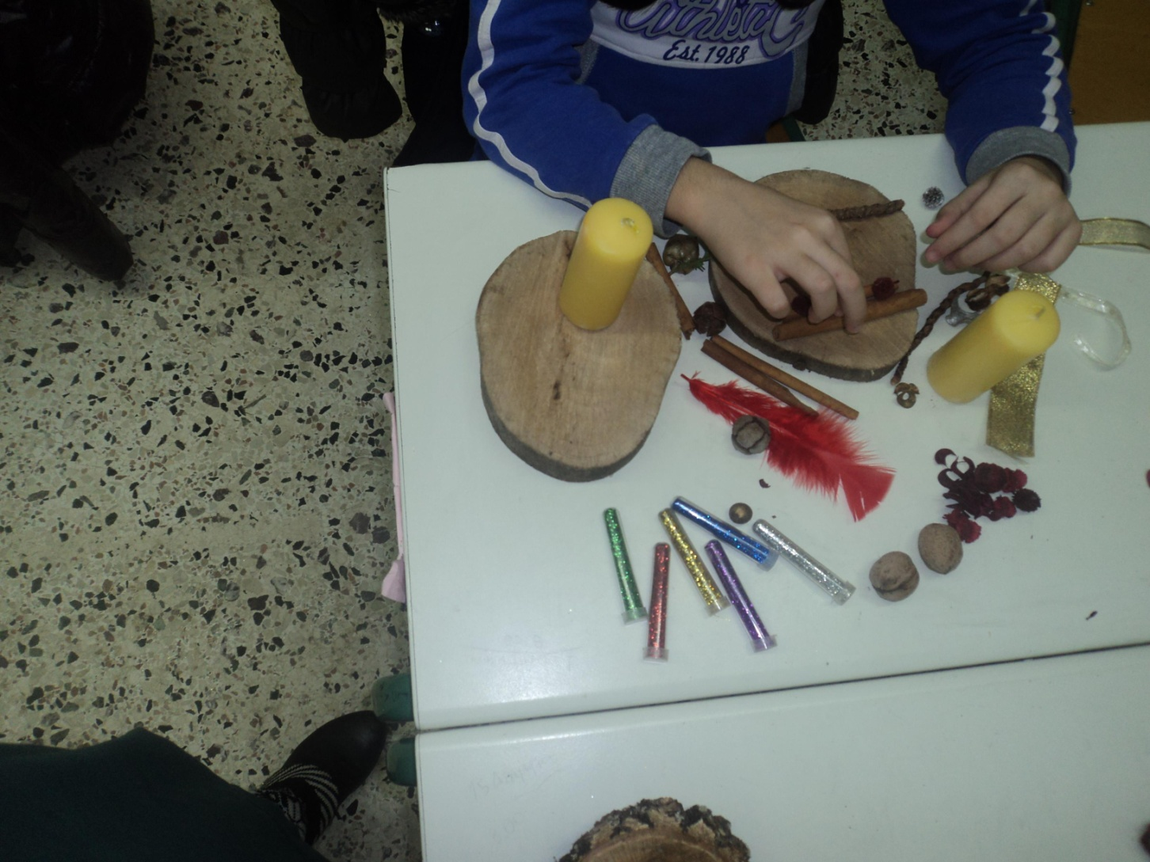
Here it is it’s almost ready!

Slide 7
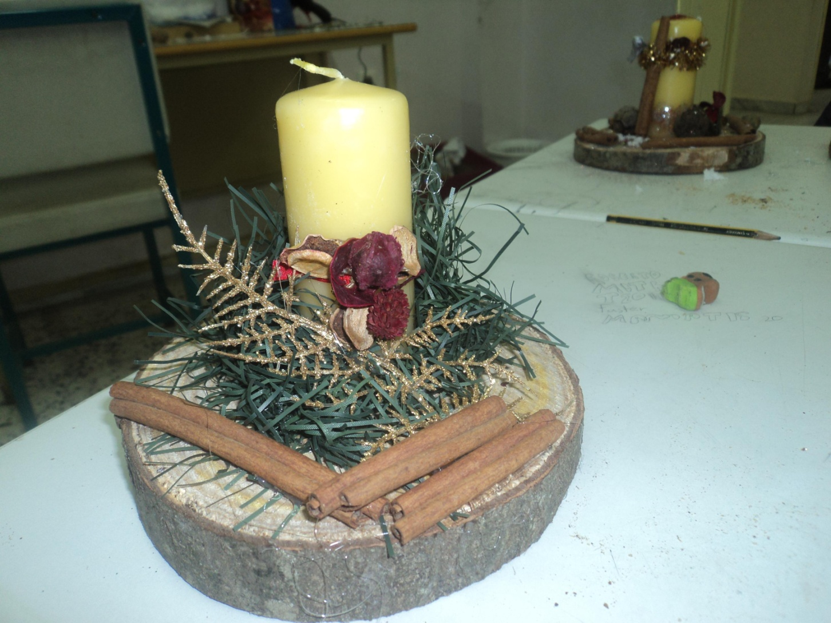
Now it’s ready!

Slide 8
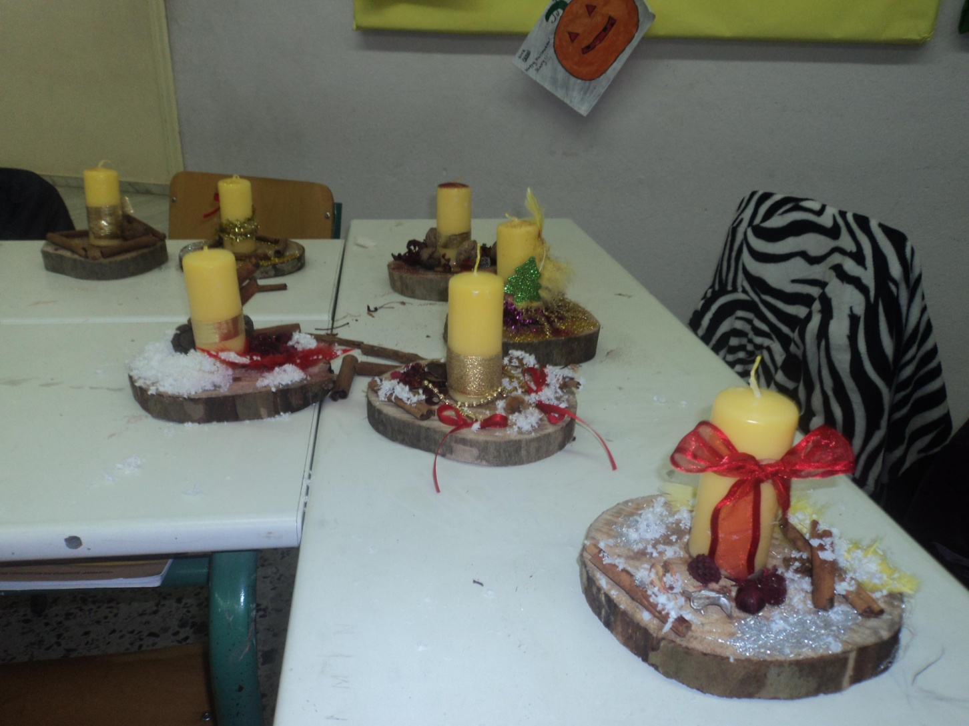
We are very proud to present you our Christmas candles

Slide 9
Merry Christmas to all!!!!!
We are very proud for our work. We will sell the candles and send the money to school in Kenya to buy food for the children

