Slide 1
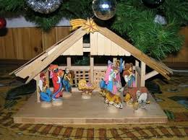
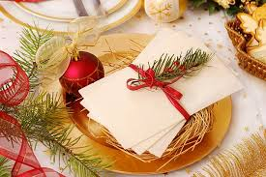
Christmas Eve
Filip Nader class 5a
Warsaw, 14 th December 2014

Slide 2
Christmas
People celebrate the Christmas Eve on
24th December every year. In Poland it is a very important day of the year.
Polish families start their preparations even
three weeks before that day. All members of the family clean up the flat/the houses, go shopping and write letters to St.Claus.

Slide 3
Christams Eve
On 24th December all people wear smart clothes. In the evening people visit their Families and eat a special supper. Before the supper people share a holy wafer and say the best wishes. Traditionally there should be twelve dishes, which equals the number of Apostols, such as red borsch and mushroom soup, dumplings with cabbage and mushrooms, noodles with poppy seed and delicacies, vegetable salads, fish and cakes. And you should try each of them.
We always leave one empty seat for an unexpected guest, because no one should be lonely that evening.
POLES DON‘T EAT MEAT THIS DAY.

Slide 4
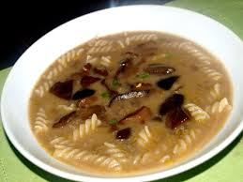
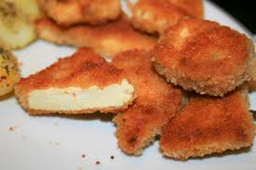
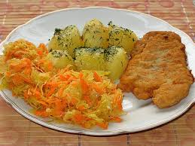
TRADITIONAL POLISH DISHES

Slide 5
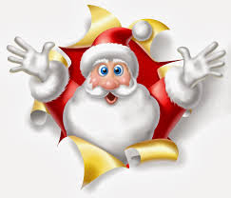
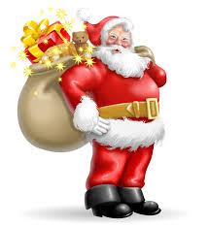
Christmas Tree
In every house in Poland there is a CHRISTMAS TREE with
beautiful decorations. This is very important for children (but adults like it, too). When everybody is busy Santa
Claus comes and leaves presents for all good children. I try to
be a good schoolboy and even a better son, so I always get
A present (I am not so sure about this year).

Slide 6
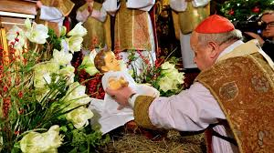
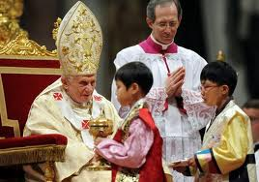
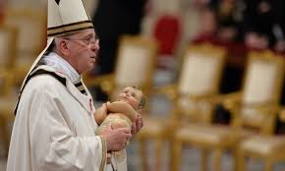
Mass at the church
At midnight people go to church.

Slide 7
Christmas Eve
I like Christmas Eve because the atmosphere is
great. However I am not keen on the food.

