Slide 1
Primary school of Zervohoria
Introduce our selves

Slide 2
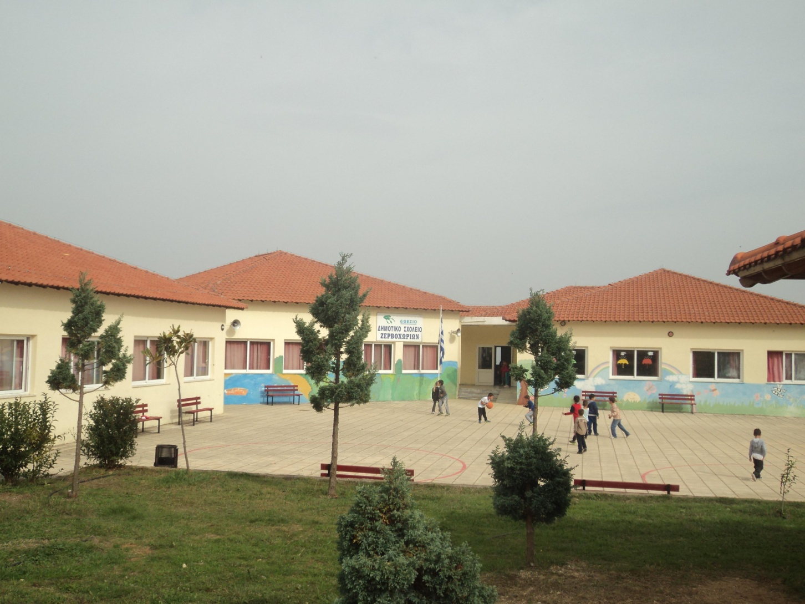
Our school building

Slide 3
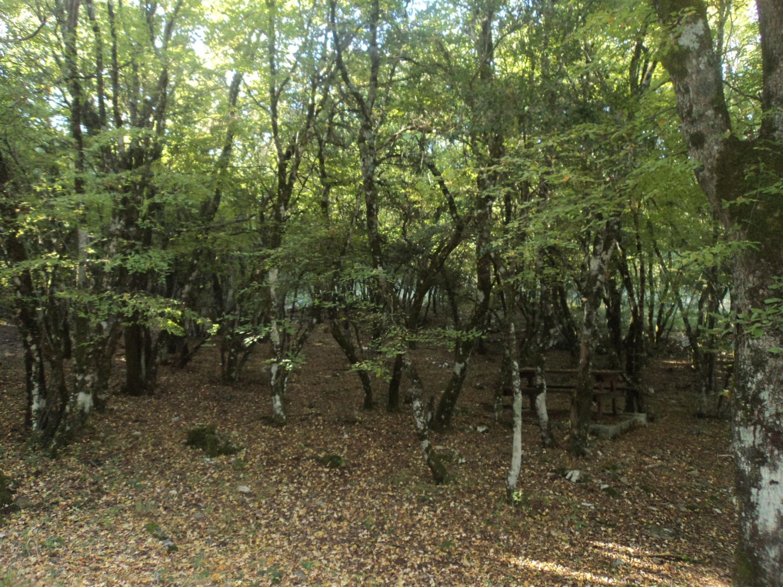
We went to the forest

Slide 4
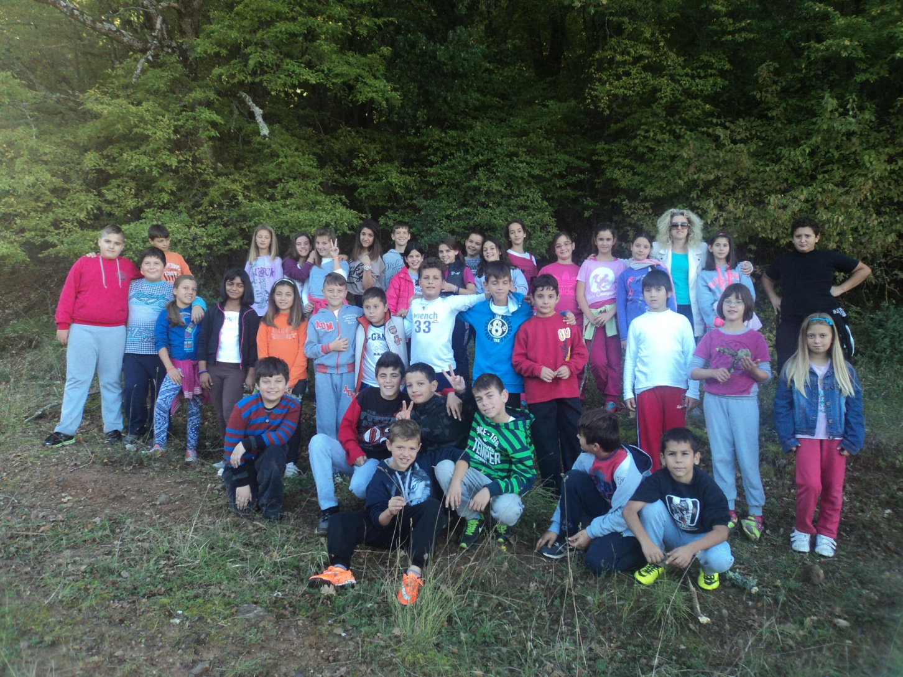
This is our 5th and 6th class

Slide 5
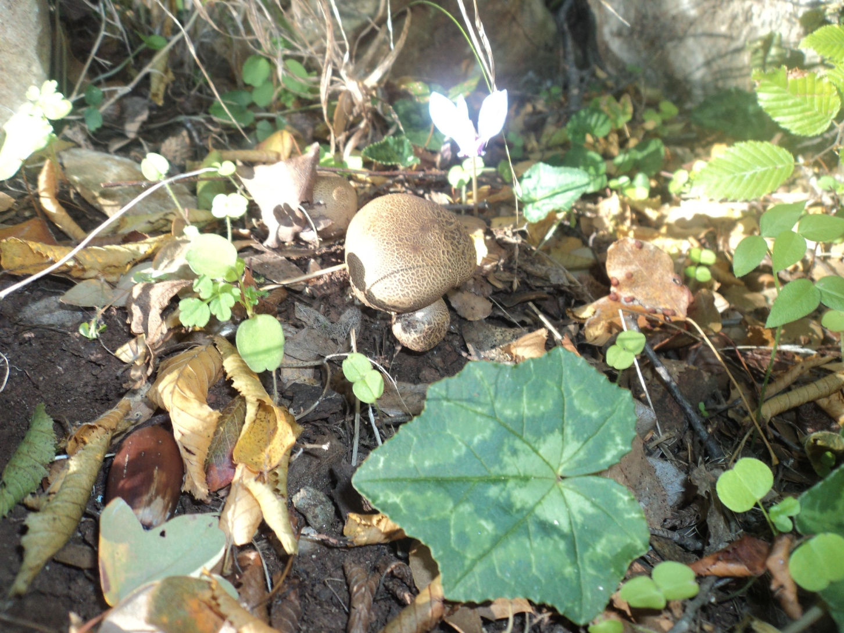
Beautiful mushrooms

Slide 6
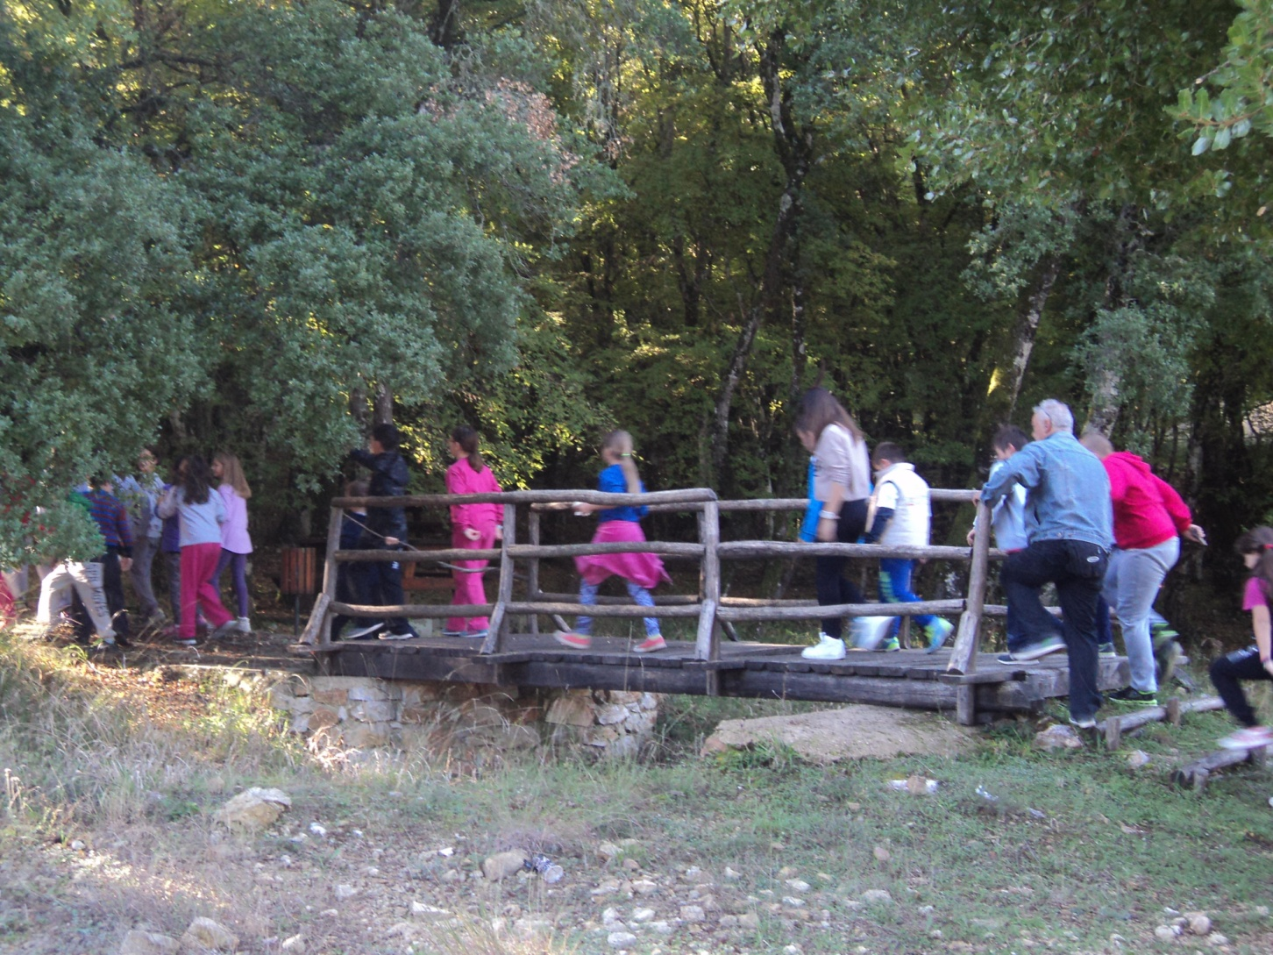
We are exploring the forest

Slide 7
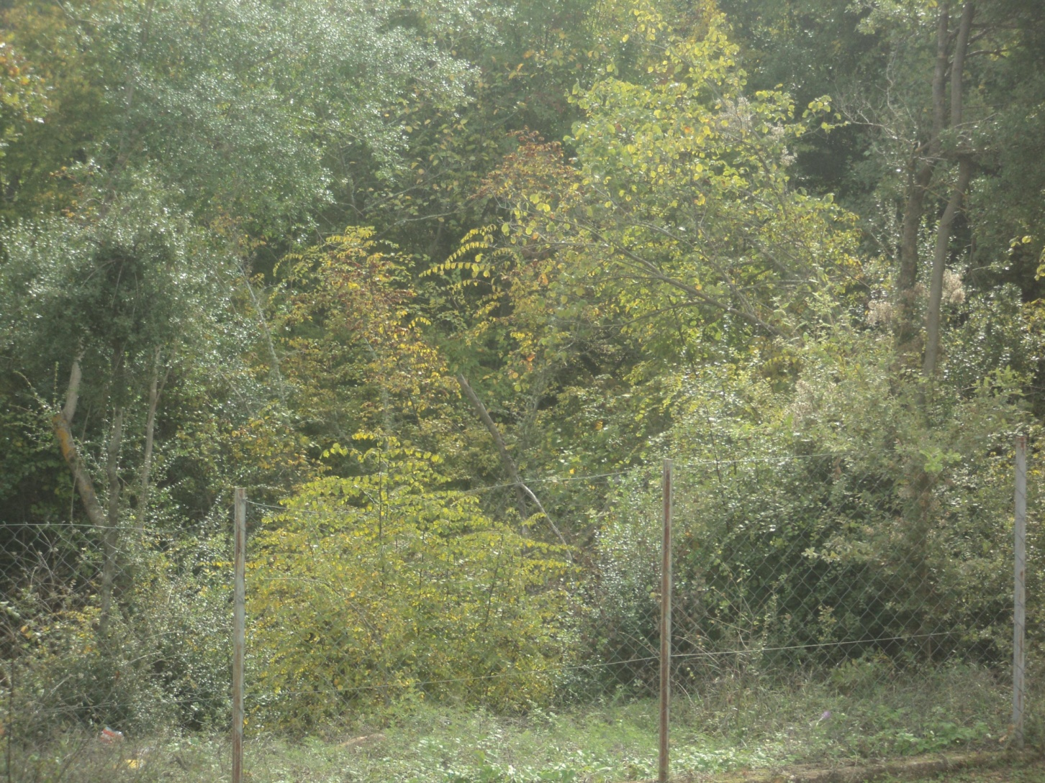
This is the forest next to our school yard

Slide 8
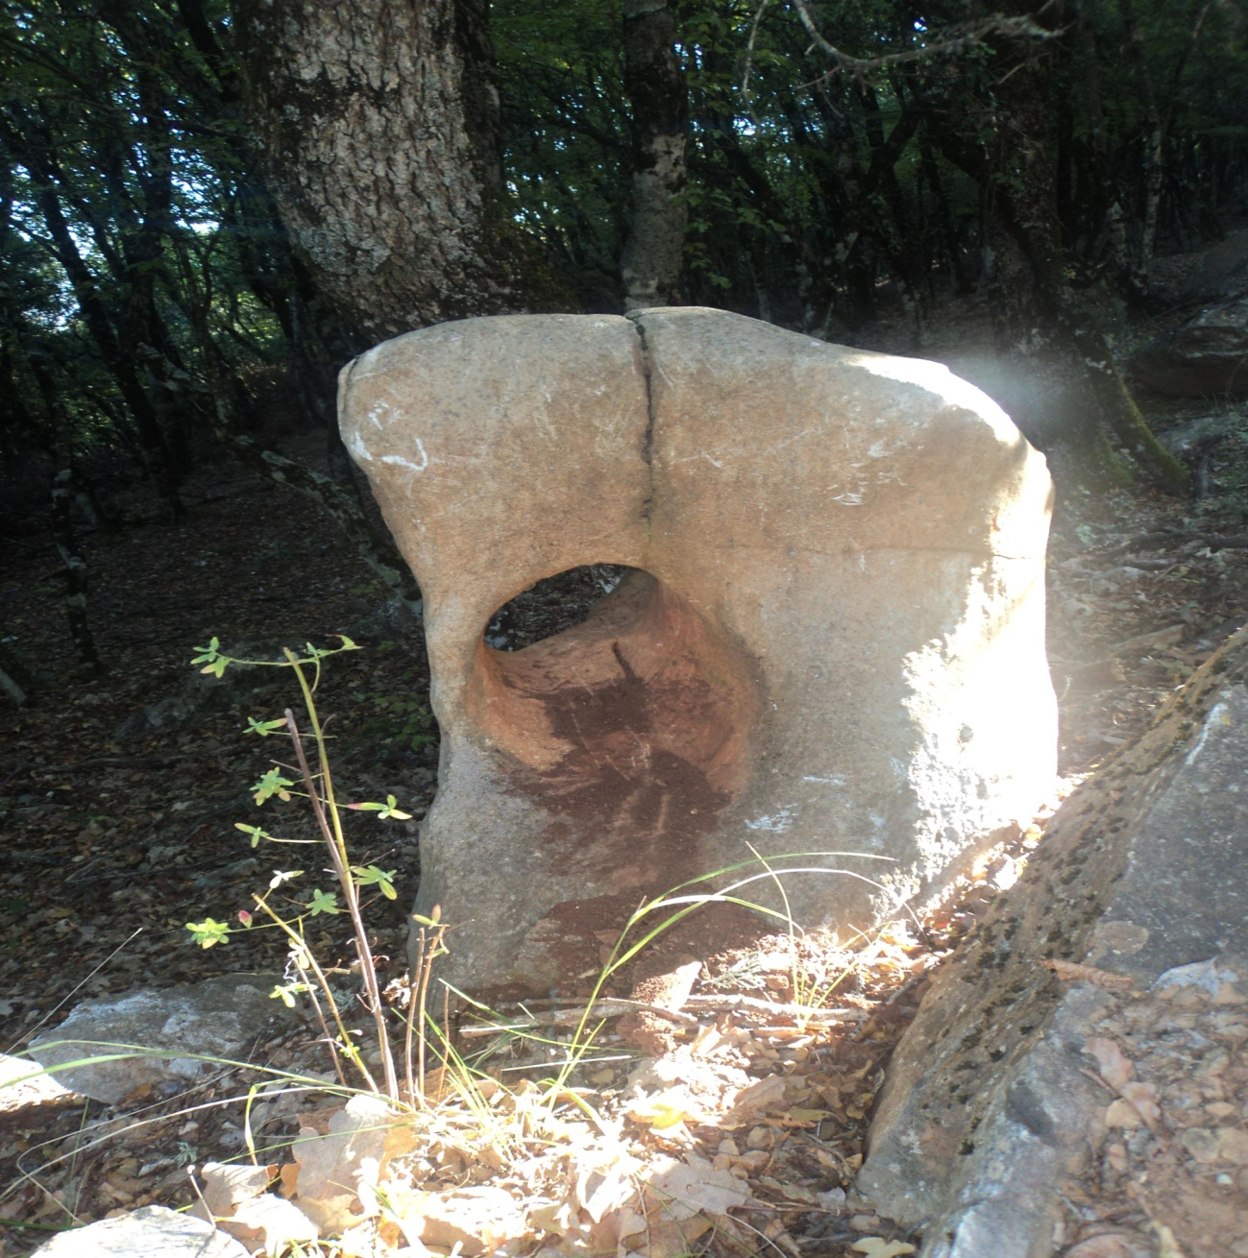
This is a stone in the forest.Look what the nature has done!!

Slide 9
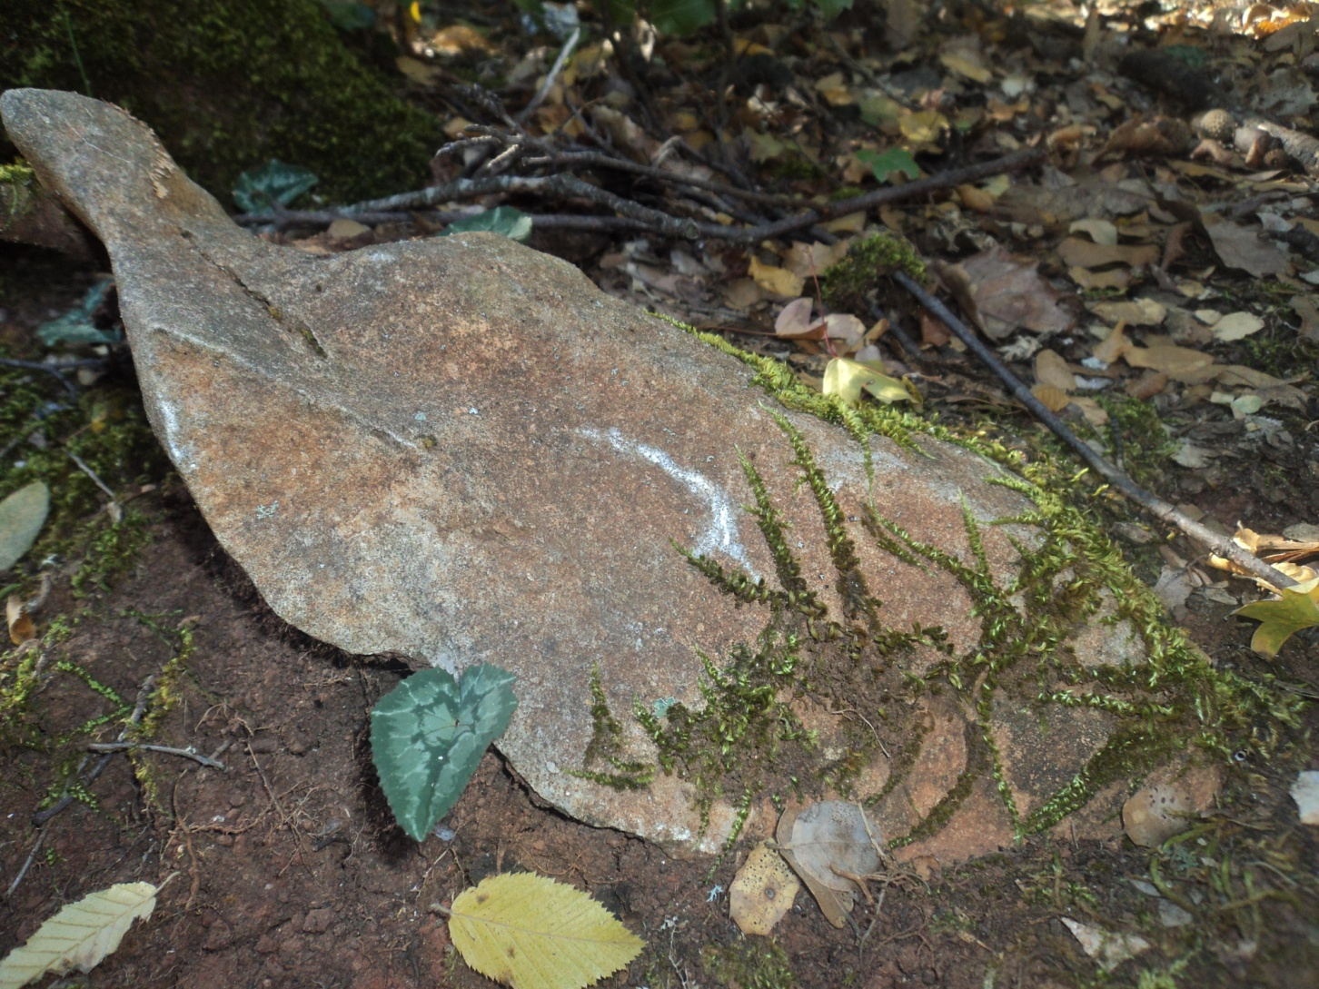
Another piece of natural art!

Slide 10
Thank you for your attention!

