Slide 1
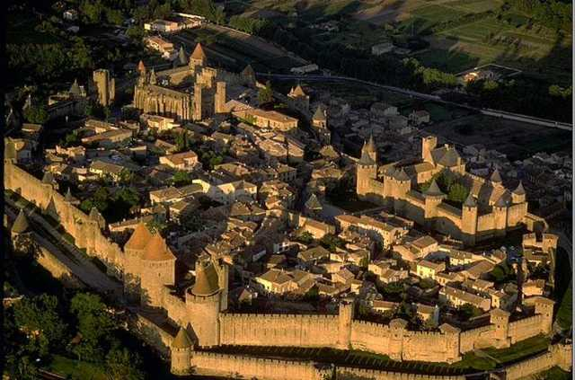
Middle Ages

Slide 2
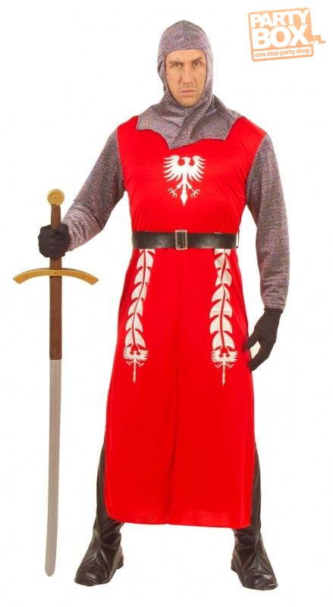
The Middle Ages LASTED 1000 years - from the fifth to the fifteenth century. IT WAS a very long period in THE WORLD HISTORY. IN THIS PERIOD a lot OF THINGS happened.

Slide 3
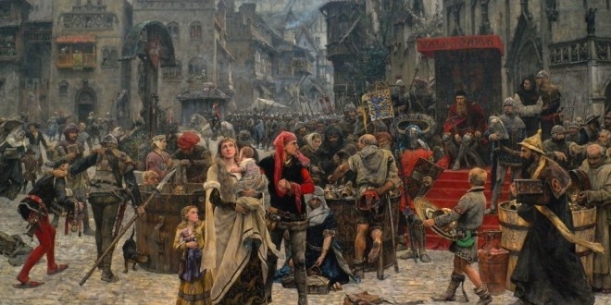
In the Middle Ages, the most important PERSON was the king and queen. AFTER them THERE was a nobility, knights, monks, merchants and finally the peasants.

Slide 4
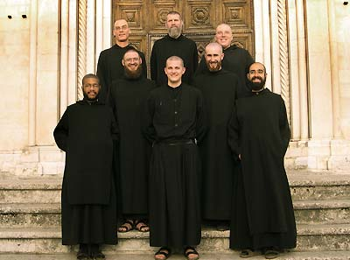
The king ruled the whole castle. Knights defended the king and the townspeople. Monks wrote letters, books and ran schools because THEY WERE the only ONE WHO KNEW how to write. Peasants cultivated THE lands OF KNIGHTS AND THEIR OWN.

Slide 5
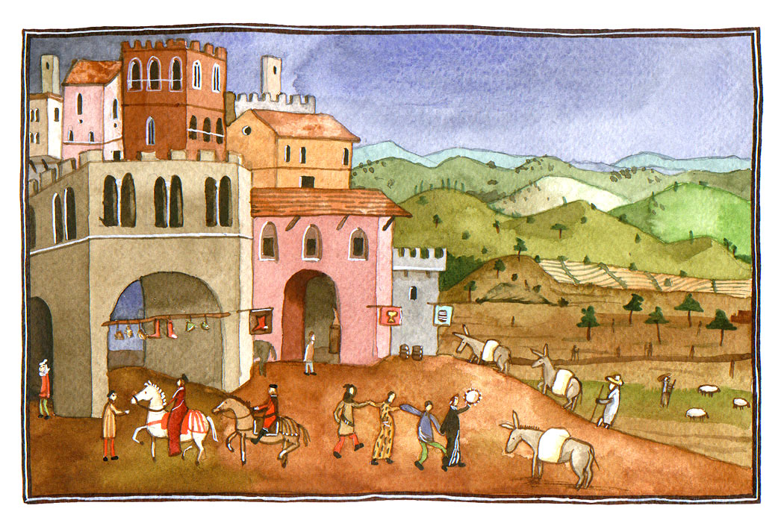
THE Castle in the Middle Ages conTAINED A FEW ELEMENTS. THERE WAS A MOAT AROUND THE CASTLE AND DRAWBRIDGE, which STOPED the enemy. THERE WERE ALSO defensive wallS, drawbridge, which closed the gate when the enemy attacked, prison courtyard, chambers and the tower which was used for observation.

Slide 6
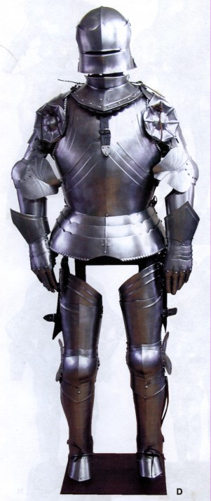
Knights wore helmets on their heads. THEY HELD A SWORD in one hand, AND A SHIELD in the other. THEY WORE THE metal gloves ON THEIR HANDS, and THE armor on the body, which protected THEM from the blows of the ENEMY. When THEY TOOK part in TOURNAMENTS THEY used LANCES ,which ALLOWED THEM TO throw off THE ENEMY FROM the horse.

Slide 7
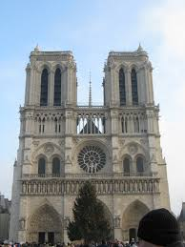
In the Middle Ages dominated two styles: Romanesque and Gothic.

Slide 8
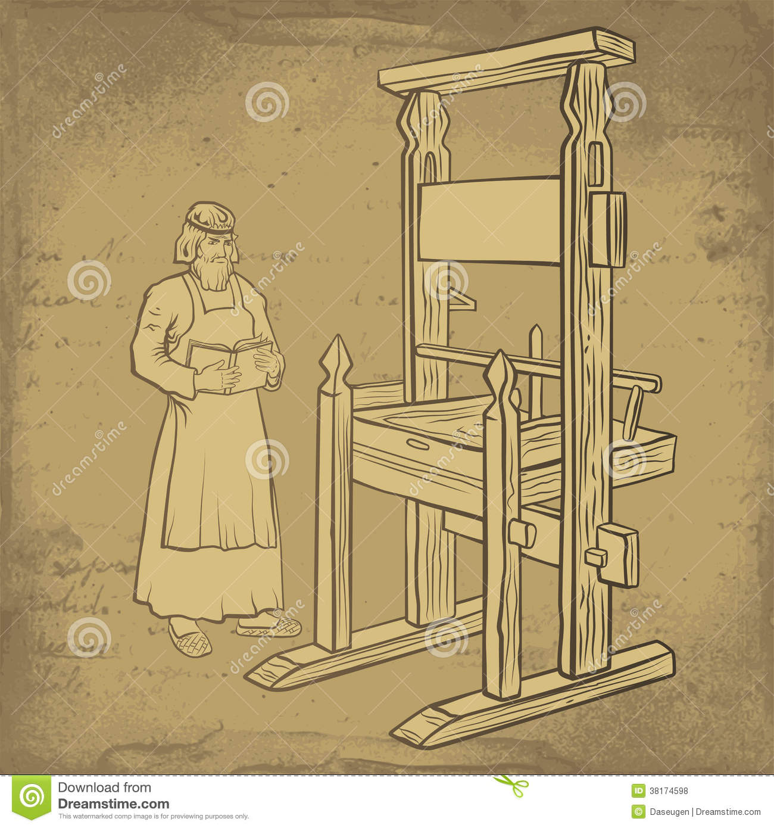
In the Middle Ages some things were invented, among other things: water mill AND A plow with THE wheels. At the end of the era THE PRINTING was invented.

Slide 9
Presented by Kacper Majewski

