Slide 1
German school system
for Erasmus+ guests

Slide 2


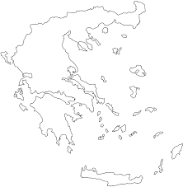
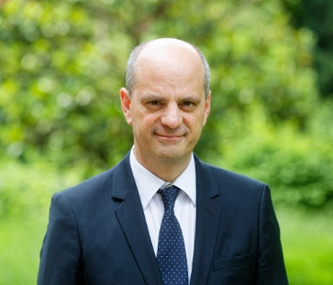
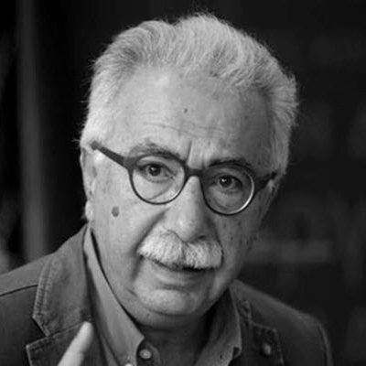
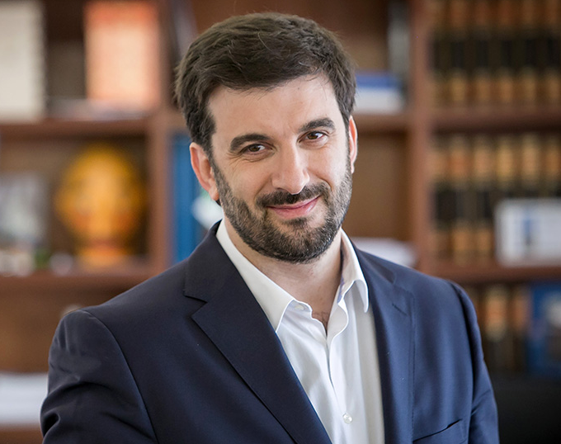
Who knows best?
Jean-Michel le sait mieux
Ο Κωστας ξερει πιο καλα
Tiago sabe melhor

Slide 3
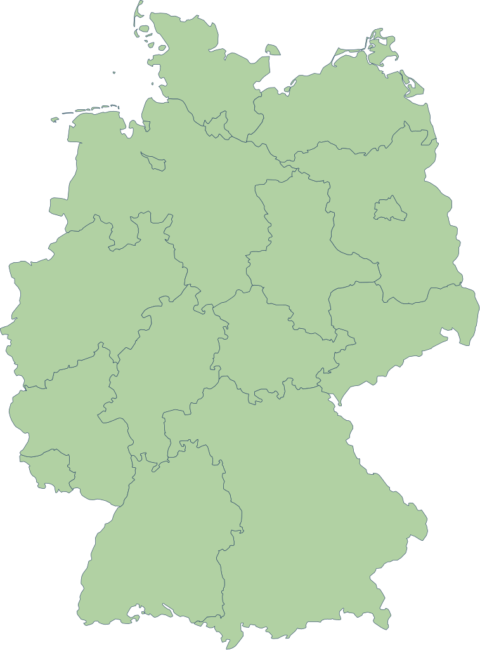
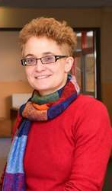
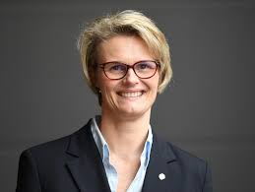
German?

Slide 4
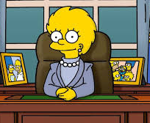

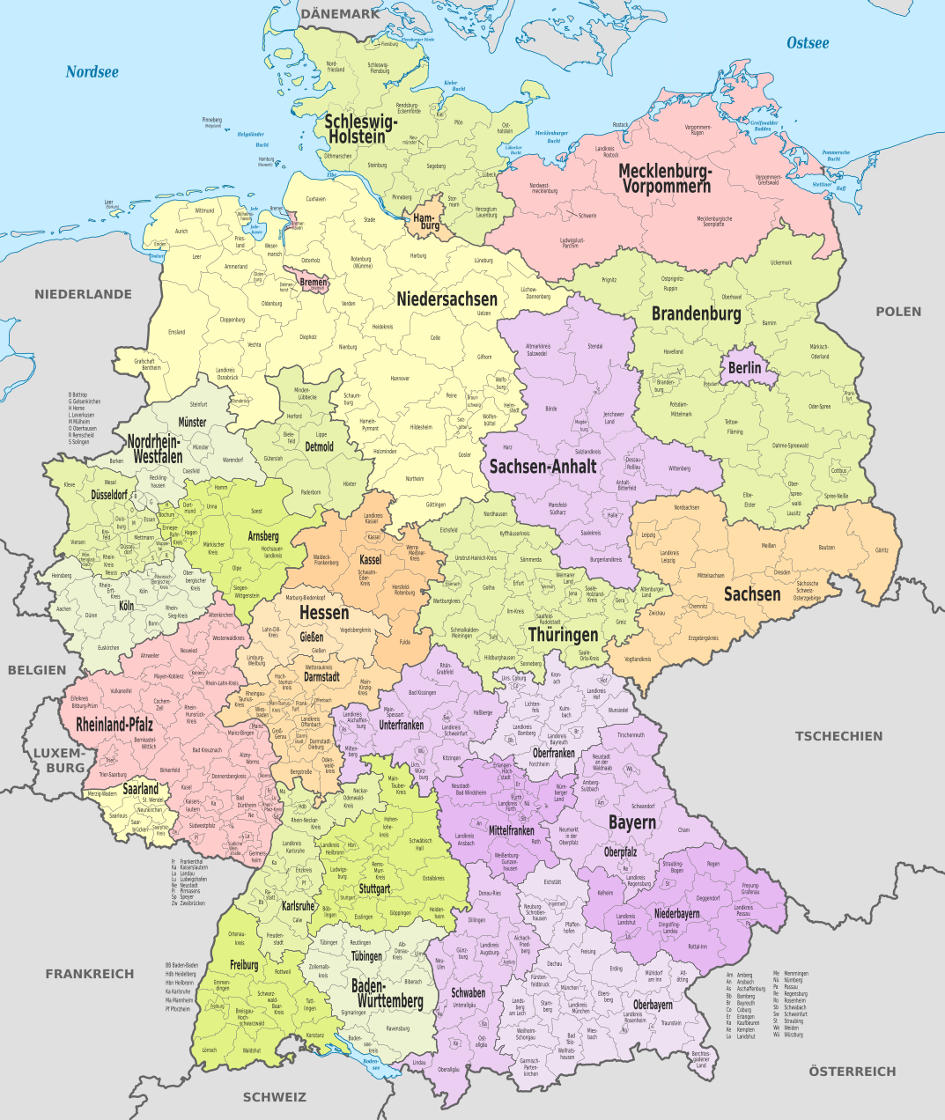
16 Systems!

Slide 5

Look and listen

Slide 6
Hessen

Slide 7
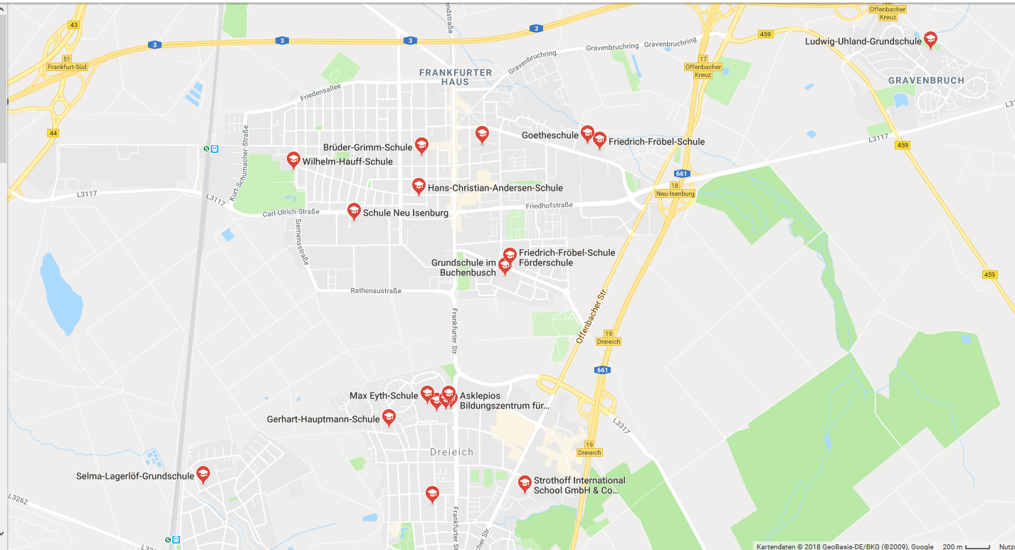
Neu-Isenburg

Slide 8
Good or bad? Let‘s ask the OECD
„When you apply for a job, can the employer trust in your CV or diploma?“
OECD Skills Outlook 2017
For Germany: Yes!
(far more than the OECD-average )
„If you come from a non-academic family - are you given the same chance as the children of academic background?“
OECD Skills Outlook 2017
For Germany: NO!

