Slide 1
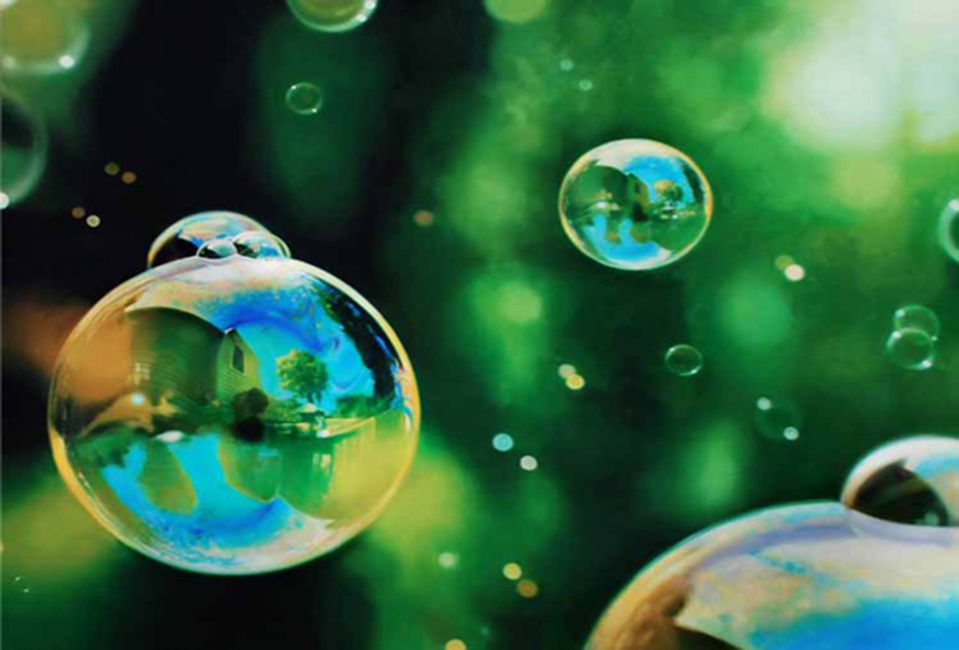
Secrets of water
Our first experiments
Project - Discovering S.T.E.M... , january -2018.

Slide 2
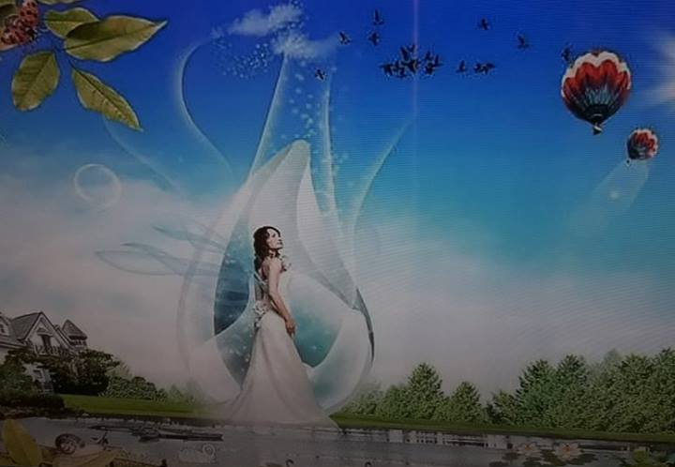
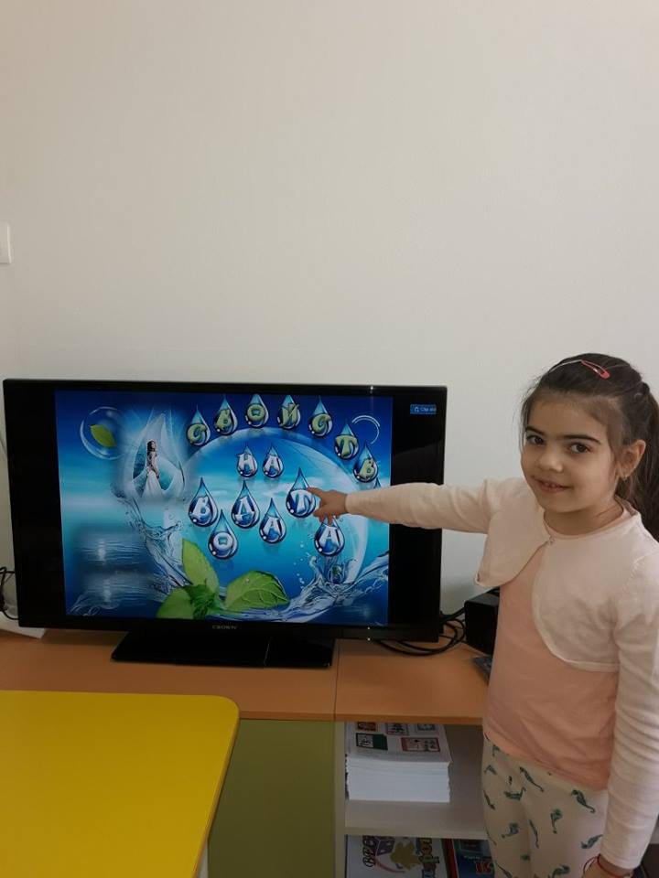
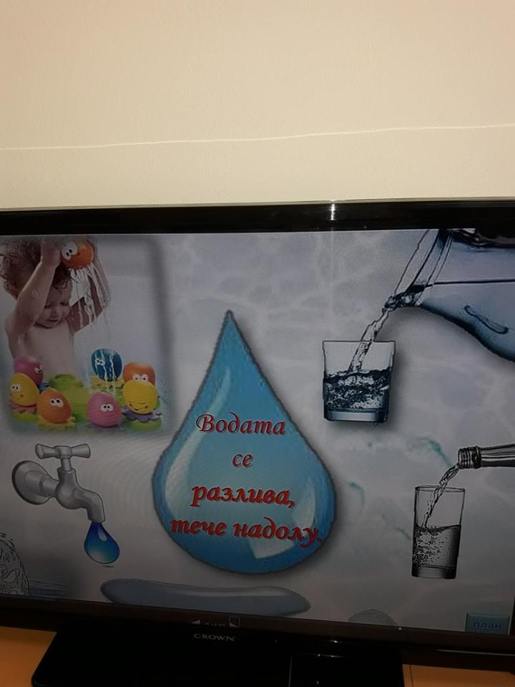
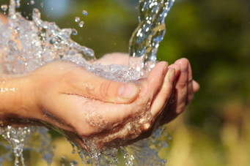
Today we talked about the beneficial power of water and its properties.
Most of the globe is covered with water. All living creatures need water. Without water there is no life.

Slide 3
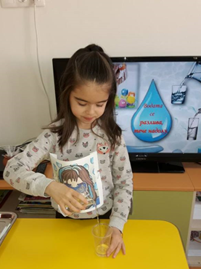
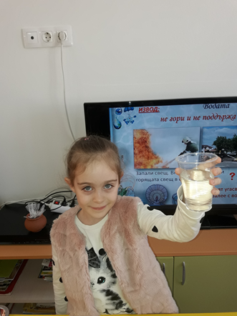
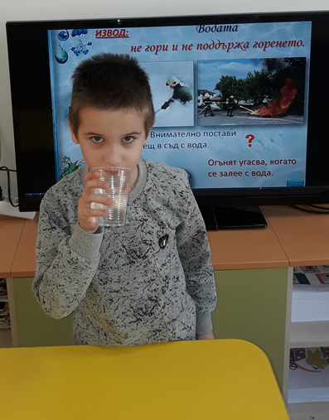
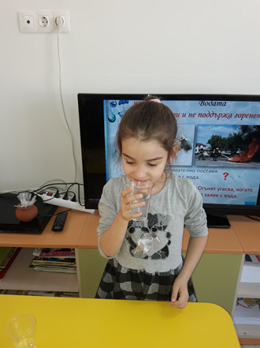
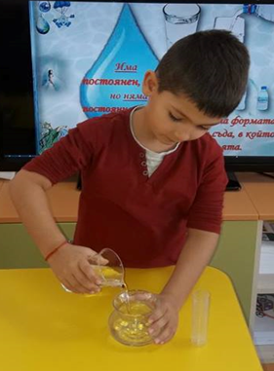
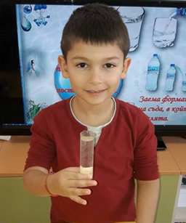
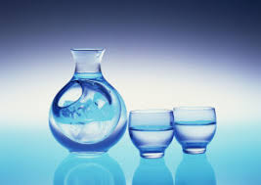
The water is liquid. It is spilled. The water is transparent. No color. No taste. No smell. No form. The water takes the shape of the container in which it is poured.

Slide 4
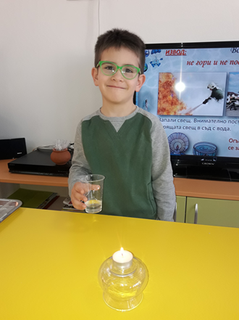
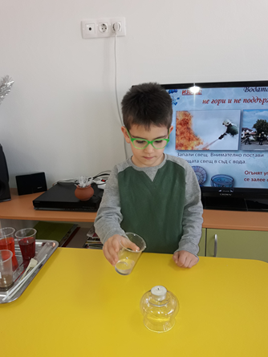
Water can not burn. If we burn a burning candle with water, it goes out.

Slide 5
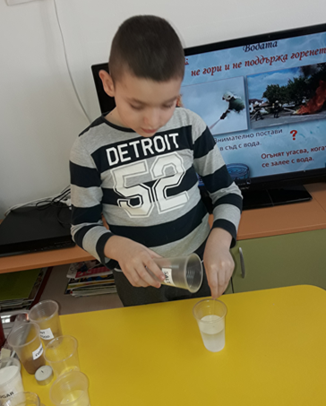
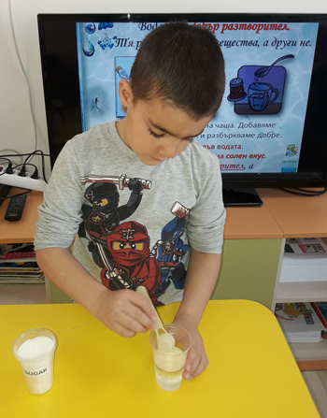
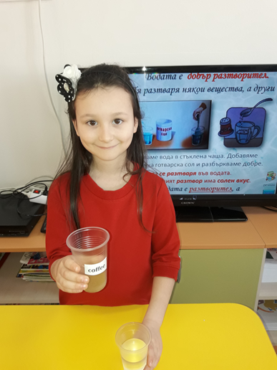
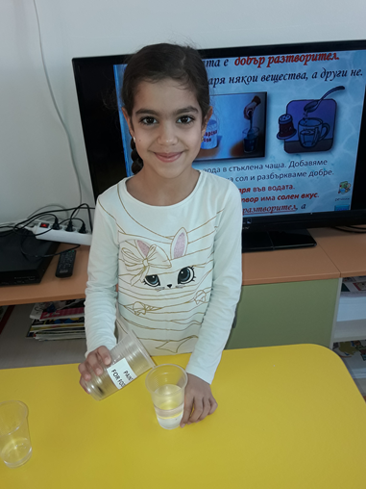
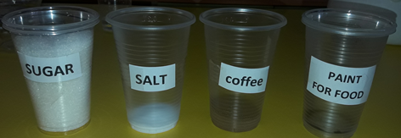
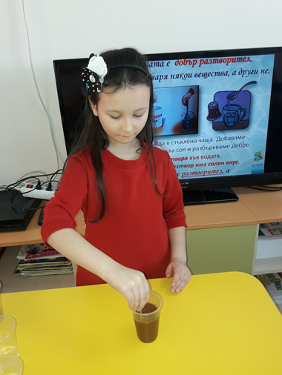
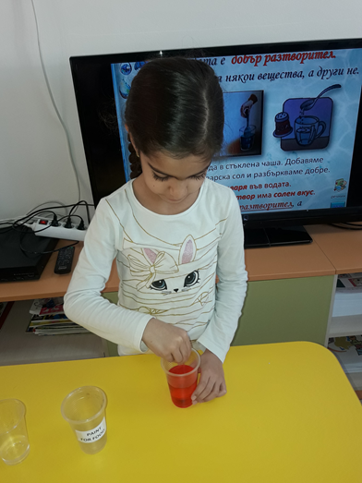
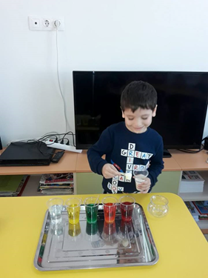
Some substances dissolve in the water and change its color, taste and smell. We have experimented with sugar, salt, coffee and pastry paint.

Slide 6
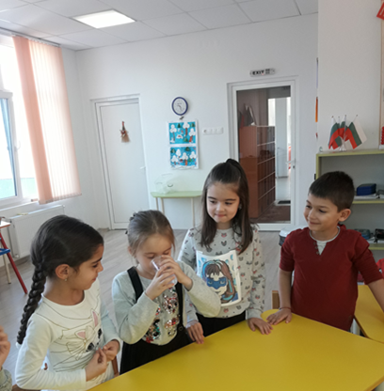
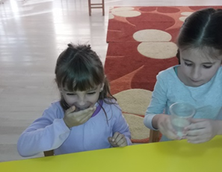
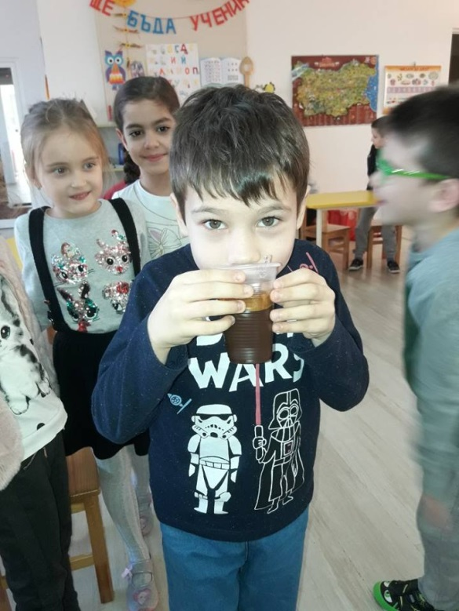
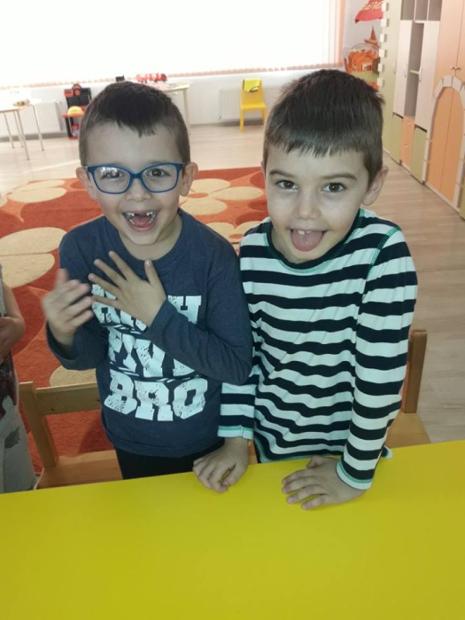
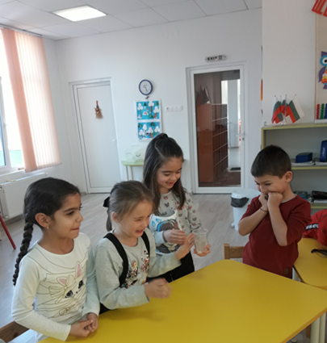
The face of our faces speaks of changing the taste and smell of the water.

Slide 7
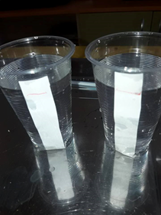
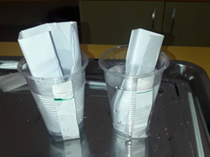
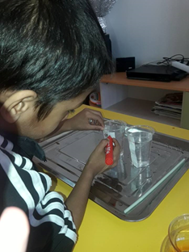
We learned that the paper was drinking the water. We took two identical glasses of water. We marked a red marker with the water level in the glasses. Then, in one glass, we dipped a folded piece of paper and the other four folded sheets of paper on the other. We waited a bit and marked a green marker on the level of water in the two cups. There was a different amount of water in the two glasses. The many papers had drank more water on one paper.

Slide 8
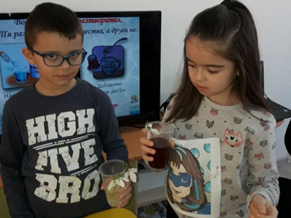
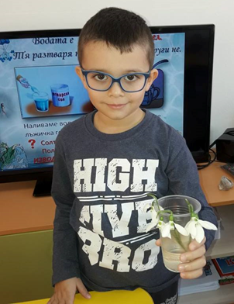
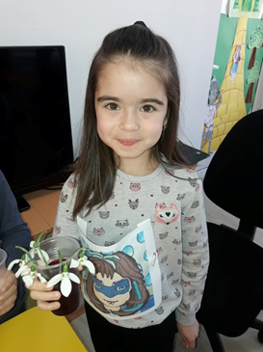
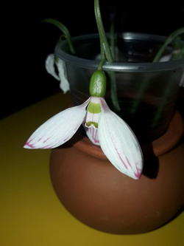
Finally, we dipped some snowdrops into plain water. Then we put the snowdrops in water, colored with red sweet paint. The next day, we found that the snowdrops that had been dipped in red paint had snuckled the paint and their blossoms began to stain Red.

Slide 9
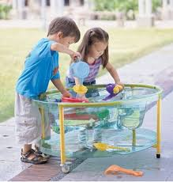
Our water games and fun will continue. See you soon!
Magdalena Petkova
Kindergarten Happy Childhood -Pleven , Bulgaria
Project - Discovering S.T.E.M... , january -2018.

