Slide 1
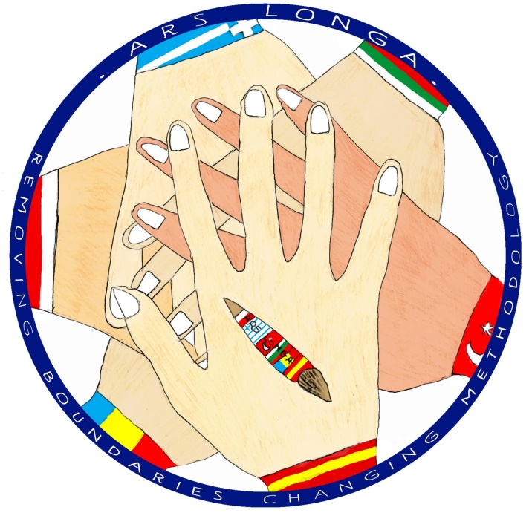
The most significant monuments and sculptures of each country
 | Male and Female artist study
ARS LONGA

Slide 2
Activities in our school regarding
the most significant monuments and sculptures of each country

Slide 3
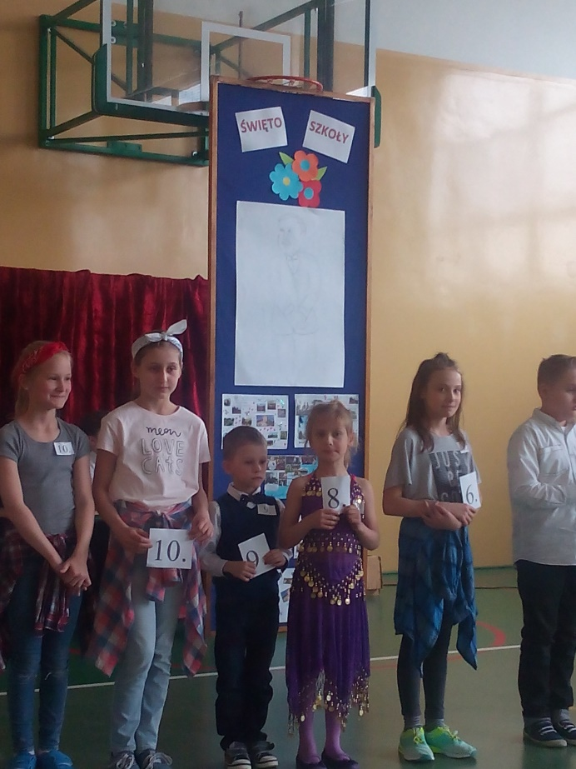
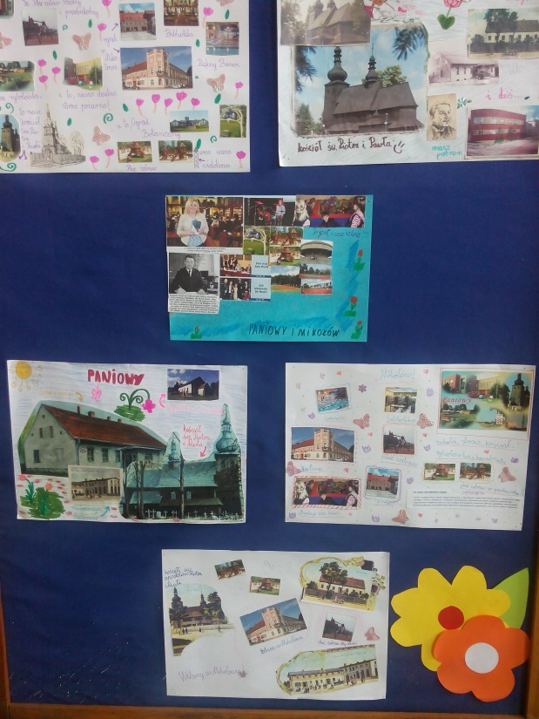
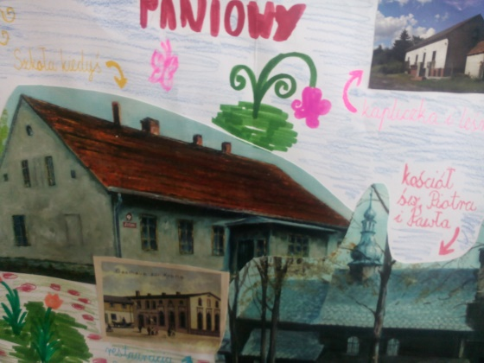
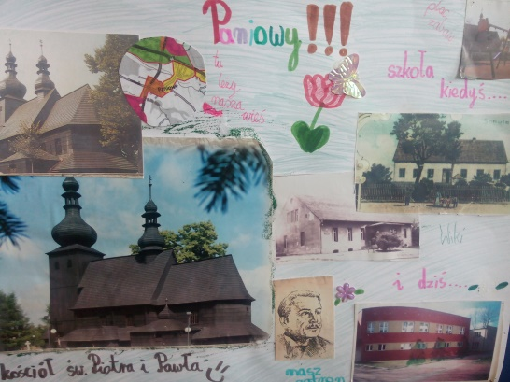
During th celebrations of the day of patron on 20th April 2017, our students made posters with the monuments of all the countries participating in our project as well as postcards with the mouments of our town, which became an element of decoration during our pupils’ performances. czniów.

Slide 4
4th grade worked on the monuments of Spain and Poland.

Slide 5
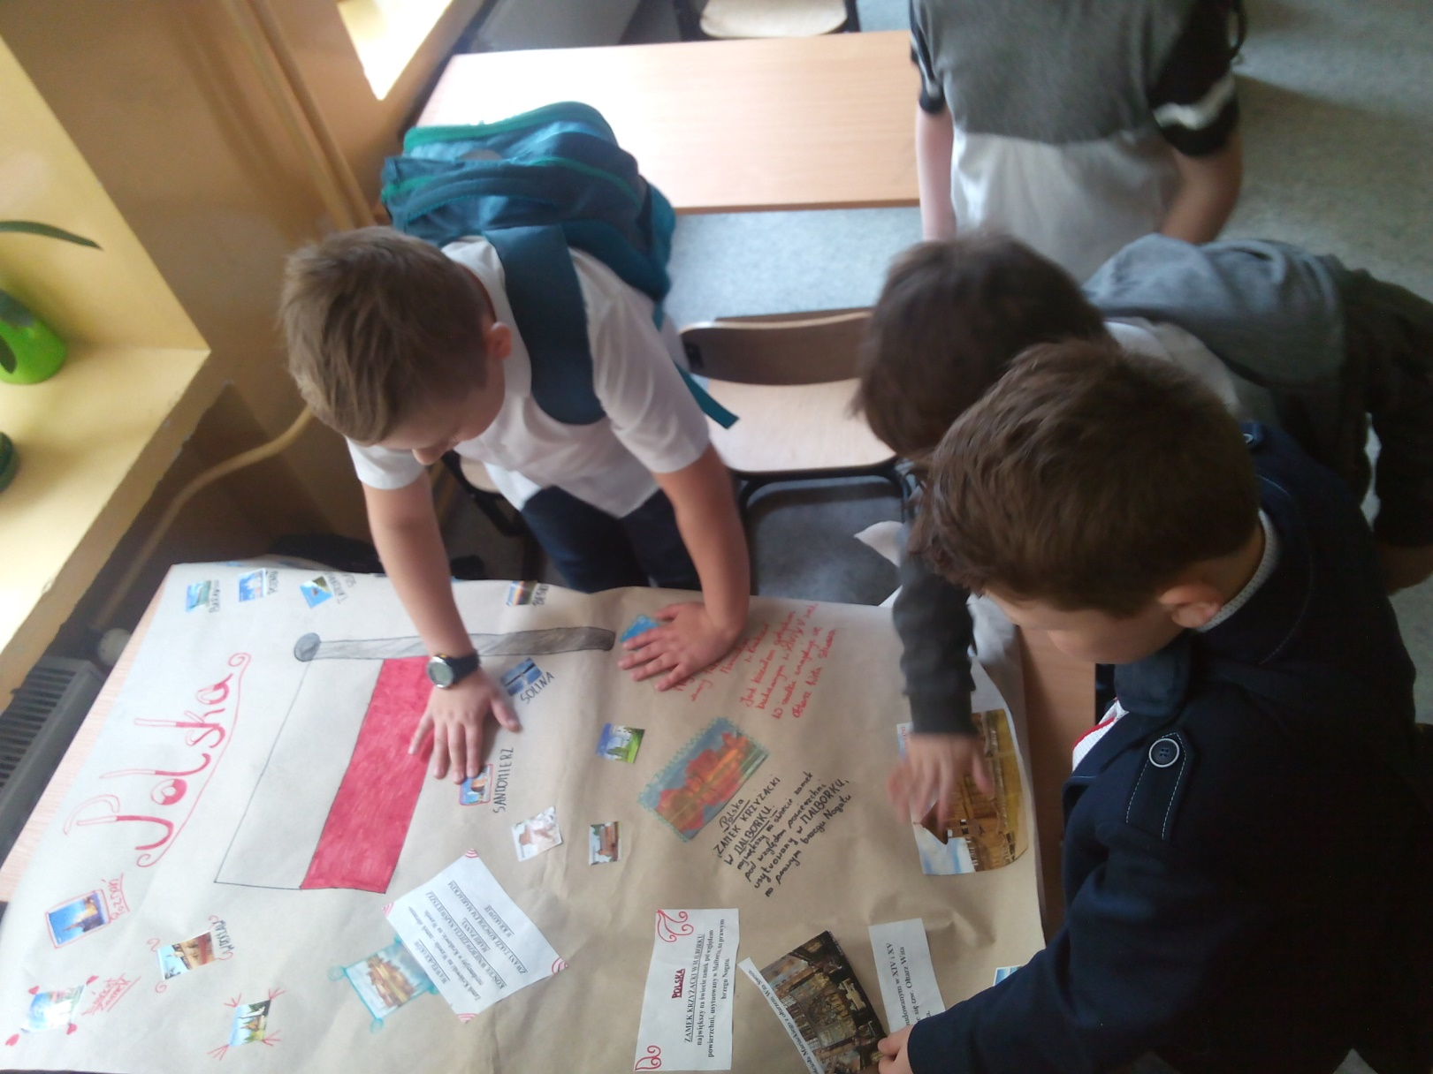
COLLABORATIVE WORK – PUPILS FROM 4TH GRADE

Slide 6
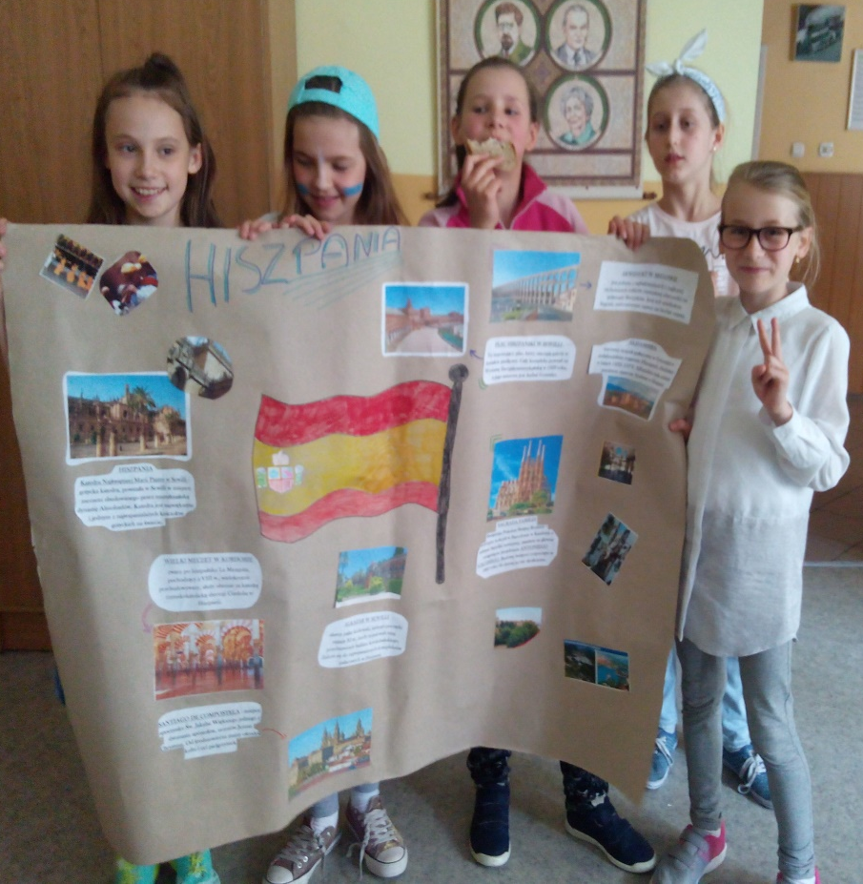
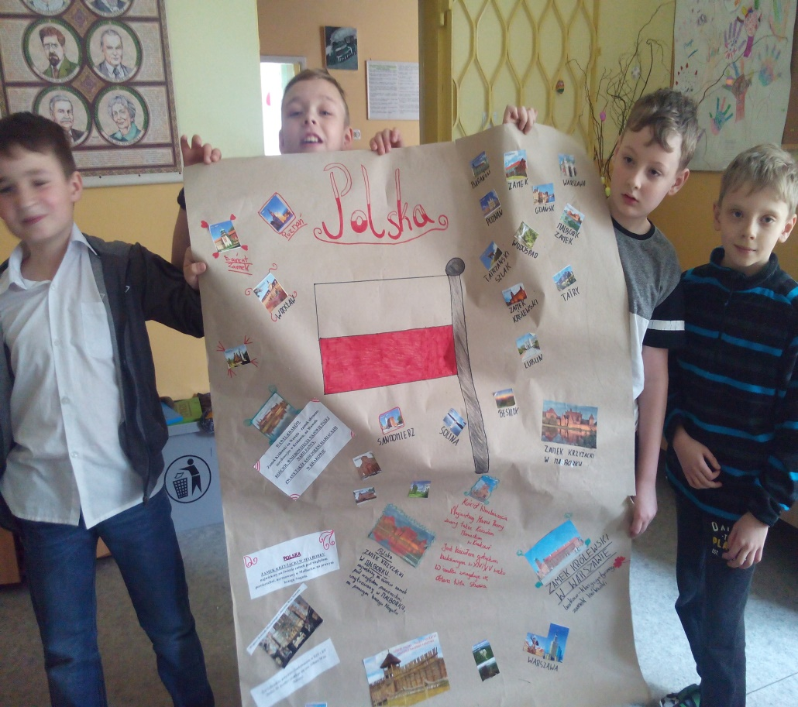
READY POSTERS…
SPAIN
POLAND

Slide 7
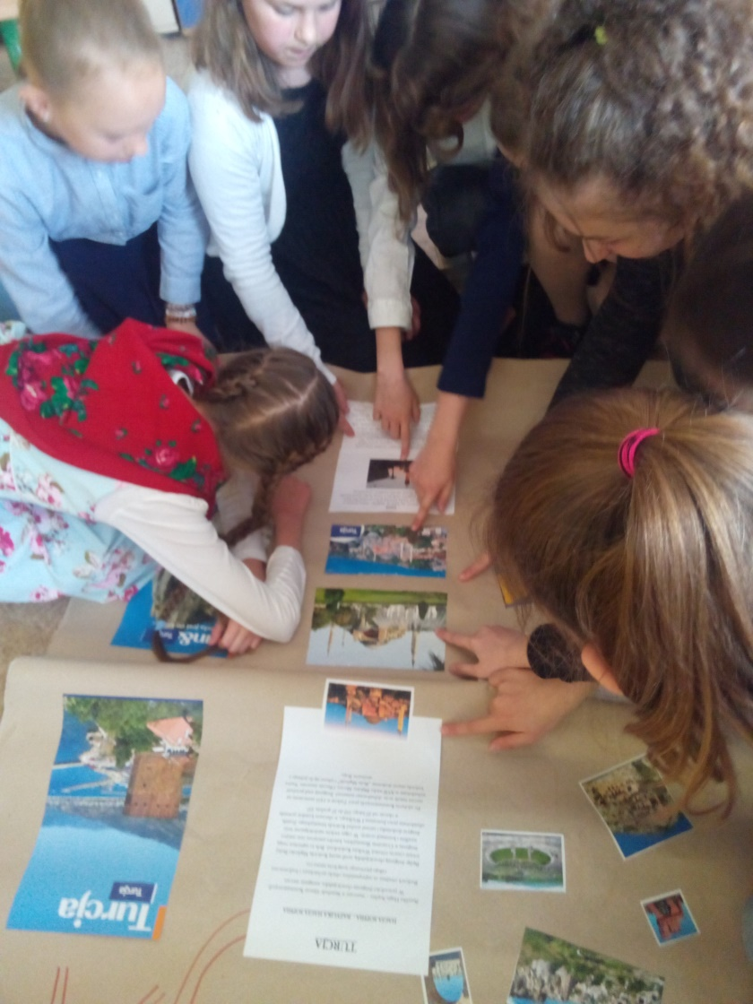
5TH GRADE WORKED ON TURKEY AND ROMANIA.

Slide 8
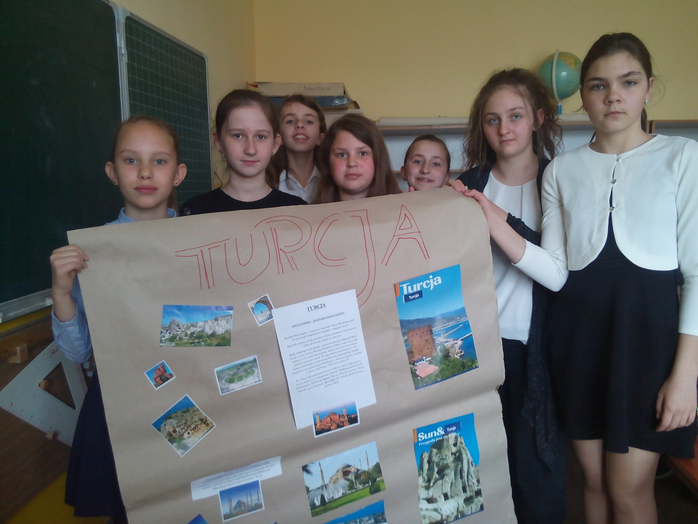

Slide 9
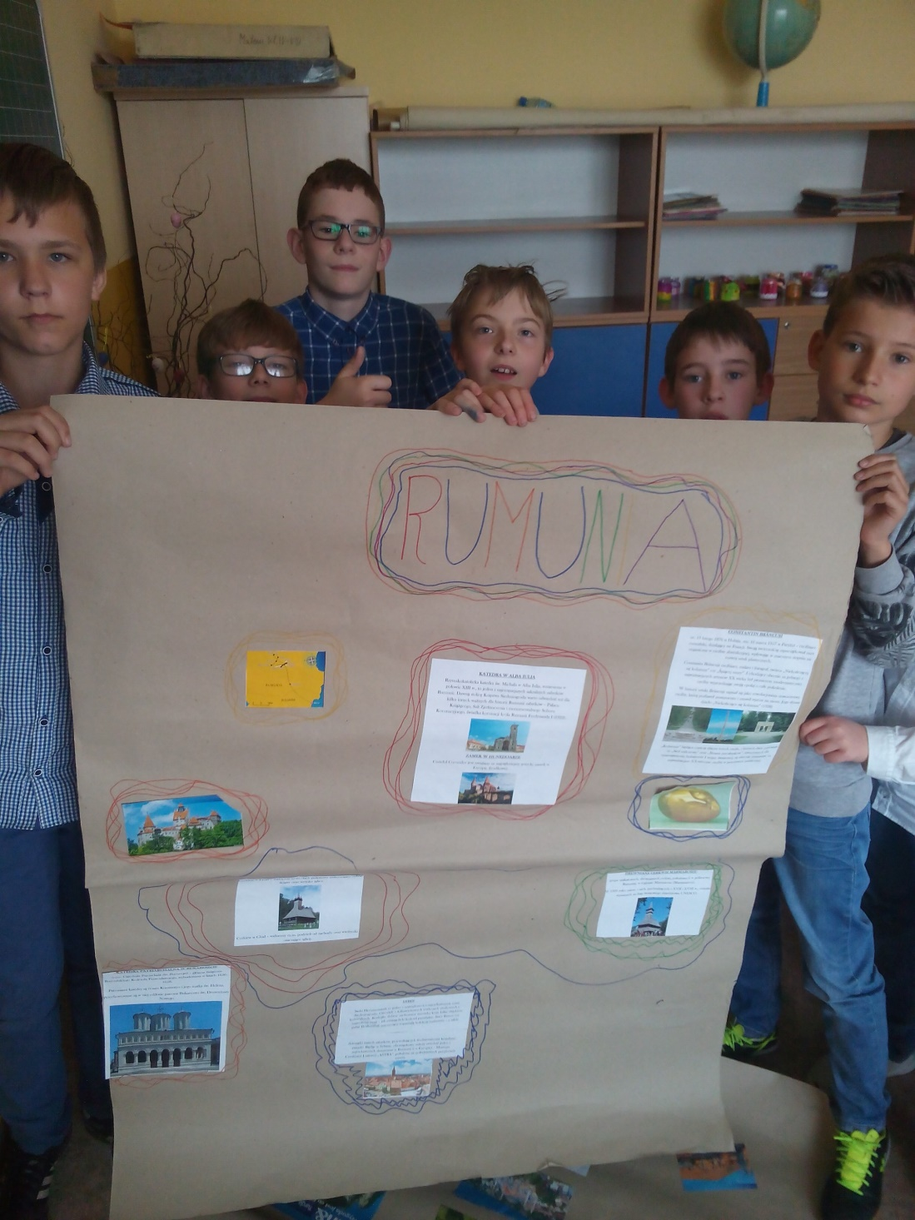
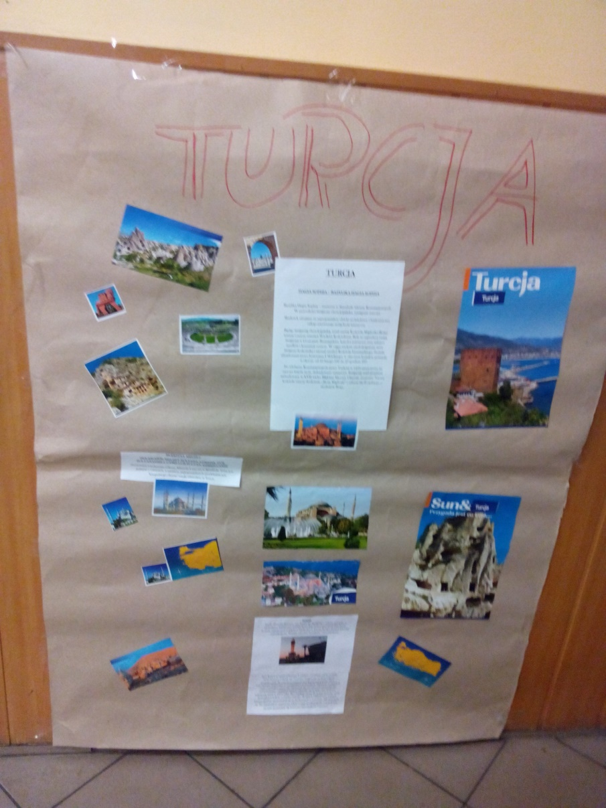

Slide 10
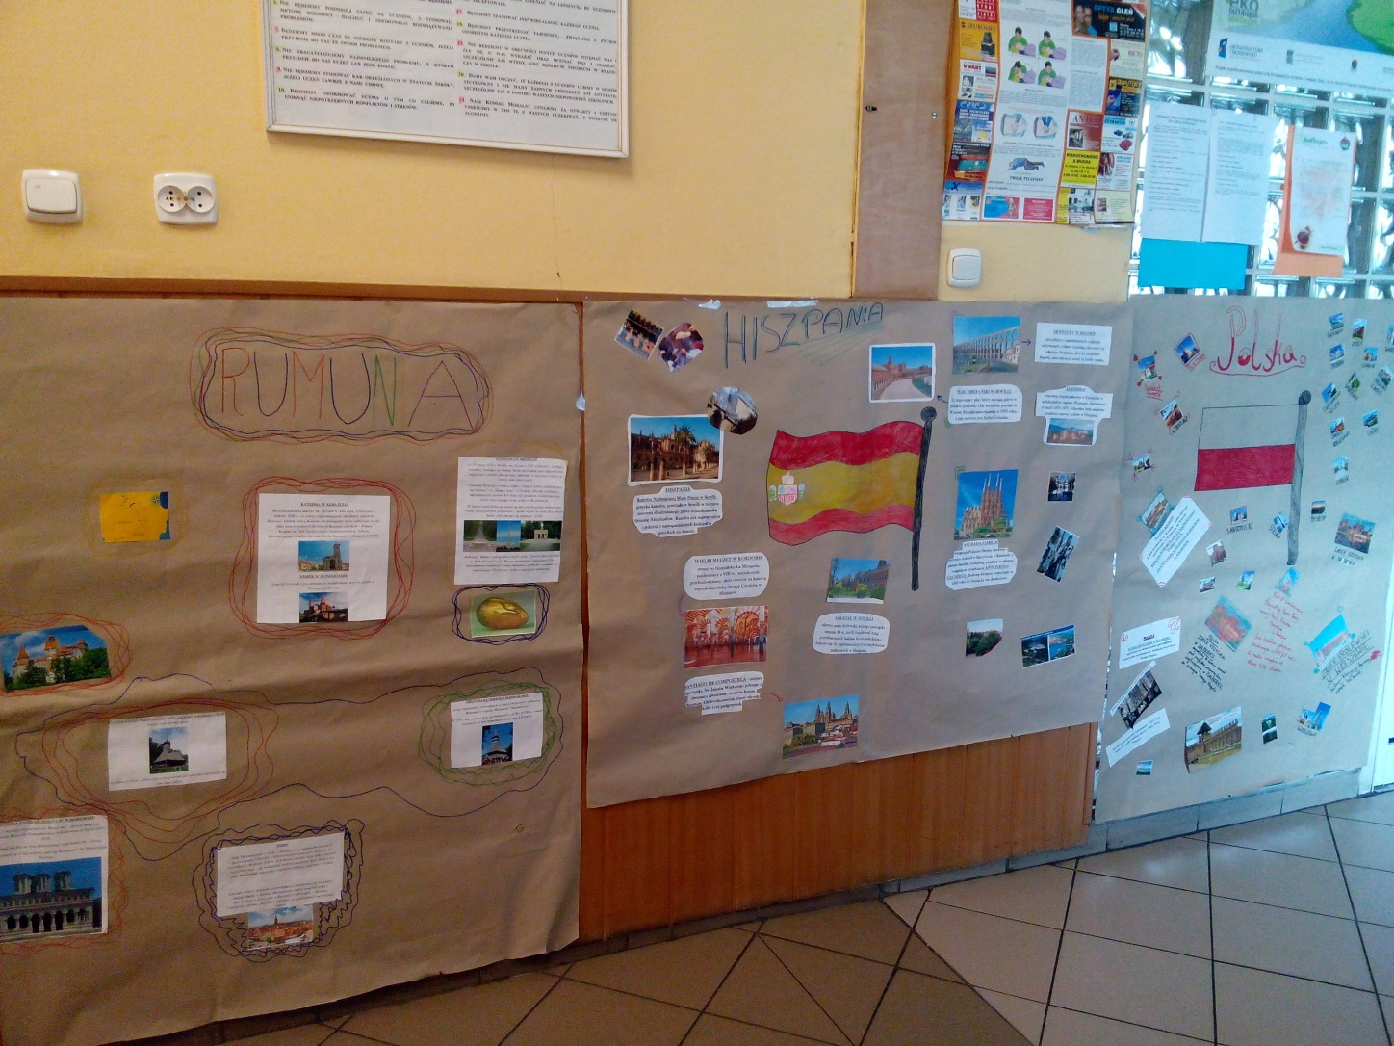
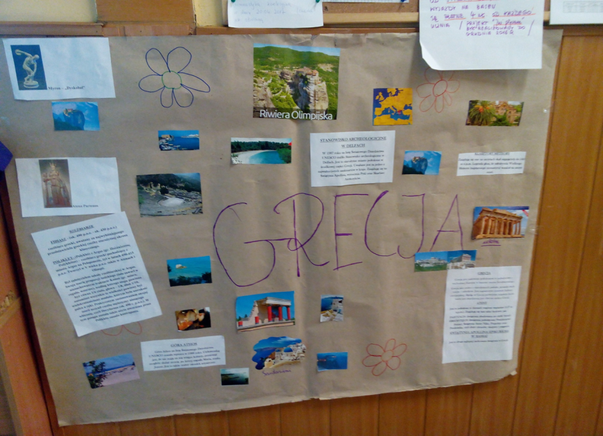
6TH GRADE WORKED ON GREECE AND BULGARIA

Slide 11
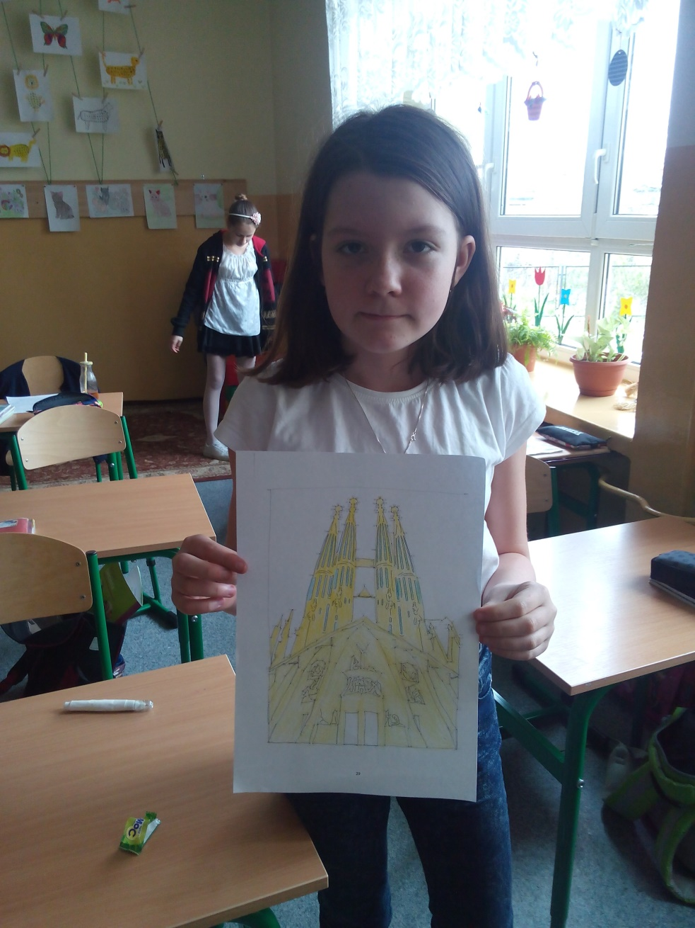
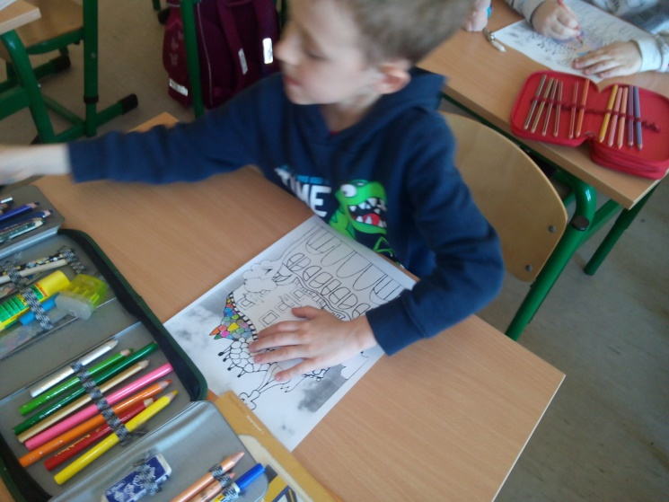
1ST, 2ND AND 3RD GRADES LEARNT ABOUT THE ARCHITCTURE OF ANTONI GAUDI.

Slide 12
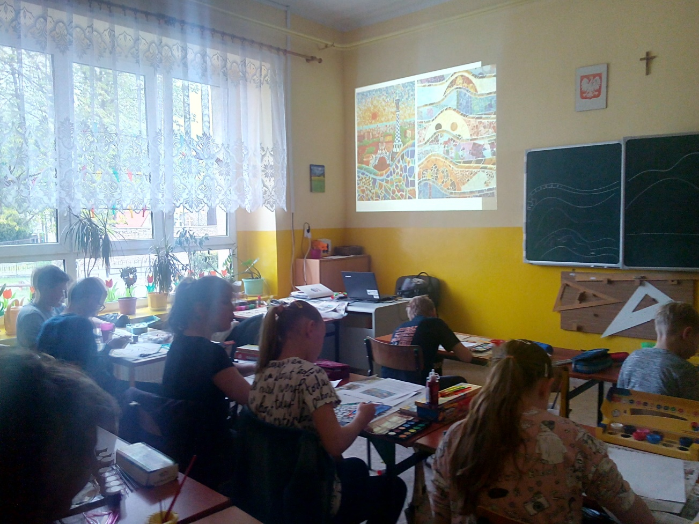
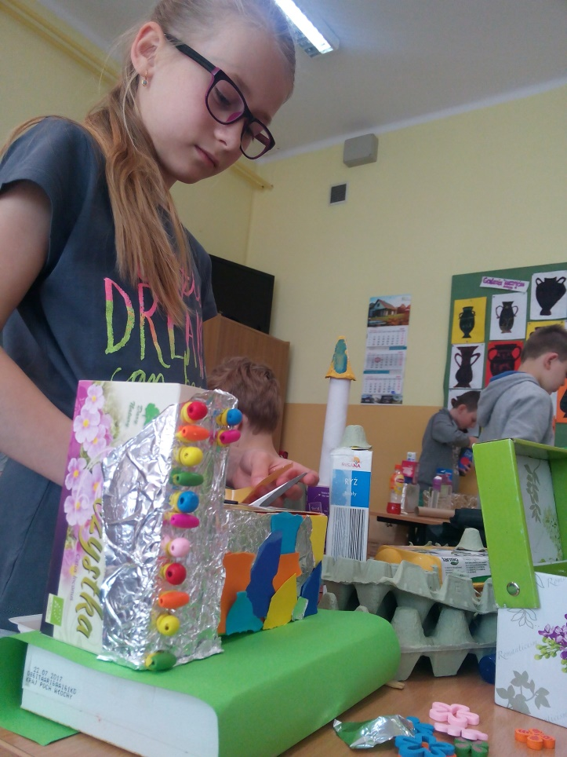
In art classes…
4th grade built a mock-up with Guell Park-style houses
5th grade painted mosaics of Gaudi, made bas-reliefs and sculptures in plaster
6th grade painted Spanish monuments and Greek vases

Slide 13
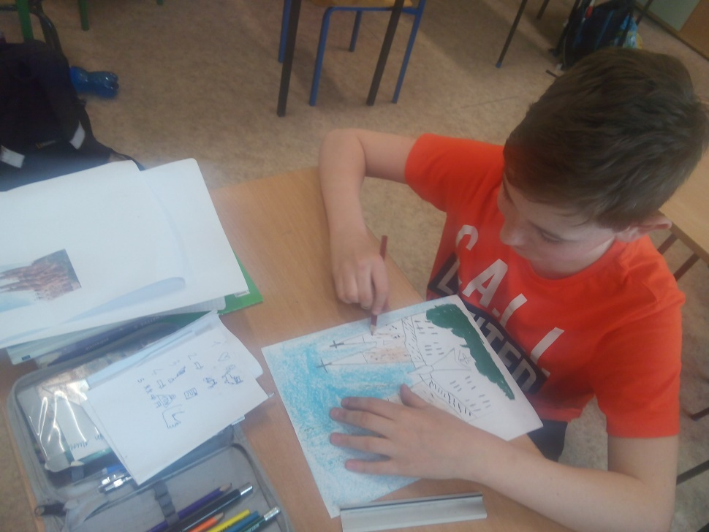
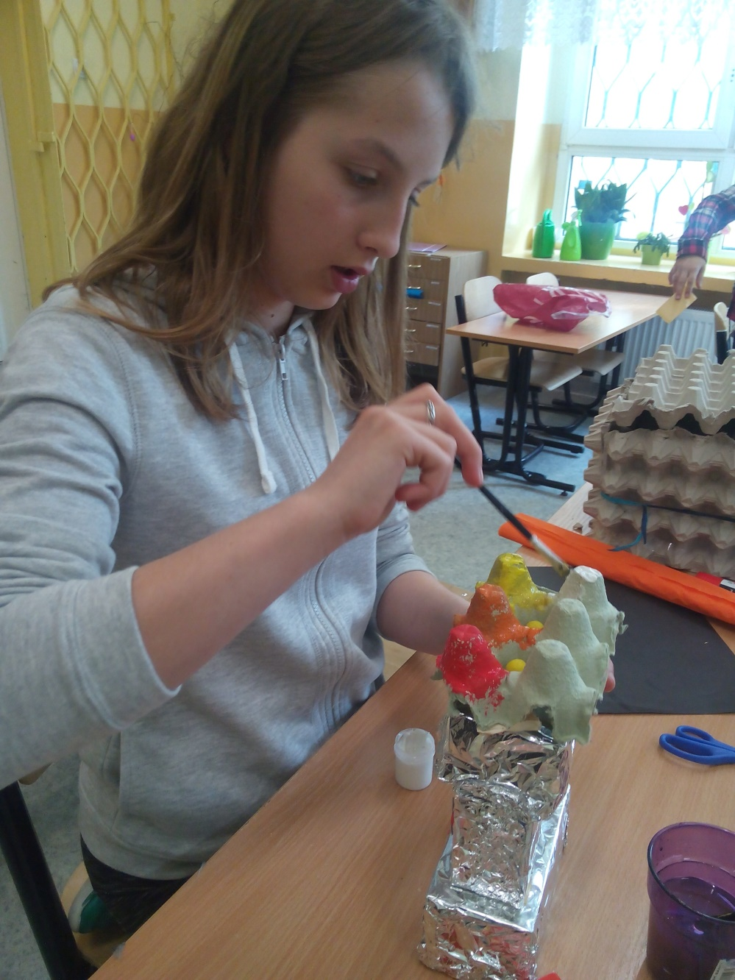
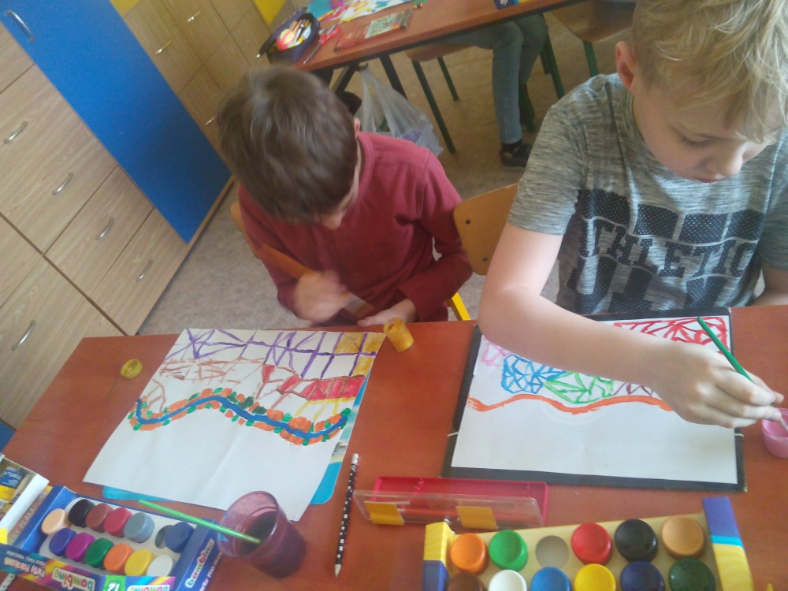

Slide 14
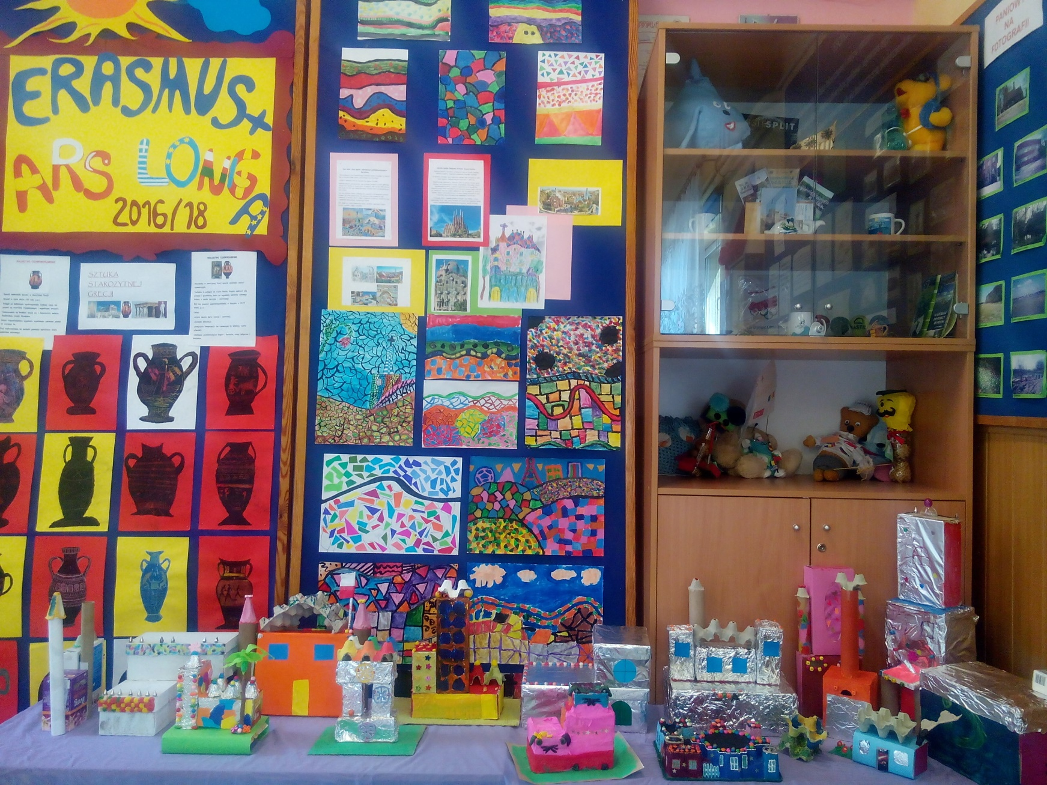
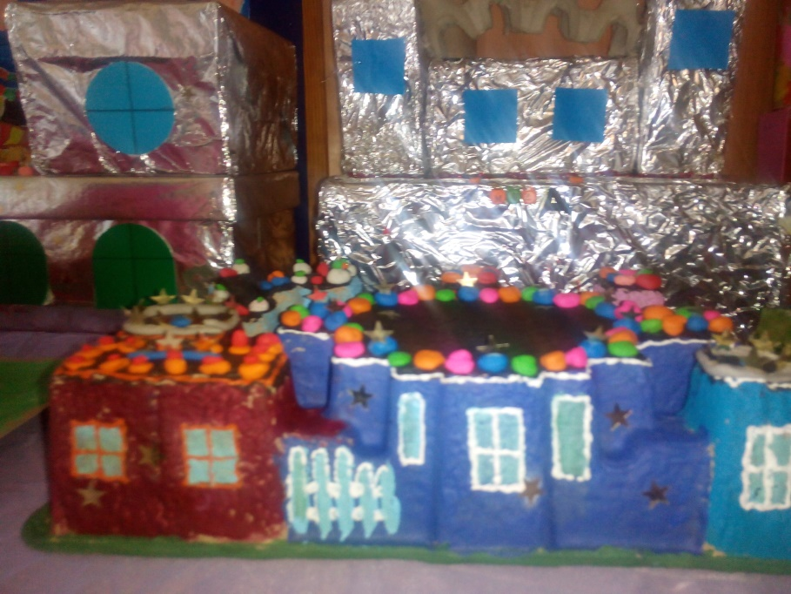
ERASMUS CORNER – students’ works

Slide 15
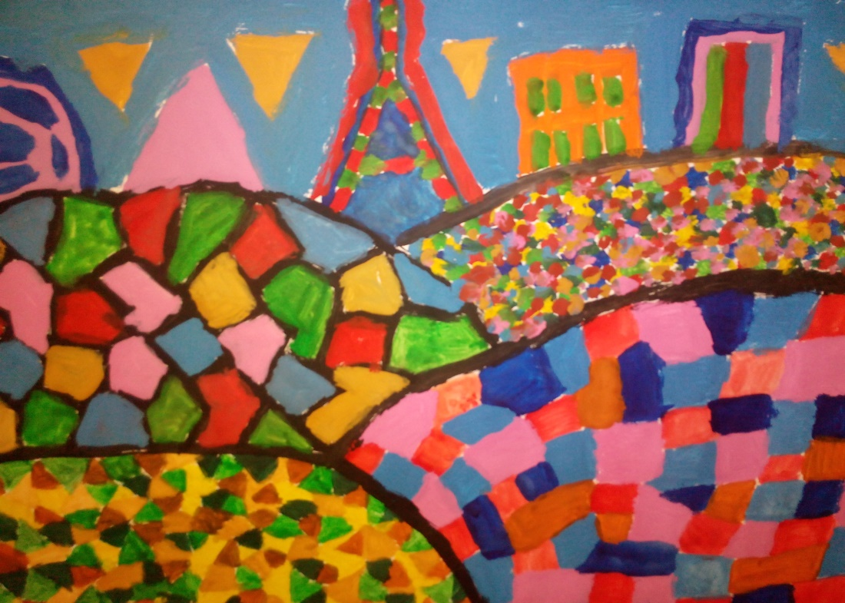
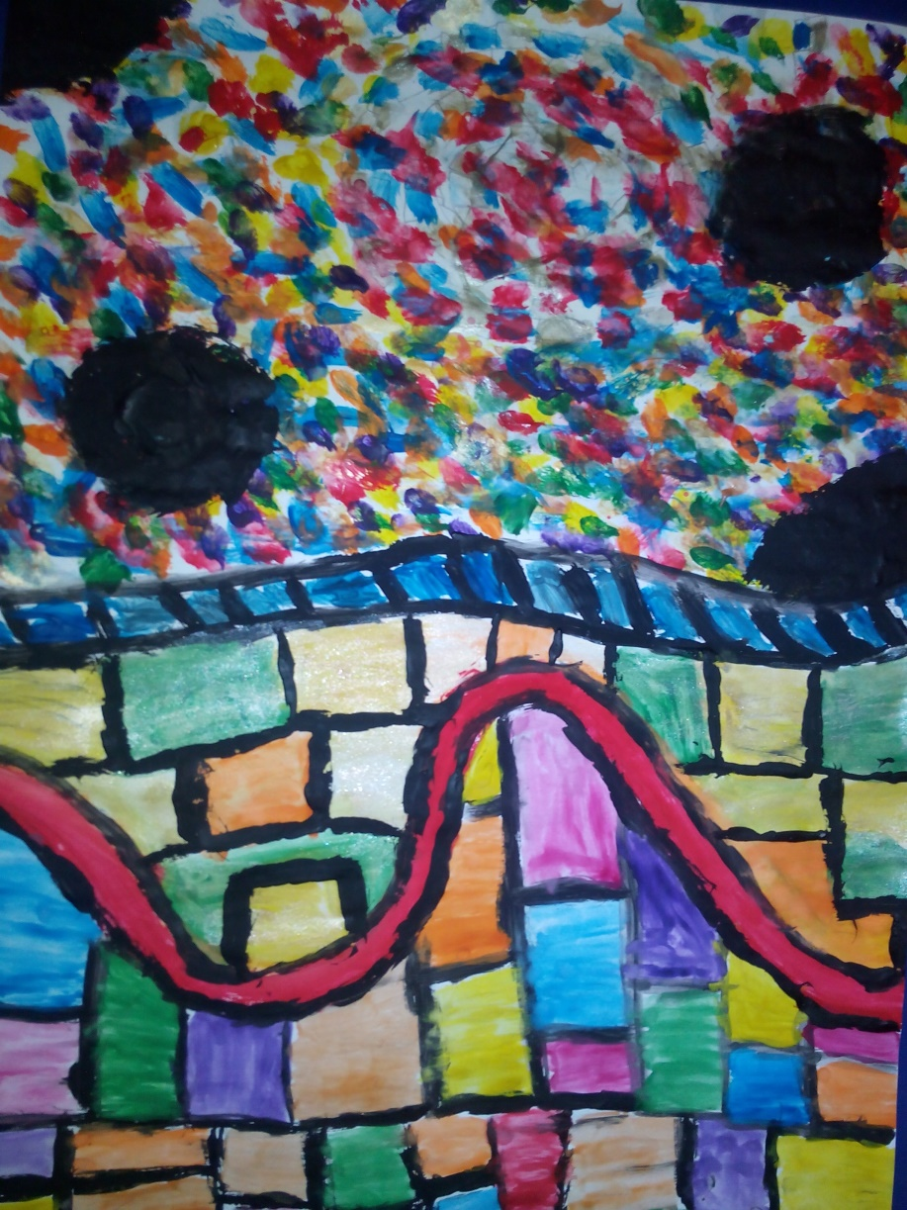
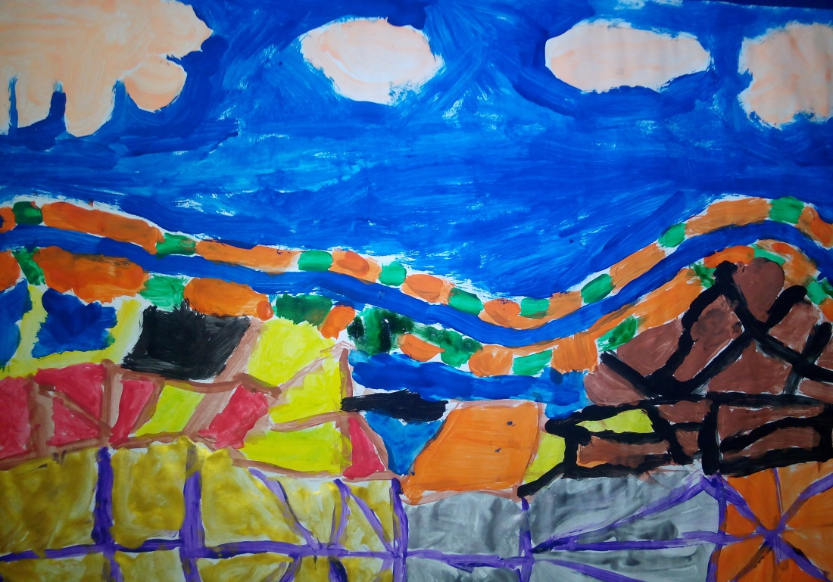
5th grade works
GAUDI’S MOSAICS

Slide 16
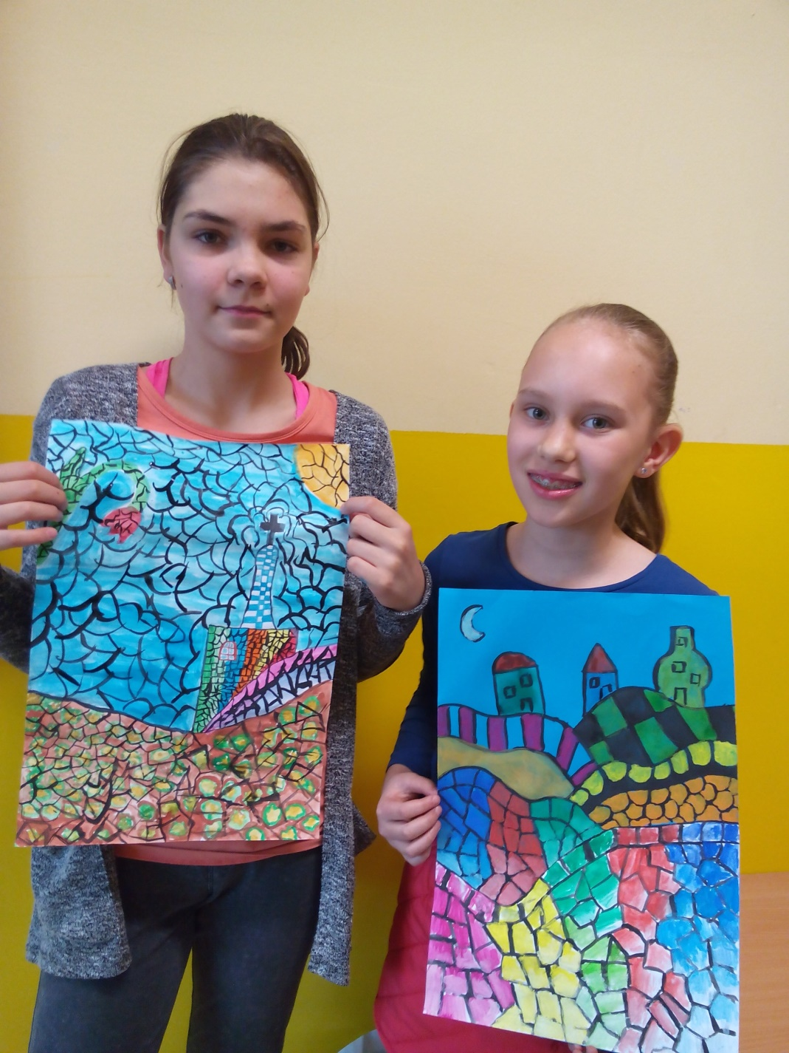

Slide 17
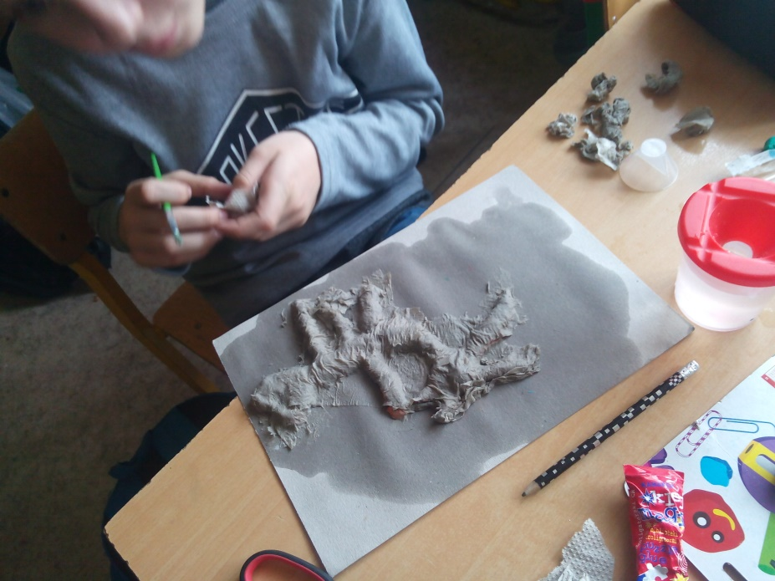
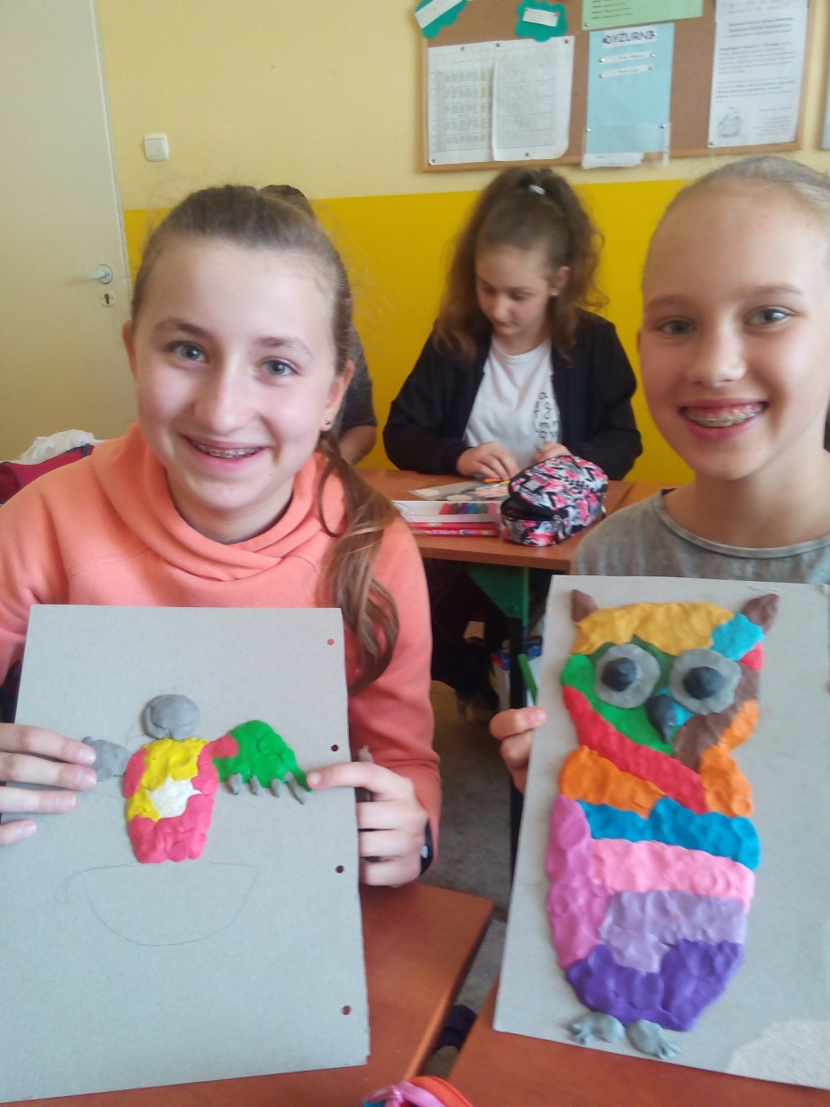
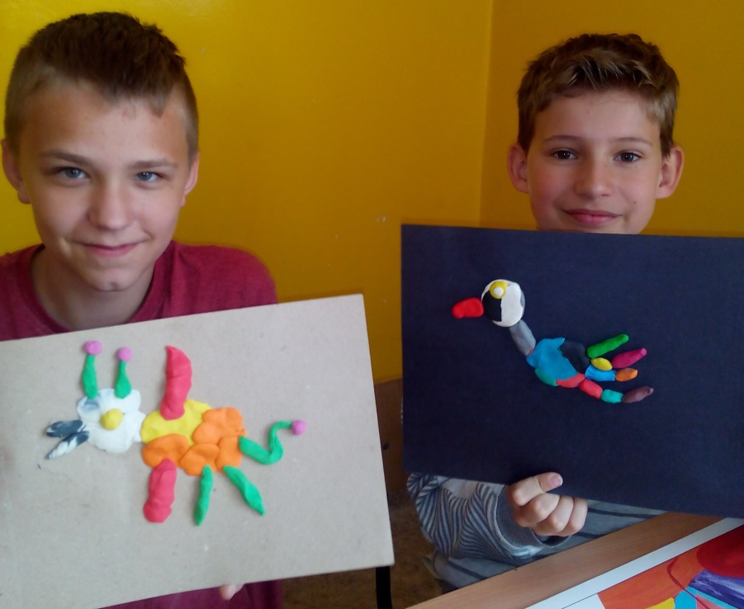
5TH GRADE AND THEIR WORKS: bas-reliefs called ‘Weird birds’

Slide 18
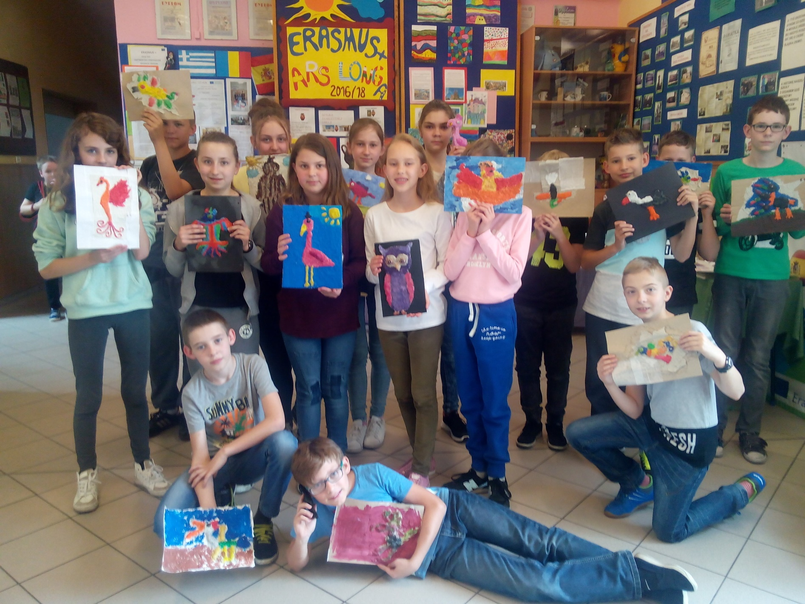

Slide 19
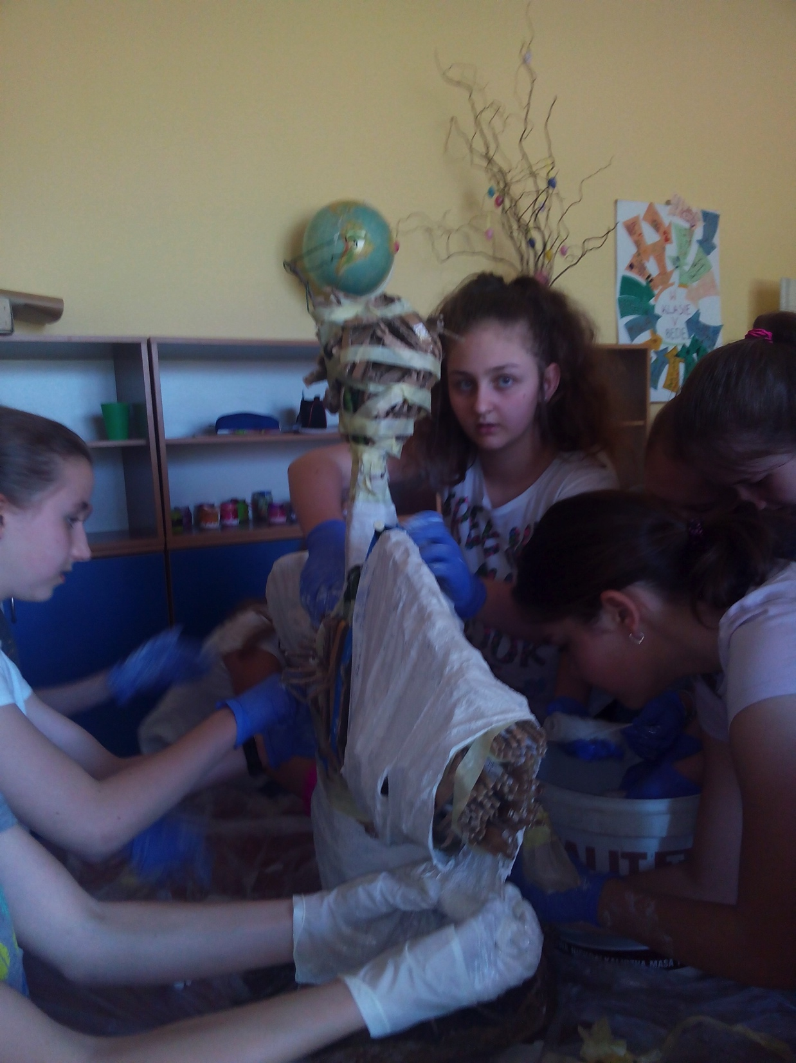
Making of the ‘Guardian Angel’ – a sculpture in plaster

Slide 20
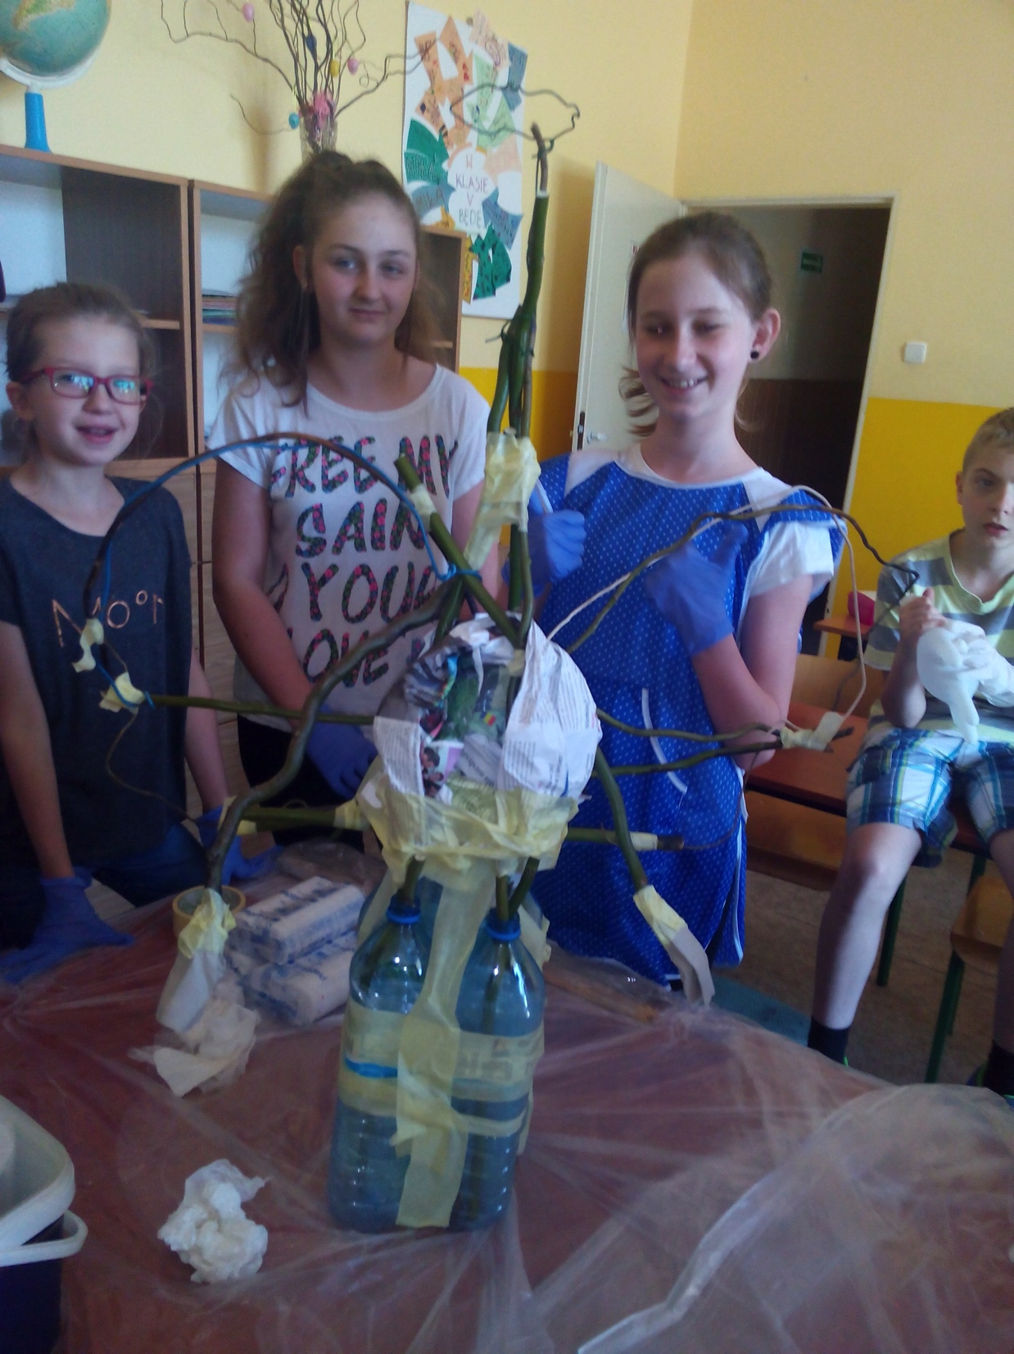

Slide 21
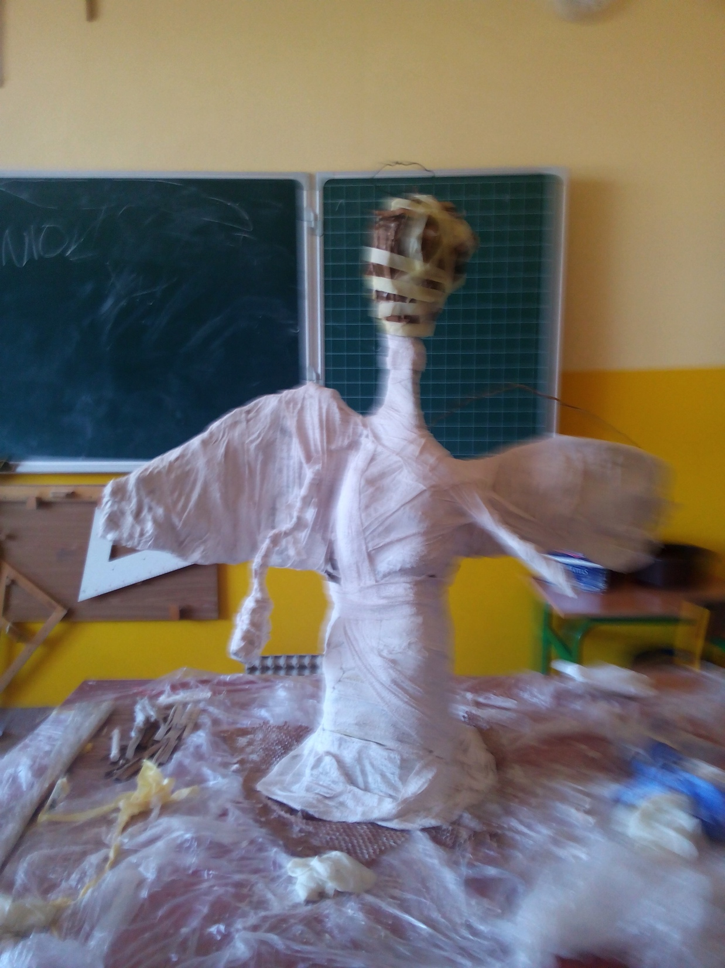

Slide 22
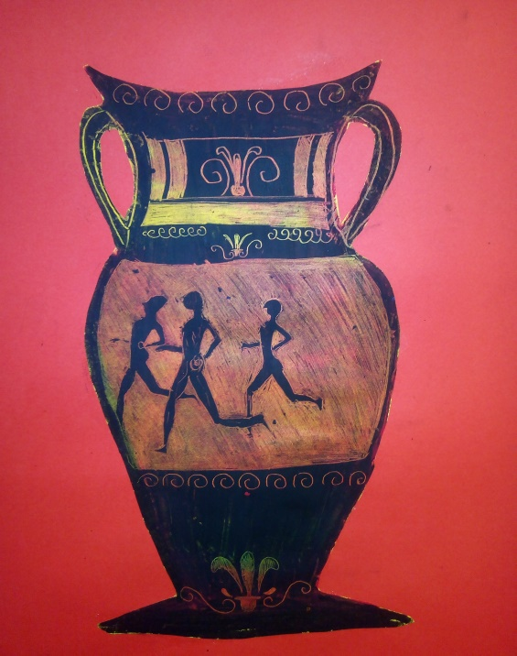
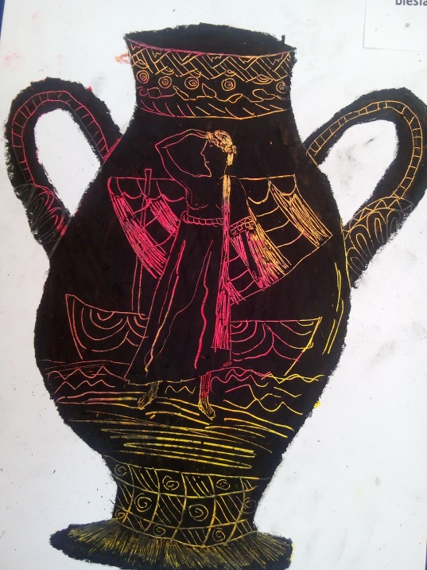
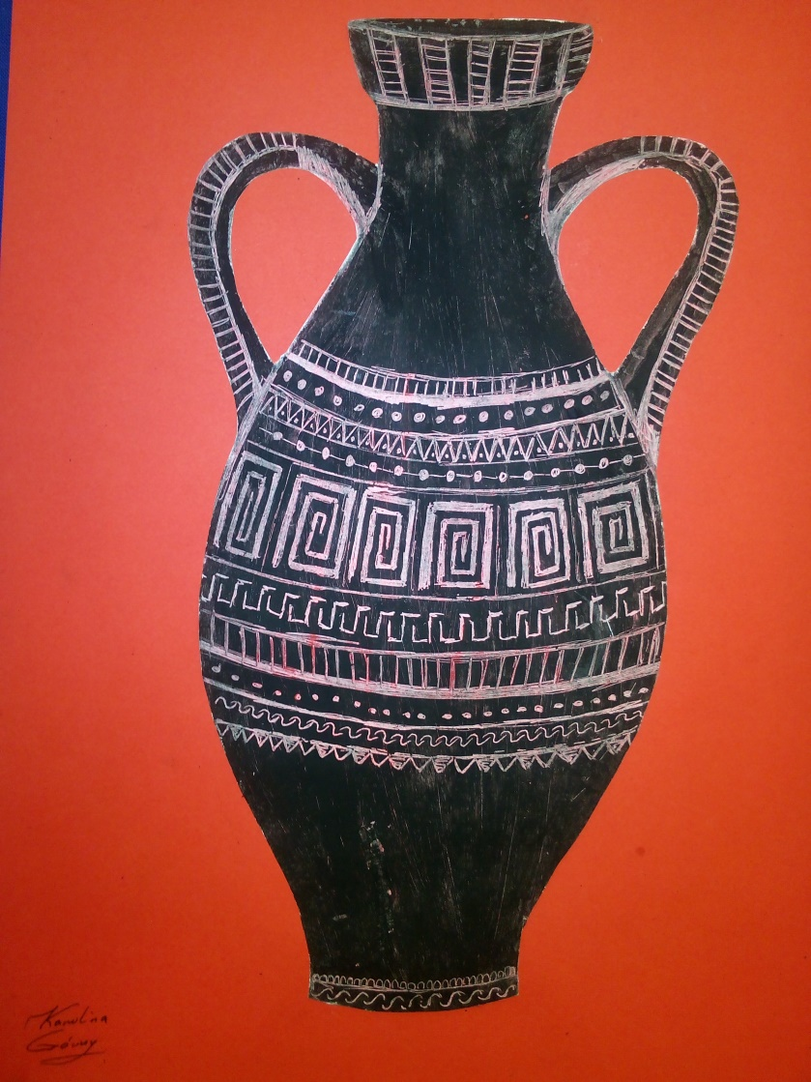
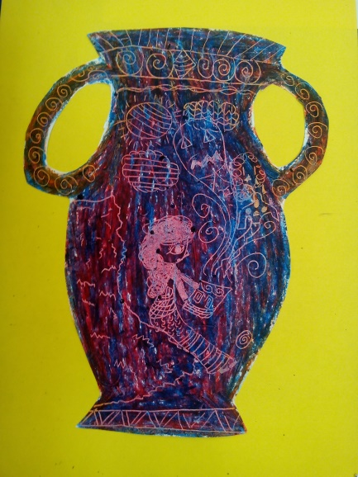
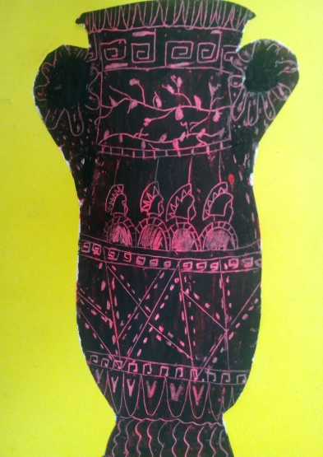
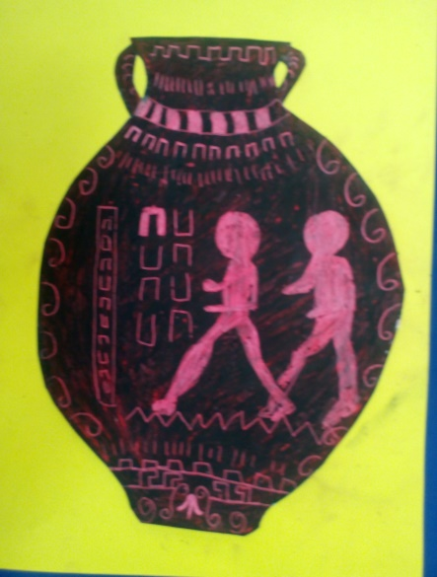
Greek vases – black- and red-figure techniques, students’ works

Slide 23
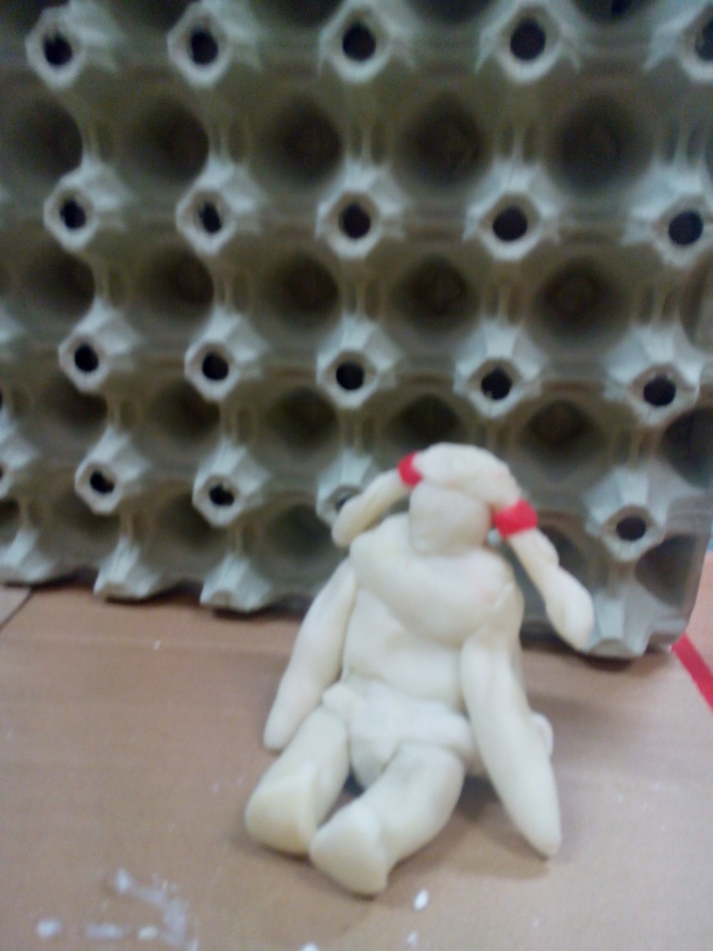
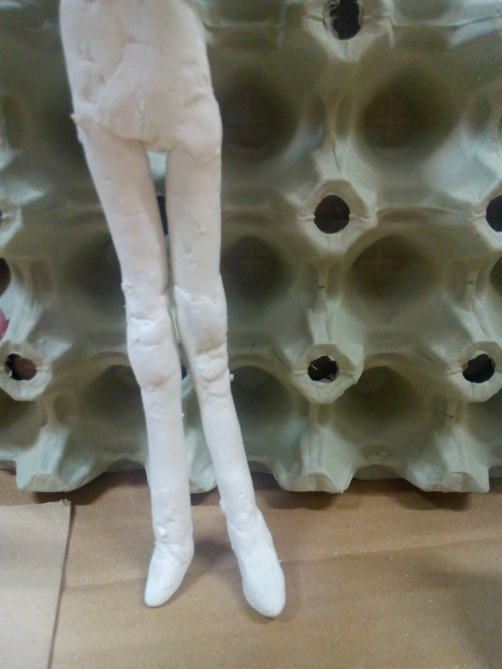
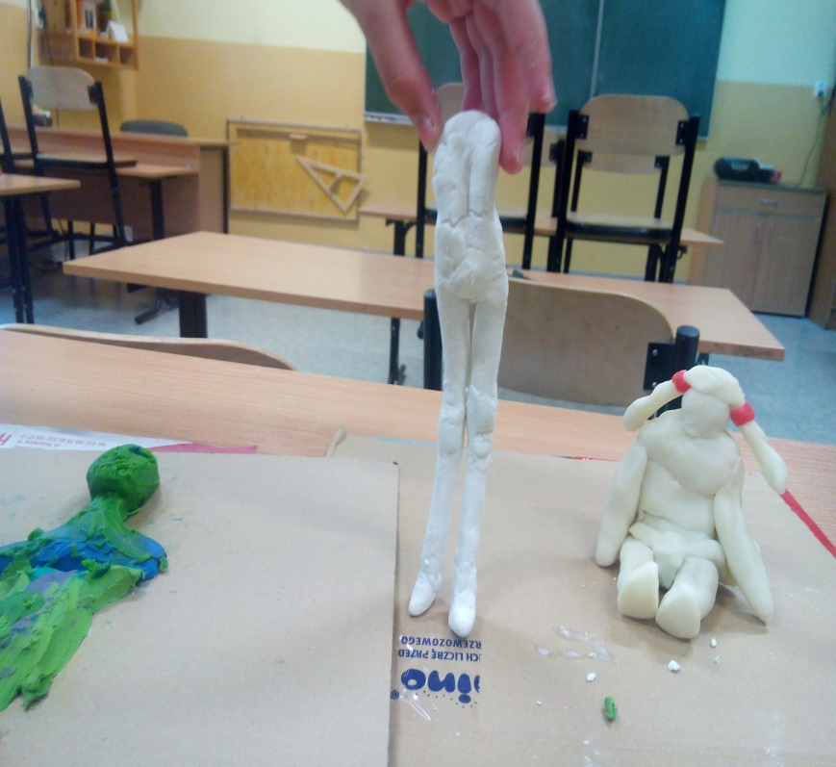
Scuptural workshops during the artistic after-school club. Students learnt about a great Polish sculptor – Małgorzata Abakanowicz. Inspired by her they made their own small sculptures.

Slide 24
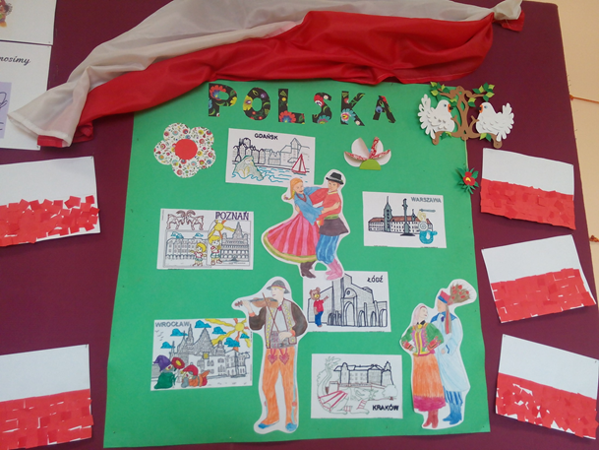
In the after-school care roomstudents learnt about Polish monuments.

Slide 25
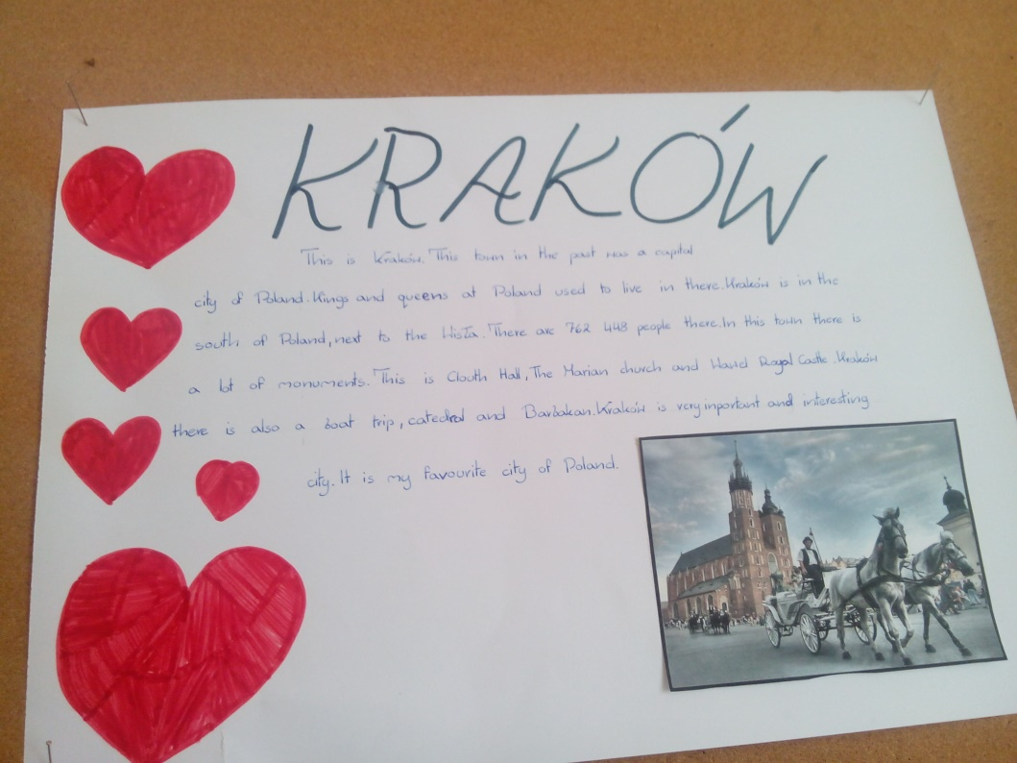
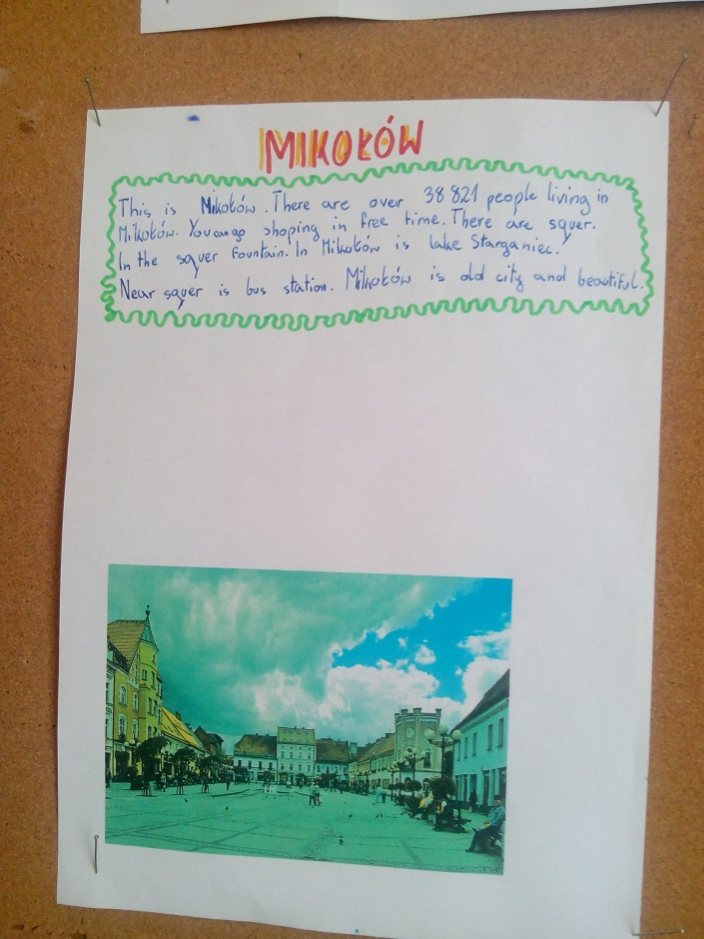
Descriptions of monuments prepared during Egnlish classes.

Slide 26
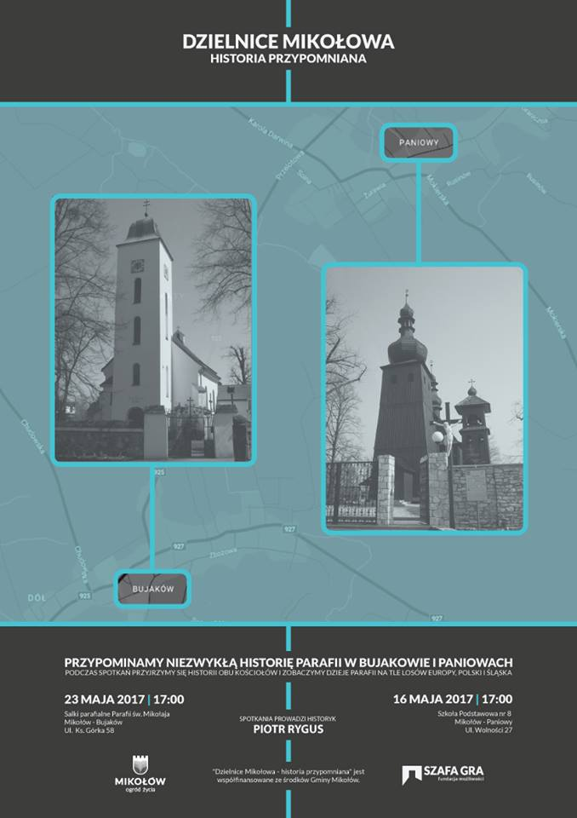
Additionally:
1.School competition „Famous cathedral of the partner countries”.
2.Participation in preparing the celebration of the 260th anniversary of our parish – outdoor painting workshops for students around our church
16.05.2017 a lecture about the
history of our church as part of
the project ‘Quarters of Mikołów
– forgotten history’.

Slide 27
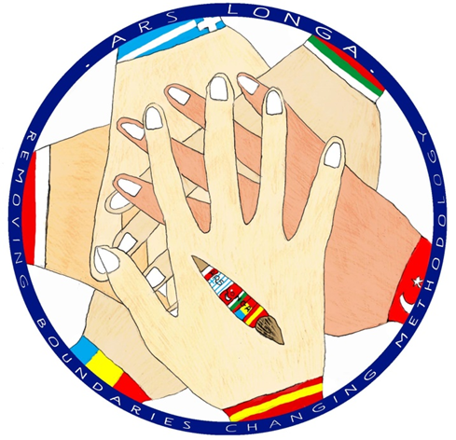
Celebration of Europe Day 2017
ARS LONGA
in Szkoła Podstawowa nr 8
in Mikołów-Paniowy

Slide 28
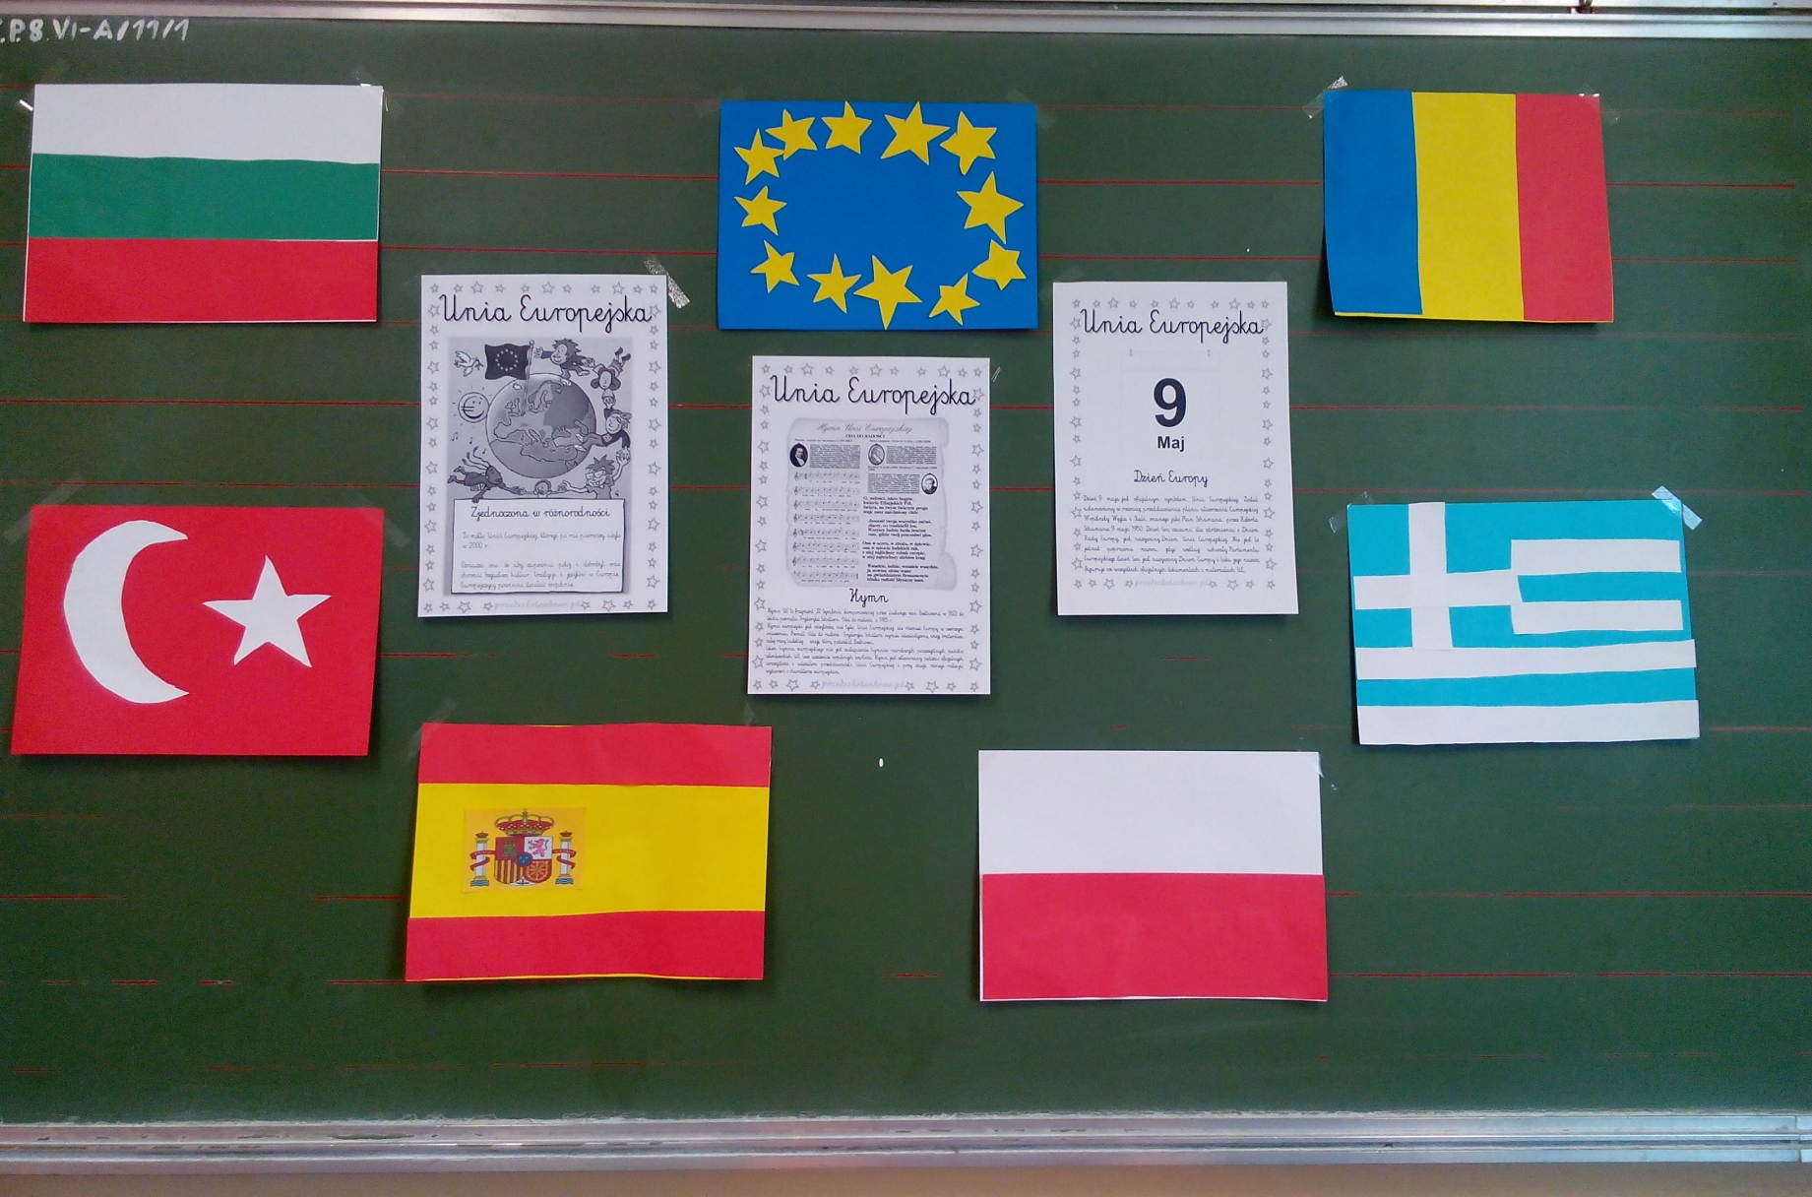
Making flags of our partner countries, videoconference, singing the ‘Ode to Joy’.

Slide 29
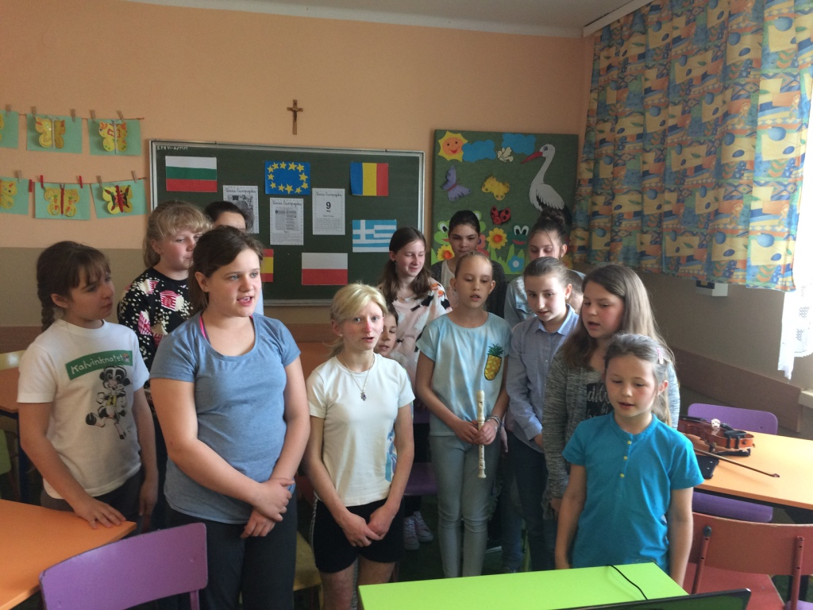

Slide 31
1st grade learnt about different EU monuments.

Slide 32
Participation of our students in 3rd District Cultural Competition about EU countries organised by after-school activity centre in Mikołów.

Slide 33
A competition – guess which EU country this picture is connected with….

