Slide 1
Immigrants, emigrants and refugees
3rd primary school of Karpenissi- Greece

Slide 2
This presentation is created for the ERASMUS+ project titled ARS LONGA and is presented in Romania.

Slide 3
Immigrants and emigrants
What’ s your definition of immigrants?
A person who leaves his/her country because he/she wants to find a better job or study abroad.
What’ s your definition of emigrants?
A person who wants to change his/her life by living in a foreign country. He/she hopes to find a better job there or better living conditions.

Slide 4
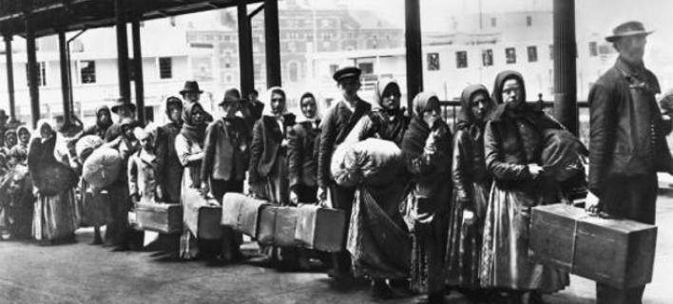

Slide 5
The following graph shows immigration during the last two years of Greek economical crisis.
If we compare the data for 2015 and 2016, immigration has decreased in the last year, especially after March 2016.

Slide 6
Greece receives more immigrants from Syria 56%
and
Afghanistan 25%.

Slide 7
Greeks emigrate mainly to Germany and
the United Kingdom.

Slide 8
Refugees

Slide 9
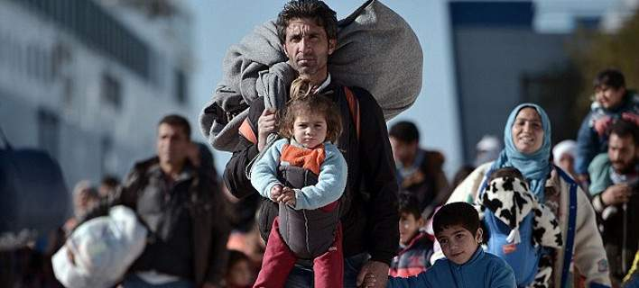
WHAT IS BEING A REFUGEE?
A refugee is someone who has to leave his/her country, because of war, natural disasters or famine.

Slide 10
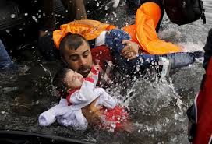
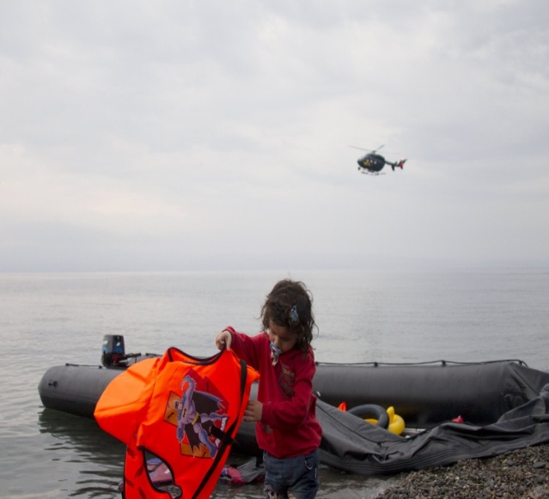
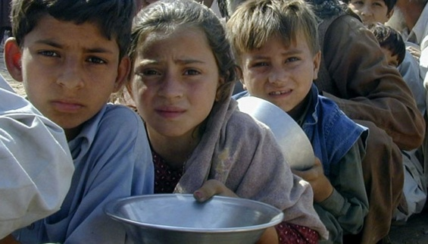
My story
My mother used to say
That people have the brain.
Now I do not know,
If that is true or so.
My trip began years ago
when war knocked on my door.
I couldn’t quite understand
what everything around me meant.
People suffering, lost in pain
All my goals for the future were in vain.
Death and sorrow all around
and all my inside crying out.
Now I must travel far away
to seas and lands I did not claim.
Some call me immigrant or refugee,
who am I anymore I cannot see!
I pray to god every single day
to find a place where I can stay.
To play and laugh, make friends a few.
To live my new life just like you!
This poem was written by the teacher of B1,
Mrs Stella Ntousiou, for the second project of ARS LONGA

Slide 11
PROPOSALS
Our action proposals to alleviate the refugee crisis.
The E. U. must take action to end war in Syria.
All European countries must open their borders for refugees.
The European Union must help refugees be reunited with their relatives around Europe.
The E. U. must open a way by land for refugees so that they are not in danger trying to reach Europe by sea.

Slide 12
Great Greek artists talking about immigration…
«τρεις μήνες οδοιπορούμε, έλιωσαν τα παιδιά και οι γυναίκες, κι οι άντρες ντρέπονται πια να ζητιανέψουν.»
Ο Χριστός ξανασταυρώνεται - Ν. Καζαντζάκης
"Three months we travel, children and women have melted down, and men are no longer ashamed to beg."
Christ Recrucified - N. Kazantzakis
«αλίμονο μας που πρέπει να ξεπατριστούμε!…»
«ως την τελευταία στιγμή τους έμενε η ελπίδα πως θα μπορούσαν να μείνουν στην παραλία ίσαμε που να περάσει η μπόρα κι ύστερα να γυρίσουνε στα χωριά τους.
Ήταν φανερό πια πως δεν μπορούσαν.»
Αιολική γη - Ηλ. Βενέζης
‘Pity on us that we have to leave our home! ... "
"Until the last moment they had hope that they could stay on the beach till the storm passes and then return to their villages.
It was obvious now that they could not. "
Wind earth - El. Venezis

Slide 13
Τρέμαν ακόμα απ' το φόβο. Τα μάτια τους ήταν κόκκινα απ' το αιμάτινο ποτάμι της κόλασης που διάβηκαν. Και σαν πάτησαν σε στέρεο έδαφος, μετρήθηκαν να δουν πόσοι φτάσανε και πόσοι λείπουν.
Και ψάχναν και για την ψυχή τους, να δουν αν ήταν στη θέση της. Μ' αυτή ήταν άφαντη. Είχε μείνει πίσω στην πατρίδα κοντά στους αγαπημένους νεκρούς και στους αιχμαλώτους, κοντά στα σπιτάκια, στα χωράφια, στις δουλειές….
Κι είπαν: περαστικοί είμαστε, ας βολευτούμε όπως όπως, κι αύριο θα ματαγυρίσουμε στα μέρη μας. Κι αποζητούσαν, τούτη την ελπίδα, με την ίδια λαχτάρα σαν το ψωμί το νερό και τ' αλάτι.
Χωρίς πατρίδα χωρίς δουλειά χωρίς σπίτι. Και μόλις χτες να θυμάσαι πως ήσουνα νοικοκύρης.
Διδώ Σωτηρίου, Οι νεκροί περιμένουν (απόσπασμα)
They were still trembling in fear. Their eyes were red from the blood river of Hell they had just crossed. and as soon as they stepped on solid ground, they were counted to see how many had arrived and how many were missing.
And they are looking for their soul, to see if it was in place. But it was vanished. It stayed back home near the beloved dead and the prisoners, near the houses, the fields, the jobs ....
And they said: we are passer-bys, let’s accommodate for now, and tomorrow will go back to our home. And they awaited for hope, with the same longing as bread and water and salt.
Without home without a job without a house. And just yesterday, you remember that you were so well off.
Dido Sotiriou, The dead are waiting (excerpt)

Slide 14
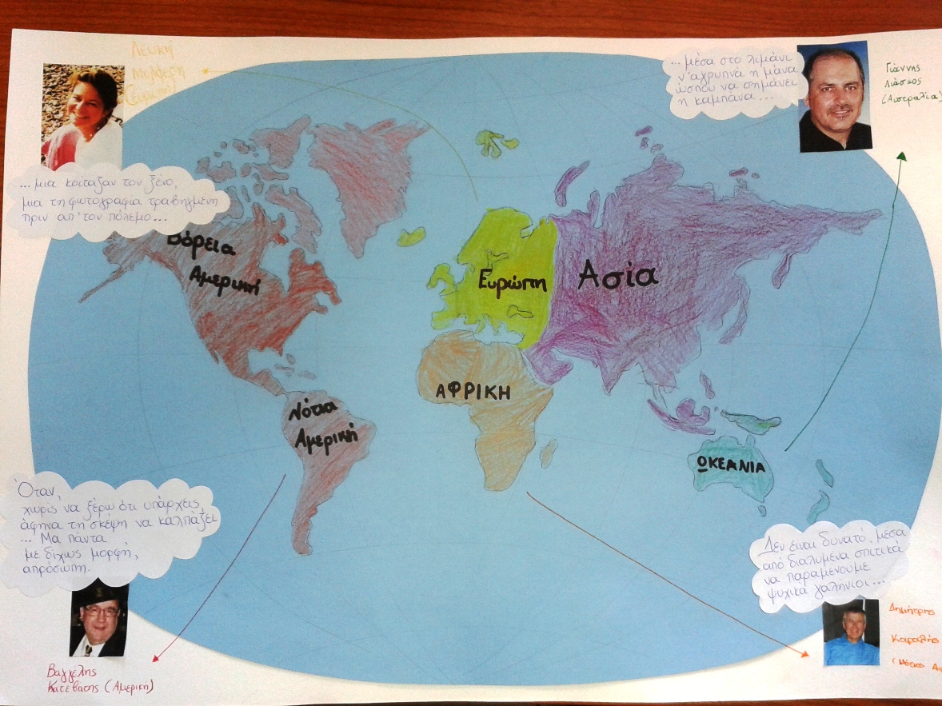
Our projects
Current Greek writers that have migrated around the world and quotes.

Slide 15
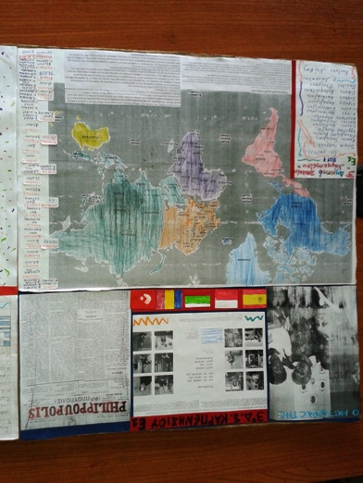
Famous Greeks that migrated abroad and made a successful career. Painter- El Greco Musician- Demis Roussos Actress- Jennifer Aniston

Slide 16
We care, we dare, we support !
What about you?
Act now!

Slide 17
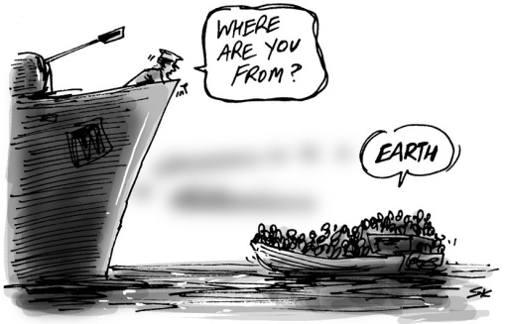
Thank you!!!

