Slide 1
KA2 - Cooperation for Innovation and the Exchange of Good Practices Strategic Partnerships for Schools
MIGRATION
EMIGRANT, IMMIGRANT, REFUGEE
Teachers responsible:
Project Erasmus + coordinator: Alina Botei
Claudia Raicu Lucica Suciu

Slide 2
People are birds with wings grown inside by Nichita Stănescu
This quote launched discussions about people and birds in real and imaginary sense.
For example:
birds can fly anywhere, people need transport;
birds and people travel with a purpose;

Slide 3
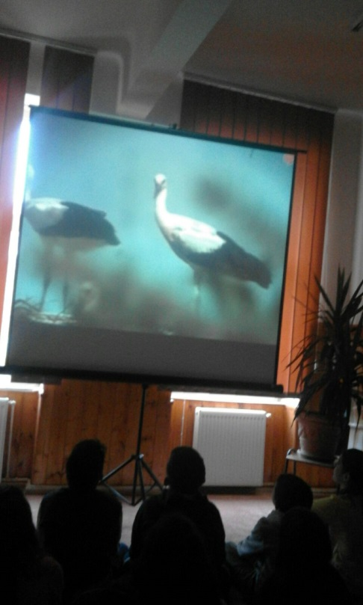
Information about birds migration for all pupils
Documentary, encyclopedia, knowledge

Slide 4
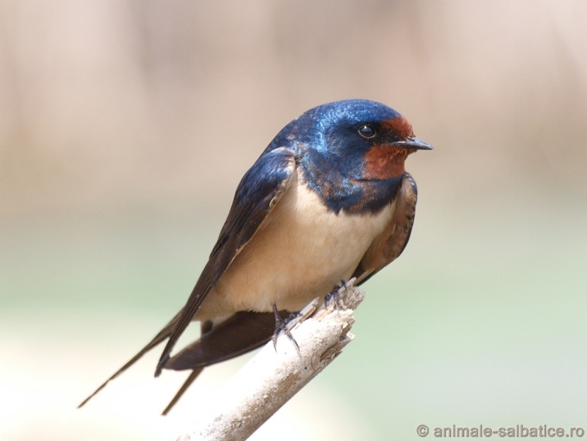
Birds coming in Romania and other places
White Storks and swallows arrive in Europe in spring and travel back in Africa in autumn.

Slide 5
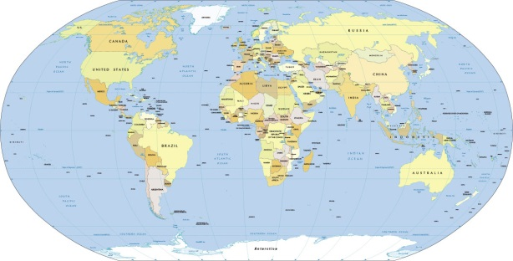
Cygnus Cygnus fly in Romania from Siberia. It sits here February - October.
The big idea:
Many birds are travelling different distances and durations, to find the ideal conditions of living: food, temperature, humidity and to avoid enemies.

Slide 6
Birds emigration - literature
Pupils from class II B have studied Apolodor by Gellu Naum.

Slide 7
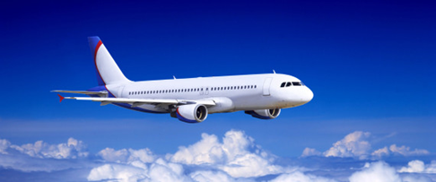
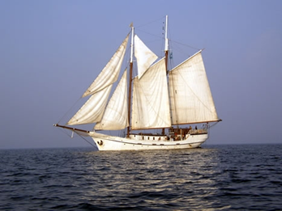
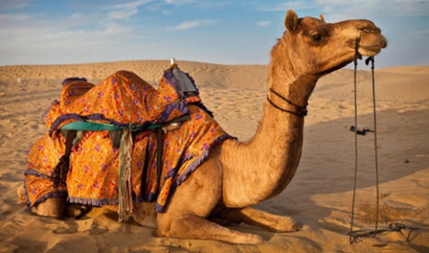
Apolodor is a penguin that was born at the South Pole. It was taken to the circus, in Bucharest, capital of Romania. Here is a singer and a dancer. Meanwhile, I`d miss family. It was encouraged by friends to return home. It must travel by vehicles because it`s a bird that can not fly.
Travelled continents: America, Australia, Africa, South America, the South Pole.

Slide 8
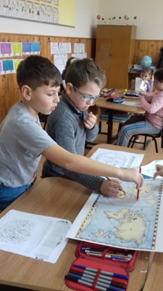
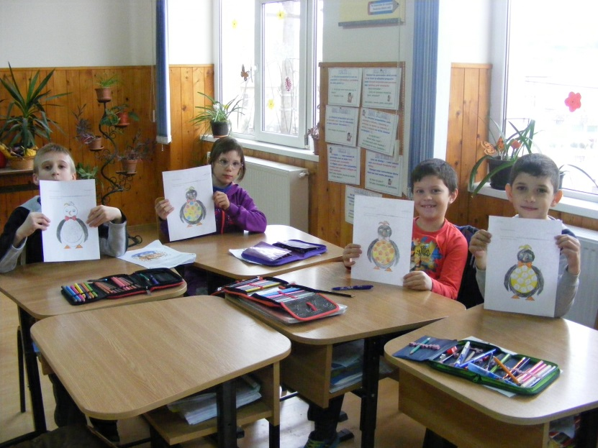
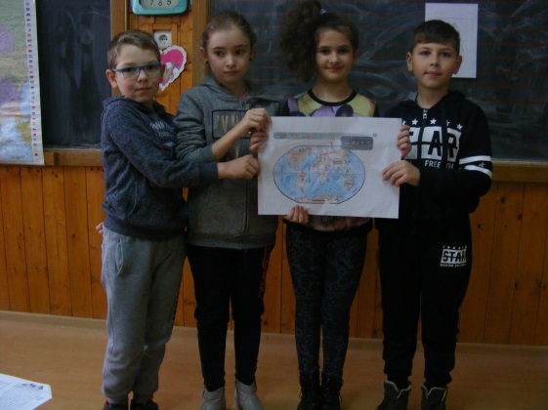
Pupil find continents on the map
Pupil did some exercises with Apolodor

Slide 9
Once reviewed its family, I`d miss friends.
The conection between literature and real life:
Anyone feels the longing for the country where it was born or the longing for the family and his friends if it leaving home for long time.
EMIGRANT

Slide 10
Who is an emigrant?
Pupils from many classes talked about people who have gone to other countries.
There are:
- parents who have left to work abroad;
- relatives who went to study;
knowledge, they left the cultural desire.
Preferred: Germany, Spain, Italy, France, England, Canada

Slide 11
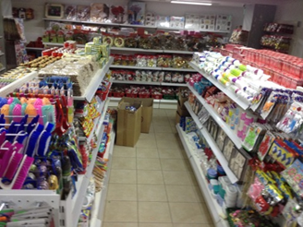
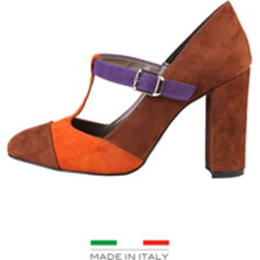
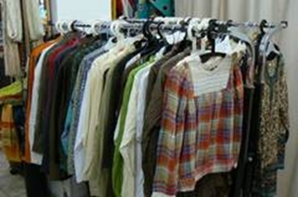
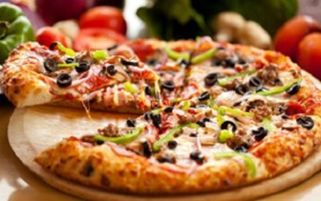
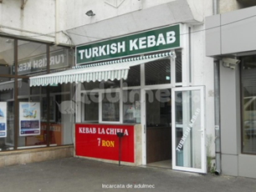
Who is an immigrant?
Questions about strangers from Romania.
Chinese-Chinese shop Italian - shoes, clothes, pizza
Turkish - Fast Food

Slide 12
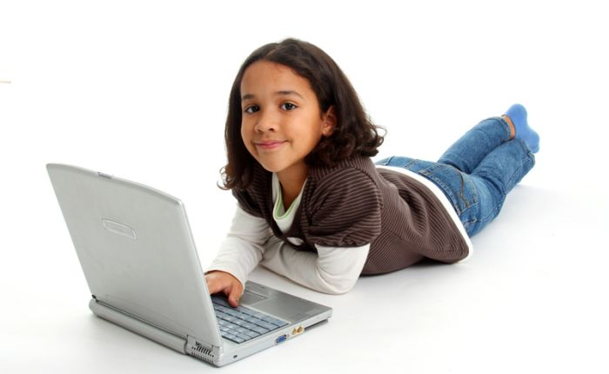
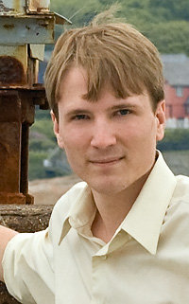
Perssons who are studing in Romania: Highschool, Faculty.
Moldavans, Syrians, Lebanese, Israelis, Chinese

Slide 13
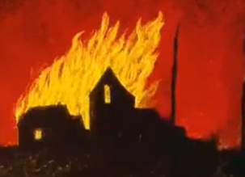
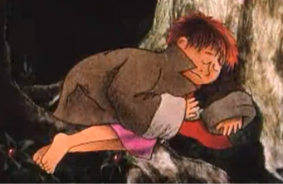
What is an refugee?
For understand what is an refugee, pupils from class III B watched:
The story of a child who was burned house and had to flee, to seek shelter, food aid

Slide 14
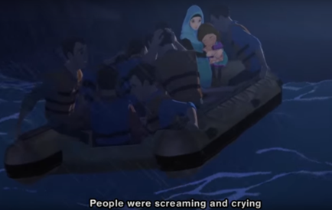
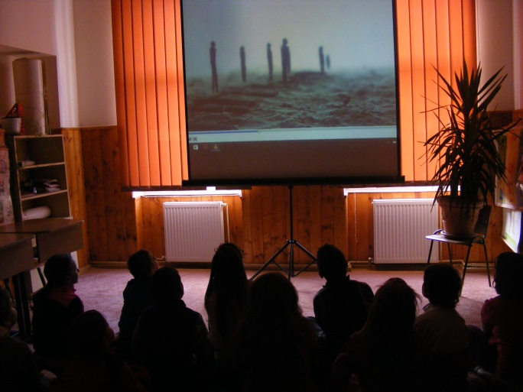
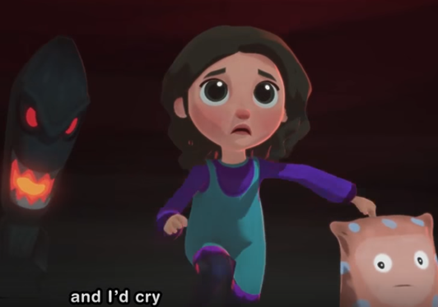
The story of a girl who lived with her mother and had to run away in the night because it was war;
A story about why people flee their native country: war, death threats, persecution

Slide 15
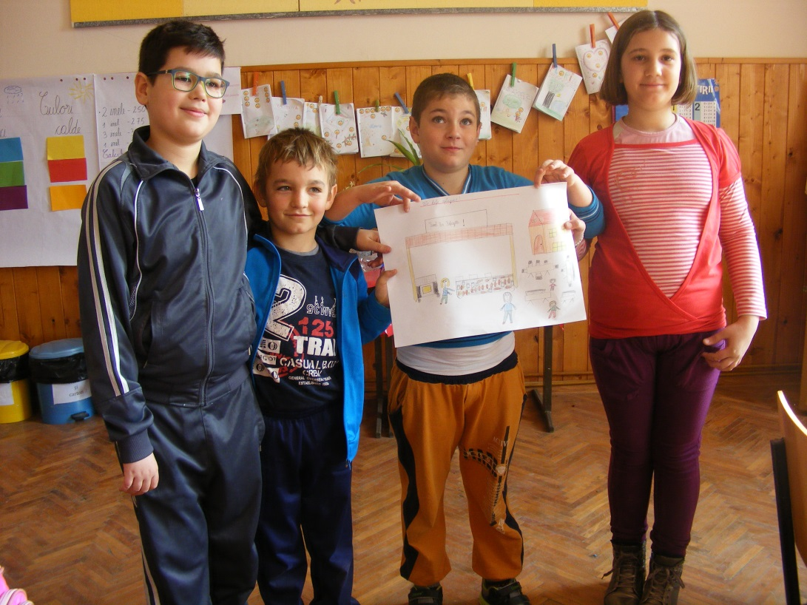

Slide 16
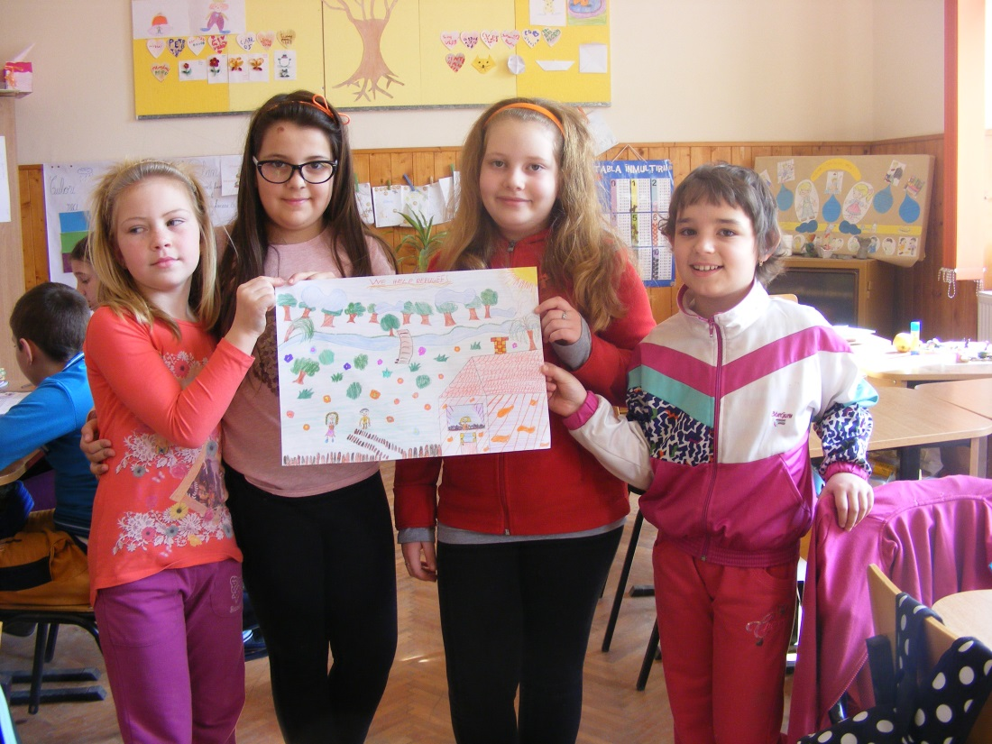

Slide 17
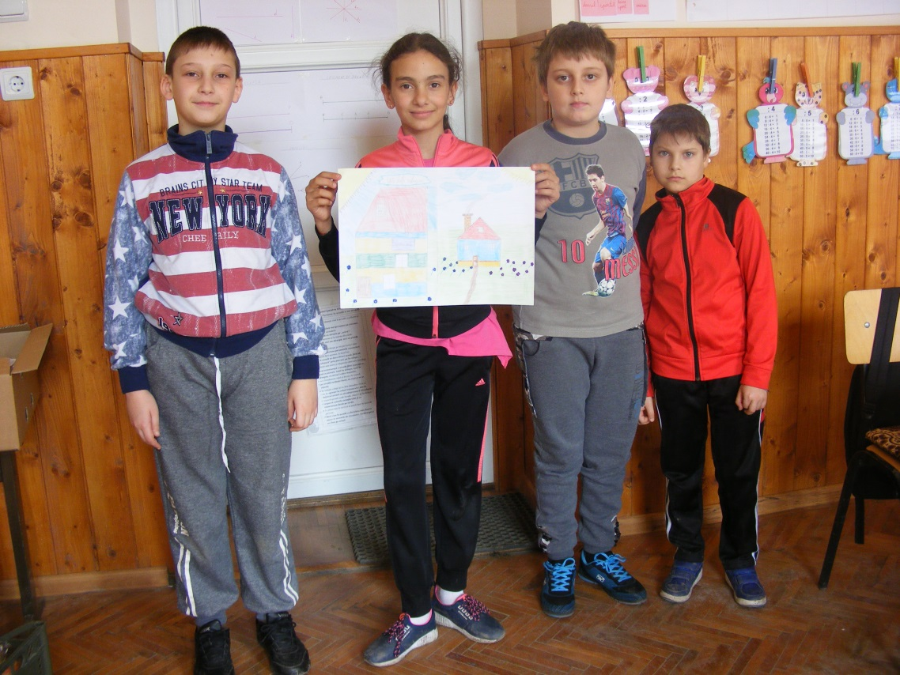
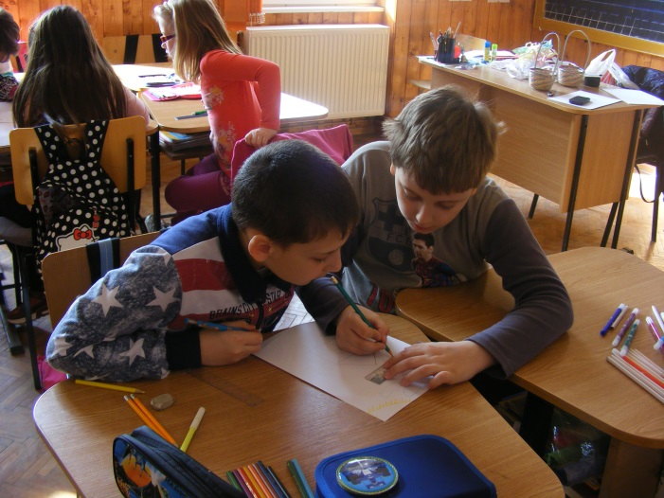

Slide 18
Statistics: emigrants-immigrants-refugees
Pupils from class IV B

Slide 19
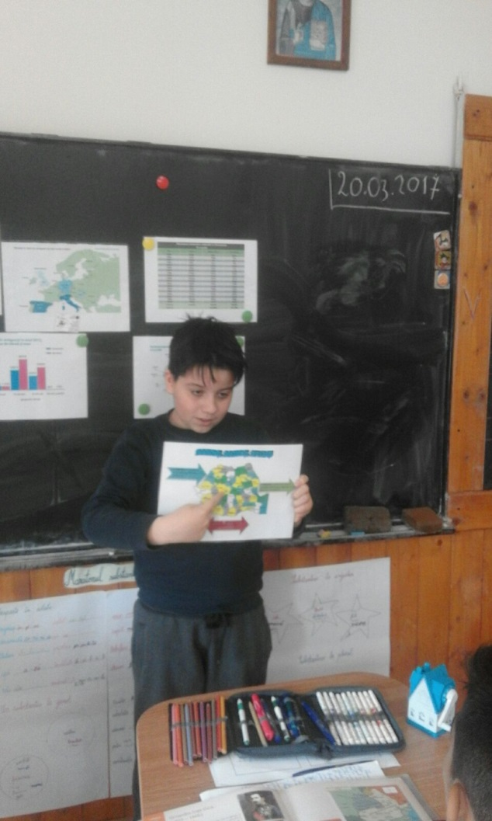

Slide 20
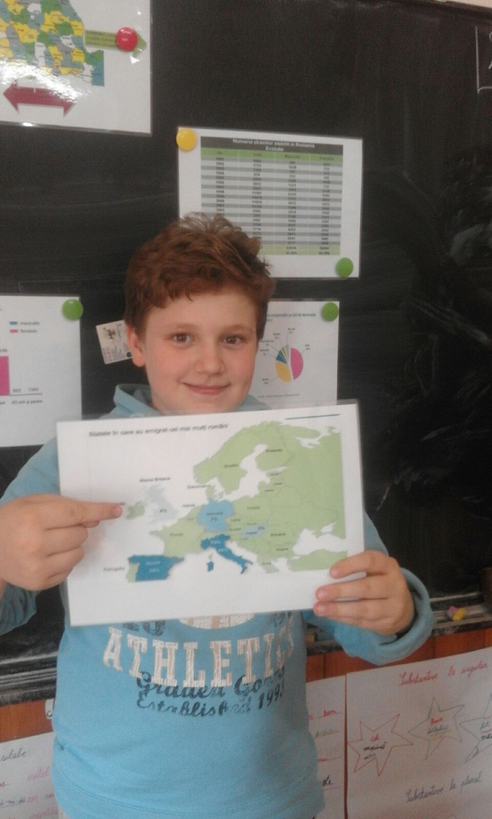

Slide 22
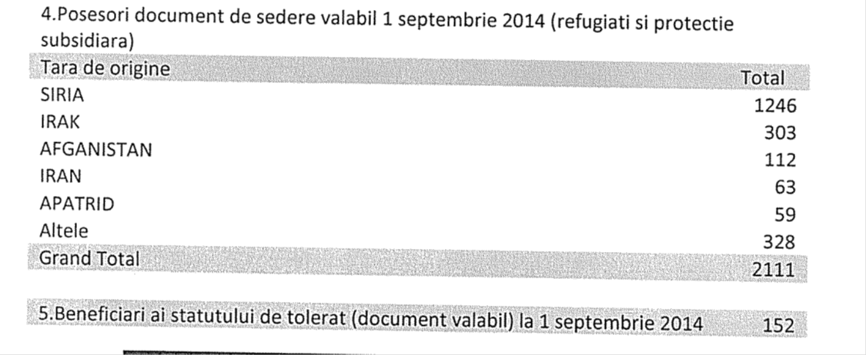
Class iiib
Statistics immigrants – in Romania
Statistics refugees – in Romania

Slide 23
Every man who I meet is superior in my way through something. I try to learn something from everybody.
Sigmund Freud

Slide 24
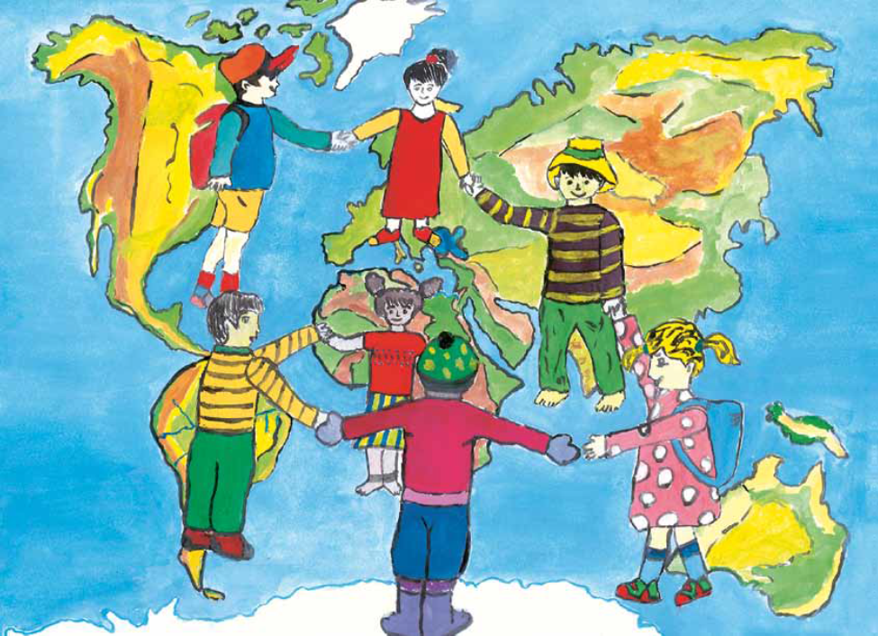
THANK YOU!

Slide 25
BIBLIOGRAPHY
www.aidrom.ro
www. arca.org.ro
http://jrsromania.org/
http://www.asociatiaconect.ro/migratie
http://www.unhcrcentraleurope.org/ro/despre-noi/unhcr-in-romania.html
https://www.youtube.com/results?search_query=what+is+a+refugee
http://cuvintecelebre.ro/

