Slide 1
Immigrants, emigrants and refugees
3rd primary school of Karpenissi Greece
4th grade
School year 2016-2017

Slide 2
This project was carried out by the students of the 4th Grade of our school and presents :
Data about immigration from and to Greece and the definitions of the terms ‘immigrant,’ ‘emigrant’ and ‘refugee’.
The students’ thoughts, feelings and suggestions about the refugee issue.
The worksheets they worked on.

Slide 3
IMMIGRANTS - EMIGRANTS
Immigrant definition
This term refers to the person who comes to another country to live there, usually for economic, political or academic reasons. In other words, people who leave their country to settle in a foreign one, want to get a better job, to escape the persecution in their homeland or to study in a school or university of prestige.
Emigrant definition
An emigrant is a person who leaves his country with the purpose of establishing himself in another. An individual becomes an emigrant for a basic reason, because the economic, political and social situation of his country of origin is not adapted to his needs. Emigrants have existed in all known cultures. Social conflicts such as wars, economic crises or diseases are the main reasons why a person makes this hard decision.

Slide 4
Now each team will have to write their own definition of both concepts. For this, the cooperative structure "1, 2 and 3" will be used.
Worksheet 1
IMMIGRANT
1 A person who leaves his/her country because he/she wants to work abroad.
2 A person who leaves his/her country because he/she wants to find a better job or study abroad.
3 A person who leaves his/her country because he/she wants to work abroad or because of political reasons.

Slide 5
EMIGRANT
1 A person who is not satisfied with the economical or political situation in his/her country and decides to live abroad permanently.
2 A person who wants to change his/her life by living in a foreign country. He/she hopes to find a better job there or better living conditions.
3 A person who decides to reside in a foreign country, hoping for better education and working conditions or for a better political regime.

Slide 6
The following graph shows immigration in Greece in 2015 and 2016.
Worksheet 2
Let's analyze the graph.
If we compare the data for 2015 and 2016, has immigration increased or decreased in the last year?
- Immigration has decreased in the last year, especially after March 2016.

Slide 7
Refugees coming to Greece- Origin

Slide 8
Worksheet 3
Indicate the two countries from which Greece receives more immigrants.
Greece receives more immigrants from Syria, 56%, and Afghanistan, 25%.
In groups you have to think of the reasons why these people leave their country.
1. People from Syria leave their country because there is a war there and they are afraid of their lives and the lives of their families. They try to find a safe place in Europe and Greece is the gate to other European countries where they have relatives.
2. People from Afghanistan leave their country because there is a civil war there and their is no safety for them. Also, they want to find a job in Greece or in another European country.

Slide 9
The following graph shows the migration of Greeks during the economical crisis.

Slide 10
Worksheet 4
Indicate the two countries chosen by Greeks to emigrate.
Greeks emigrate mainly to Germany and the United Kingdom.
In groups you have to think of the reasons why Greeks leave their country.
1. Greeks leave their country because of the unemployment in Greece. They want to find a job abroad. Some of them have jobs in Greece but are not well paid, so they want to find a better job abroad to support their families.
2. Young Greeks emigrate because they want to study abroad and stay there if they manage to find a job.

Slide 11
The reason for emigration to Germany and the United Kingdom will be explained below.
GERMANY: The need for manpower and the aging of population explain why Germany is the first destination of Greeks. Germany has launched various programs to attract qualified immigration. The most sought after specialists are engineers, industrial technicians, computer scientists, doctors and nurses. There are also opportunities to work in the care of the elderly or in the construction. Additionally, a lot of Greeks have relatives who have been living in Germany for decades and help the newcomers to find a job and host them until they do.
UNITED KINGDOM: The profile of the emigrant is of young professionals, usually doctors, who cannot find a well paid job in Greece. Also young people who want to study in English universities.

Slide 12
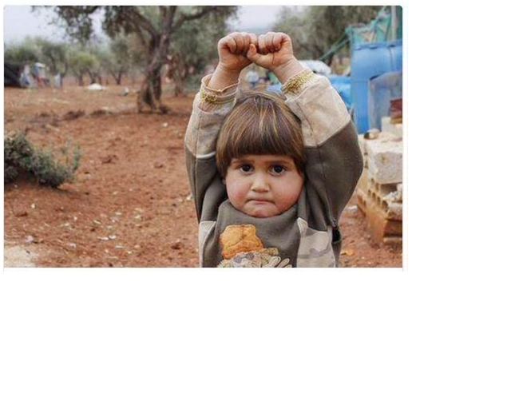
Refugees
Worksheet 5
In groups you will have to think and give a single opinion on this image.
This child is in a country at war. He/she is sad and ready to cry. He/she is afraid and lonely. He/she is raising his/her hands as a protest: “No more war”.

Slide 13
WHAT IS BEING A REFUGEE?
Now each team will have to write its own definition. For this, the cooperative structure "1, 2 and 3" will be used.
1 Refugees are people who leave their countries because of war, looking for a safe place for their families.
2 Regugees are people who leave their countries because of war, famine or natural disasters.
3 Refugees are people who leave their countries because of war, civil war or famine.
GROUP-CLASS DEFINITION
A refugee is someone who has to leave his/her country, because of war, natural disasters or famine.

Slide 14
Worksheet 6
The vast majority of refugees arriving in Greece come from Syria. Surely you have heard of this subject on some occasion.
Why do you think they come to Greece?
Greece is close to Syria and refugees think that it will be easy for them to enter Europe by passing through our country.
Do you think the European Union helps refugees to go where they intent to or Greece to overcome the refugee crisis?
Some European countries help refugees but some others are hostile towards them. Our neighboring countries keep their borders closed for refugees while countries like Germany, Italy or France keep their borders open for them.

Slide 15
Now read carefully the following piece of news which shows the testimony of Laila, a refugee Syria.
When we got here we had money to buy some food. Now it's over. We queue for hours for a sandwich. My husband recently told a journalist that "people are tired. Maybe tomorrow they will knock down the door and flood the border." The journalist said, "How many guns do you have?" If we knew how to carry weapons or if we wanted to carry weapons, we would not have fled Syria. We want peace. We are tired of death.
We fled a war, and now the European Union is at war against us, a psychological war. When we hear rumors that we will be allowed in Europe, we celebrate it. These leaders give us new hope, then extinguish it. Why is the door open to refugees? Why do you welcome people? If they had stopped before, we would not have arrived. We would not have put our lives at risk, my children, me, and thousands of others, to cross.
I am 39 years old and I am Kurdish from the city of Hasakah. I knew from the news that Hasakah was threatened by Daesh. Every day last spring, the government bombed the outskirts of the city. Sometimes a stray bomb landed near us.
One day, at five in the morning, we heard the bombing and we knew Daesh had arrived. I took my kids and two backpacks, and I fled. In those days, everyone had two backpacks ready at all times: one with important documents and another with garments and other necessities. We ran through the channel of a dry river. It was still muddy and our ankles drooped.
Even before Daesh arrived, life under the Kurdish forces was very hard. There was no wood for bonfires. I once asked my husband, "If we use one of the ceiling beams to put on the stove, do you think the roof would fall?" Serious. "Yes," he said. "I would fall, and above all we would be living in the street."
If you have a son in Hasakah, you have to go to war today. It does not matter if he is an only child or if he is a student. If there is not a child, a girl has to go. Someone from every home has to fight if they want to stay in the area. Kurdish forces tried to recruit my daughter. He had to take her to Turkey.

Slide 16
Most of my family is in Germany, so we decided to go there. We spent two months in a border area before fleeing to Turkey where my husband was working. We found a trafficker through Facebook - a relative by marriage - and flew to Izmir. Two days later, we were in the dark with another 35 people somewhere on the Turkish coast.
We were the last on the beach, my daughter, her husband, her baby and me. My daughter was crying. She said that she did not want to go and that if she died, it was me. Not know what to do. Then, as if it were a dream, a young man came and lifted her, her and the baby, to bring them into the ship. She was alone on the shore. I waded the boat. The traffickers took me from below, and my nephew got me up.
On the day we arrived in Idomeni there were people who were still crossing the border into Macedonia. We thought we had arrived. We thought the hardest part had been the sea.
I have three sisters and three brothers in Germany. The European Union wants to keep us divided between countries. If we sign the relocation program and the European Union assigns us a European country and we get citizenship, would we be able to go to be with our family in Germany? I'm afraid the laws will change and we can not go.
In our country we refuse to part. Are we going to agree here? Everyone in Idomeni just wants to go with their families, otherwise they would not have made this dangerous trip to be with them. In the next tent there are two women who have not seen their husbands in two years. The men are in Germany and can not take their wives and children with them.
I want all European leaders to listen to me: if any of them agree to be separated from their child, I agree to do the same. Or your brother or sister, or your cousin.
If you want to do this to us, give us back what we have lost to get here, and send us back to Syria. If he had wanted to live among strangers, he would have tried to go to Canada. If you are sick, who will help you? You need your brother, your sister, your mother, your father.

Slide 17
After reading, has your opinion changed?
Our opinion has not changed. On the contrary, what Laila says support our original opinion. Moreover, Laila’ s testimony shows how desperate and exhausted refugees are.

Slide 18
Proposals
In a group you will have to think about action proposals to alleviate the refugee crisis.
All European countries must open their borders for refugees.
The European Union must help refugees be reunited with their relatives around Europe.
The E. U. must open a way by land for refugees so that they are not in danger trying to reach Europe by sea.
The E. U. must take action to end war in Syria.

Slide 19
Worksheet 7
Each group will have to analyze the meaning of each vignette and write a sentence in which you synthesize the message or write your opinion about it.

Slide 20
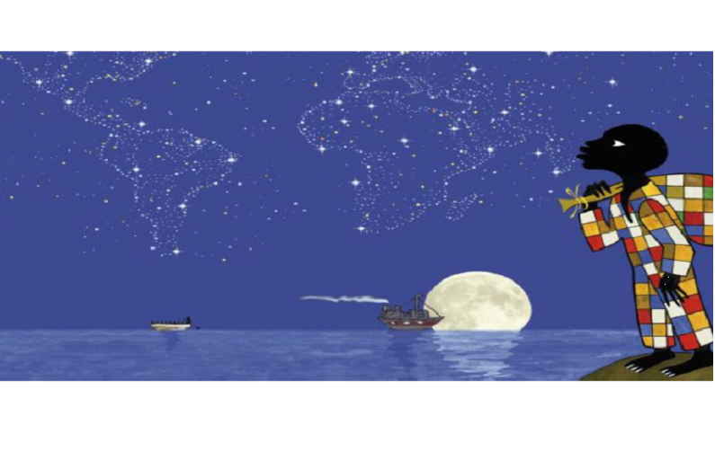
The poor and homeless refugee has reached the sea and is now wondering which way to go or how to get to the country of his dreams. He will be exploited by traffickers who will promise him a safe passage to Europe. “Is the refugee going to make it to Europe and safety?”

Slide 21
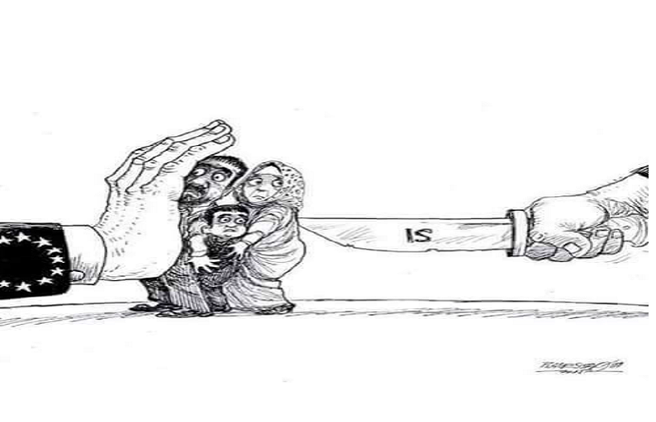
Refugees are caught in the middle. Behind them there is ISIS killing or threatening them. In front of them there is the European Union blocking the entrance to Europe. “Who can help them?”

Slide 22
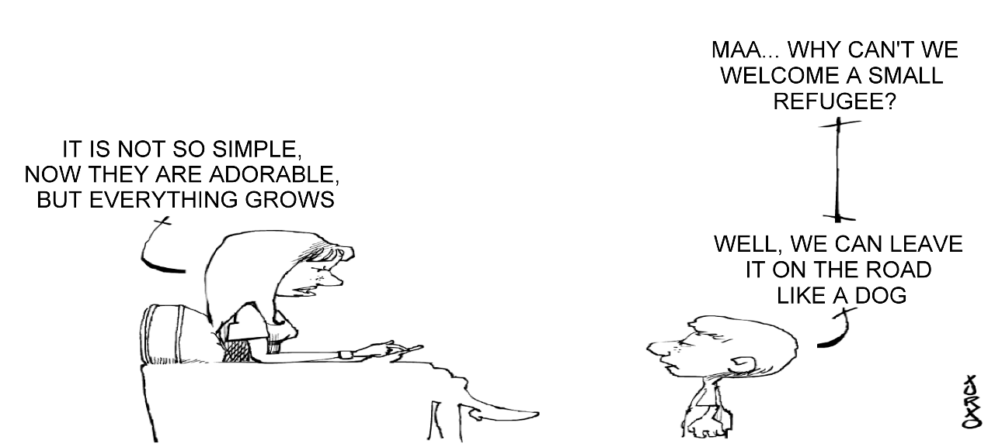
Some people in Greece and Europe treat refugees as if they where inferior to them or not even humans. They feel absolutely superior to them. These people never think that someday they may become refugees themselves. “What if you where in a refugee’s place?”

Slide 23
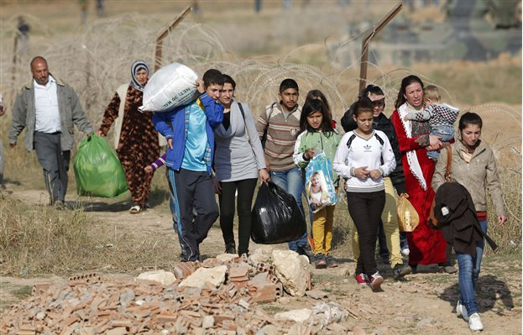
Refugees have to leave home on foot, so they can carry only what is absolutely necessary. Most of the times they don’ t know where they are going. They are just trying to escape death and horror. “Where to?”

Slide 24
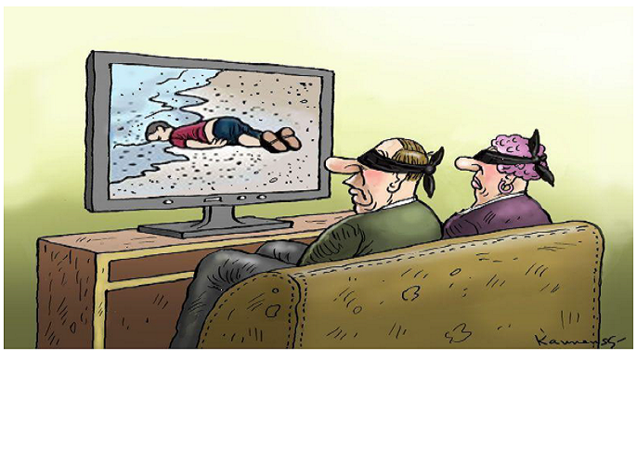
These people refuse to see what is going on in their own country. Refugees are dying in Greek seas and their bodies are washed ashore, even children’ s bodies. They are indifferent to other people’ s pain. “When will you open your eyes?”

Slide 25
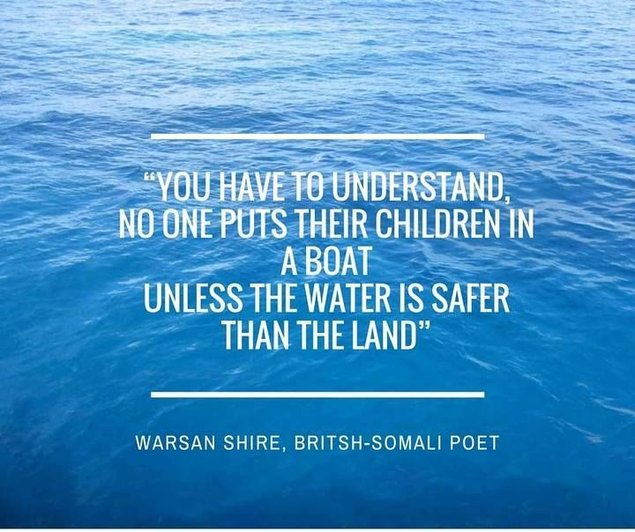
Thank you!!!
Special thanks to our Spanish partners for sharing their work and for their valuable help.

