Slide 1
WASTE SEGREGATION IN POLAND AND KROTOSZYN AREA
by Ola Król,
Gabi Grzempowska
and Klaudia Horak

Slide 2
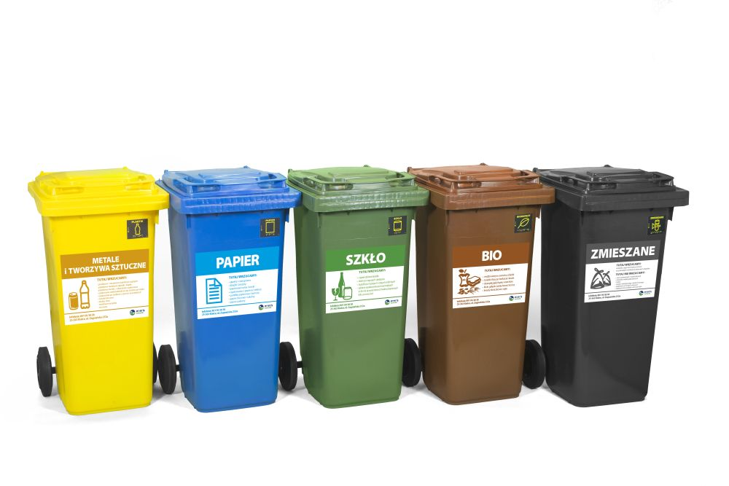
Waste is one of the most important environmental problems in Poland and in the world. In Poland, 135 million tonnes of waste are produced annually.
In schools, in our homes and in other public places we throw out the rubbish to suitable colored containers.

Slide 3
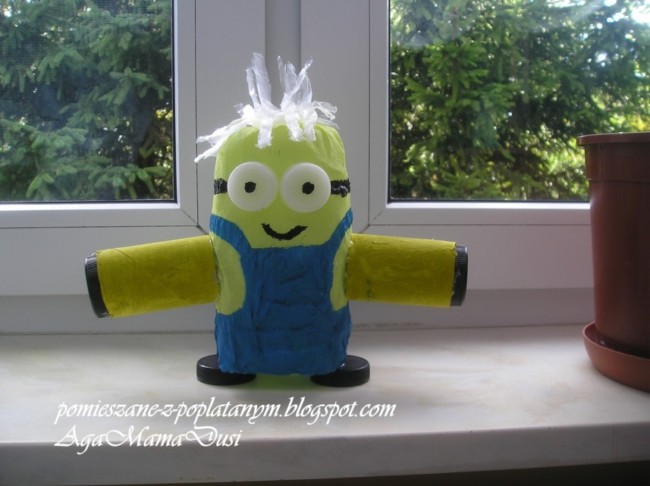
HOW DOES IT WORK?
In our area waste collection is organised by Eko7 – it is an official administrative body that decides which company will collect waste from households and institutions.
At the moment it is collected by EKO – a municipal waste collection department
from Kalisz, a city 50 km
east from Krotoszyn.
They all definitely
like ecological names!

Slide 4
In Krotoszyn area waste is collected e v e r y t w o w e e k s.

Slide 5
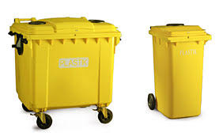
YELLOW (PLASTIC AND METALS)
WHAT DO WE THROW IN?
uncorked and flattened bottles, bottle caps, plastic food packaging, drink cartons, cosmetics packaging and cleaning agents plastic bags,aluminum cans, aluminum foil, colored metals
WHAT DO WE NOT THROW IN?
Syringes,used batteries and
accumulators, medical articles

Slide 6
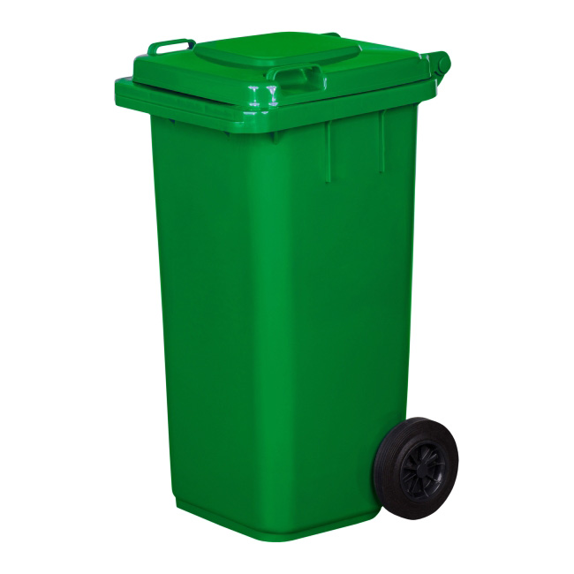
GREEN (GLASS)
WHAT DO WE THROW IN?
bottles
glass jars for drinks and food
cosmetics glass containers
WHAT DO WE NOT THROW IN?
Mirrors
Plant pots
Light bulbs
Glass thermometers

Slide 7
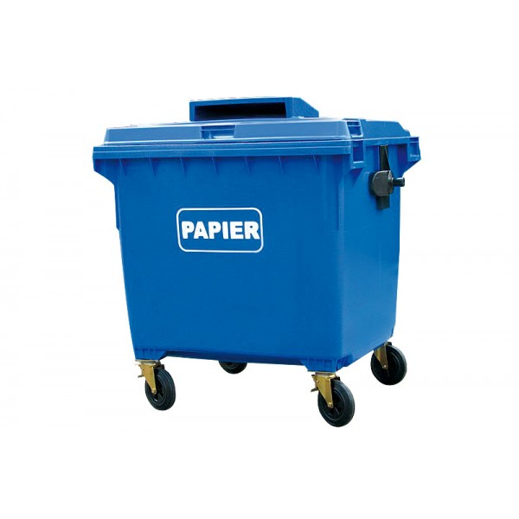
BLUE (PAPER)
WHAT WE THROW?
packaging made of paper, cardboard, catalogs, leaflets, newspapers, magazines,office paper, notebooks, books, wrapping paper, paper bags
WHAT WE NOT THROW IN?
Milk cartons, diapers, wallpaper

Slide 8
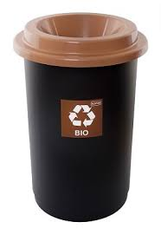
BROWN (BIO)
WHAT DO WE THROW?
branches of trees and shrubs, grass, leaves, flowers, sawdust, tree bark, fruit and vegetable waste and peeling
WHAT WE NOT THROW IN?
bones of animals, meat and carcass
medicines
animal droppings

Slide 9
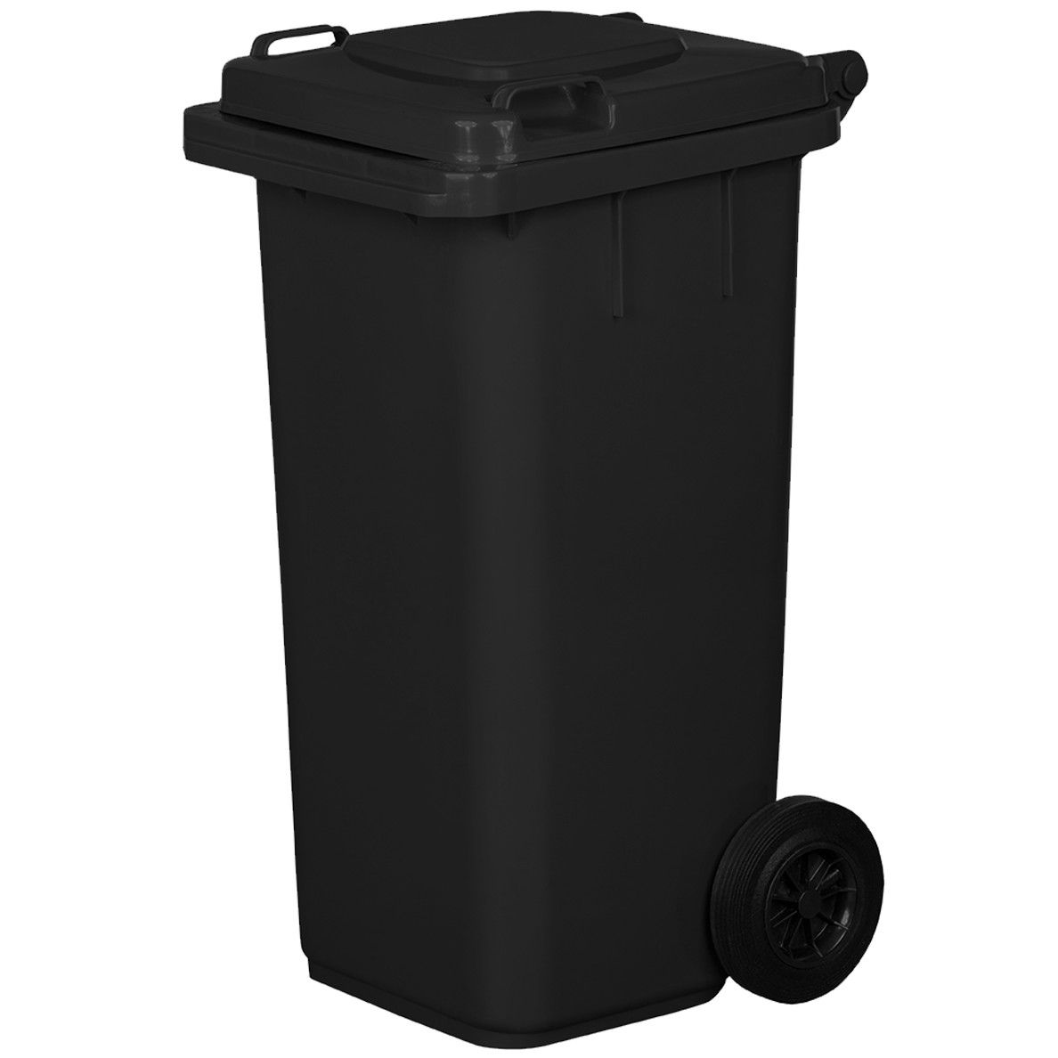
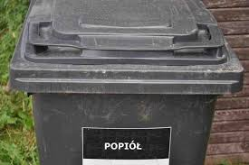
BLACK AND BLACK: mixed waste and ash/cinders
Everything that cannot be segregated goes into a black bin for mixed waste.
Households that produce ash and cinders from coal furnace have an „ASH” bin which is usually black, too.

Slide 10
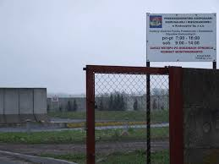
WASTE COLLECTION SITE (PSZOK)
PSZOK is simply a collection site for sorted waste.
Here everyone can bring and leave free of charge their waste sorted by type.
They also accept :
bulk items like furniture, household appliances
dangerous waste like electronic waste, chemicals, medicines or batteries
tyres and construction waste in limited amounts.
Sadly, it suffered from a major fire last year.
In reality it is a very basic facility at the moment - it is located on the former rubbish dump.

Slide 11
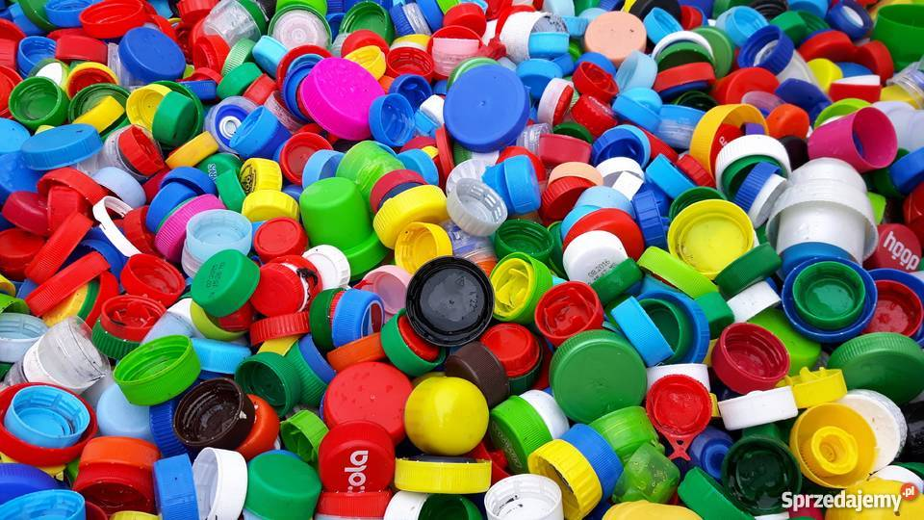
WE ARE WORKING AT KOŁŁĄTAJ !
IN OUR SCHOOLS WE COLLECT BOTTLE CAPS.
On their quantity depends how many new wheelchairs will
be donated to the disabled.
It connects ecology with helping sick people.

Slide 12
THANK YOU FOR YOUR ATTENTION

