Slide 1
VIDEOCONFERENCE – democracy at our schools, evaluation of simulated elections, evaluation of the proejct
@mb@ss@dors of Europe@n Democr@tic Culture
4 June 2019

Slide 2
Videoconference
PROGRAMME:
Introduction
Democracy at our schools – each school presents
Results of simulated elections – Zuzana
Evaluation of the project (each school will evaluate the project)
Conclusion

Slide 3
Results of simulated students´ elections to the european parliament

Slide 4
Results of simulated students´ elections to the european parliament
Date of the Mock electons | 1273
Number of all students | 470
Number of students who took part in elections to the EP
% participation in elections | 36.92 %

Slide 5
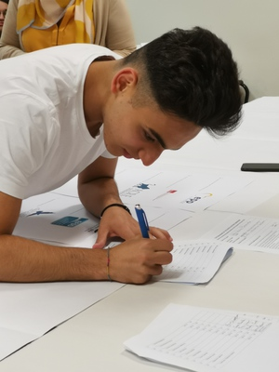
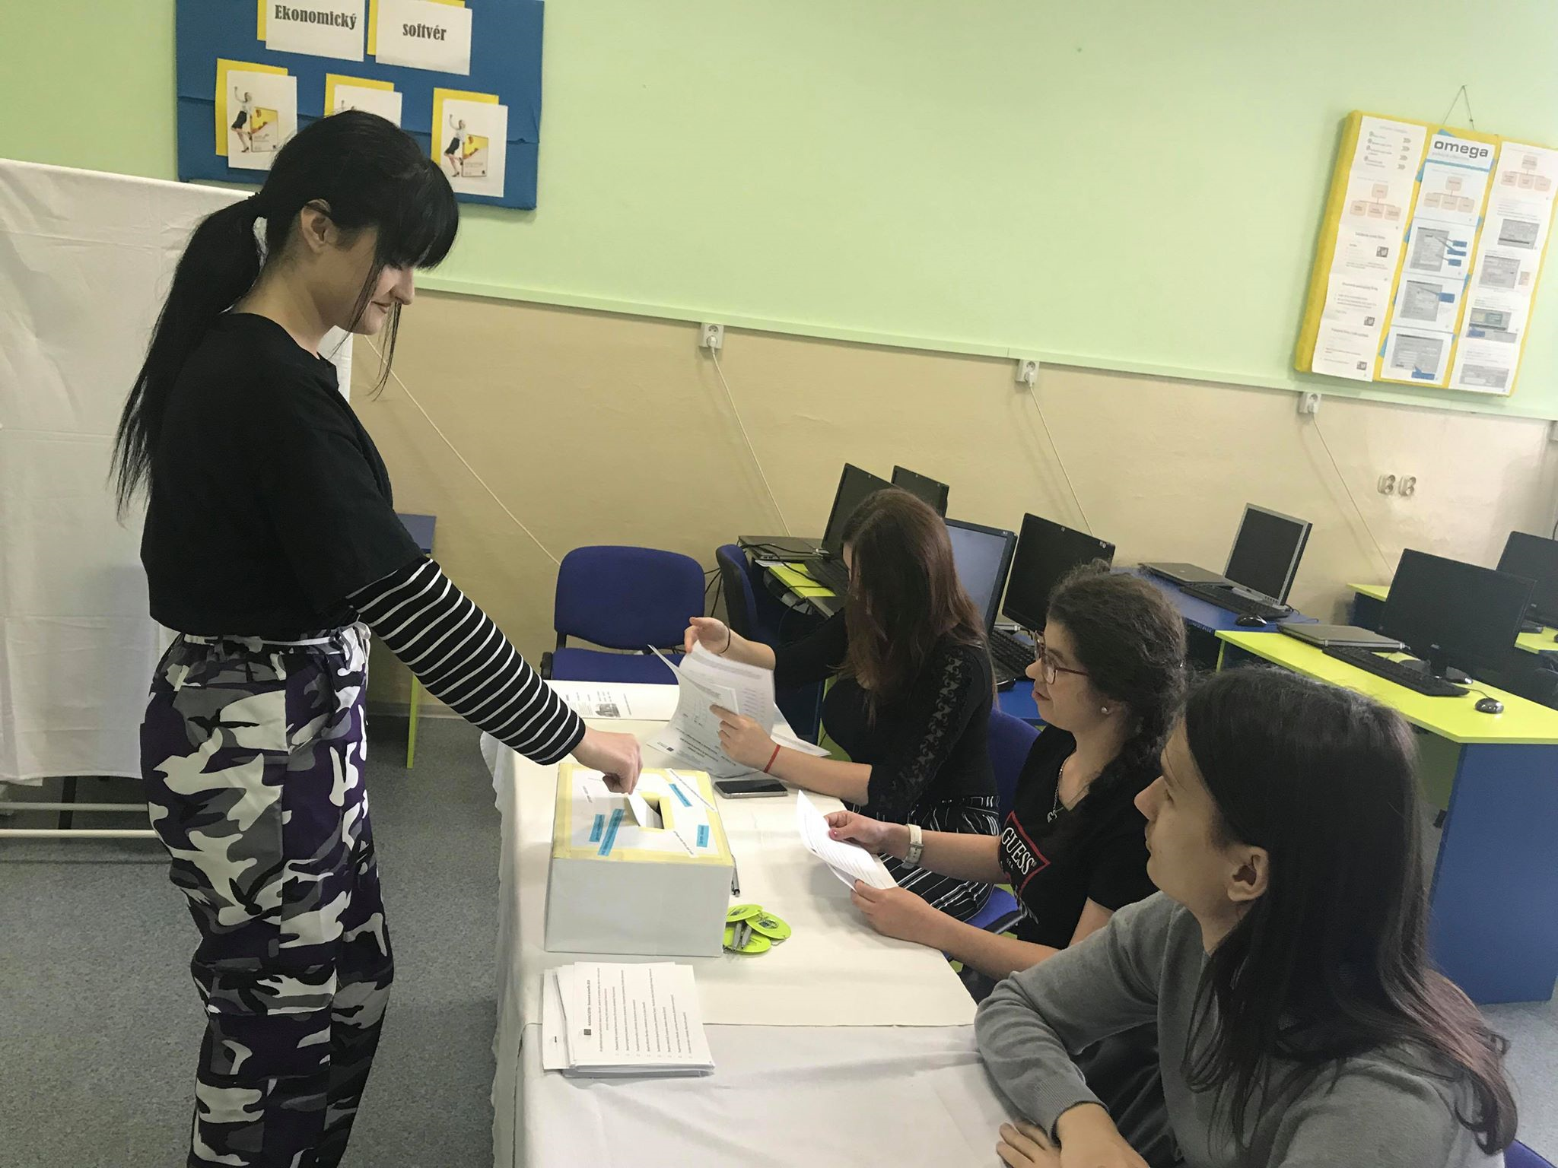
Conclusions of Simulated students´ elections to the European Parliament
students have chosen proEuropean and democratic political parties.
If young people receive sufficient civil, human rights and European education in the open democratic spirit, if they understand the importance of civic activism and if they get a meaningful choice and a clear political offer, so they can choose rationally and deliberately from this offer.
Results of these elections also shows that work on the project „@mb@ss@dors of Europe@n Democr@tic Culture“ was worth it.

Slide 6
Evaluation of the project
Hard work
Discussions about topics connected with democracy, democratic school,
Collaborative work with support of collaborative tools of web 2.0 (padlet, answergarden, tricider, storybird, ...
Learnt a lot about democracy
Found new friends in slovakia, romania, italy
Improved english, ict skills, team leading and working skills
Involved not only project students but also all schools in simulated elections = added value of this project
becaME PART OF Active participation in thE LIFE OF OUR SOCIETY , THE eu AND MUCH MORE

Slide 7
EVALUATION
We were evaluating our project during working on it and at the end of the project. Our students filled in the questionnaire to evaluate the project.
Here it is and the results of the evaluation made by students and teachers are here too. Students also expressed their reflections about the project it the Answer Garden and Genial.ly tool Web 2.0.

Slide 8
Evaluation of the project

Slide 9
Evaluation of the project

Slide 10
Evaluation of the project

Slide 11
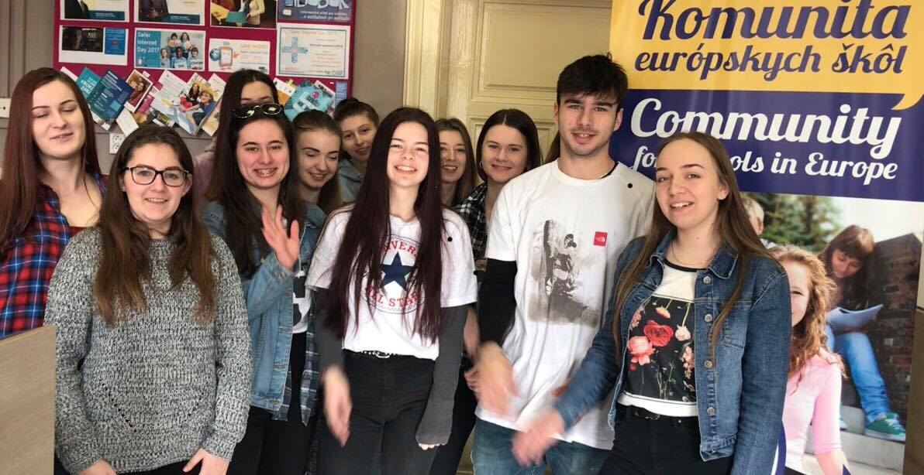
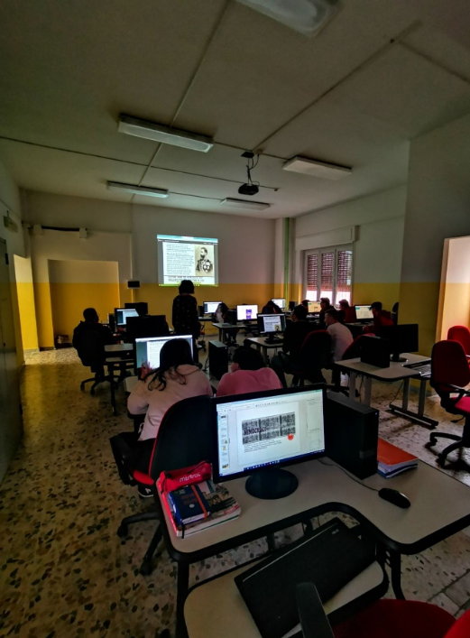
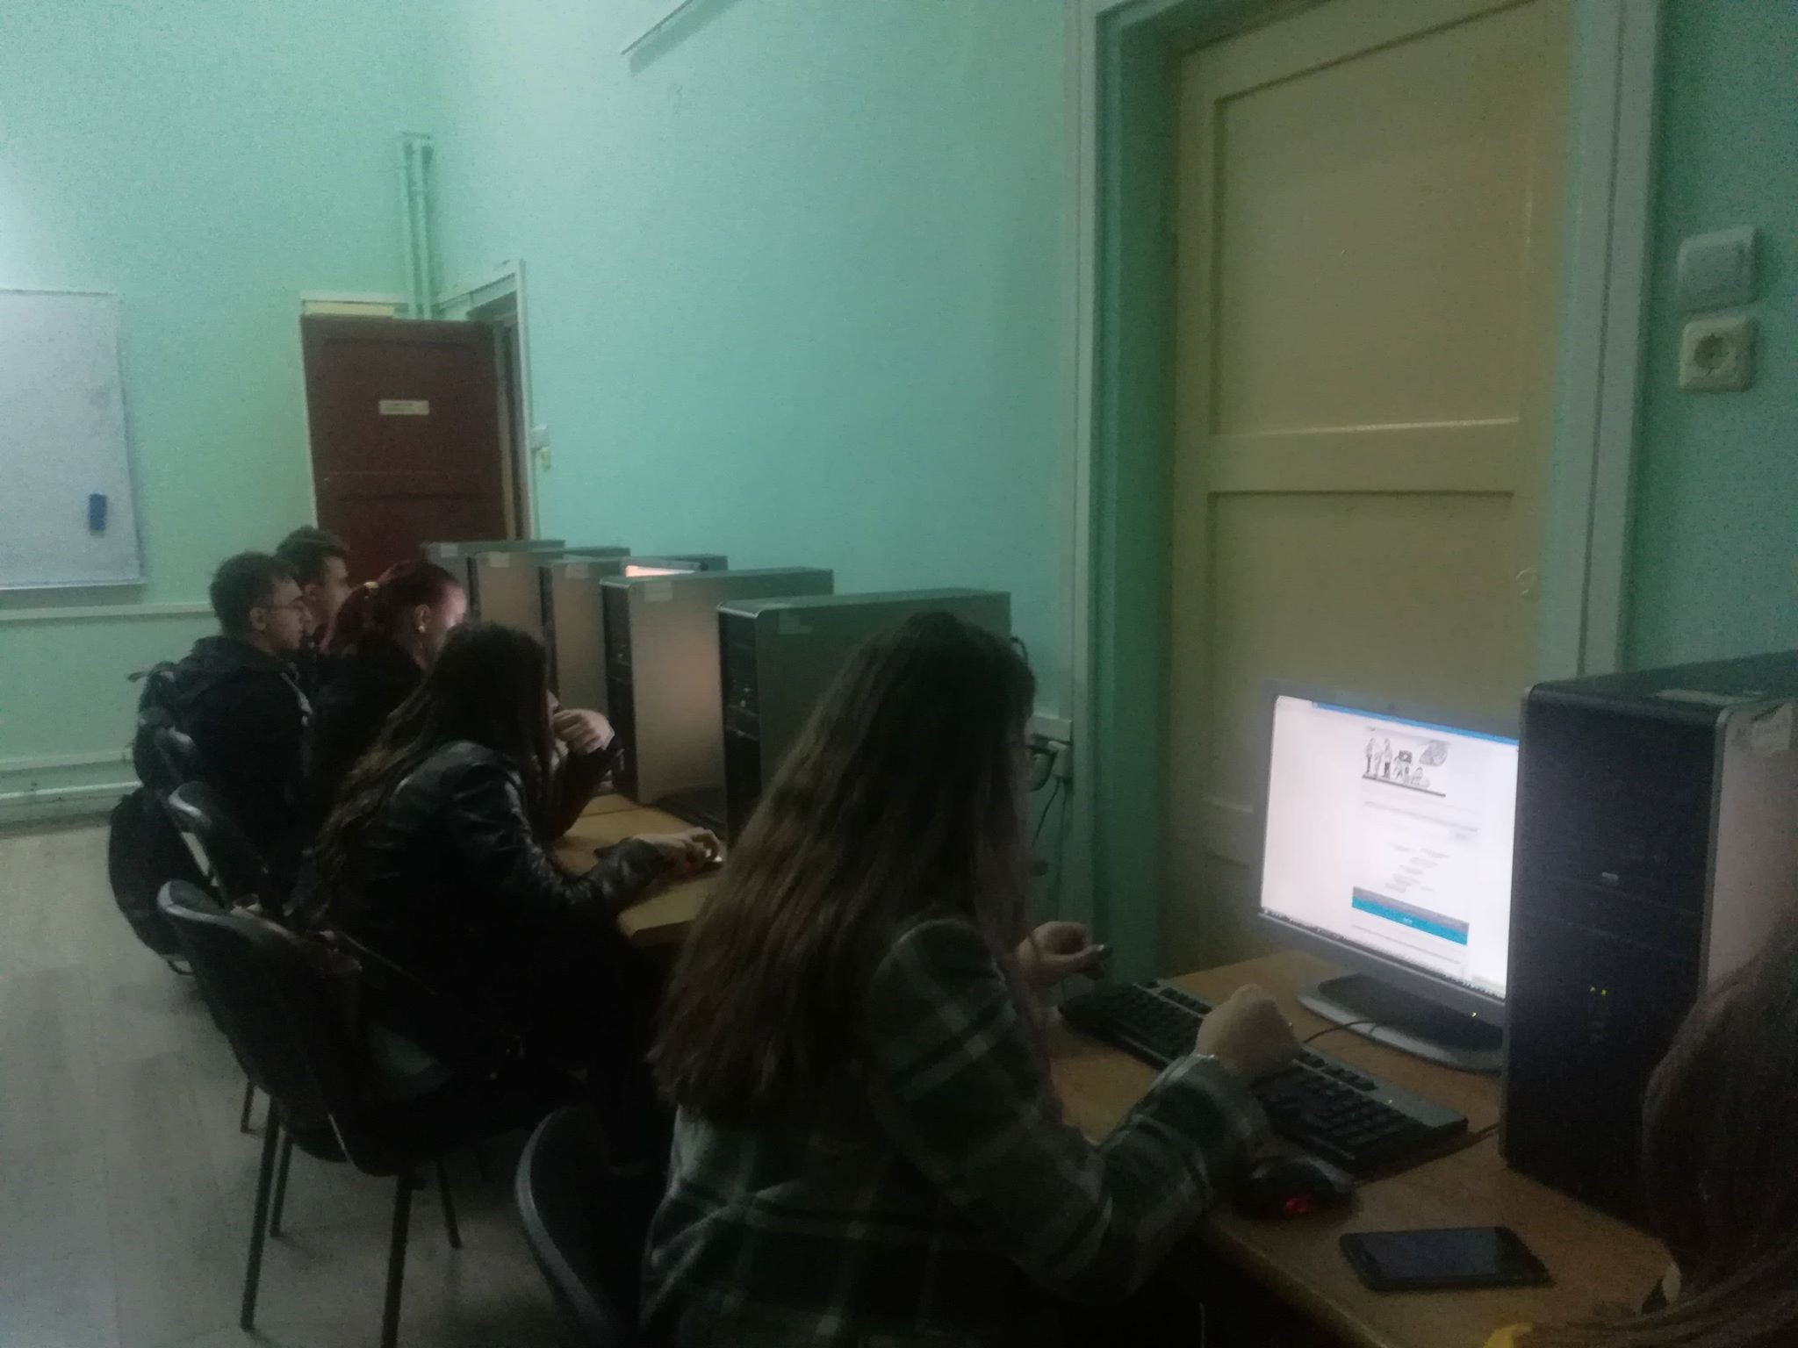
THANK YOU FOR ONE YEAR OF A GREAT COOPERATION ON OUR PROJECT ☺

