Slide 1
Democracy in romania
By Andreea Mariut, Delia Chirilescu, Ema Popescu ,Alexandra Teodorescu, Alexandra Marcu, Alexia Iosif, Cristiana Tudor,Laurentiu Loghin,Traian Dumitrascu,Tudor Cerbanescu

Slide 2
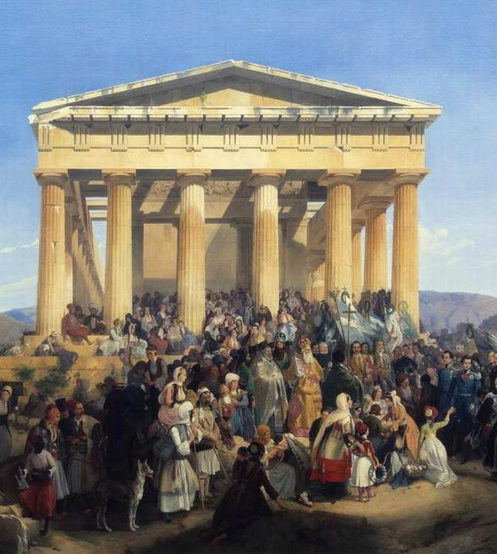
Democracy
"Of the people, by the people, for the people" -Abraham Lincoln
The word democracy comes from the Greek words "demos", meaning people, and "kratos" meaning power; so democracy can be thought of as "power of the people": a way of governing which depends on the will of the people.
This Photo by Unknown author is licensed under CC BY-SA.

Slide 3
Origin of democracy
Anthropologists have identified forms of proto-democracy that date back to small bands of hunter-gatherers that predate the establishment of agrarian, sedentary societies and still exist virtually unchanged in isolated indigenous groups today. In these groups of generally 50-100 individuals, often tied closely by familial bonds, decisions are reached by consensus or majority and many times without the designation of any specific chief.[3] Given that these dynamics are still alive and well today, it is plausible to assume that democracy in one form or another arises naturally in any well-bonded group or tribe.
These types of democracy are commonly identified as tribalism, or primitive democracy. In this sense, a primitive democracy usually takes shape in small communities or villages when there are face-to-face discussions in a village council or with a leader who has the backing of village elders or other cooperative forms of government.[4] This becomes more complex on a larger scale, such as when the village and city are examined more broadly as political communities. All other forms of rule – including monarchy, tyranny, aristocracy, and oligarchy – have flourished in more urban centers, often those with concentrated populations.[5

Slide 4
History of democracy
A democracy is a political system, or a system of decision-making within an institution or organization or a country, in which all members have an equal share of power.[1] Modern democracies are characterized by two capabilities that differentiate them fundamentally from earlier forms of government: the capacity to intervene in their own societies and the recognition of their sovereignty by an international legalistic framework of similarly sovereign states. Democratic government is commonly juxtaposed with oligarchic and monarchic systems, which are ruled by a minority and a sole monarch respectively.
Democracy is generally associated with the efforts of the ancient Greeks and Romans, who were themselves considered the founders of Western civilization by the 18th century intellectuals who attempted to leverage these early democratic experiments into a new template for post-monarchical political organization.[2] The extent to which these 18th century democratic revivalists succeeded in turning the democratic ideals of the ancient Greeks and Romans into the dominant political institution of the next 300 years is hardly debatable, even if the moral justifications they often employed might be. Nevertheless, the critical historical juncture catalyzed by the resurrection of democratic ideals and institutions fundamentally transformed the ensuing centuries and has dominated the international landscape since the dismantling of the final vestige of empire following the end of the Second World War.

Slide 5
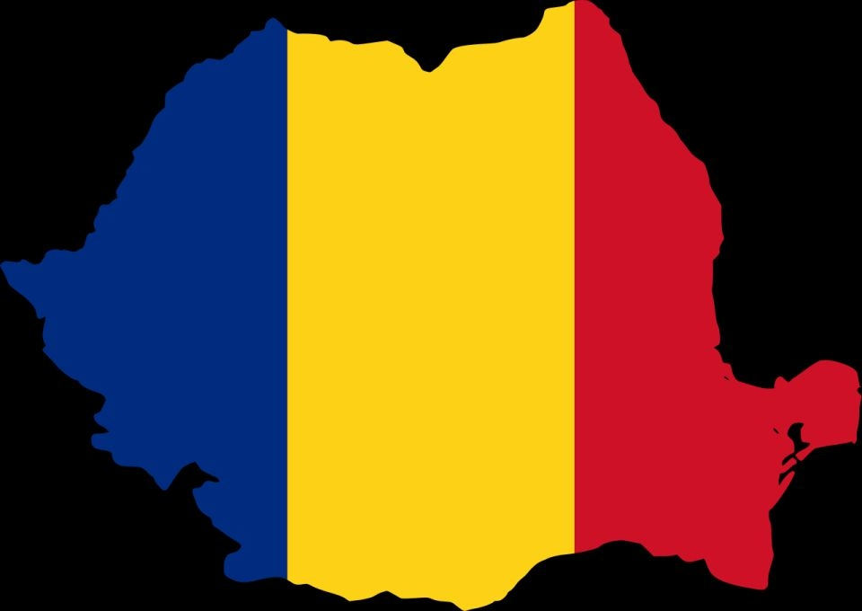
Democracy in romania
Democracy in Romania appared at the beginnig of the 20th century.
Constitution of Romania (also called the Constitution of Union), confirmed by King Ferdinand, was issued in order to adapt the Romanian State to the new realities after the Great Union of 1918, replacing the one in 1866. Among others, it guaranteed freedom of expression and gathering, of conscience and religion. Constitution of Romania (also called the Constitution of Union), confirmed by King Ferdinand, was issued in order to adapt the Romanian State to the new realities after the Great Union of 1918, replacing the one in 1866. Among others, it guaranteed freedom of expression and gathering, of conscience and religion..
This Photo by Unknown author is licensed under CC BY-SA.

Slide 6
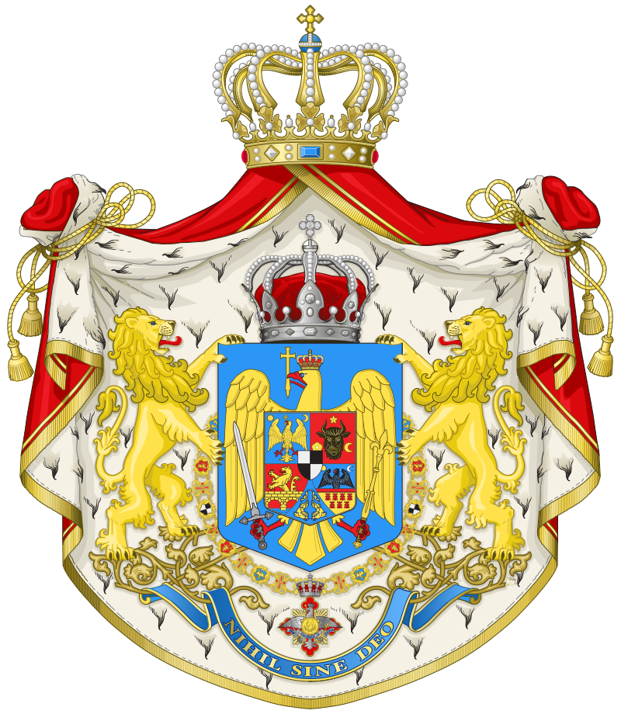
Constitution in 1923
Constitution of Romania (also called the Constitution of Union), confirmed by King Ferdinand, was issued in order to adapt the Romanian State to the new realities after the Great Union of 1918, replacing the one in 1866. Among others, it guaranteed freedom of expression and gathering, of conscience and religion. The right to vote was expanded beyond the 1866 census based regulations: it was universal for all males, equal, direct, compulsory and secret. Although the constitution had advanced and democratic features, its deficiencies often subvert democracy. For instance, the king appointed the president of the Council of Ministers, who then organised elections. The government was thus in a position to ensure that its party won a majority in the legislature.

Slide 7
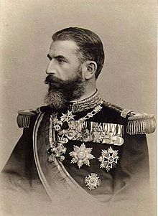
Democracy in Romania in the beginning of the xxth century
The rest of Ferdinand’s reign will be marked by the challenges brought by a greater state. The most important moment will be adopting a new Constitution, in 1923, that will offer a legislative framework appropriate for the country’s further development.
After the war, Ferdinand, having a completely different personality than his uncle, will be greatly influenced by the energetic Ion I.C. Brătianu, leader of the National Liberal Party. The king’s close ties with the liberals will bring numerous critics from the other political parties, especially the National Peasants’ Party. Fate had it that the two leaders of Romania, King Ferdinand and Ion I.C. Brătianu, died in the same year, 1927, only a few months apart, leaving the country in front of new challenges.

Slide 8
Picture from the newspaper that published the constitution in 1923

Slide 9
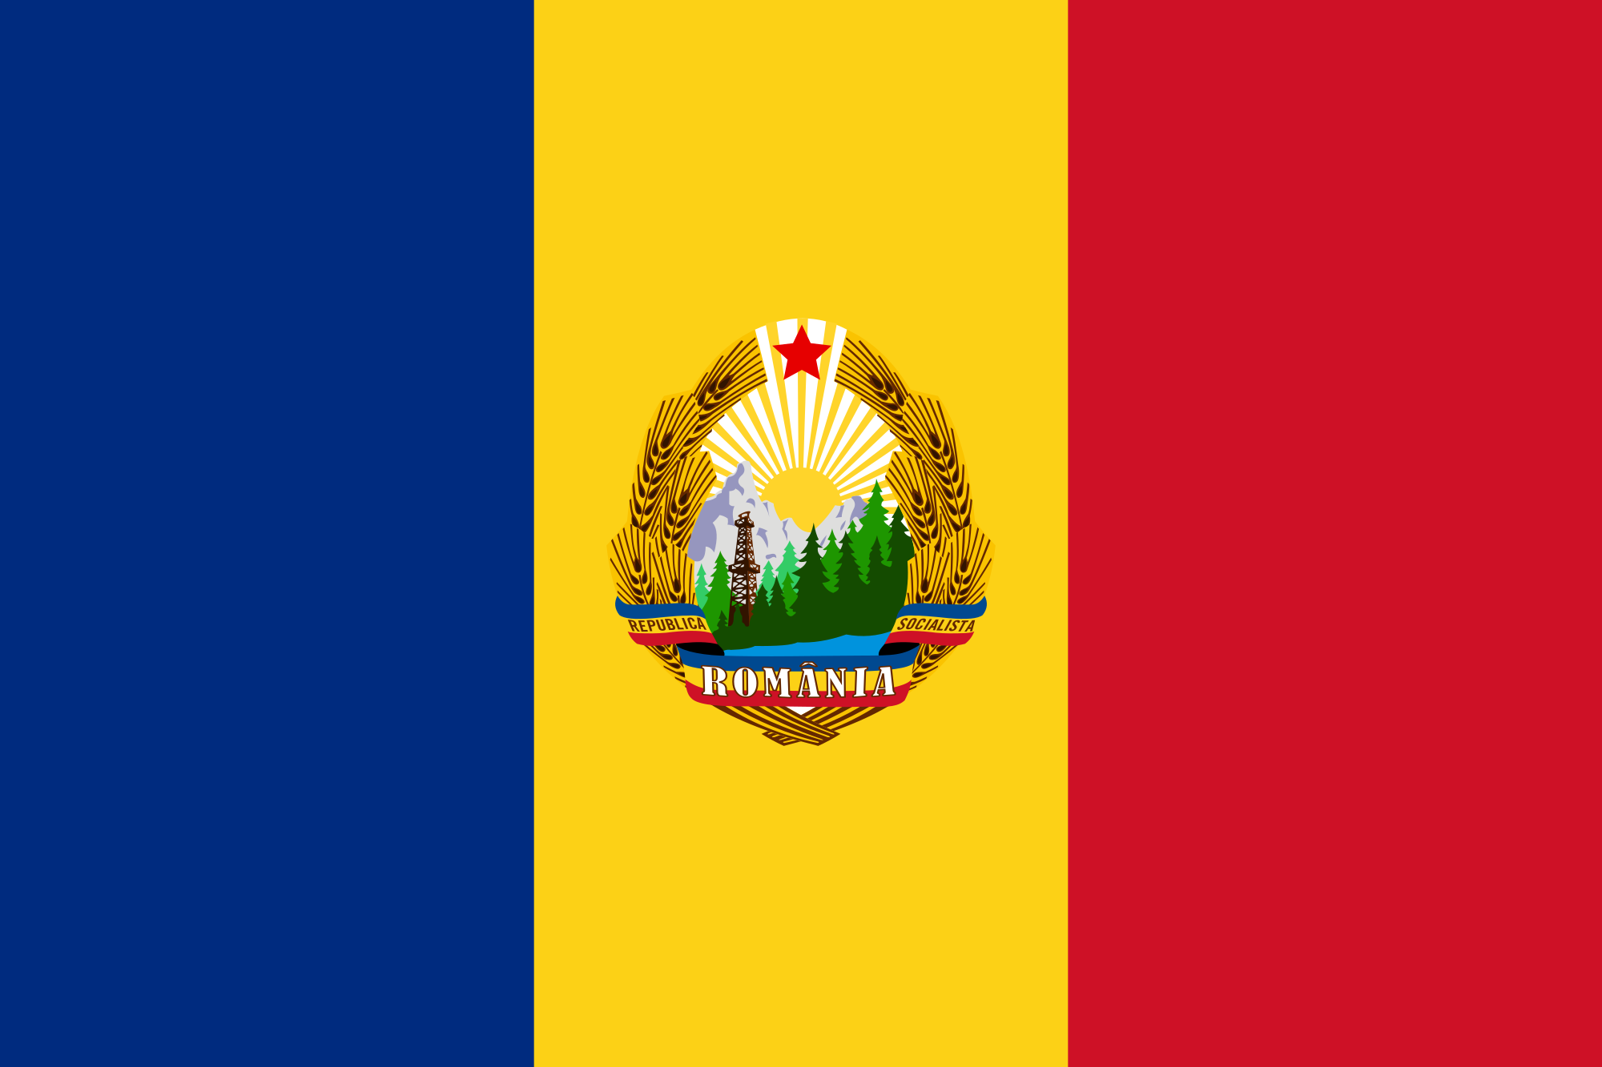
TransiTION TO COMMUNISM
During The Second World War, Romania joined on the side of the Axis Powers to recover it's territorial losses from the USSR, and so was on the losing side of the war.
The soviet army occupied Romania immediately after the arrest of General Ion Antonescu.
King Mihai was forced to abdicate on December 31, 1947, one year after the communists had falsified the results of the parliamentary elections from November 1946.
That moment marked the destruction of democracy in Romania and the complete takeover of the power by the communists for the following 42 years.

Slide 10
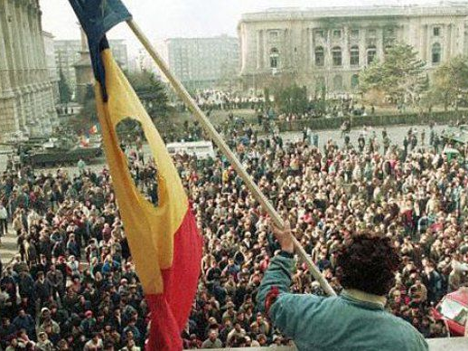
The Revolution of 1989
Nicolae Ceausescu was unwilling to step down or allow for liberalization. The Romanian Revolution of December in 1989 started in Timisoara, spread to the largest cities in Romania and lived its most dramatic moments in Bucharest where the highest number of victims was registered. Ceausescu tried to escape, but was betrayed, arrested and executed a few days later, on Christmas, December 25.
After a rough start in the 1990s and a difficult transition, Romania joined NATO in 2004 and the European Union in 2007.

Slide 11
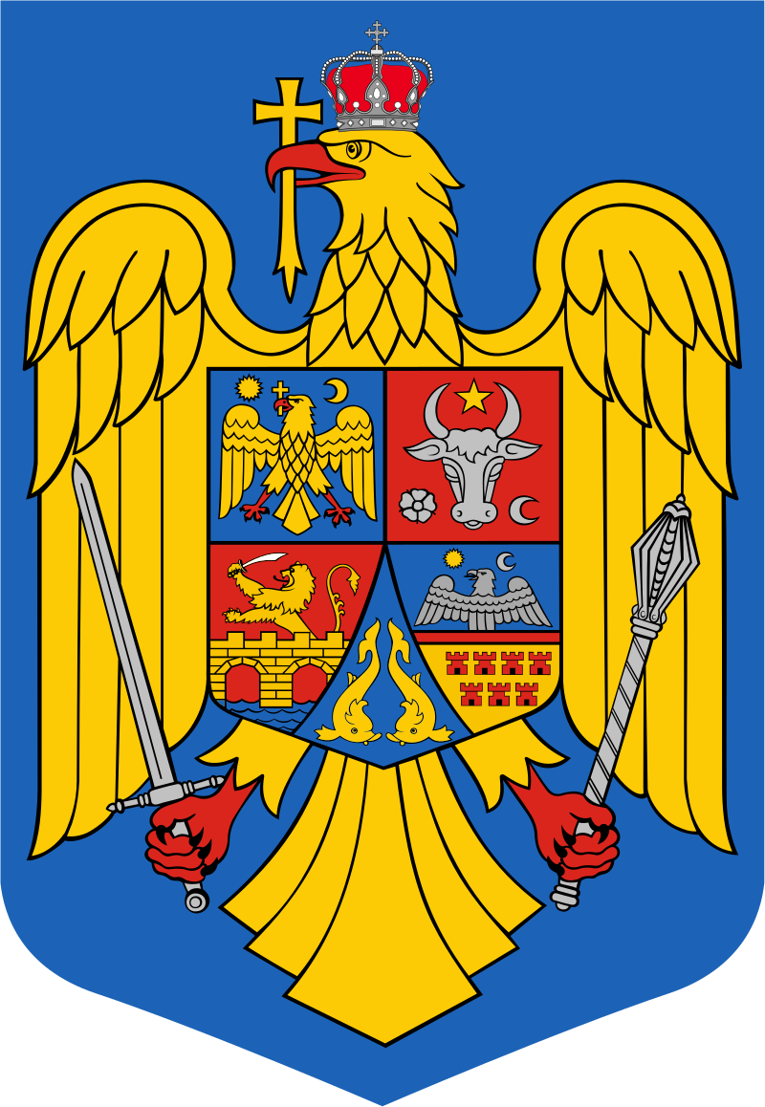
1991 Constitution
In December 1991, a new constitution was drafted and subsequently adopted, which proclaims it a democratic and social republic, deriving its sovereignty from the people. According to the constitution, "Human dignity, civic rights and freedoms, the unhindered development of human personality, justice, and political pluralism are supreme and guaranteed values."
The constitution provides for a President, a Parliament, a Constitutional Courtt and a separate court system which includes the High Court of Cassation and Justice. The right to vote is granted to all citizens over 18 years of age.

Slide 12
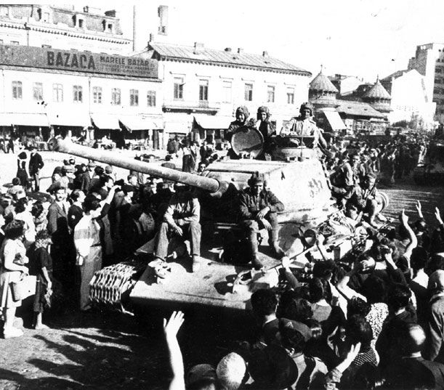
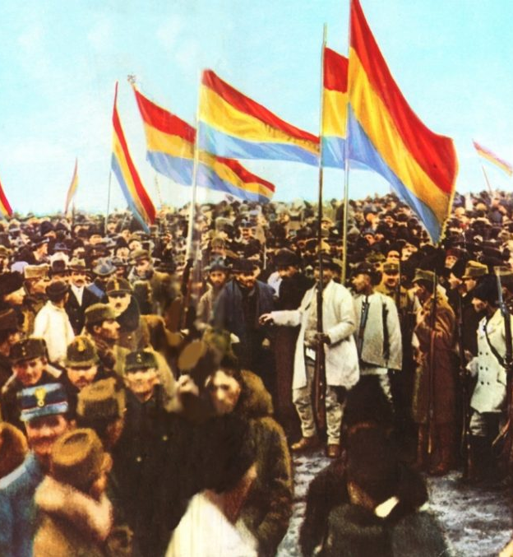
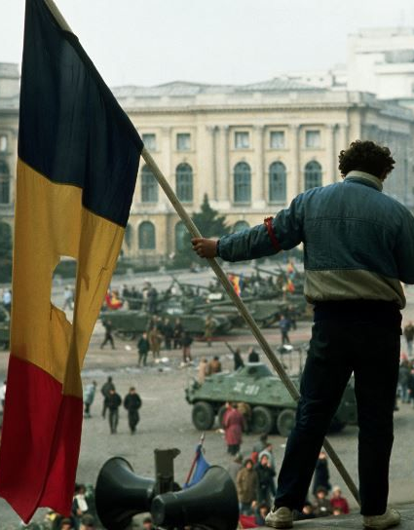
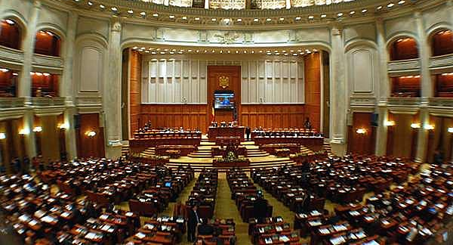
pictures

