Slide 1
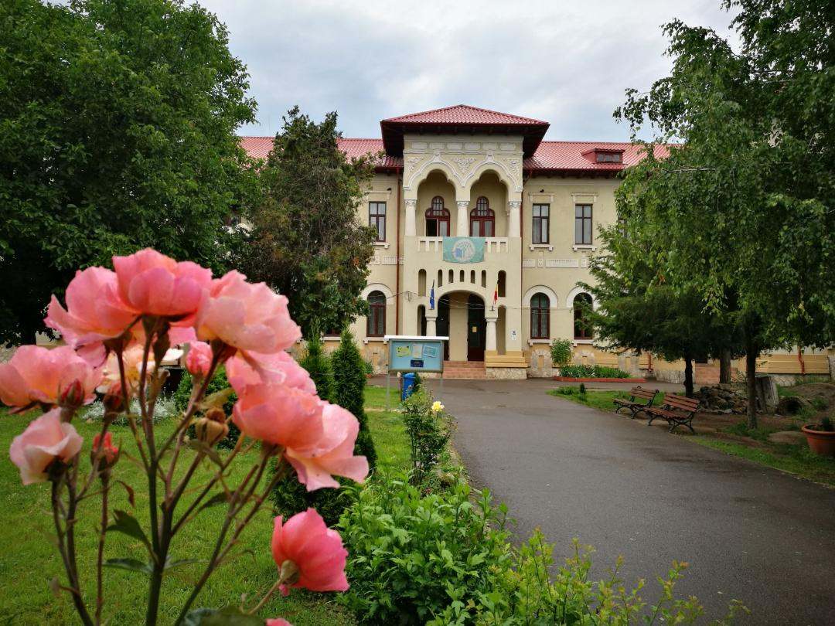
My democratic school ROMANIAN SCHOOL
By ema Popescu and delia chirilescu

Slide 2
The history of our school
l
On October 22, 1893, Take Ionescu, Minister of Cults and Public Instruction signs the School Settlement Order, the purpose of which is to train teachers for Dobrogea. On November 1, 1893, Ion Bănescu is appointed school principal. One of the benchmarks that qualifies our institution is that of September 1895, occasioned by the inauguration of the Cernavoda bridge. Normal School was attended, on this occasion, by King Carol I, accompanied by Take Ionescu and General Poenaru. They were impressed by the way the school looks.
On 1993, on the anniversary of the 100th anniversary of the establishment of the Constantine School Brătescu "- the institution received the honorary title of the National Pedagogical College, Constantin Brătescu ", the first National College in this part of the country.
In October 2003, the Ministry of Education, Research and Youth, the National Agency Socrates and the European Union Delegation established the competition to award the certificate "EUROPEAN SCHOol"
Our school won four times consecutive title of the European School, being the only institution in Dobrogea and one of the 4th schools in the country that have achieved this performance.

Slide 3
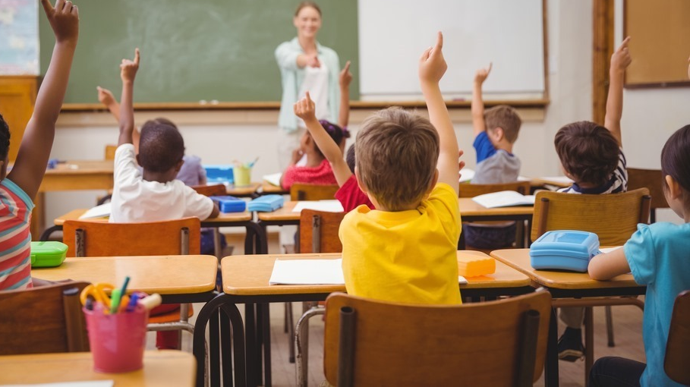
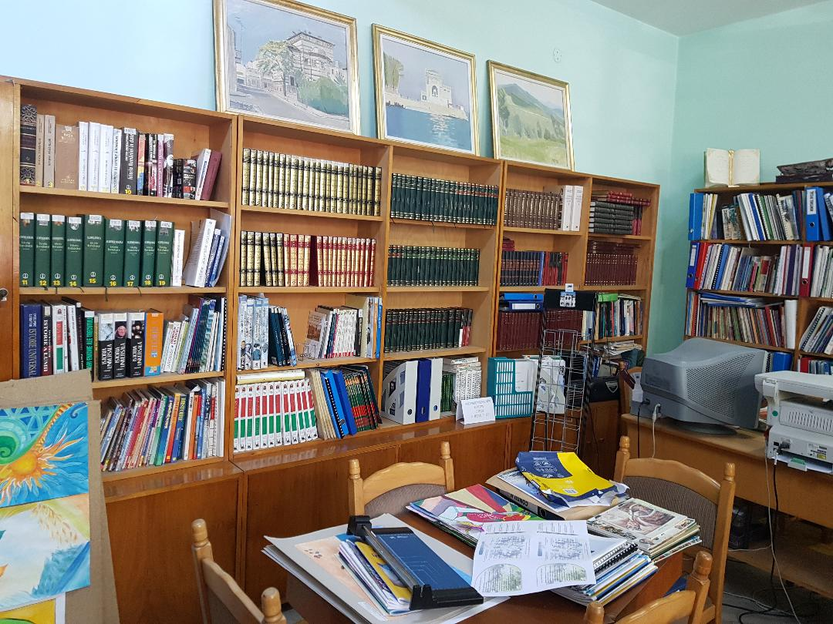
why is our school democratic
IN OUR SCHOOL, in Romania WE integrate children with disabilities.
In our school all children can learn, play games in their free times and enjoy to read.

Slide 4
OUR DEMOCRATIC SCHOOL
In our school children and teenagers are accorded all the rights and responsibilities of democratic citizenship; the students practice the principles of free speech, free association, and freedom to choose their own activities. A democratic school is a school where students are trusted to take responsibility for their own lives and learning, and for the school community. The students can learn from interacting with others who are older and younger than themselves. Democratic schools are governed democratically, usually at weekly school meetings at which each student and staff member has one vote.

Slide 5
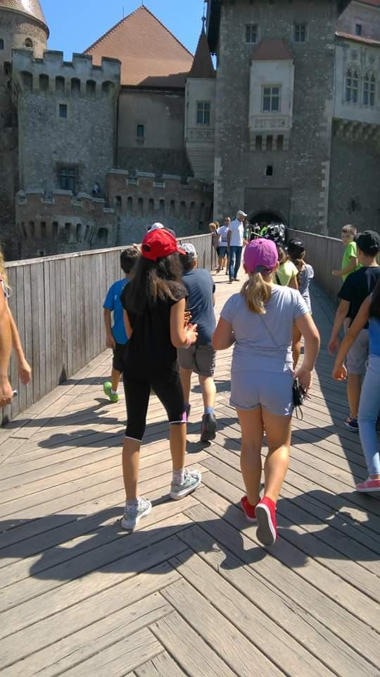
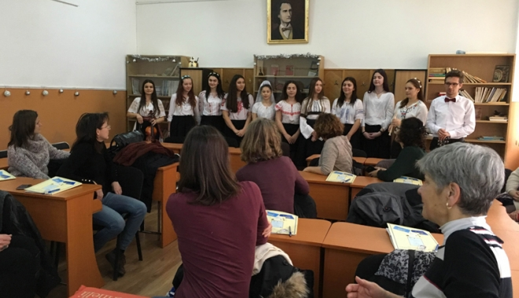
WHY IS OUR SCHOOL DEMOCRATIC
In this school, students of different nationalities and cultures are all accepted.
We also help students will low financial income,by giving monthly scholarships .

Slide 6
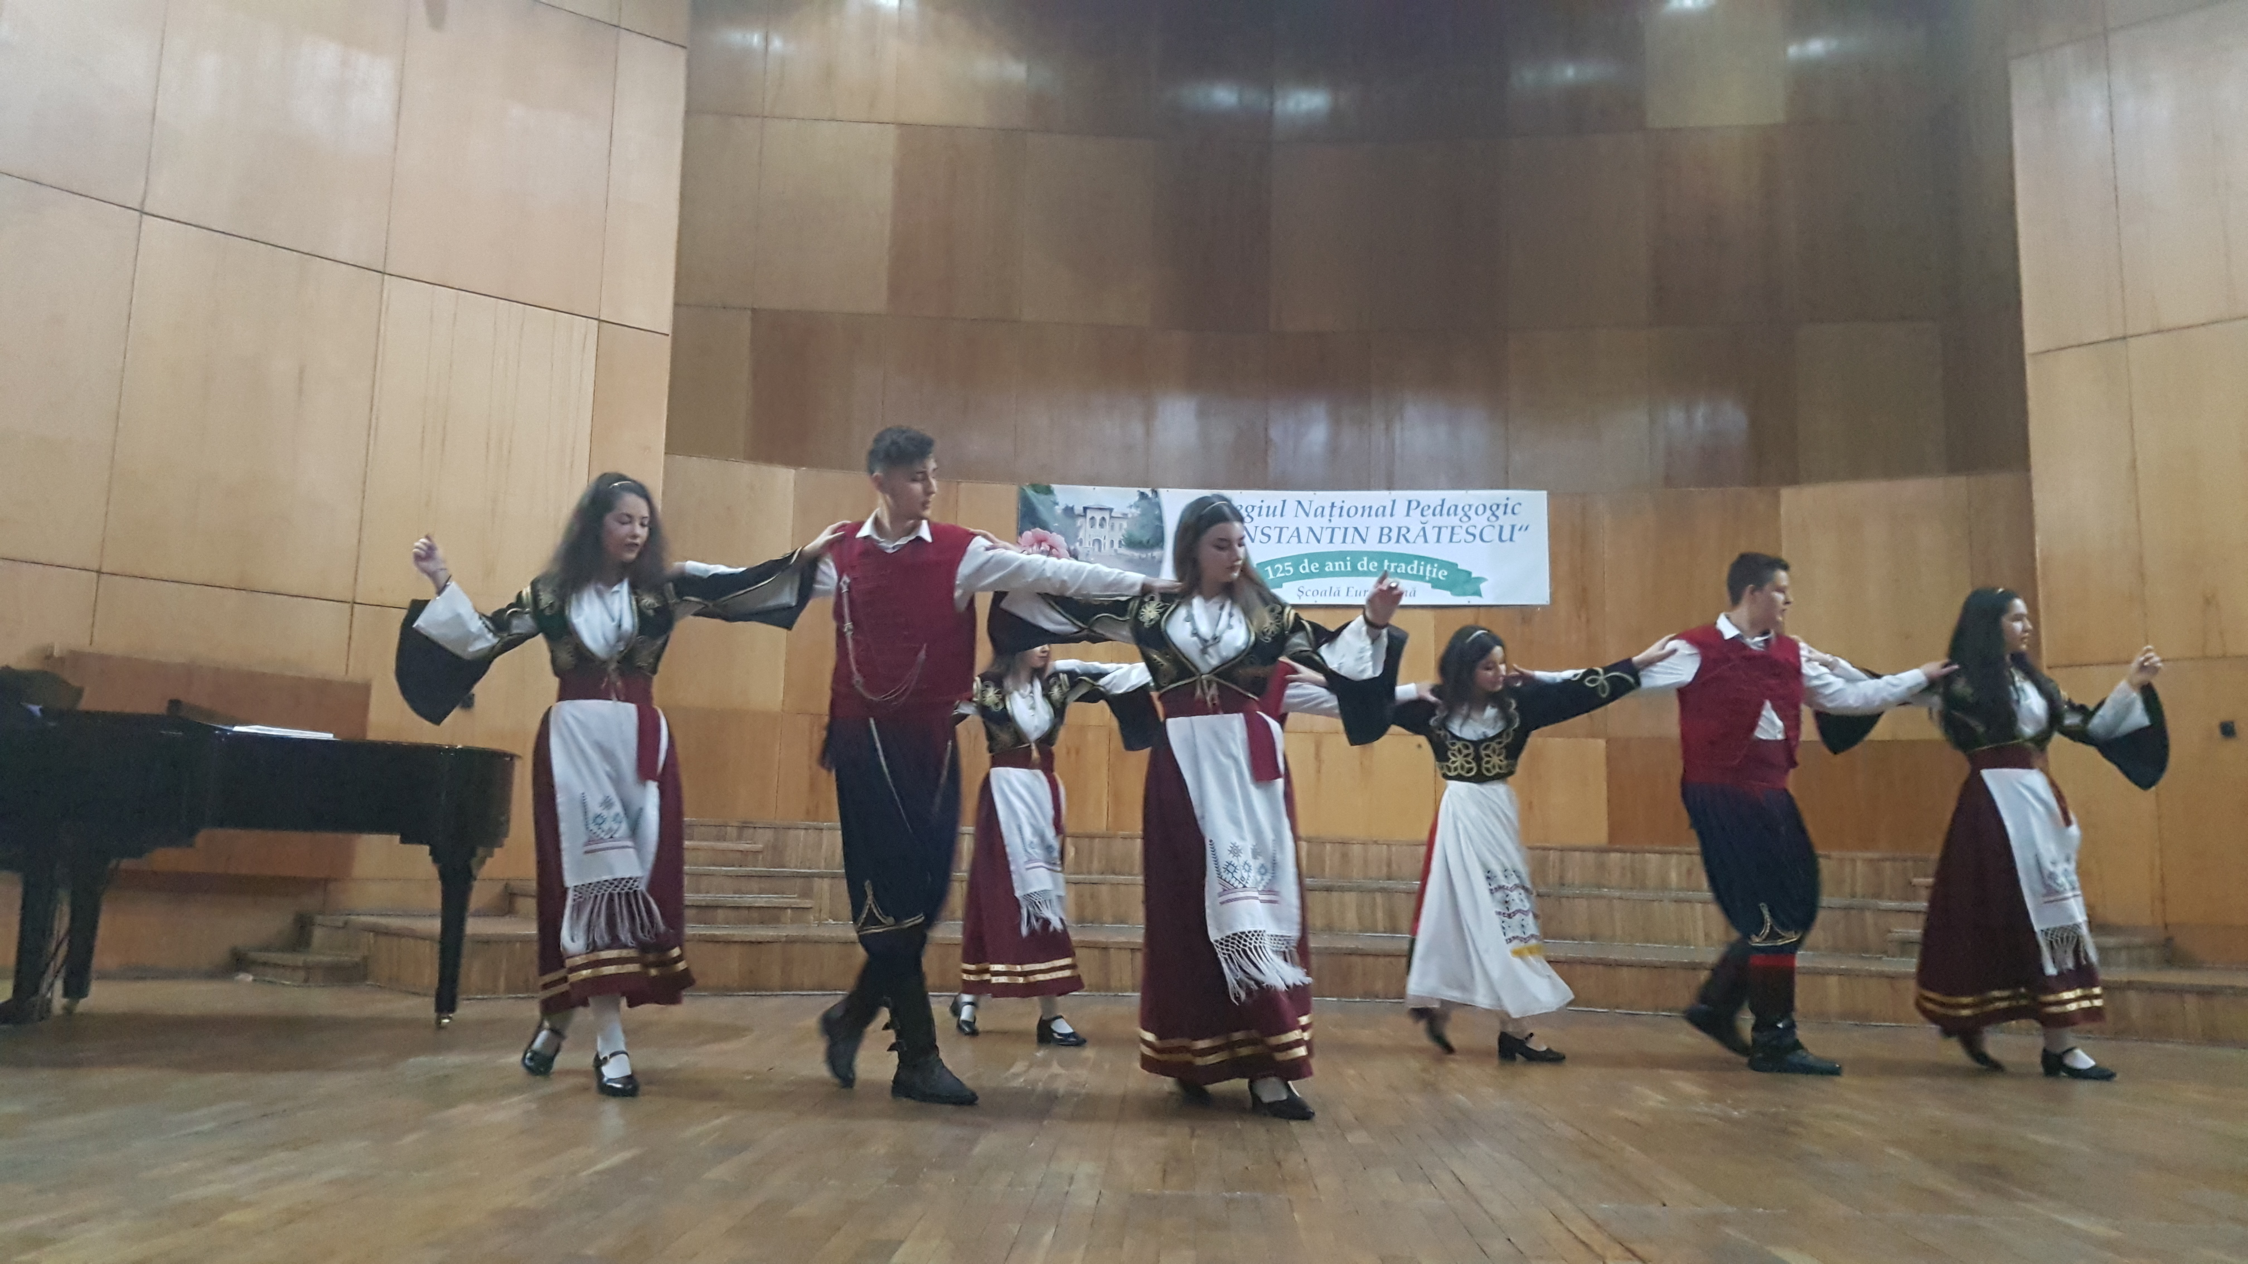
Our students was involved in different national and international projects about : migrations,diversity, democracy, human rights, equality.

Slide 7
Why is our school democratic
Every student has the right to express himself and be listened to.
We communicate very good with the teachers and know we can always rely on them.

Slide 8
MY SCHOOL IS DEMOCRATIC BECAUSE….. We VOTe AT SCHOOL
Voting at school is a unique civic learning experience which teachers and class students can build upon in the classroom to help young people become educated, engaged citizens. Our students can choose each year their representative on the board of the school.

