Slide 1
DEMOCRACY AT OUR SCHOOLS BUSINESS ACADEMY LEVICE SK

Slide 2
Business Academy = democratic school
Business Academy in Levice in Slovakia is a democratic school and it has several reasons:
Our school upholds our students and human rights
The school has democratic teachers with human and democratic approach to students
A school has a whole school approach to democratic principles, from the content of lessons through to the school culture and management structure.
Our school provides quality education for all students.
There are no diffrences seen and done among students from the teachers aor school´s point of view
Our school has students´ regulations based on democratic principles

Slide 3
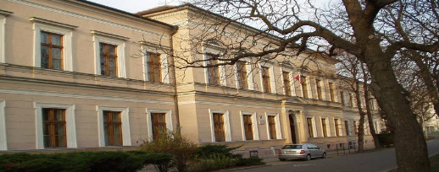
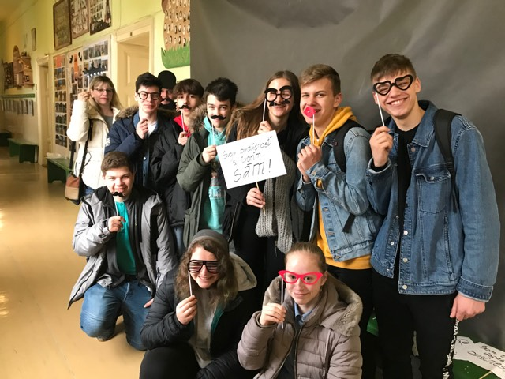
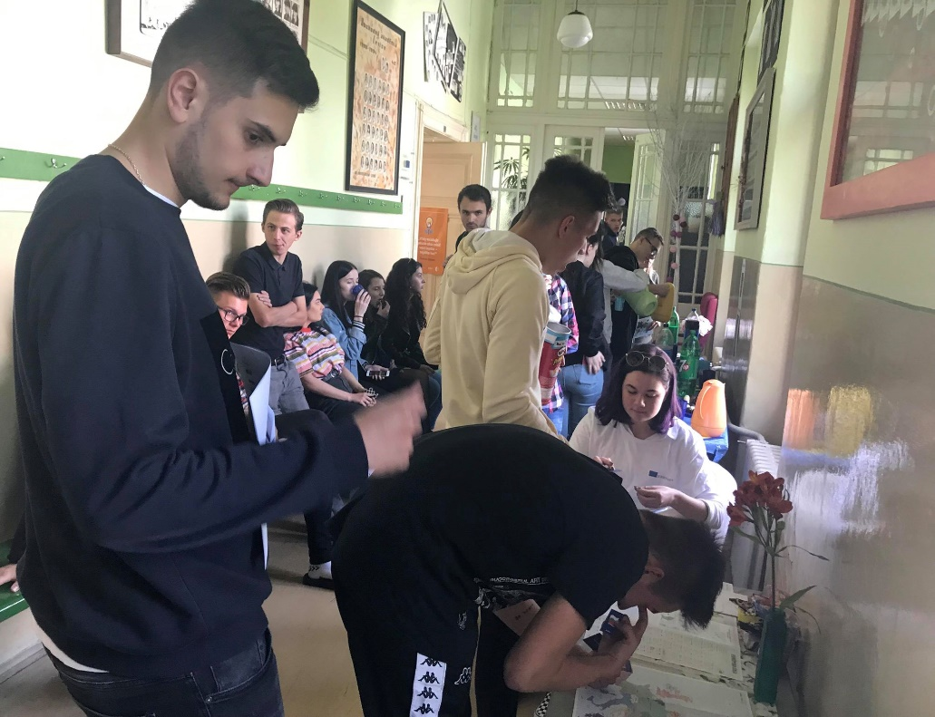
Business Academy = democratic school

Slide 4
Business Academy = democratic school
There are very good and friendly relationships between teachers and students
Students can express their opinions freely at school
Disabled students are part of our school, we all help them ☺
We - students partly can choose what to study at our school, e.g. there is a choice of optional subjects
Students at our school are trusted to take responsibility for their own lives and learning, and for the school community
Our school has space for creativity, tolerance for individualism, and understanding of how the world is changing around us. Our school has a school board that solves the problems of our students, that is why we consider our school DEMOCRATIC

Slide 5
School council
Business Academy has its School council, where there is one student from each class who represents our students will.
We call it the voice of students
School council cooperates with the school management
Students´ council works very well and it is helpful to students
It organizes a lot of activities for students at our school

Slide 6
School council
Activities of the School council for students:
Sports activities
Matriculations for students of the first grade
Helloween day
Christmas party
Valentine´s day
School ball
Charity activities and much more
We are pretty satisfied with its activities for us students ☺

Slide 7
Film about democracy at Business Academy
Film about democracy at BA Levice

Slide 8
THANK YOU FOR YOUR ATTENTION ☺

