Slide 1
Nonverbal phone communication

Slide 2
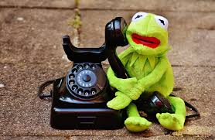
Introducion
What do you think about such introducing ☺ ?
How do you feel when somebody talked with you in such sleepy or exiting voice?

Slide 3
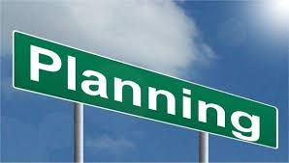
Plan meeting
Introducing session
Workshop in groups
Summary and task for next meeting

Slide 4
What You have to Do in Workshop?
Everybody will be divided in small groups
In the group present yourself like you on a Job Review using your body language as much as you can. Make funny things and your collegues have to guess:
What are you doing during phone conversation?
3. Every groups have a desk where you need to put stickers. What can you do or cannot do during a phone conversation.
4. After 20 minutes we come back to the main session, present your actions and receive the new task for next meeting

Slide 5
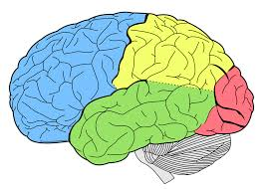
Why do we present incorrect situation during a phone conversation?
Our brain need action,
need theatre and emotions
to remeber some informations.
Most of you know
how should look a good phone conversation,
But while speaking, people forget about it.

Slide 6
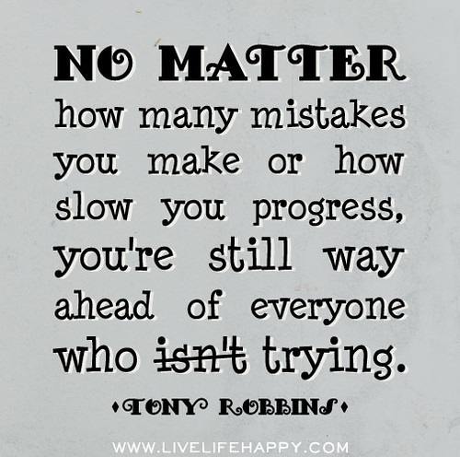
Time to make Mistakes ☺
Now it’s your time to Be Active;
You have the possibilities to meet other students and cooperate with them;
IT IS a Great OPORTUNITY to Catch the Necessary Experience;
Great Chance to make the First Step in the Business World.
You Are Young and Ambitious, You are Great and full of Crazy Ideas !!!
Good luck to everybody and have some FUN !!!

Slide 7
SUMMARY

Slide 8
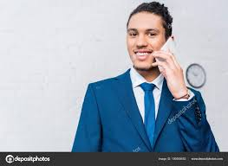
TIPS for Succesfull Phone Conversation
Start smiling before you answer the telephone.

Slide 9
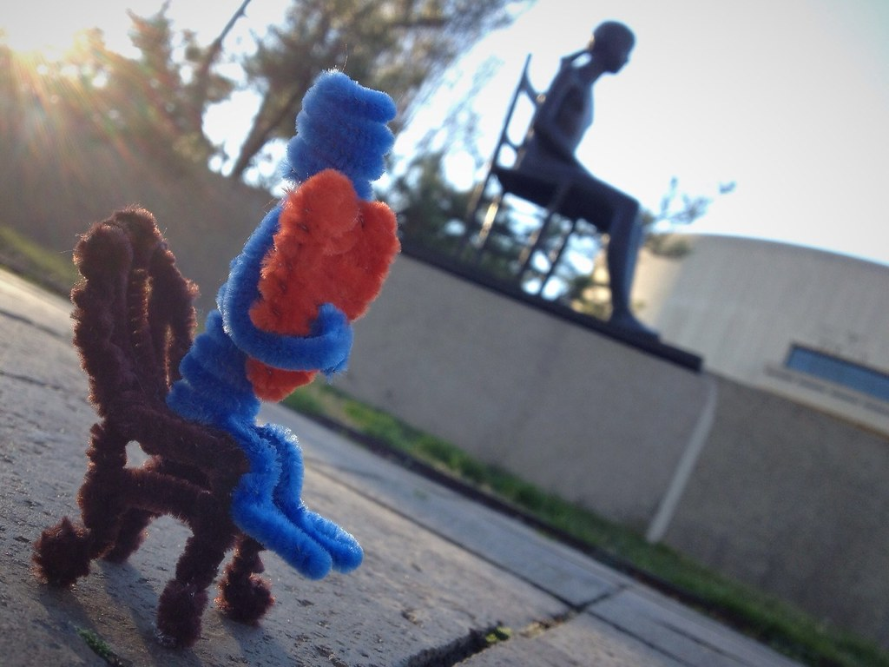
Sit up straight with both feet on the floor.

Slide 10
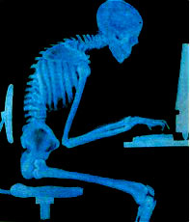
Don't slouch.

Slide 11
Treat callers with respect.

Slide 12
Voice is the most important thing in the body language
It has strong influence on the impression you project of yourself and your company

Slide 13
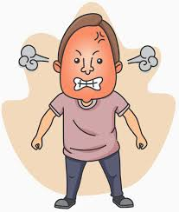
Raising one’s voice can be a sign of anger

Slide 14
Rapid speech can convey a sense of urgency

Slide 15
Silence can indicate disagreement

Slide 16
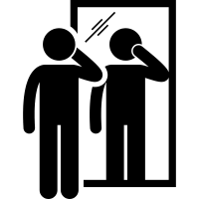
CURIOSITY
customer service representatives in call centers
often encouraged to keep a mirror nearby
so they can keep a smile on their face.
Believe, it makes a difference!

Slide 17
Literature:
Nonverbal Tips for Phone Conversations –Rachel Beohm - https://rachelforte.medium.com/nonverbal-tips-for-phone-conversations-248d00a82601
Non-Verbal Communication: Still Important on the Phone - Lin Grensing-Pophal- https://hrdailyadvisor.blr.com/2018/05/25/non-verbal-communication-still-important-phone/
Non-Verbal Communication on the Telephone - https://www.directutor.com/content/non-verbal-communication-telephone
Not crazy, just talking on the phone: Gestures and mobile phone conversations - Carolyn Y. Wei - https://www.washington.edu/news/archive/relatedcontent/2007/February/rc_parentID30477_thisID30522.pdf
The action of looking at a mobile phone display as nonverbal behavior/communication: A theoretical perspective - Takashi Nakamura - https://www.sciencedirect.com/science/article/pii/S0747563214005652
Komunikacja niewerbalna w obsłudze klienta. Rozmowa telefoniczna, rozmowa sprzedażowa -https://www.projektgamma.pl/strefa-wiedzy/artykuly/komunikacja-z-klientem-rozmowa-telefoniczna

Slide 18
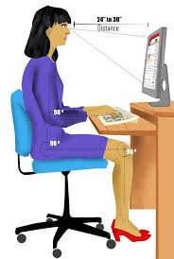
New task Presentation of company Video Conference
Prepare the presentation of the company
using all the most important and strong non-verbal communication
Each teams estimates another with pointing out the most important things :
- voice, hands, look, body and anything else that is important.

Slide 19
Thank you for your attention !!!

