Slide 1
EliteTrans

Slide 2
History of Elite Trans
January 2017 – founded company
At the beginning the basic activity : forwarding services in Poland
May 2017 our first great cooperation with the local market leader –Speed Way Transport
February 2018 our company won the first award for the most successful logistics company in 2017/2018
2019 our company increase tull 450 employees and was created new branches.

Slide 3
Year 2020 - Pandemic situation in the World Anyway our car fleet is increased: 80 tilt trucks 50 –frigo truks 40 – overload trucks NOW WE ARE INTERNATIONAL TRANSPORT - FORWARDING COMPANY
we have achieved

Slide 4
Development
Our trucks were modified by an aerodynamic specialist.
- less air resistance
- lower fuel consumption
GREEN LOGISTIC safe OUR PLANET

Slide 5
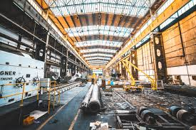
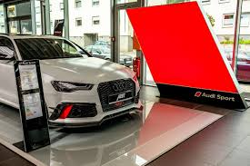
SOLUTION BY INDUSTRY WHAT’S KIND OF GOODS WE CARRY
AGRICULTURE
AUTOMOTIVE
BEAUTY
CHEMICALS
DRINKS
FOOD
STEEL
PHARMACEUTICAL

Slide 6
SERVICES OFFERED
We offer transport by:
- Air;
Rail;
Intermodal;
Sea;
Road;
Groupage;
Custom services;
Wharehouse services.

Slide 7
Advantages
Advantages:
knowledge of the market
Branches in most European countries and 4 in America and 7 in China
A wide range of services
Great relationship with customs offices on all European borders

Slide 8
OUR PRIORITY
Smile on the face of our customers
and
Never to give up

