Slide 1
Company Presentation (video conference)
Project Necessary Skills and Instruments for Supply Chain Management

Slide 2
Plan of the Meeting
1) Presentation of the Companies
TASK :
- look with attentively at presenter;
- found the positive point in his/her body language
- after each presentation answer on questions on Metimeter
2) Workshop in the groups.
TASK :
Every groups create the TIPPS (do’s & don’ts) for professional video conference.
3) Summary and new task for the next meeting.

Slide 3
SUMMARY

Slide 4
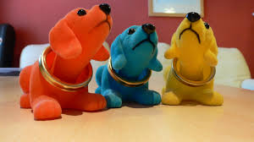
TIPS FROM BUISINESS SPECIALIST
1. EXPRESS YOURSELF :
SMILING;
NODDING;
RAISE YOUR EYEBROWS;
All theese act will generate positive emotion in your audience

Slide 5
2. STRAIGHTEN YOUR POSTURE
Shortslef said. “You could be saying the right things,
but your body is conveying 1,000 negative cues.
That negativity is what people are going to remember.”
https://today.duke.edu/2020/09/body-language-tips-engaging-video-meetings

Slide 6
3. LEAVE ROOM FOR YOUR HANDS
If you need make gestures with hands while speaking,
just arrange some place between desk and your chair.
but don't wave your hands too much ☺

Slide 7
4. MAKE EYEs CONTACT
Try to look directly into your webcam.

Slide 8
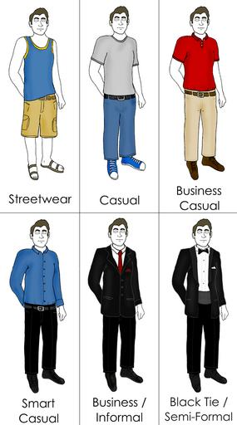
5. WEAR CLOTHES YOU WOULD WEAR TO AN IN-PERSON MEETING

Slide 9
Literature:
https://today.duke.edu/2020/09/body-language-tips-engaging-video-meetings
https://highfive.com/blog/5-body-language-tips-better-video-conferences
https://www.ringcentral.com/us/en/blog/7-body-language-tips-for-your-next-video-meeting/

Slide 10
NEW TASK
FORMAL LETTER
order letter,
order of complain,
promotion letter,
inquiry letter,
or any other letter which you write to you counterparty (contractor, suppliers, partners etc.)

Slide 11
Thank you for Attention !!!
„Video Conference”
Project Necessary Skills and Instruments for Supply Chain Management

