Slide 1
ZincTrans
Zuzanna Milewska
Zespół Szkół nr 6 im. Karola Brzostowskiego w Suwałkach

Slide 2
ZincTrans...
ZincTrans, the world's largest delivery services company, was founded 25 years ago. Our transformation into a multi-billion dollar global corporation reflects the growth of modern transportation, international trade, logistics and financial services. We offer our customers the benefits of access to the world's largest air freight network and the unmatched European road network. We commit ourselves to provide the highest quality and environmentally friendly services. In the future, ZincTrans will bring the world closer together.

Slide 3
OUR core VALUES
RESPONSIBILITY
We listen to the needs of our employees, customers and business partners and this way we set our development goals.
GROWTH
Our team consists of people with passion. Thanks to our talents, knowledge and competences, the company's continuous development is possible.
SENSITIVITY
It is our strength that helps us engage in important issues and implement unique projects.
COOPERATION
Good solutions are created from the exchange of experience, the clash of views and creative thinking. Together we can achieve more and do great things.

Slide 4
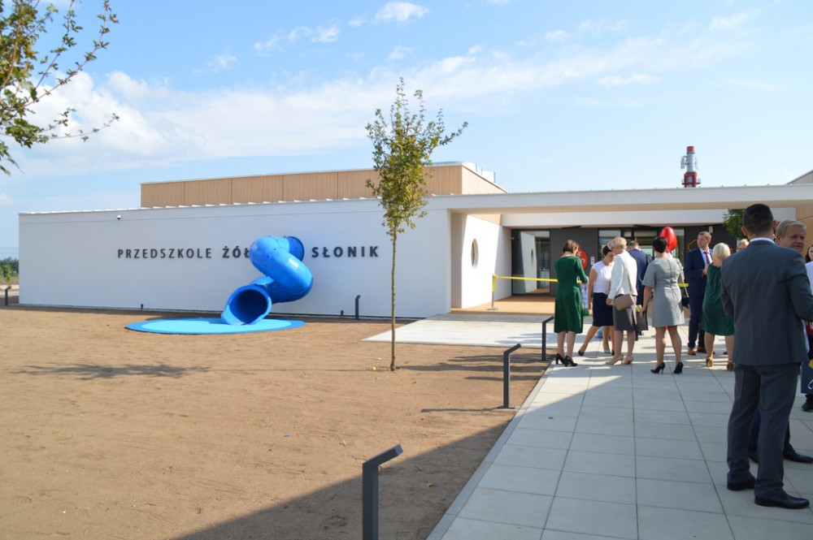
ZincTrans total number of employees is 325thousand including 1,500 people who have been working here for over 15 years.
Free nurseries and kindergartens were created for the children of our employees.
It is possible to enroll a child for the winter break or summer camps.
Language courses are available.

Slide 5
ZincTrans offers different modes of transport:
Sea transport (International)
- Full Container Load (FCL)
- Less than container load (LCL)
- Refrigerated containers
Air transport (International)
- Dangerous goods
- Bulky goods
Railway (Between Europe and Asia)
- Full container load
- Less than container load

Slide 6
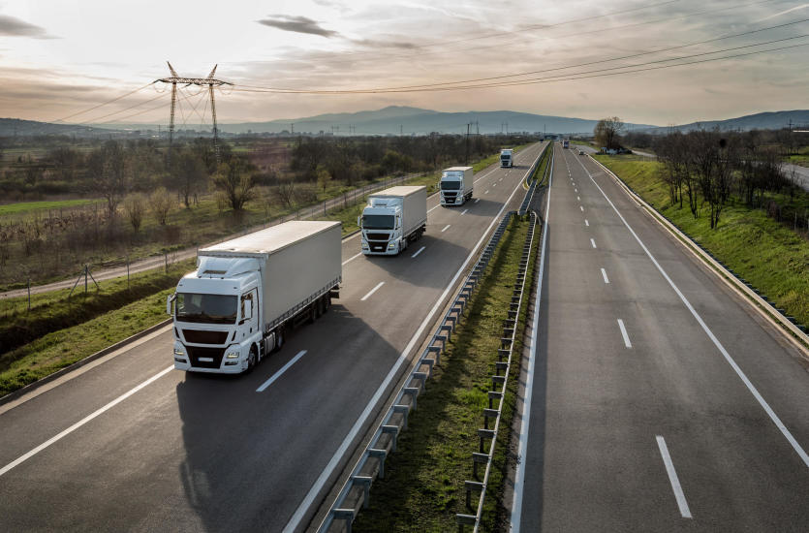
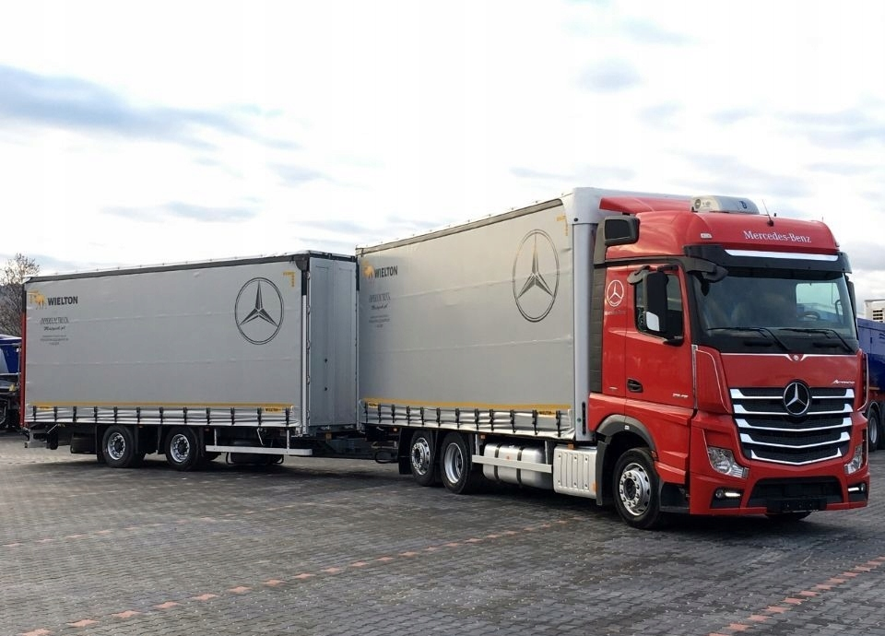
ZincTrans offers different modes of transport:
Road transport (international and domestic)
- Break bulk cargo
- Full truck load
- Dangerous goods
Types of trailers:
Tandem trailers
Universal trailers

Slide 7
Thank you for your attention!

