Slide 1
Organisation of the transport from Austria to Poland
Project : Necessary Skills and Instruments for Supply Chain Management

Slide 2
Steps in organisation transport
Creating common platform for forwarders (students) from Suwalki and Warsaw
Looking for suppliers throught Internet
When you found transport company, check on platform if anybody else has that same company.
Rule: One company for one forwarder

Slide 3
Steps in organisation transport
4. Writing on the platform data’s company
Make a phone to the transport company and ask if they do transport (ex. Transport cars) from Austria to Poland.
Example of the conversation:
Hello, my name is … . I’m studing to be a forwarder.
We received the task to organise transport of the cars from Austria to Poland.
I see on your website that you realise such kind of goods
Could you help me and give me the average price?

Slide 4
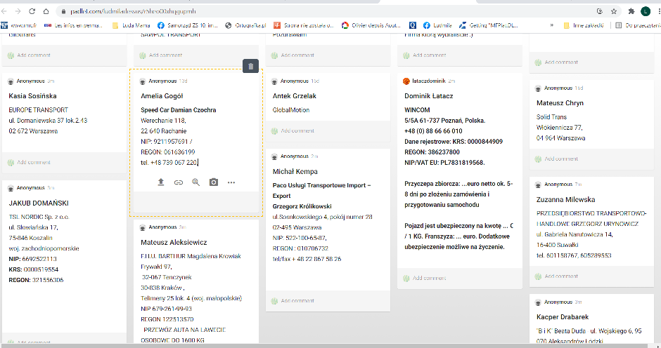
PLATFORM: padlet.com Cooperation between Warsaw and Suwalki. Transport companies with auto transport trailer

Slide 5
Price analysis
Price competition does not allow to show the costs of individual companies on the presentation,
WE PRESENT
Average prices of transporting a car from Austria to Poland
by special auto transport trailers

Slide 6
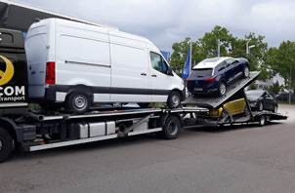
Car carrier trailer – for several vehicals
Price: 350 – 500 euro
Time od delivery: 5-8 days

Slide 7
Car hauler trailer – only one vehicul
Price: 600-800 euro
Time of delivery : 2-3 days

Slide 8
Enclosed Car Hauler Trailer – only one vehicul
Price: 1250 - 1450 euro
Time od delivery : On Demand

Slide 9
Additional information for transportation:
1 hour free for loading and unloading, followed by € 40 - 50 per hour
Terms of payment: The invoice is payable at the time of loading at the latest.
Our driver will load vehicles and will fix them to the trailer with straps
Vehicles that cannot be freely steered and pulled with a winch, as well as lowered vehicles, are billed only by prior arrangement.
The vehicle is insured for the amount of 40-50 € / 1 KG. Additional insurance possible on request.

Slide 10
INCOTERMS 2020
Transport from Austria to Poland -- EXW (Ex-Work)
The seller has fulfilled its obligation when the goods are made available to the buyer, usually at the seller’s location.
The seller should package the goods appropriately or as specified in the agreement between both parties.
The buyer is responsible for loading the goods on their transport and everything else necessary to get the goods to the final destination.
Attention ! The buyer is at risk even if the seller is assisting with the loading.
Precautions should be taken.

Slide 11
What INCOTERMS could be used for our situation?
FCA – Free Carrier
Most Often
The buyer hires a transport that picks up the goods at the seller’s warehouse.
The seller must load the goods on the buyer’s transport, at which point the risk for the goods transfer to the buyer.
Alternatively (very rarely)
The seller and buyer may agree that the seller transport the goods to a buyer’s warehouse. In this case, the buyer is responsible for unloading the goods from the seller’s transport.
In both cases, the seller should package the goods appropriately or as specified in the agreement between both parties
In addition, the seller is responsible for export clearance. (EX-1) – In case if the goods will be transported beyond the EU borders
https://www.shippingsolutions.com/blog/incoterms-2020-fca-spotlight-on-free-carrier

Slide 12
OF course it could be other, for example DDP- Delivery Duty Paid, BUT …
DDP puts the maximum risk and responsibility on the seller.
It requires the seller take responsibility for clearing the goods for export,
Bear all risks and costs associated with delivering the goods,
Unload goods at the terminal at the named port or place of destination,
Clear the goods for import clearance and payment,
Bring the goods to the place of destination.
Risk transfers to the buyer only at the destination
https://www.shippingsolutions.com/blog/incoterms-ddp

Slide 13
DDP – Delivery Duty Paid
Suggestion for Sellers : If you choose DDP
Be sure that you know very well all regulations in country where you plan to transter goods.
Use local company for helping you with customs clearance.

Slide 14
Thank you for cooperation and your attention !

