Slide 1
Learning forwarding from the inside. What is it like?
Aleksandra Świacka
Project
Necessary Skills and Instruments for SCM

Slide 2
A freight forwarder's profession - what is it?

Slide 3
The work of a forwarder consists of organizing the transport of goods within the country and abroad. The Freight Forwarder, on his own behalf or on the behalf of the Customer, decides when and how to send or receive the shipment and other activities related to the transport.
This Photo by Unknown author is licensed under CC BY-SA-NC.

Slide 4
What are the tasks of the forwarder?

Slide 5
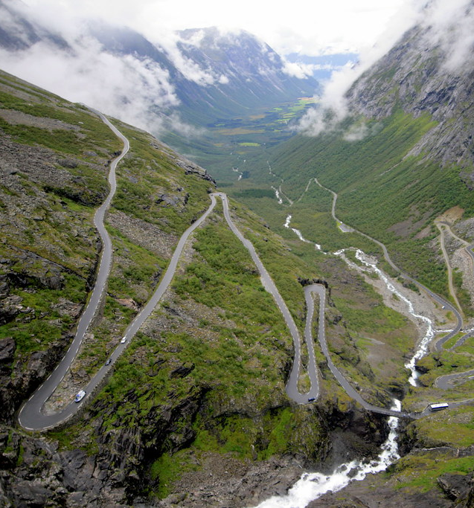
Tasks of the forwarder:
searching for customers and negotiating with them the conditions of handling and transporting loads in order to sign contracts related to the organization of activities and transport of all types of transport,
giving professional advice on the selection of the type of transport and means of transport, insurance of goods, selection and planning of the route of transport,
distribution and securing the cargo in transport,

Slide 6
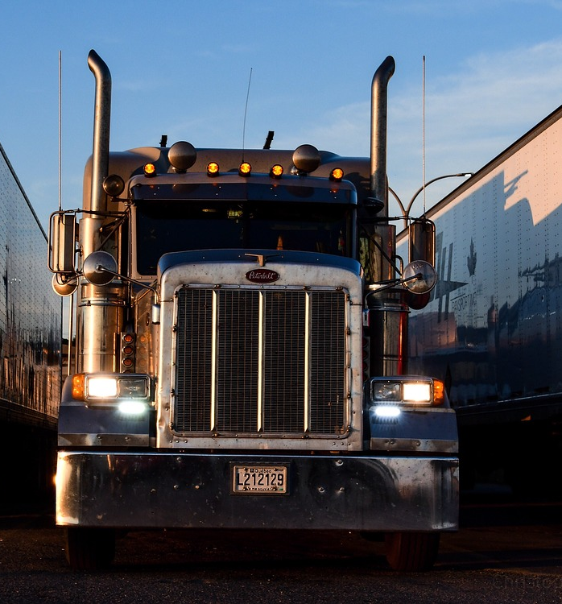
Tasks of the forwarder:
specifying the details of transport,
price negotiations,
organizing the loading and unloading of goods,
combining shipments and looking for return loads for optimal use of the means of transport,
supervising and monitoring the process of cargo movement and reloading activities,
organization and preparation of customs clearance,​
organization of temporary overloading​.

Slide 7
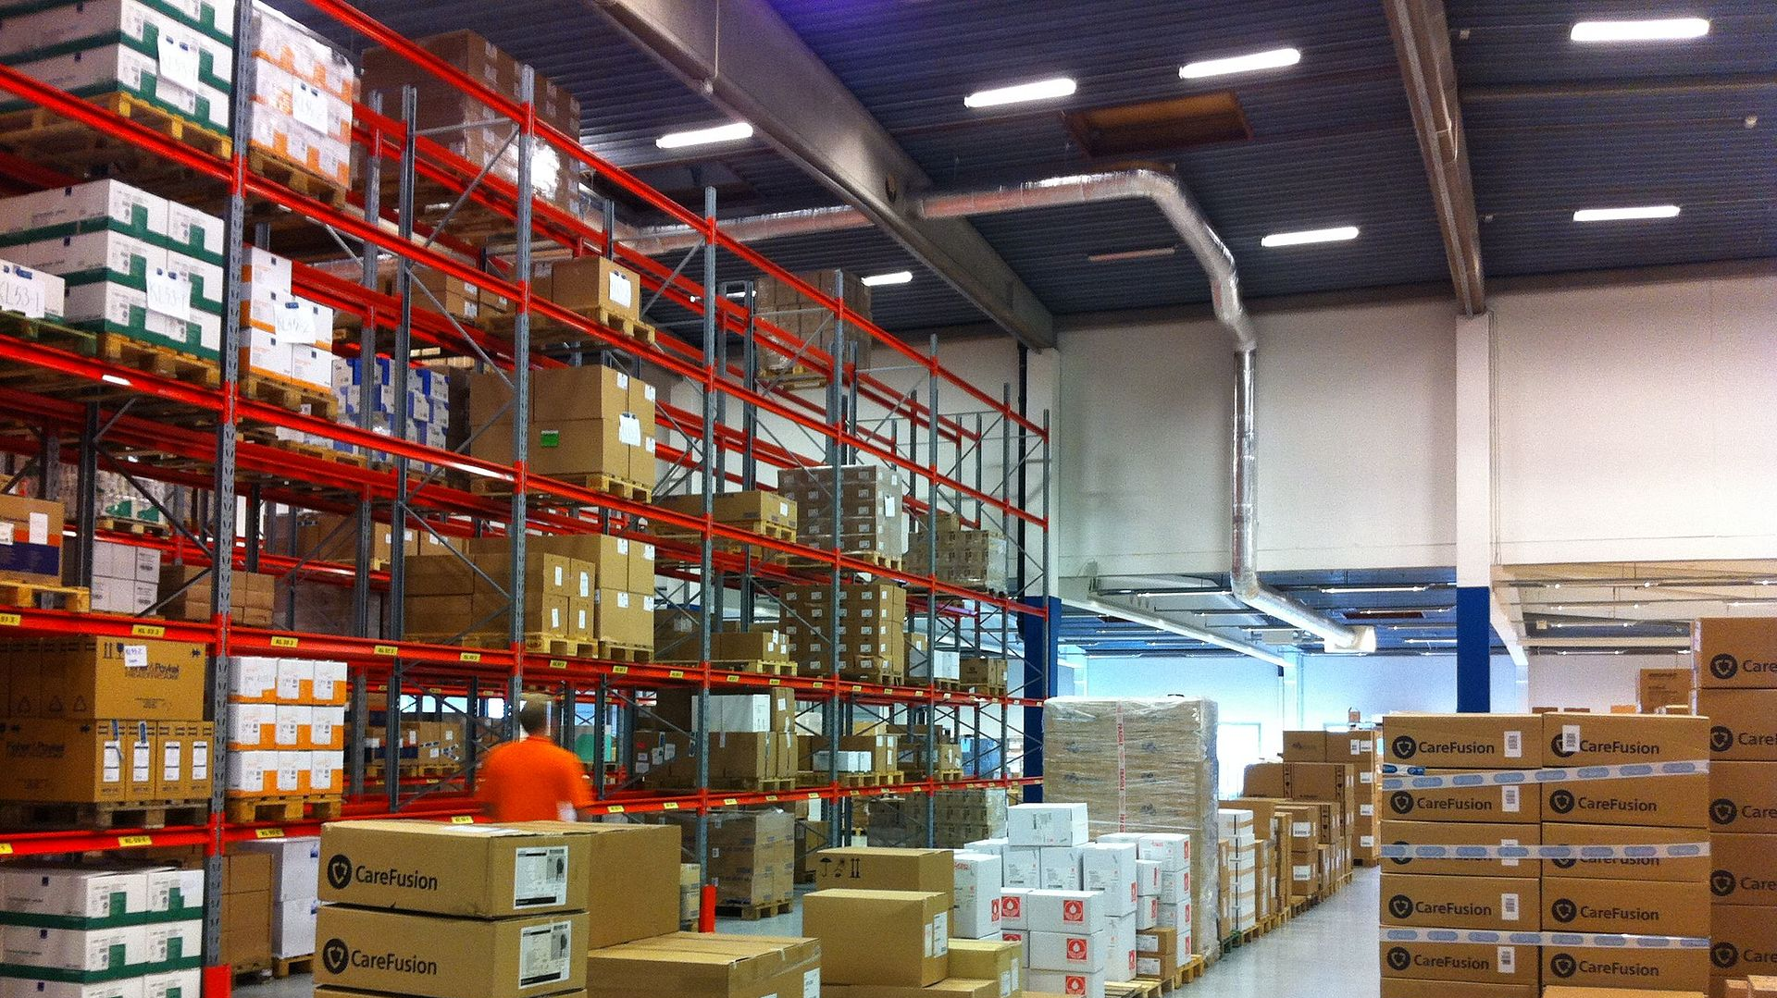
Vocational subjects:
Work safety
Means of transport
Transport and forwarding
Business English
Business studies
Social competences and organization of teamwork
Law and insurance in transport

Slide 8
Vocational subjects:
Packages and transport units
Marketing and negotiations
The basics of logistics and warehousing Statistics
Transport and forwarding management
Economics of transport
Office and IT skills

Slide 9
At school, we will obtain the AU.31 Qualification. Organization of transport and customer and contractor service. AU qualification. 32.Z. the development of transport and forwarding schedules . We obtained this qualification during summer internship due to the fact that the second half of our class are learning to be logistics technicians.

Slide 10
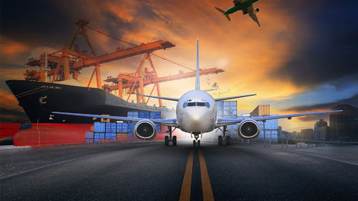
Thank you for your attention!

