Slide 1
PolShip transport company

Slide 2
OUR COMPANY IN NUMBERS
113452 5623 20623 3567
kilometers satisfied completed partner
travelled customers orders companies

Slide 3
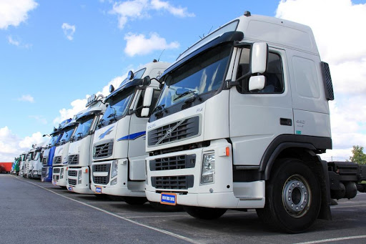
OUR HISTORY
The PolShip company has been present on the market since 1990.
For the first 5 years, the activity dealt with the import of various things.
Thanks to the technology and electronic advances that were growing at the time, the company prospered and developed, gathering funds for further investments.

Slide 4
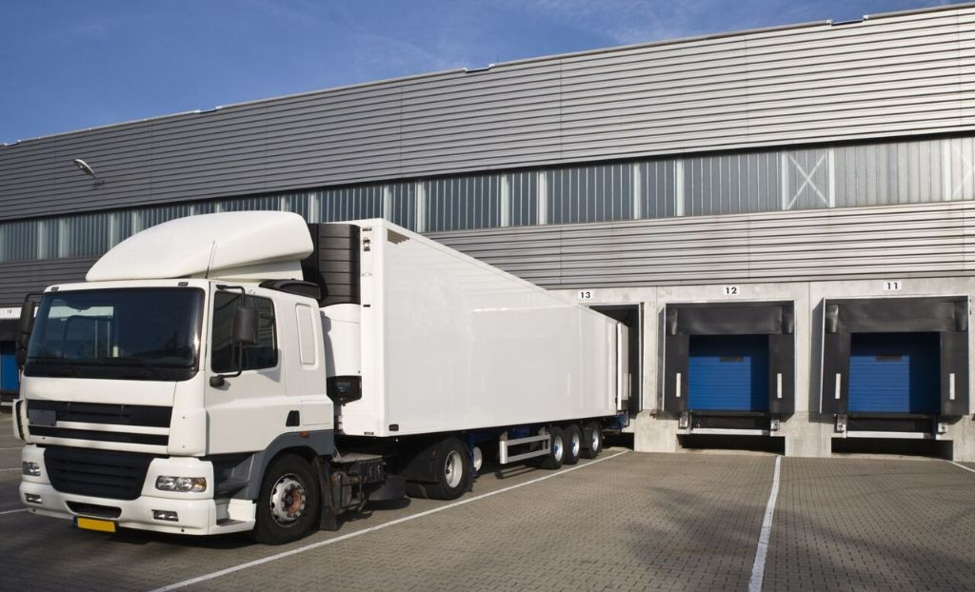
OWN CARS AND FUTURE WE NEVER EVEN DREAMED OF
In 2002, the company started with 2 MAN trucks and semi-trailers,
In 2005 cooperation with the well-known company
IKEA and VOLVO.
Currently, the PolShip company has 190 MAN, Mercedes, DAF trucks and 200 semi-trailers for various types of transport, with different payloads and capacities.

Slide 5
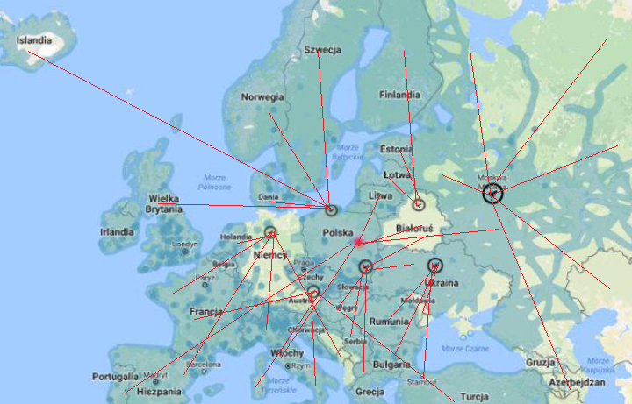
OUR HEADQUARTERS AND AREA OF OPERATION

Slide 6
WHAT OUR COMPANY OFFERS
Our company is able to offer you road, rail and sea transport which is mostly done in intermodal and groupage way. We also are able to provide our clients a magazine to rent.

Slide 7
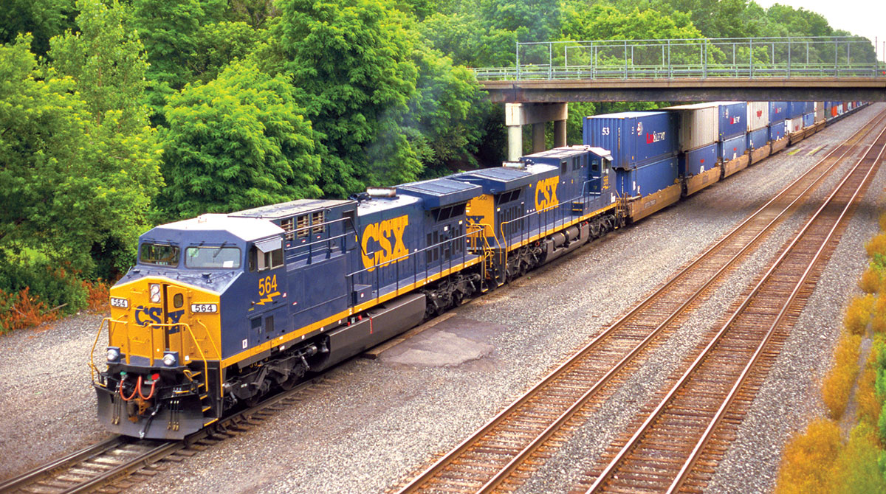
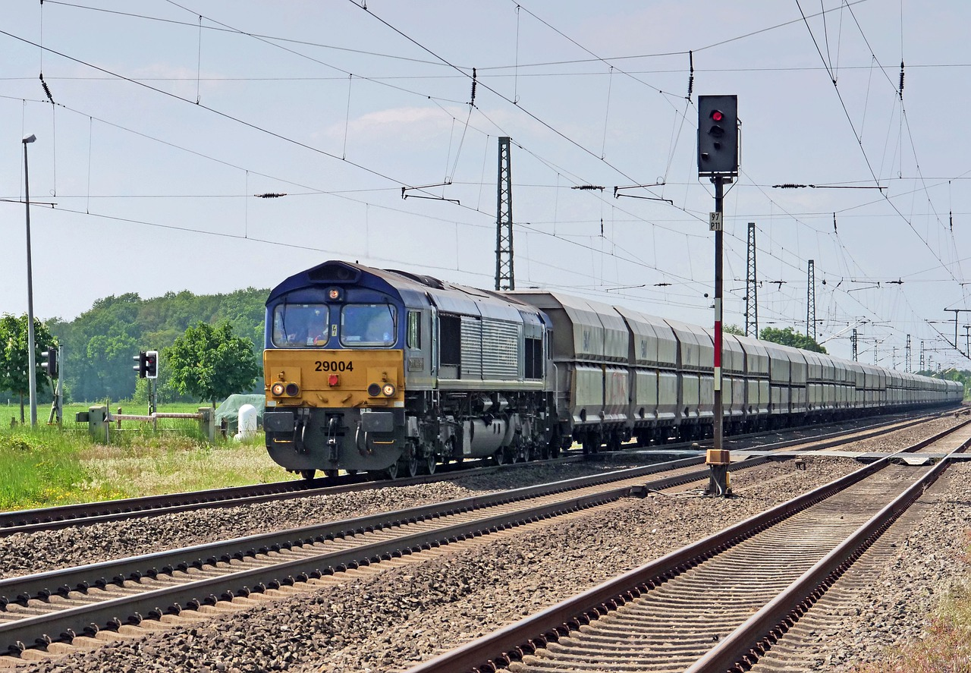
ARE YOU LOOKING FOR FAST AND CHEAP TRANSPORT?
We cooperate with European railway companies. Our services are enjoyed by clients from Europe and the Middle East.

Slide 8
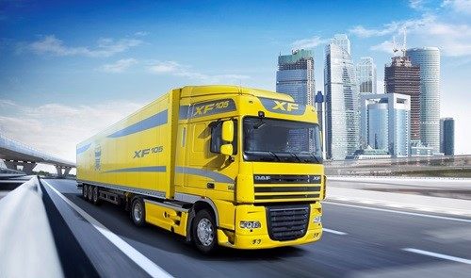
DO YOU HAVE A LOAD THAT REQUIRES FAST AND NOT EXPENSIVE TRANSPORT?
If so, our company offers the best solution on the market. We specialize in road transport across the territory of Eurasia, and You will surely like affordable prices.

Slide 9
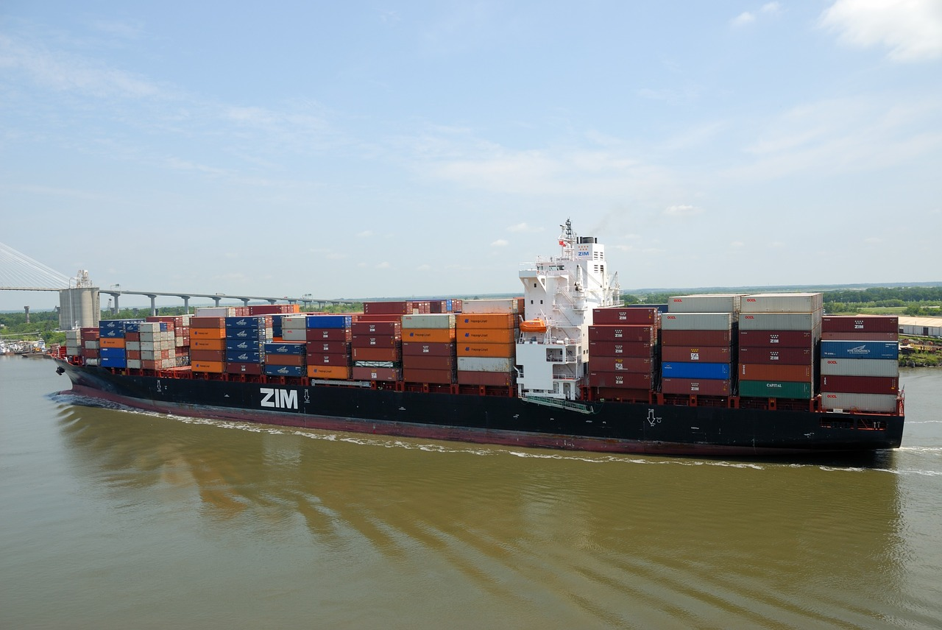
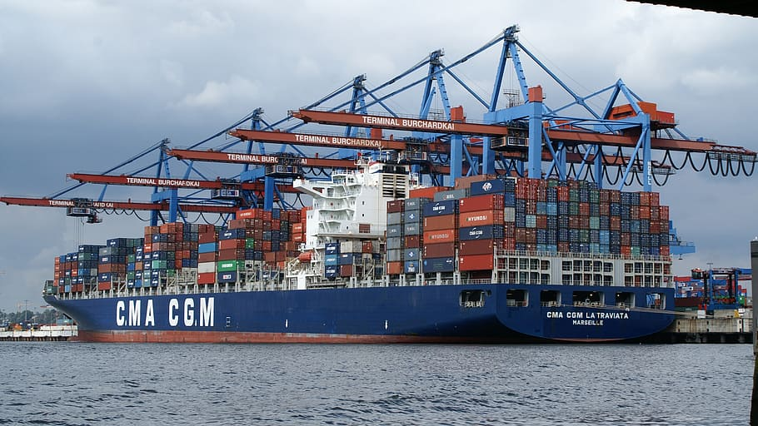
Are you planning to carry a large load?
Do you need to transport the cargo over a long distance but do not care about time? Our company also has a solution for this need. Mainly our ships sail on the Baltic Sea, but if necessary, we can also prepare long-distance transport.

Slide 10
ADDITIONAL SERVICES

Slide 11
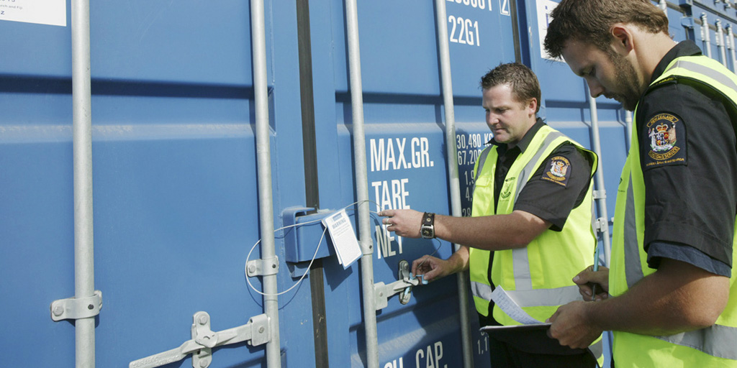
CUSTOMS SERVICES
Customs services AEO certificate as a guarantee of priority service

Slide 12
INSURANCE
PolShip offers its clients a cargo insurance service.
Our "all risks" cargo insurance conditions are the most convenient and reliable solution for the most demanding customers.

Slide 13
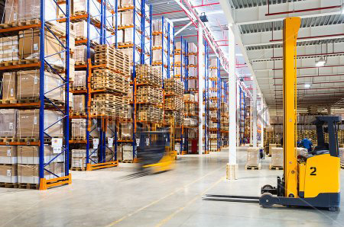
STORAGE
We can offer you warehousing services and the most competitive warehousing logistics.

Slide 14
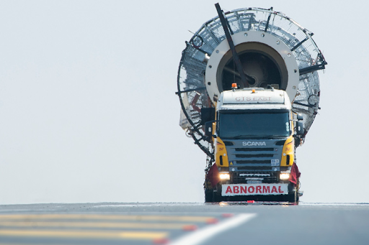
PROJECT LOGISTICS
Project logistics is a comprehensive service provided as part of a specific investment project, covering all methods of goods delivery.

Slide 15
ADVANTAGES OF OUR COMPANY
• Accuracy
• Reliability
• Fast action
• Highly educated employees
• Good knowledge of all procedures and organization of transport
• Timeliness
• Appropriate high-class equipment with GPS transmitters, seals and other security systems
• Professionalism

Slide 16
We invite You to use our services
Let's make logistics easier together

