Slide 1
CLASSICS FROM DIFFERENT PERSPECTIVES
CURRICULUM INTEGRATION
Ali ayağ multı-program anatolıan hıgh school - süloğlu - edirne
By Hılal altay and her students

Slide 2
I am Hilal altay
I am an English Teacher in Edirne Süloğlu Ali Ayağ Multi-Program Anatolian High School.
In this project, we examine five types of classics; a film, a poem, a book, a piece of music and a painting.
We have partners from different countries (Greece and Georgia) so our project language is English.

Slide 3
Our project ıs hıghly entegrated wıth the englısh lesson outcomes.
Students use the target language during whole process of the project. (Watching the film, discussing, using web2 tools, writing a poem, reading a poem, acting) So, English lessons and this project have the same goals.

Slide 5
Integratıon wıth lıterature
During reading activities, students find out the meanings of the vocabulary from the context, the plot and the conflicts.
During the project process, students write different types of texts. ( Poems, sketches, e-letters)
In poem month, students read the poem and the life of Shakespeare. They also examine the poem in terms of the period it was written.
Students understand the book, texts, poem and comments.

Slide 6
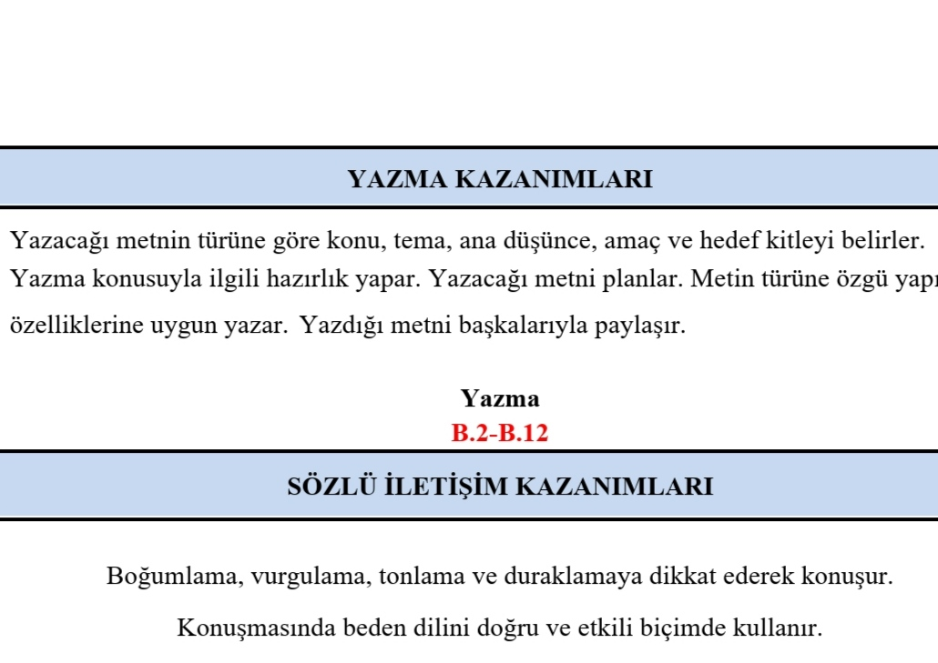
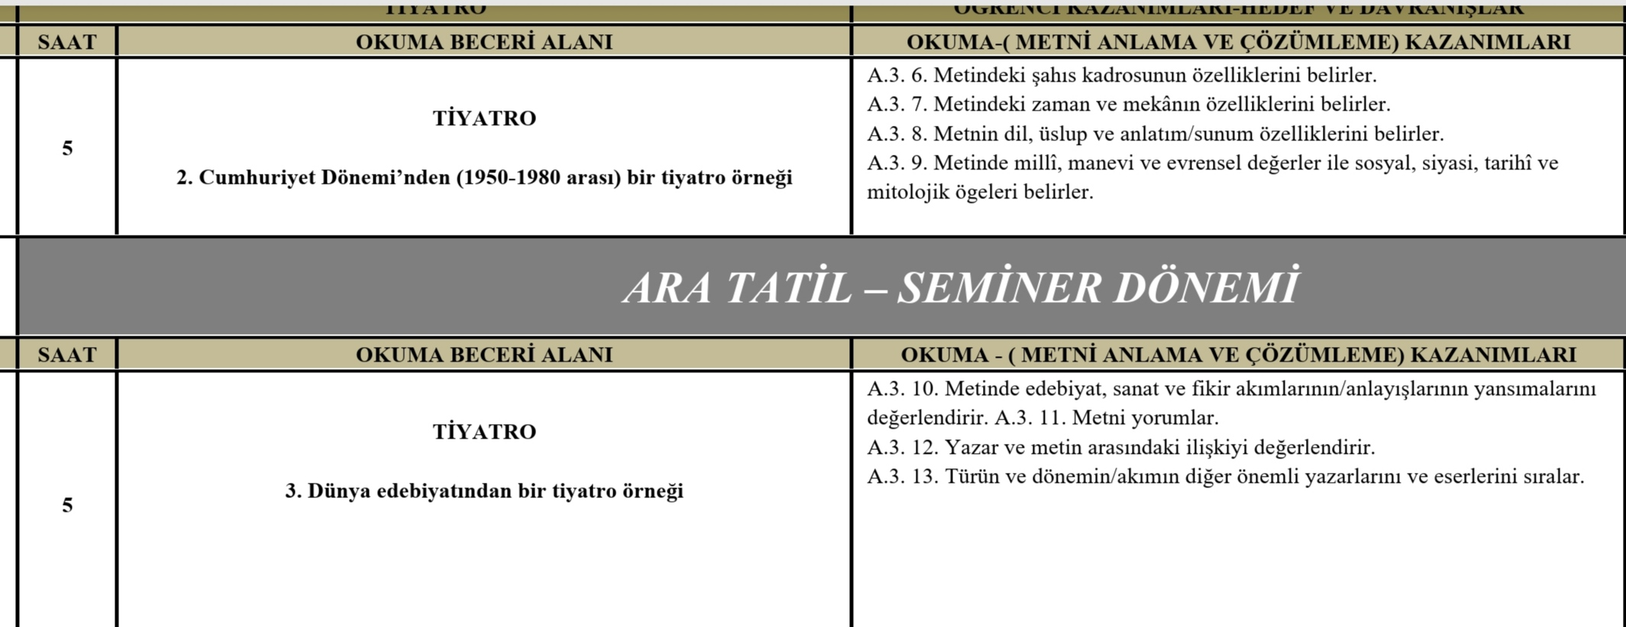

Slide 7
Integratıon wıth vısual arts
In our painting month, students learn about famous painters and famous paintings.
They have the chance for painting a classic painting and examining it.

Slide 8
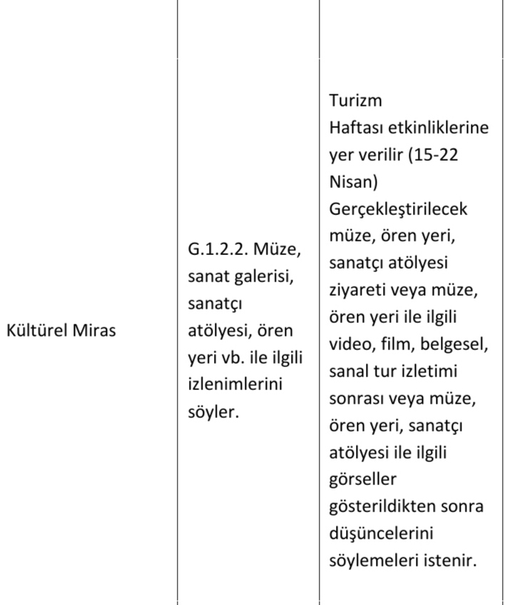
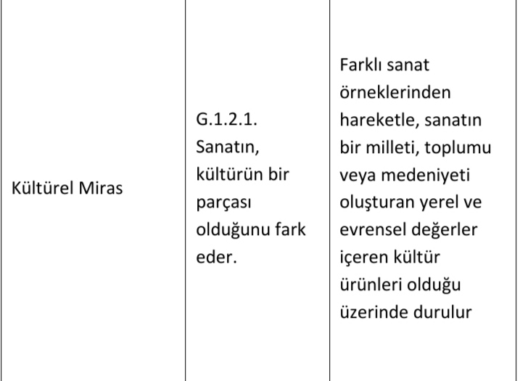

Slide 9
Integratıon wıth musıc
During our music month, students listen to the 9th symphony af Beethoven.
They also sing the symphony and learn about Beethoven. (They search about him, watch the film Understanding Beethoven)

Slide 10
