Slide 1
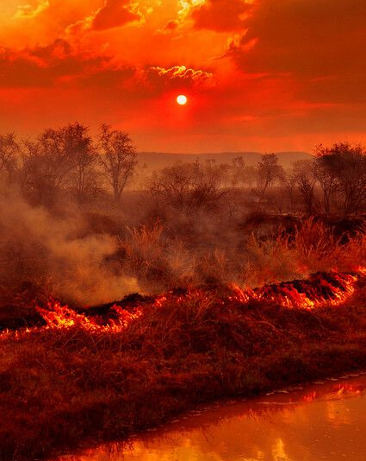
ERASMUS + SLOVAKIA
What causes water scarcity?
Fires in Australia

Slide 2
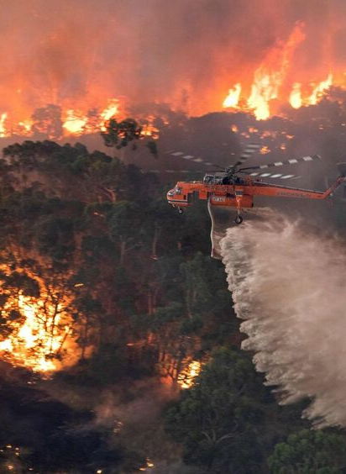
CAUSES?
Can climate change cause fires? The murder fires occured regularly and long before the climate crisis, which only accelerated the fires. But journalists and politicians from all over the world point to a terrible fire as a confirmation of their worst climate change concerns. According to them, Australian Inferno is just a mind decoction of the horrors that lie ahead.
FIRES IN AUSTRALIA

Slide 3
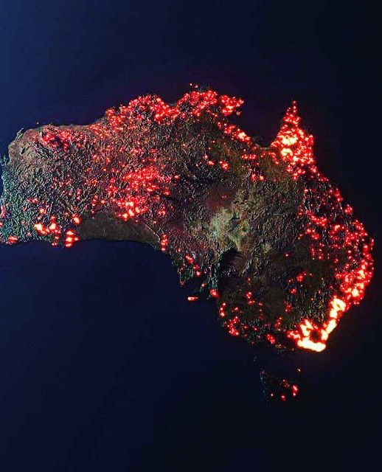
Space imagery also shows the seriousness of the situation in Australia.
Tragedy of unprecedented dimensions. So people perceive the worst poses in Australia's history. Even a month after the fires, the situation is not much better and the rain has brough only a brief relief.

Slide 4
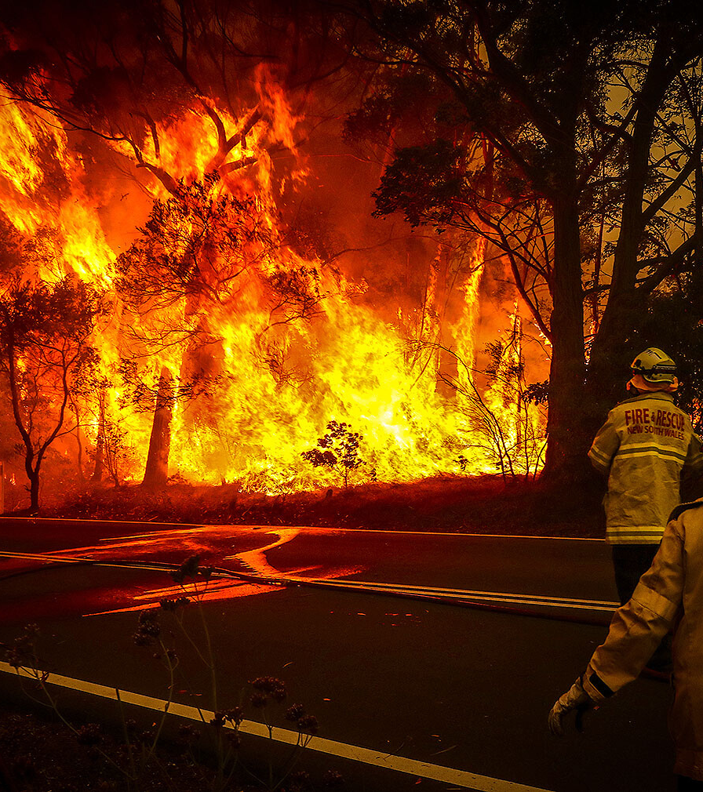
In a fire they discovered a water system that is older than the pyramids in Egypt
The system is approximately 25 meters long, but other burnt-out landscapes like canals and ponds can also be seen.

Slide 5
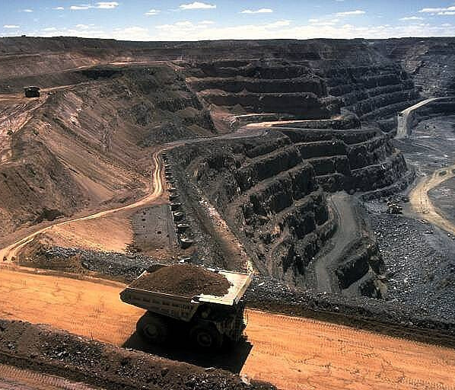
Weakened industry
Large-scale fires in Australia also affect coal production, which is one of the country's main export commodities.

Slide 6
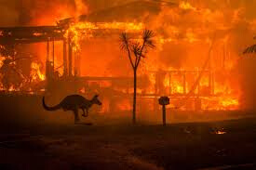
Victims
The Devastating fires killed 29 people, milions of animals, destroyed more than 2,500 houses and burned 11 miliion hectares of land since September.

Slide 7
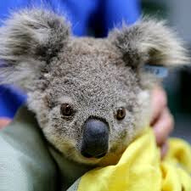
Koalas are in danger
The future of the koala, perhaps Australia's best-loved animal, is under threat because greenhouse gas emissions are making eucalyptus leaves – their sole food source – inedible.
Scientists warned yesterday that increased levels of carbon dioxide in the atmosphere were reducing nutrient levels in the leaves, and also boosting their toxic tannin content. That has serious implications for koalas and other marsupials that eat only, or mainly, the leaves of gum trees. These include a number of possum and wallaby species.

Slide 8
Donate
ON THE INTERNET WE CAN FIND A PLENTY PAGES WHERE WE CAN DONATE MONEY TO AUSTRALIAN FOUNDATIONS:
https://donate.wwf.org.au/donate/koala-crisis/koala-crisis
https://donatebushfires.org/
https://www.redcross.org.au/

Slide 9
Thank you for your attention

