Slide 1
Mark Zuckerberg
Peter Štrpka

Slide 2
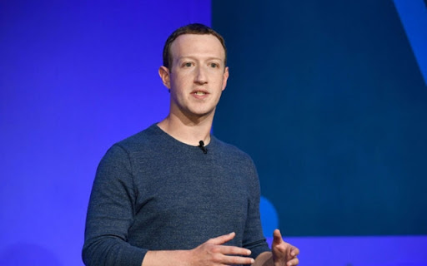

Slide 3
Who is Mark Zuckerberg ?
Mark Elliot Zuckerberg (born May 14, 1984) is an American internet entrepreneur and philanthropist. He co-founded Facebook, Inc. and serves as its chairman, chief executive officer, and controlling shareholder. He also co-founded and is a board member of the solar sail spacecraft development project Breakthrough Starshot.

Slide 4
Born in White Plains, New York, Zuckerberg attended Harvard University, where he launched the Facebook social networking service from his dormitory room on February 4, 2004, with college roommates Eduardo Saverin, Andrew McCollum, Dustin Moskovitz, and Chris Hughes. Originally launched to select college campuses, the site expanded rapidly and eventually beyond colleges, reaching one billion users by 2012. Zuckerberg took the company public in May 2012 with majority shares. His net worth is estimated to be nearly $82 billion as of February 2019, increasing over the past year with Facebook stock as a whole.

Slide 5
In 2007, at age 23, he became the world's youngest self-made billionaire. As of 2019, he is the only person under 50 in the Forbes ten richest people list, and the only one under 40 in the Top 20 Billionaires list.
Since 2010, Time magazine has named Zuckerberg among the 100 wealthiest and most influential people in the world as a part of its Person of the Year award. In December 2016, Zuckerberg was ranked 10th on Forbes list of The World's Most Powerful People.

Slide 6
Childhood
Zuckerberg was born on May 14, 1984, in White Plains, New York.
At Ardsley High School, Zuckerberg excelled in classes. After two years, he transferred to the private school Phillips Exeter Academy, where he won prizes in mathematics, astronomy, physics, and classical studies. In his youth, he also attended the Johns Hopkins Center for Talented Youth summer camp. On his college application, Zuckerberg stated that he could read and write French, Hebrew, Latin, and ancient Greek. He was captain of the fencing team.

Slide 7
Early programming
Zuckerberg began using computers and writing software in middle school. His father taught him Atari BASIC Programming in the 1990s, and later hired software developer David Newman to tutor him privately. Zuckerberg took a graduate course in the subject at Mercy College near his home while still in high school. In one program, since his father's dental practice was operated from their home, he built a software program he called "ZuckNet" that allowed all the computers between the house and dental office to communicate with each other. It is considered a "primitive" version of AOL's Instant Messenger, which came out the following year.

Slide 8
Facebook
On February 4, 2004, Zuckerberg launched Facebook from his Harvard dormitory room. An earlier inspiration for Facebook may have come from Phillips Exeter Academy, the prep school from which Zuckerberg graduated in 2002. It published its own student directory, "The Photo Address Book", which students referred to as "The Facebook".

Slide 9
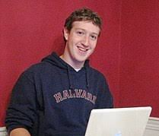

Slide 10
Once at college, Zuckerberg's Facebook started off as just a "Harvard thing" until Zuckerberg decided to spread it to other schools, enlisting the help of roommate Dustin Moskovitz. They began with Columbia University, New York University, Stanford, Dartmouth, Cornell, University of Pennsylvania, Brown, and Yale. Samyr Laine, a triple jumper representing Haiti at the 2012 Summer Olympics, shared a room with Zuckerberg during Facebook's founding. "Mark was clearly on to great things," said Laine, who was Facebook's fourteenth user.

Slide 11
Zuckerberg, Moskovitz and some friends moved to Palo Alto, California in Silicon Valley where they leased a small house that served as an office. Over the summer, Zuckerberg met Peter Thiel, who invested in the company. They got their first office in mid-2004. According to Zuckerberg, the group planned to return to Harvard, but eventually decided to remain in California. Since then facebook has been growing.

Slide 12
The End

