Slide 1
Use of electricity in our household

Slide 2
Top 5 household Appliances Which use the most electricity
Our top 5 appliances with the biggest usage of electricity in our household include a fridge, freezer, televison, washing machine and domestic sewage treatment plant, which is located in our garden, because we do not have sewerage in our village.

Slide 3
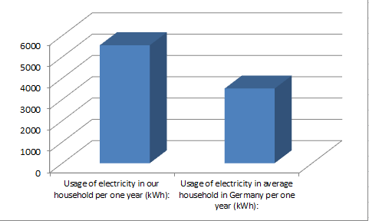
Total usage of electricity in our house
Total usage of electricity in our house is 5 546,4 kWh per year, which means it is 462,2 kWh per one month and 15,4 kWh per one day. In 2010, an average usage of electricity of one average household in Germany was 3 512 kWh per year. So compared with average German household we have more than 1,5 times bigger usage of electricity.

Slide 4
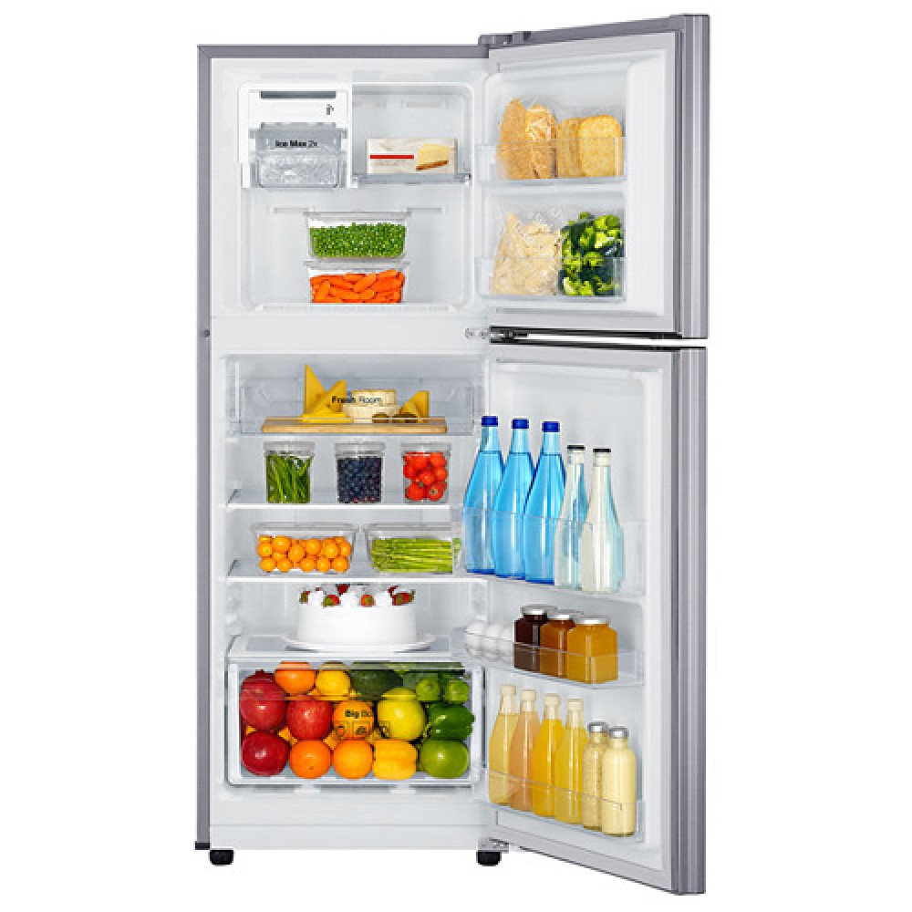
Fridge

Slide 5
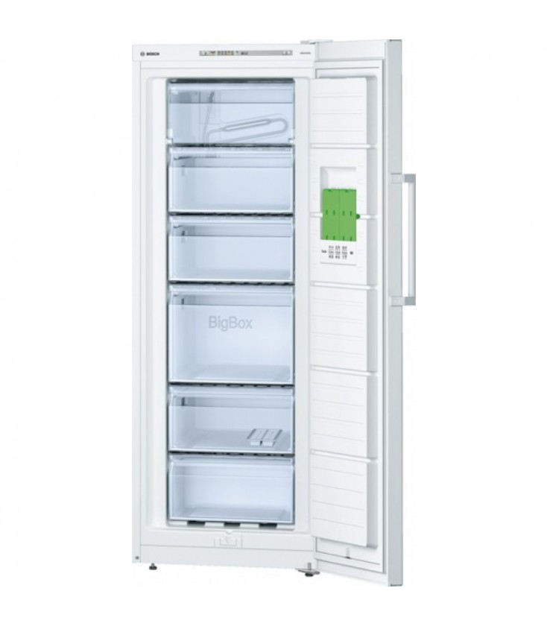
Freezer

Slide 6
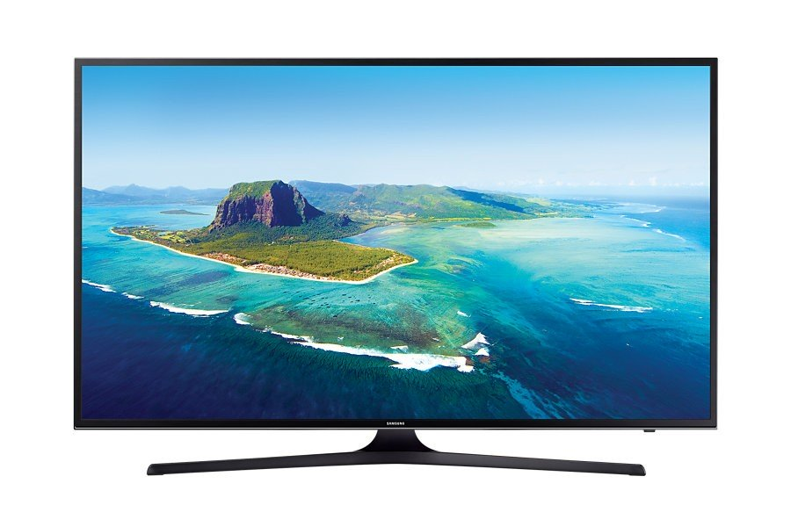
Television

Slide 7
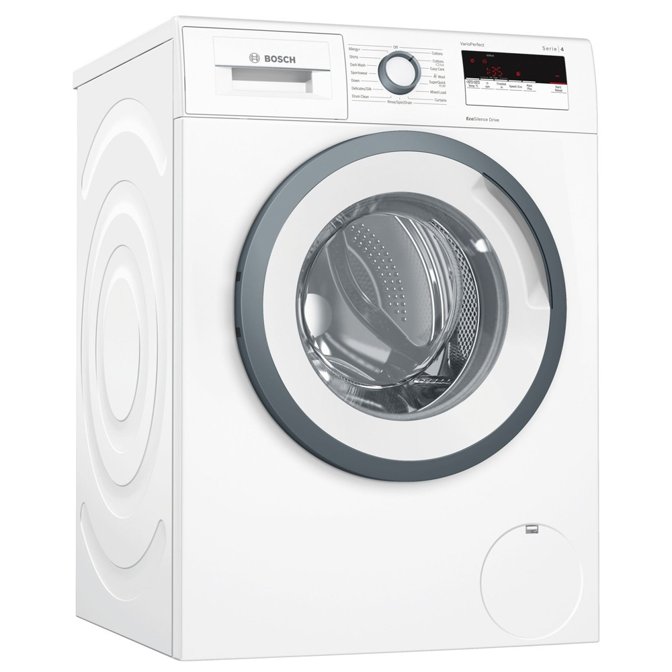
Washing machine

Slide 8
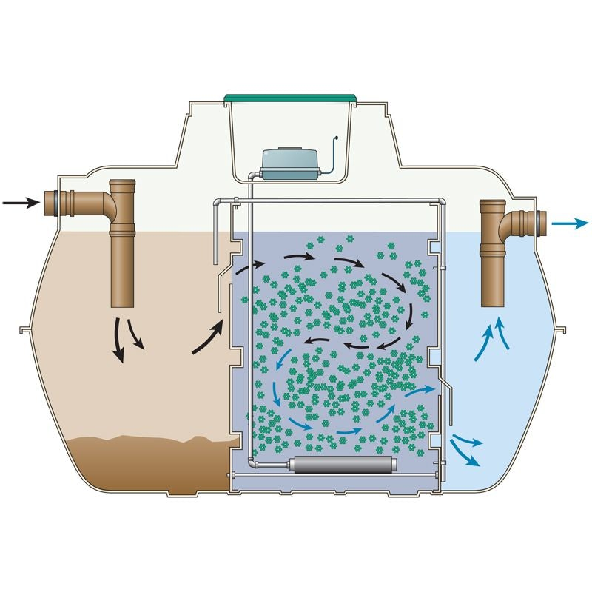
domestic sewage treatment plant

Slide 9
Total use of electricity by top 5 appliances

Slide 10
Total use of electricity by top 5 most demanding appliances is:
3,87 kWh per day
116,5 kWh per month
1413 kWh per one year

Slide 11
Distribution of usage of electricity in our household

Slide 12
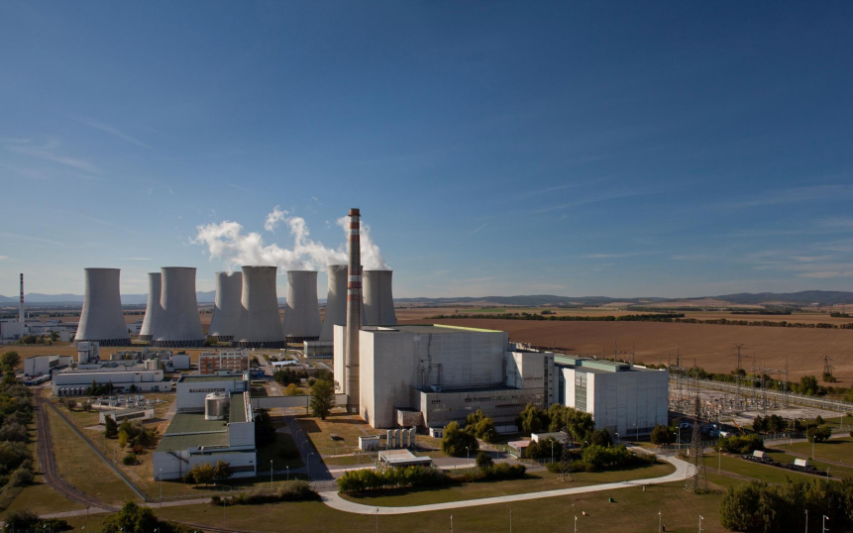
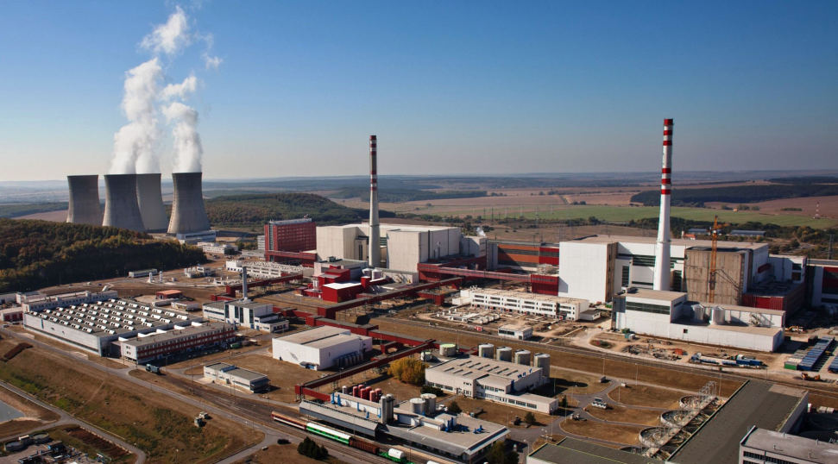
Production of electricity in slovakia
The biggest part of production of electricity in Slovakia is presented by nuclear power plants. We have four reactor blocks, two are located in Bohunice (AE Bohunice) and the other two in Mochovce (AE Mochovce). Together they are delivering more than half of the electricity in Slovakia.

Slide 13
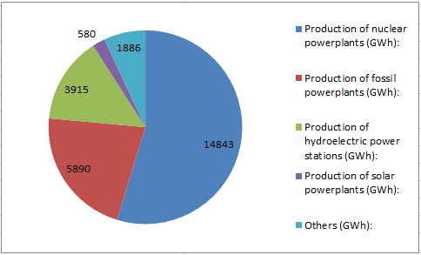
The second biggest part of production of electricity is presented by powerplants which are producing electricity from fossil fuels. The third biggest part are hydroelectric power stations. The most powerful hydroelectric power stations in Slovakia are PVE Čierny Váh and Gabčíkovo Waterworks. We are also producing electricity from solar powerplants but compared to nuclear, fossil and hydroelectric powerplants it is only a small amount of energy.

Slide 14
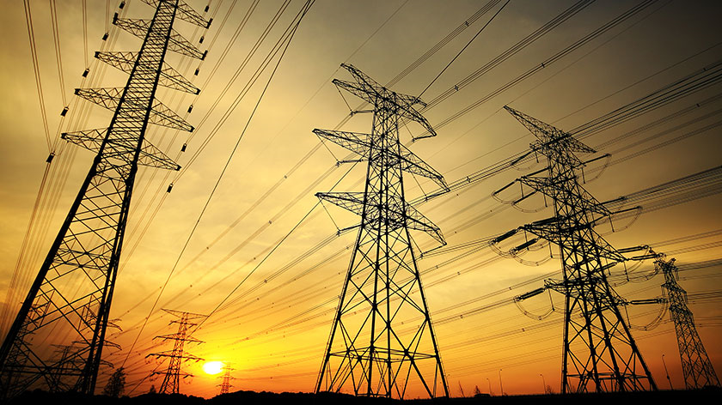
Thanks for paying attention!
Made by: Viliam Uhliar

Slide 15
Sources:
https://energoklub.sk/sk/clanky/ako-sa-v-roku-2018-vyvijala-spotreba-a-vyroba-elektriny-na-slovensku/
https://www.seas.sk/atomova-jadrova-elektraren
Own sources

