Slide 1
free fall parachuting
Sophia Novosádová
I.B

Slide 2
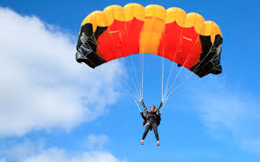
Parachuting
is a method of transiting from a high point to Earth with the aid of gravity, involving the control of speed during the descent using a parachute or parachutes
it may involve more or less free-falling which is a period when the parachute has not yet been deployed and the body gradually accelerates to terminal velocity.

Slide 3
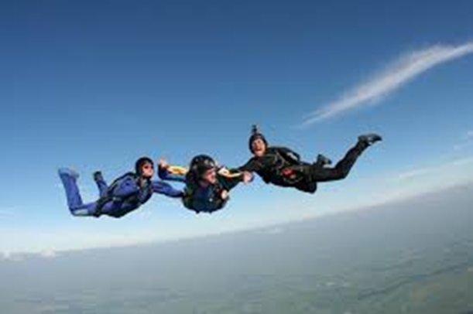
Free fall parachuting
the term 'freefall' refers to the part of a skydive where you're not using your parachute, you're simply falling through the sky, with nothing to hold you back
it's called 'freefall' because you literally are free, there are no constraints, no bungee cords, nothing but the open air and the wind in your face

Slide 4
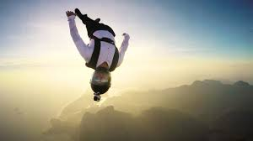
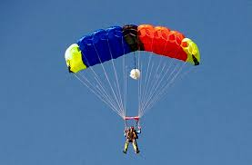
Difference between free fall parachuting and parachuting
difference between free fall parachuting and parachuting is that in free fall parachuting, we freefall before deploying our parachutes, and in parachuting, we deploy the parachute straight away
free fall parachuting parachuting

Slide 5
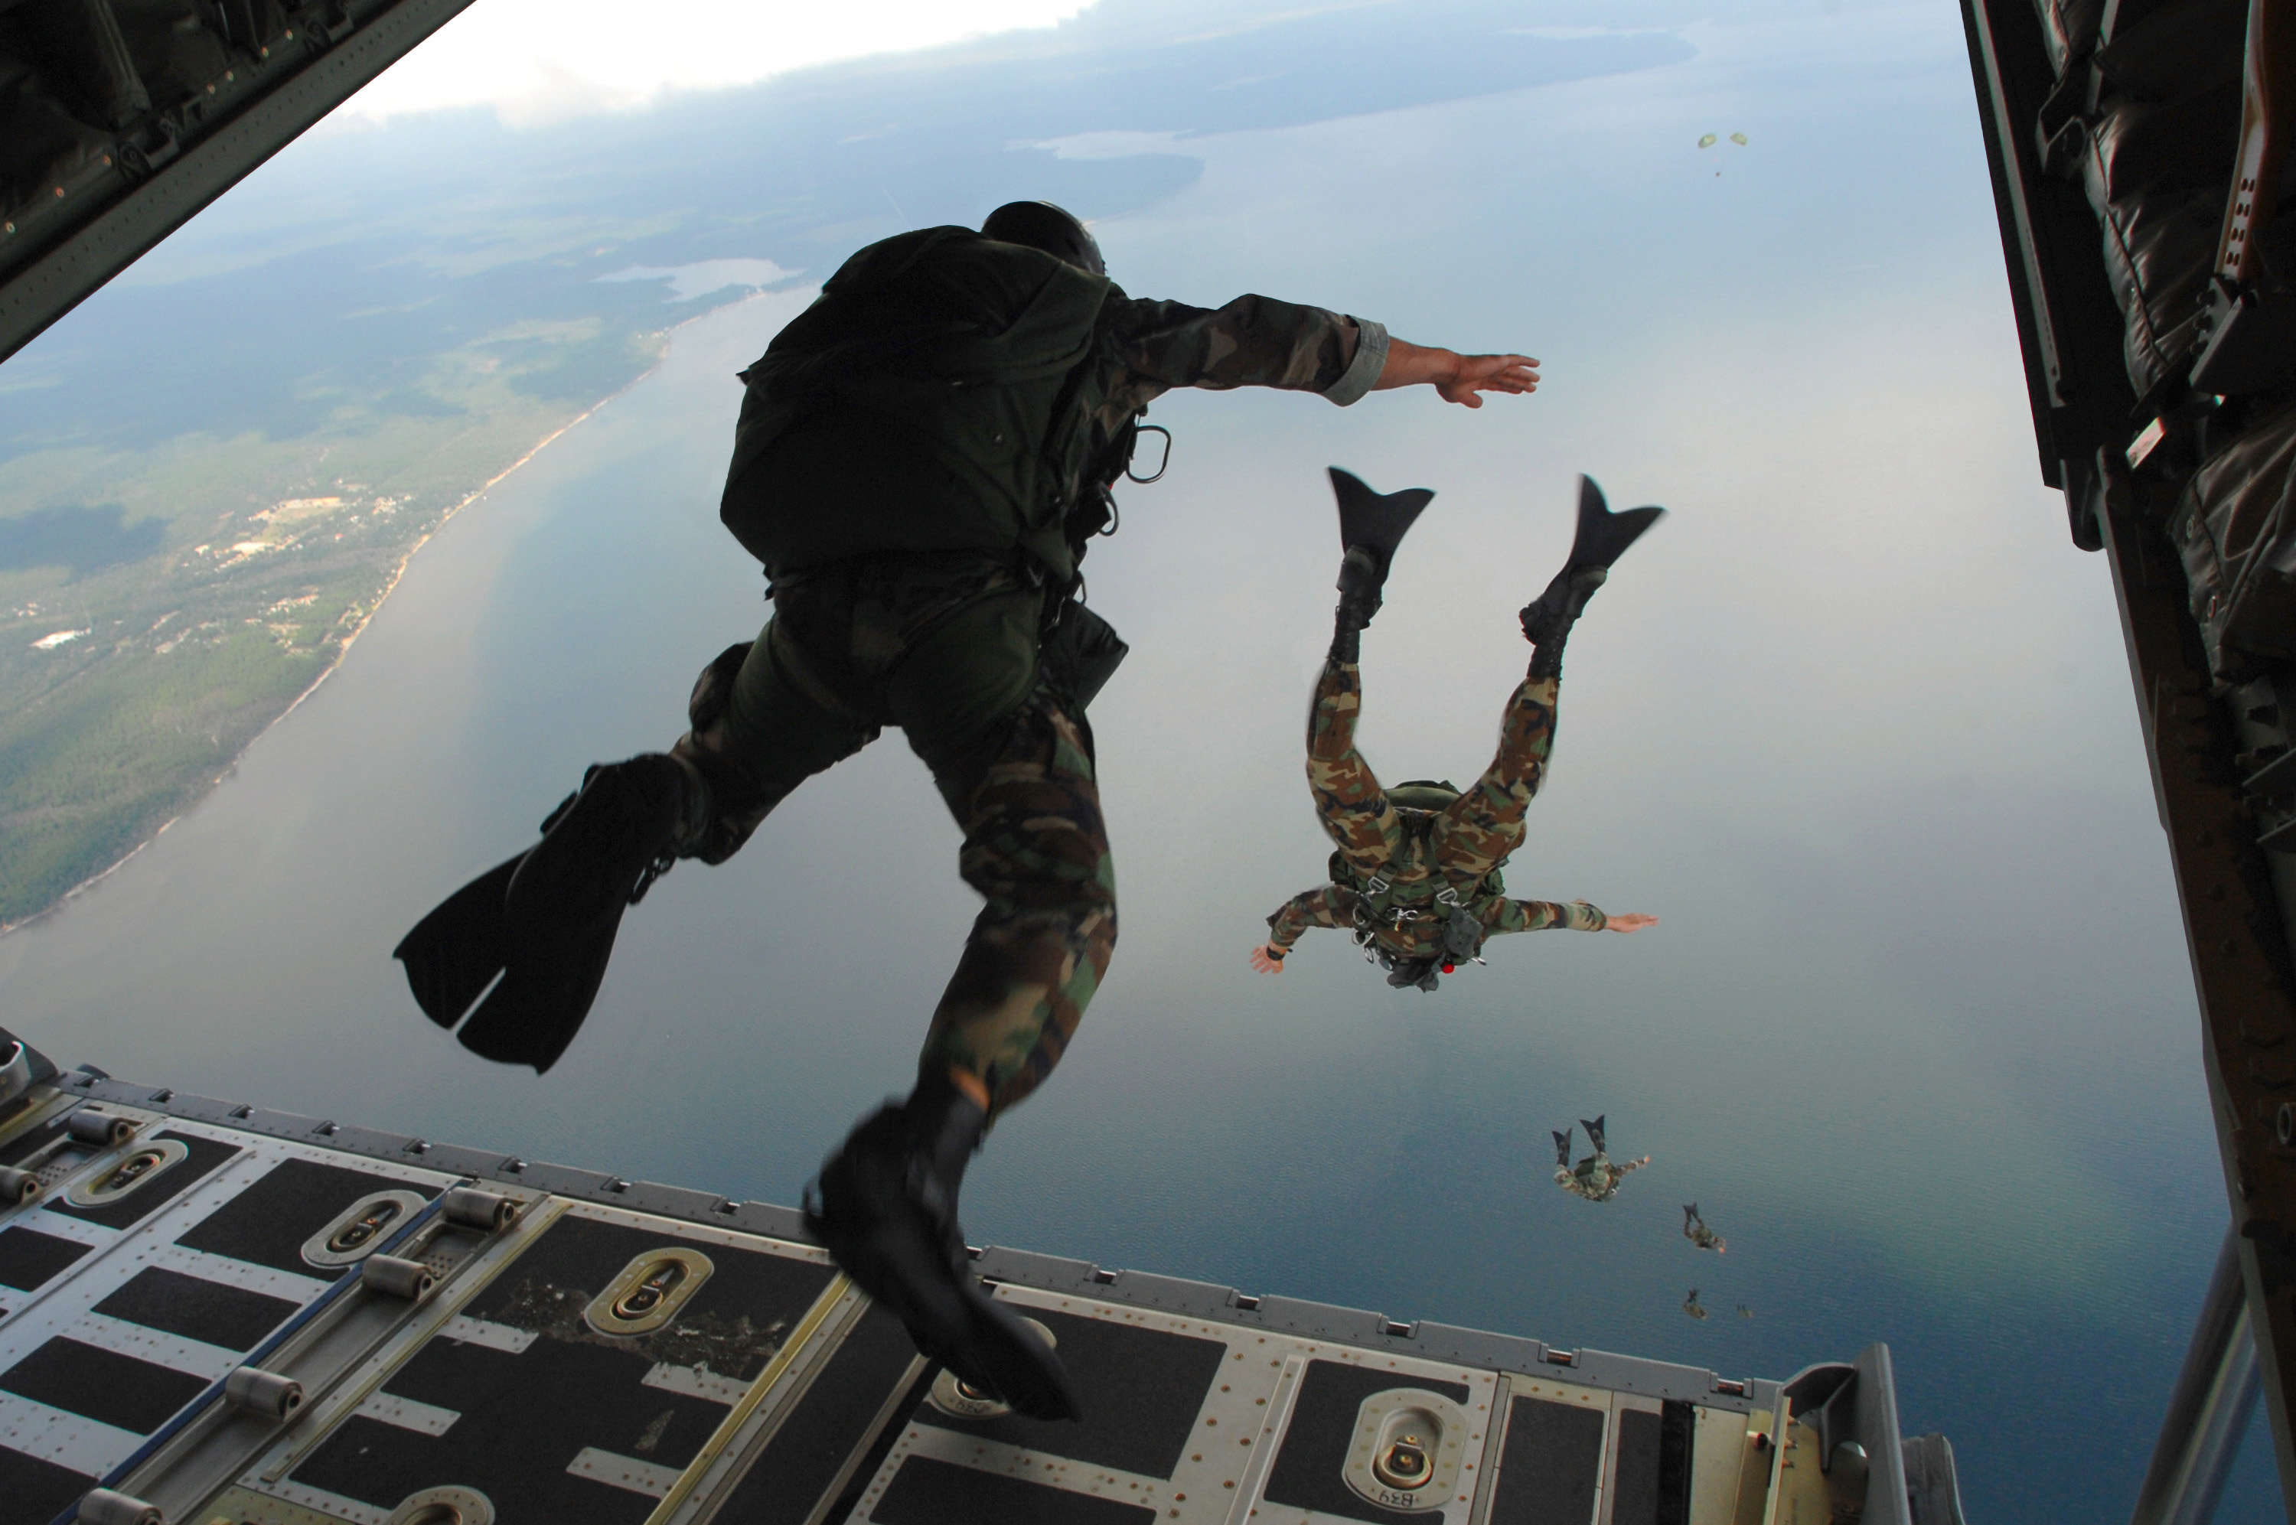
How fast is free fall?
near the surface of the Earth, an object in free fall in a vacuum will accelerate at approximately 9.8 m/s2, independent of its mass
with air resistance acting on an object that has been dropped, the object will eventually reach a terminal velocity, which is around 53 m/s for a human skydiver

Slide 6
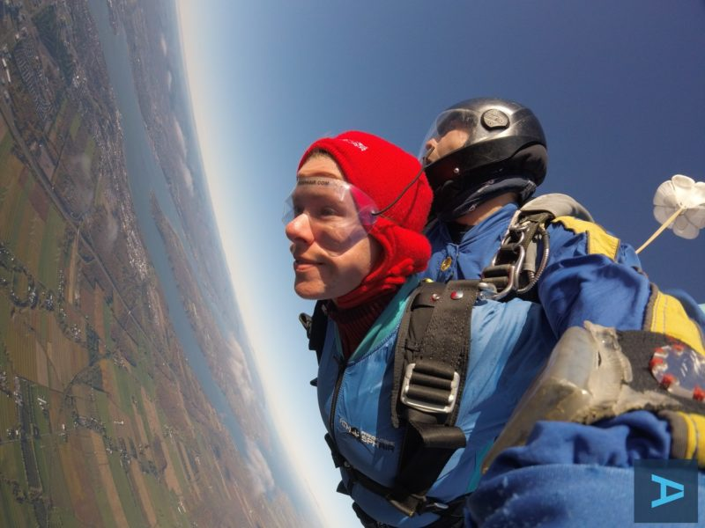
How long can you free fall?
on average, you fall 200 feet per second during a skydive
from 10,000 feet, this means you'll be in freefall for approximately 30 seconds
from 14,000 feet, you'll fall for 60 seconds
from 18,000 feet, it's about 90 seconds

Slide 7
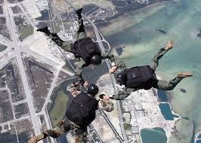
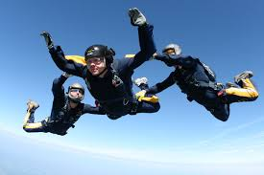
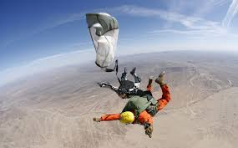

Slide 8
Resources
https://en.wikipedia.org/wiki/Parachuting
https://www.skydivecarolina.com/blog/skydiving-freefall-what-to-expect/
https://www.skydiveorange.com/2017/05/16/how-long-do-you-freefall-when-skydiving/
https://en.wikipedia.org/wiki/Free_fall

