Slide 1
Electric energy in the home
Karolína Kollárová 2.A

Slide 2
Energy consumption in our home
This table shows the consumption of the appliances per week
For the month of November these five appliances consumed approximately 62.68 kWh which is 54.03% of total monthly consumption
The graph shows the percentage consumption of the appliances per month

Slide 3
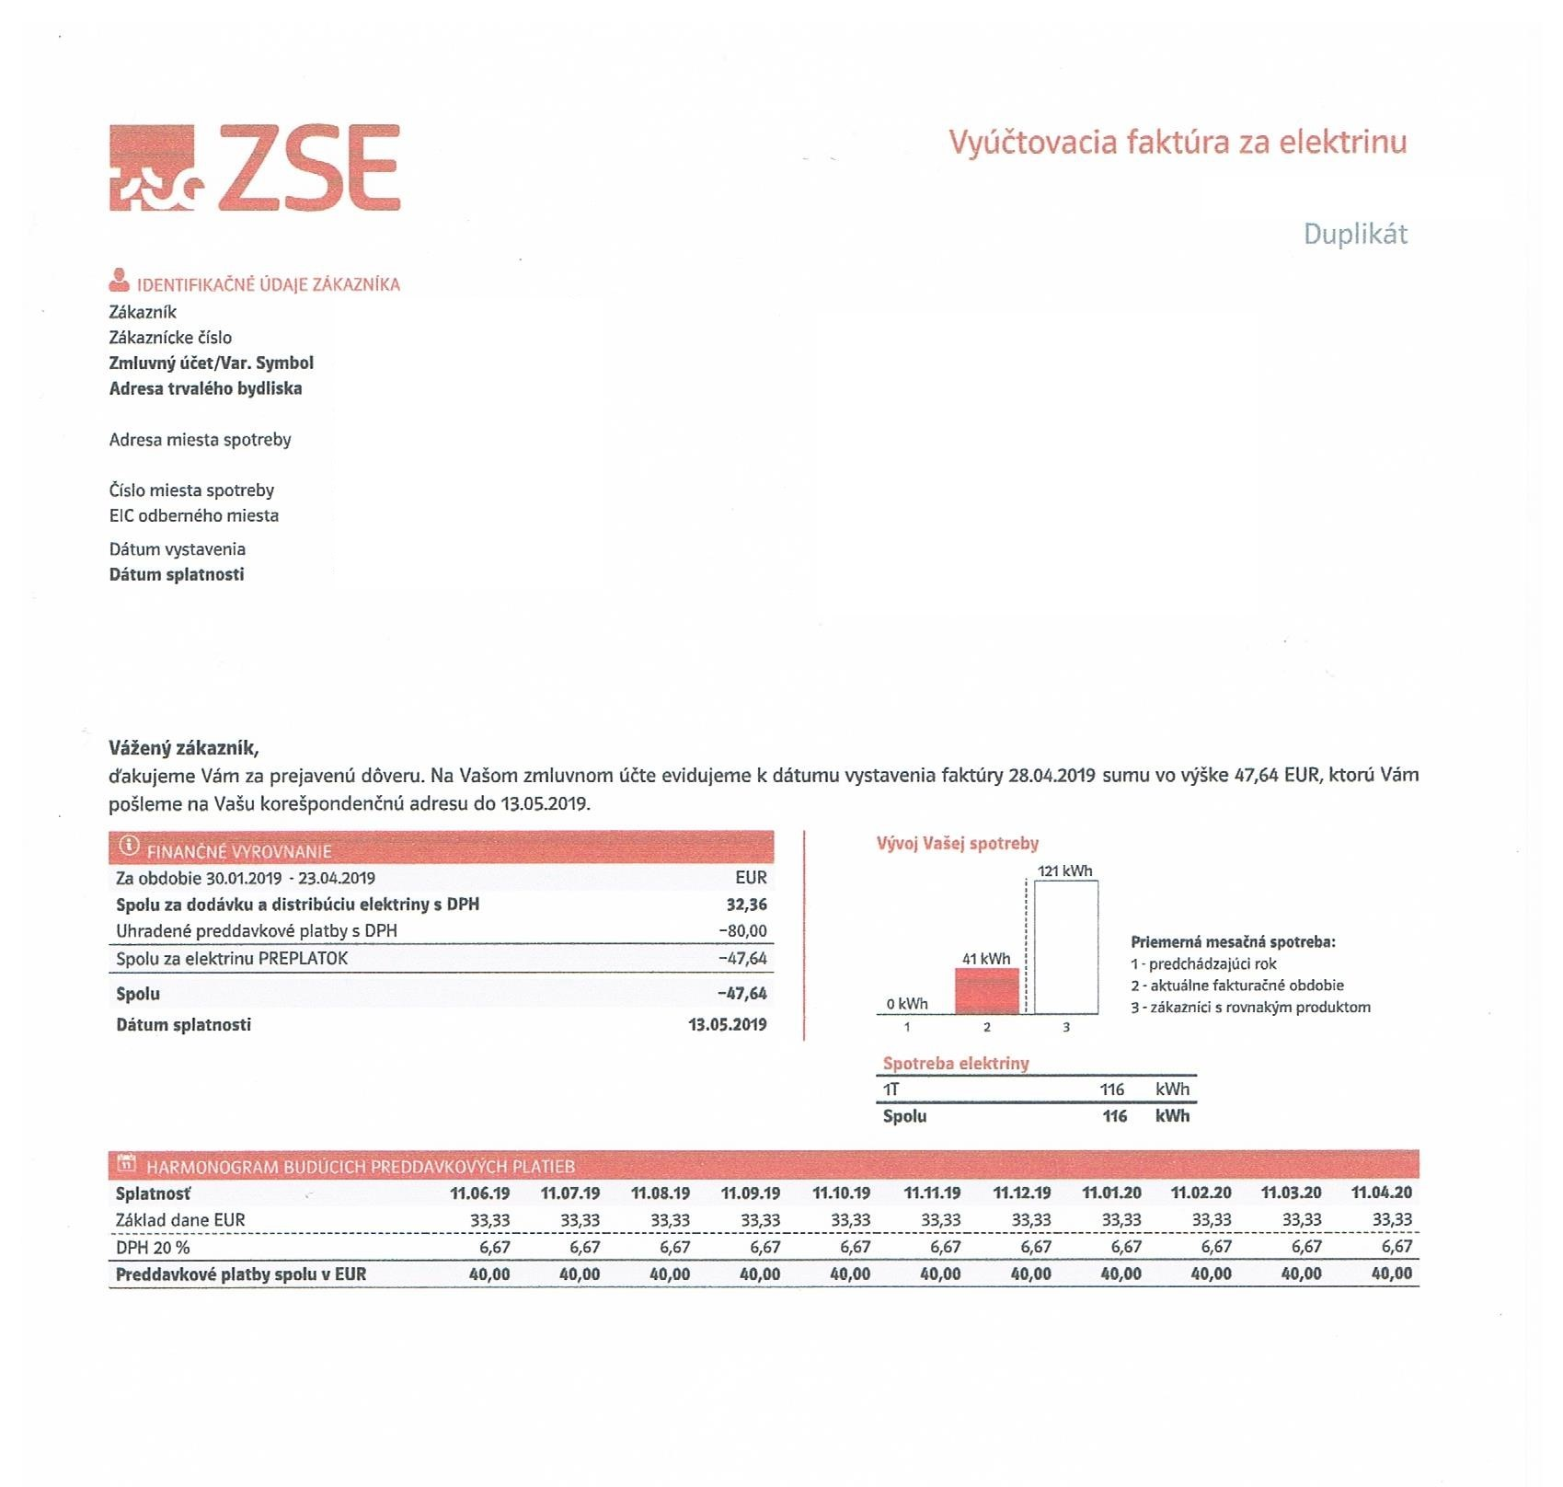
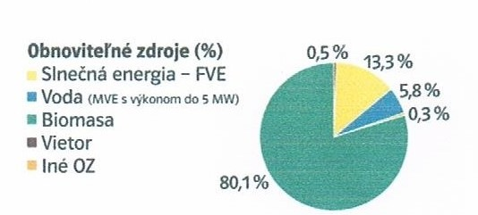
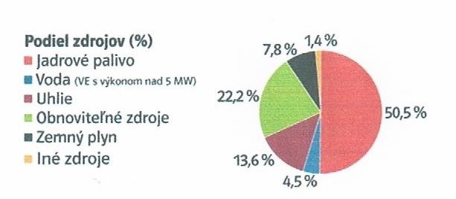
Power consumption per month: listings and graphs

Slide 4
Annual average family consumption
I apologize but the graphs and tables are in the original version as they are downloaded from the Internet.

Slide 5
Types of electricity production in Slovakia
More than half (56.9%) electricity in Slovakia comes from nuclear power plants, 16.8% produce hydro power plants, 12.8% heat and 13.6% come from other sources (steam, photovoltaic/solar/, wind). The main electricity producer is the stock company Slovak Power Plant, which operates 2 nuclear, 2 coal, 35 water and 2 photovoltaic power plants.
The chart can show that Slovakia is based on the production of nuclear energy and fossil fuel energy.

Slide 6
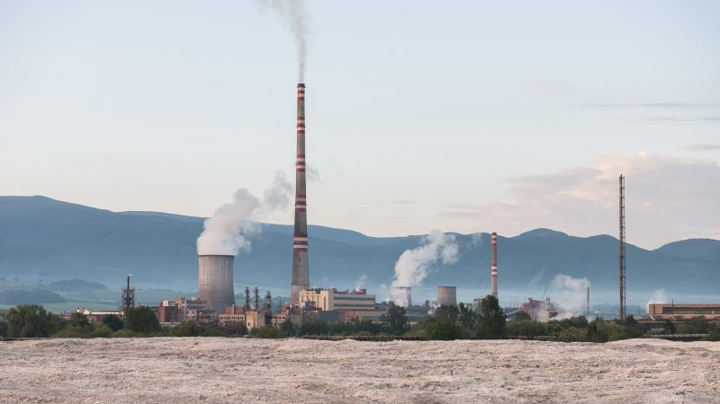
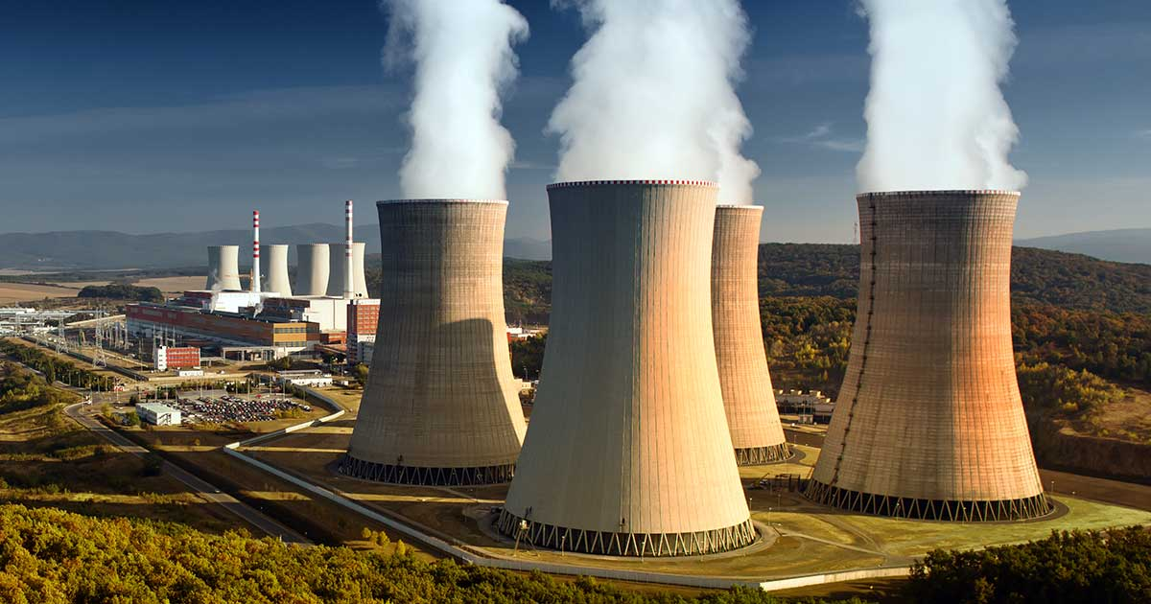
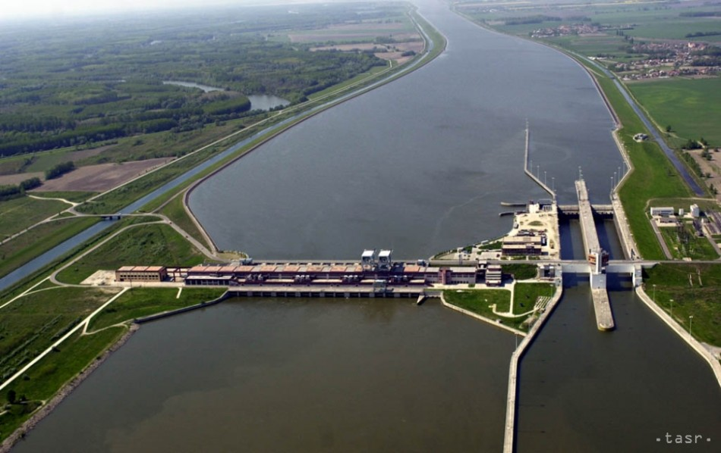
Power plant Nováky
Nuclear power plants
The production of nuclear energy is a leader in Slovakia.
There are 2 nuclear power plants in our territory: The Atomic power plant Jaslovské Bohunice and Mochovce.
Thermal power plants
Under the administration of Slovakia there are two thermal power plants namely: power plant Nováky and power plant Vojany.
Hydro Power
In Slovakia there are very many and their energy production is represented in the second
place, but due to the large dry during the year, their performance decreased.
The most powerful power plants are: PVE Čierny Váh and The water work of Gabčíkovo.
A further 22 smaller power plant also plays an unrepresentative role.
The atomic power plant Mochovce
The water work of
Gabčíkovo

Slide 7
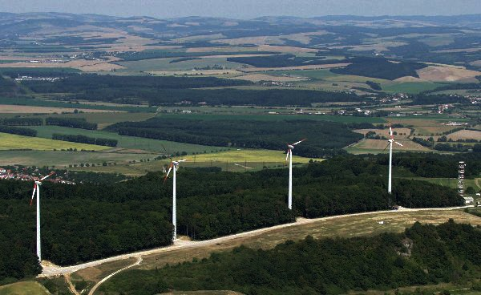
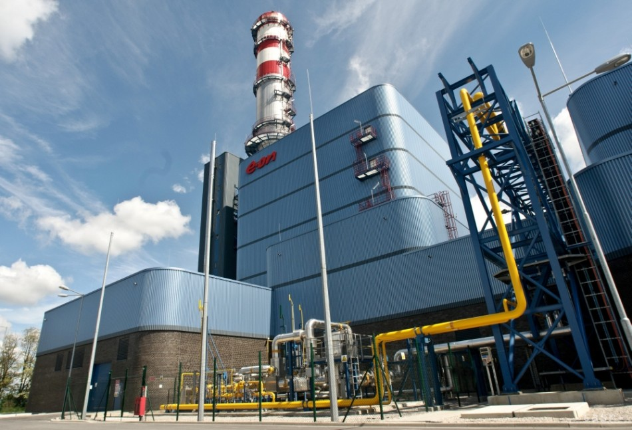
The wind power plant Cerová
The Paroplynew power plant Malženice
Other power plants
Slovakia owns a number of other power stations: wind turbines, photovoltaic and paroplynew.
Due to the non-economic operation of the paroplynew sources, these are temporarily conserved.
The share of other energy production is negligible, representing a tenth of the percentage
Wind turbines
Wind turbines have a relatively young history in Slovakia.
The wind power plant Cerová is first wind plant was built in 2003 and includes 4 turbines.
The second, the wind power plant "has only one turbine and it's a sharp hill.
The third VP of Skaliská contained 4 turbines and was in operation for four years. In 2008, it dismantled it.

Slide 8
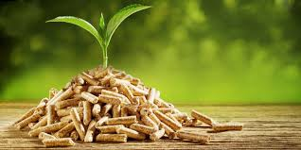
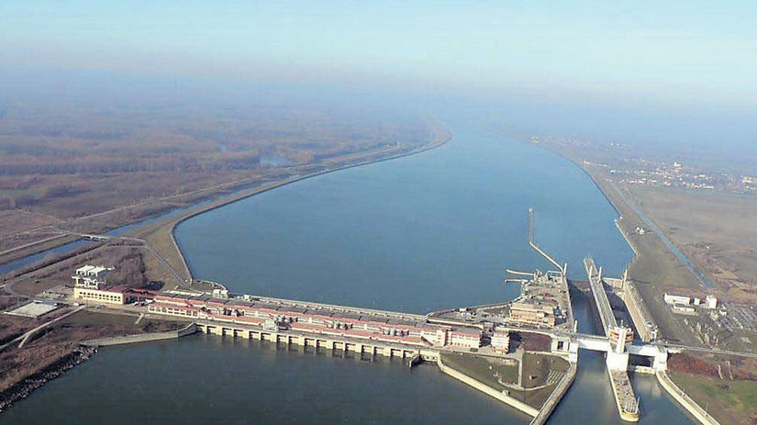
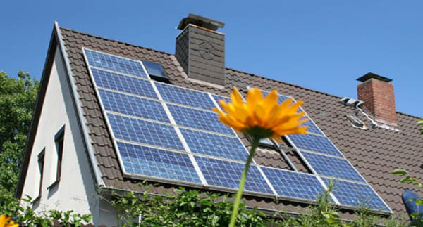
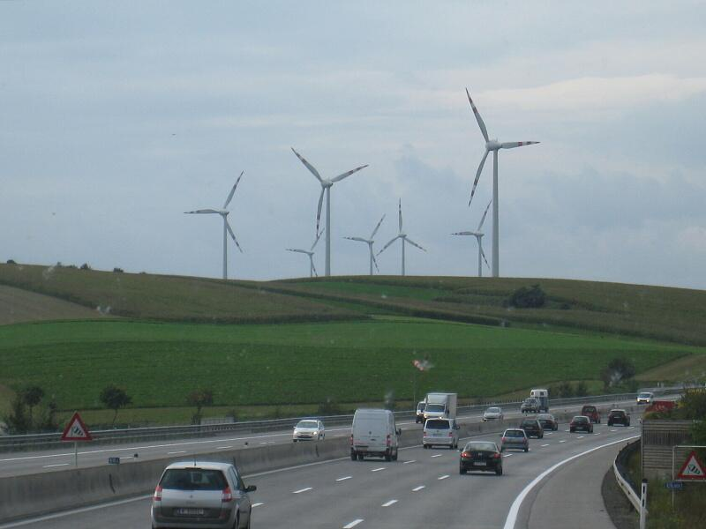
Types of electricity production in Austria
Hydro power From a topographical point of view, Austria has high potential for rivers, water reservoirs and pumping water plants. The most electric station is located on the eastern and southern parts of the Danube. Due to environmental restrictions, the problem is to obtain permits to construct new tanks or pumping stations Wind energy In Austria there are currently 1260 wind turbines with a performance of 2844 MW, which annually produce approximately seven billion kilowatthodine, which corresponds to approximately 11% of electricity consumption.
Others
I cannot also mention that the share of phopotent resources in the country is around 30%. And at the same time, power plants mainly use natural gas but also oil or coal.
For example, other types of energy production are biomass or photovoltaic.

Slide 9
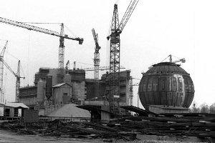
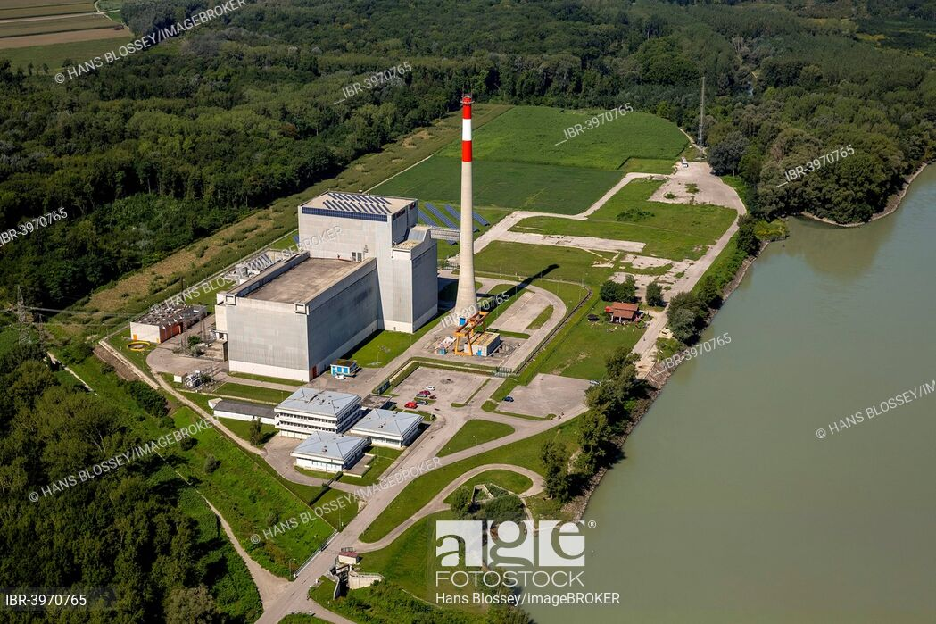
Austria and nuclear power plants
Nuclear power In the range of years 1965-1999 there were attempts to exhibit six nuclear power stations, but only in 1972 the construction of a non-small atomo-electric plant was started. Only the Zwentendorf an der Donau was found only 60 kilometres from Vienna. Interesting: Austria is the only country that owns the model of the real nuclear power plant at scale 1:1. While our neighbors are owned by a nuclear power plant, the resistance of the atom is kept. So this method of energy does not exploit.
Zwentendorf

Slide 10
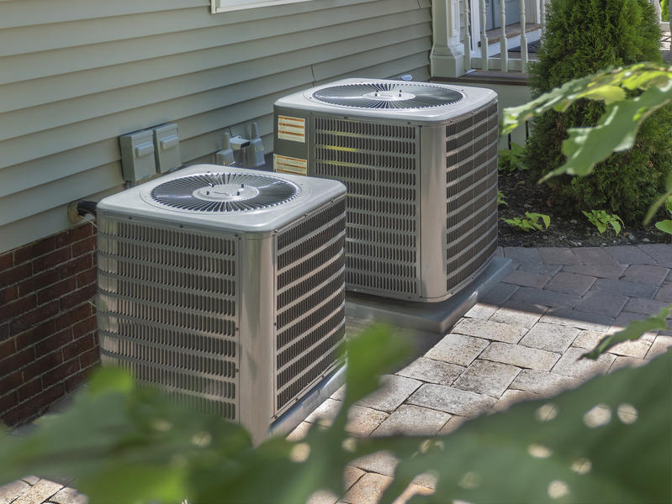
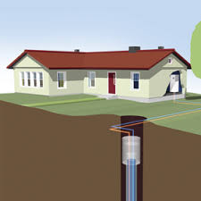
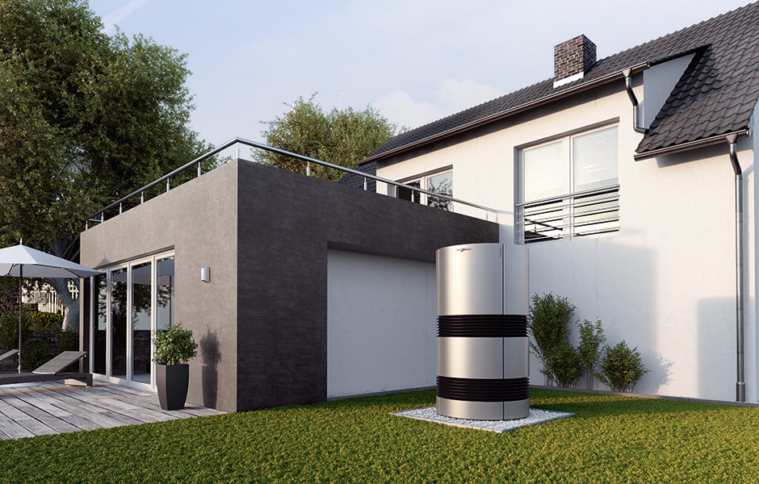
Heat pump
Earth-Air
Earth-Water
The Hornorakúska company KNV developed an intelligent heat pump.
The day divided into six cheap, 12 medium bullion and six precious hours. The pump uses cheap times, a more pronounced increase is limited by a fixed maximum price.
The basic prerequisite for the implementation of this price model is the Smart Meter activated and the pump must have intelligent control with an Internet connection in order to handle price signals.
The new pump will bring savings not only to consumers, but also to energy suppliers. Consumption is shifting to periods where enough energy is produced, for example during periods of strong wind or sunlight. In this way, renewable energy sources are more easily integrated into the market.

Slide 11
Comparison of Austrian and Slovak energy (according to me)
After reading many articles, I learned new information and came to some opinions. Austria is very environmentally based and rightfully belongs to developed countries. The fact that they replace non-renewable sources of renewable energy production is a big plus. Another such plus is that Austria is a country without nuclear power.
Specifically, they own one reactor, but it has never been started and serves only as a model. With the replacement of resources, they also had to be more creative in purchasing energy on the European market.
However, even such a developed country has negative points. Because of the substitution of resources, their tariffs are among those higher in Europe.
Where there are wind farms you will not find birds. And there's more problems.

Slide 12
However, Slovakia seems to me very undeveloped in terms of energy. We are not backward, we are not thinking ahead and we are not thinking about the environment at all. And it should also be noted that we cannot handle energy as Slovakia is completely self-sufficient in the field of energy production. But even so much energy comes from foreign exports.
Interestingly, Austria has a greater export of energy from abroad than Slovakia.
Slovakia will probably never be at the level of Austria, but we can try to make some changes that would help us make life easier. However, it is unlikely that we will be independent of nuclear energy.

Slide 13
Resources
https://www.seas.sk/zakladne-udaje
https://sk.wikipedia.org/wiki/Zoznam_elektr%C3%A1rn%C3%AD_na_Slovensku
https://dennik.hnonline.sk/podniky-a-trhy/254993-rakusko-potrebuje-energiu
https://www.aktuality.sk/clanok/563261/v-rakusku-vznikol-cenovy-model-ktory-usetri-naklady-na-elektrinu/
https://www.nuclear.sk/rozhovor-vyrabat-elektrinu-z-jadra-dava-v-rakusku-zmysel/

Slide 14
Thank you for your attention

