Slide 1
Christmas Eve

Slide 2
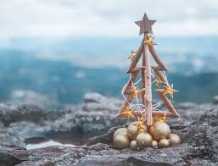
Preparation for Chistmas
Mostly Lithuanians decorate their home and Christmas tree in two ways. Some prefer minimalism - straw, cones, candy, gingerbread, apples, berries, which are close to the ancient Lithuanian culture. Meanwhile, others give in to the spirit of the American Christmas, choosing light bulbs, glowing toys, glitter.
Both types of decoration mentioned above can look festive, luxurious and tasteful at home.

Slide 3
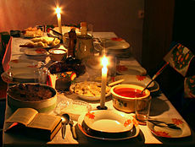
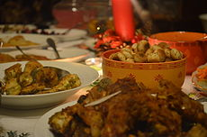
Christmas Eve
Christmas Eve is a holiday celebrated on Christmas Eve (24 December). Now it’s usually a dinner for family or close friends. Christmas Eve is also called a dish that used to feed elderflies on that day.

Slide 4
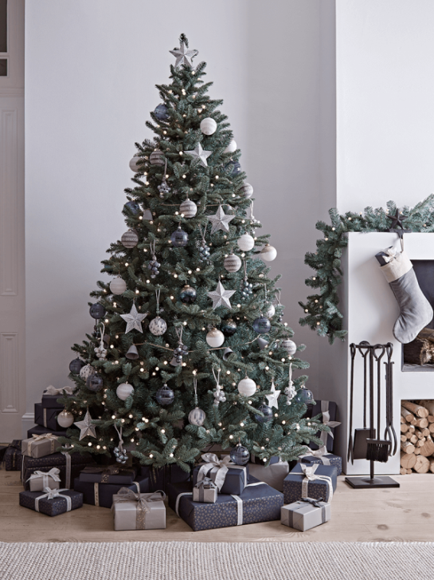
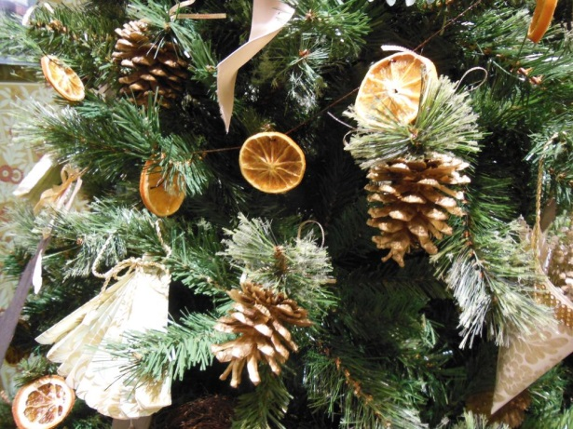
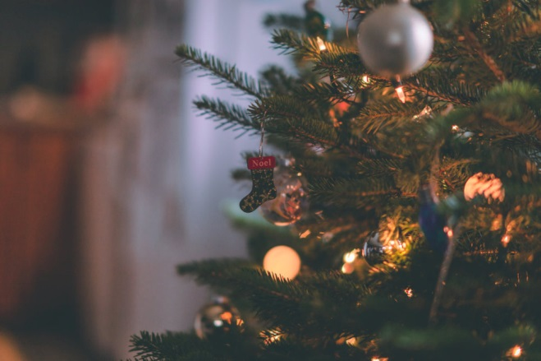
In Lithuania, every family has a tradition to decorate the Christmas tree. We hang Christmas ornaments on it, sometimes ginger sticks, dried orange peels or something what the family likes and what looks beautiful for them. On Christmas Eve we put gifts under the tree and we unpack them on 25th December.

Slide 5
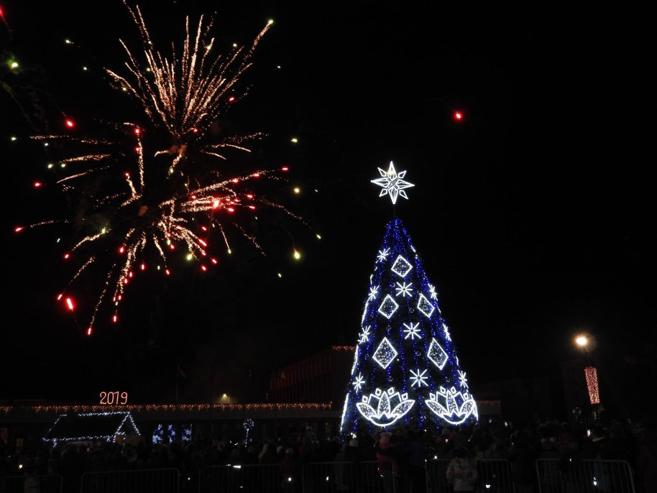
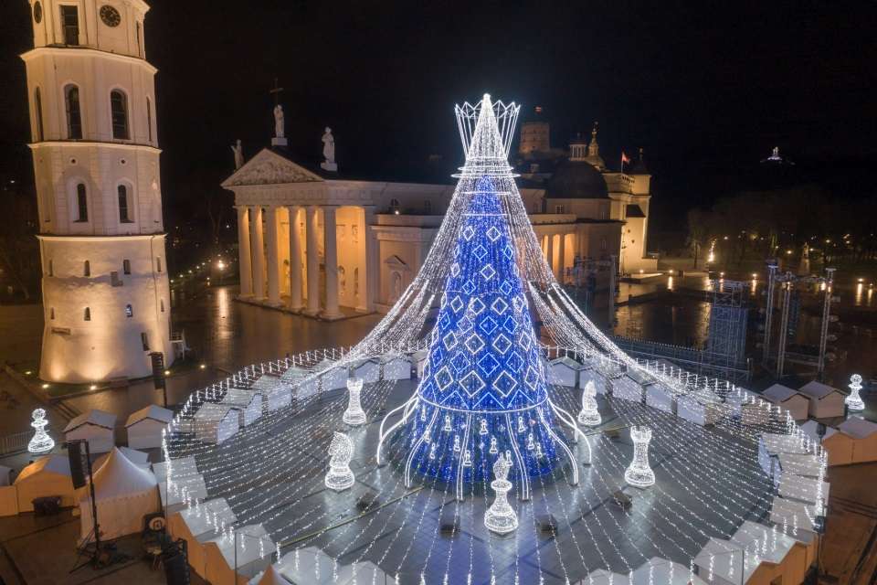
Every town decorates a Christmas tree every year. Some of the towns make it from real spruce and other towns make it from spruce branch and a metal foundation.
Ignalina‘s Christmas tree
Capital city Vilnius Christmas Tree

Slide 6
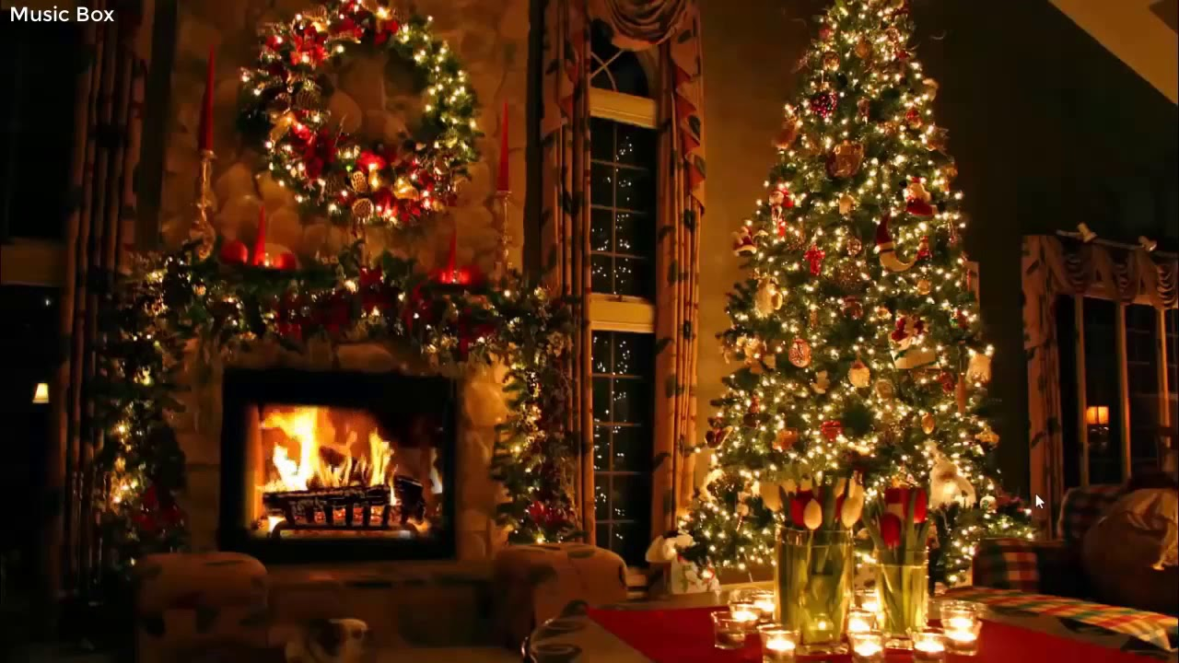
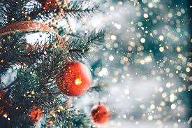
So, the Christmas tree is a very important thing nowadays. If you don‘t have a Christmas tree in your house, you won‘t have holidays spirit at your home.

Slide 7
Preparation for the Christmas evening

Slide 8
Preparation for the Christmas eve isn't just getting the dishes ready, there's a lot more.
For example cleaning yourself and your home, or paying back the loans and saying sorry to people you caused something bad to.
To get ready for this magical eve young and old work, decorate the Christmas tree which was very important, decorate the house itself and others, just feed animals and do routine works as that.
But the important part was the foods. There should be 12 dishes on the table and you have to taste all of them. Every dish for every month of the year.

Slide 9
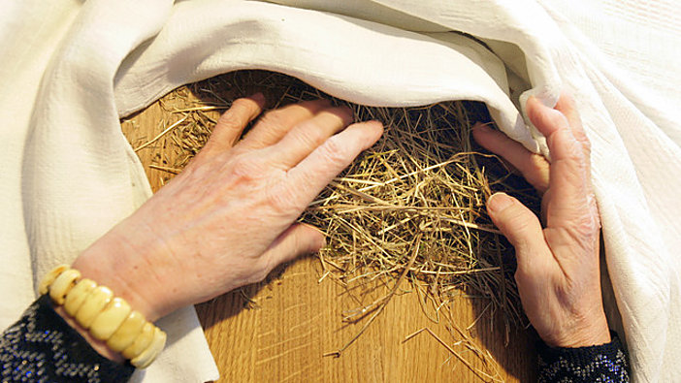

Slide 10
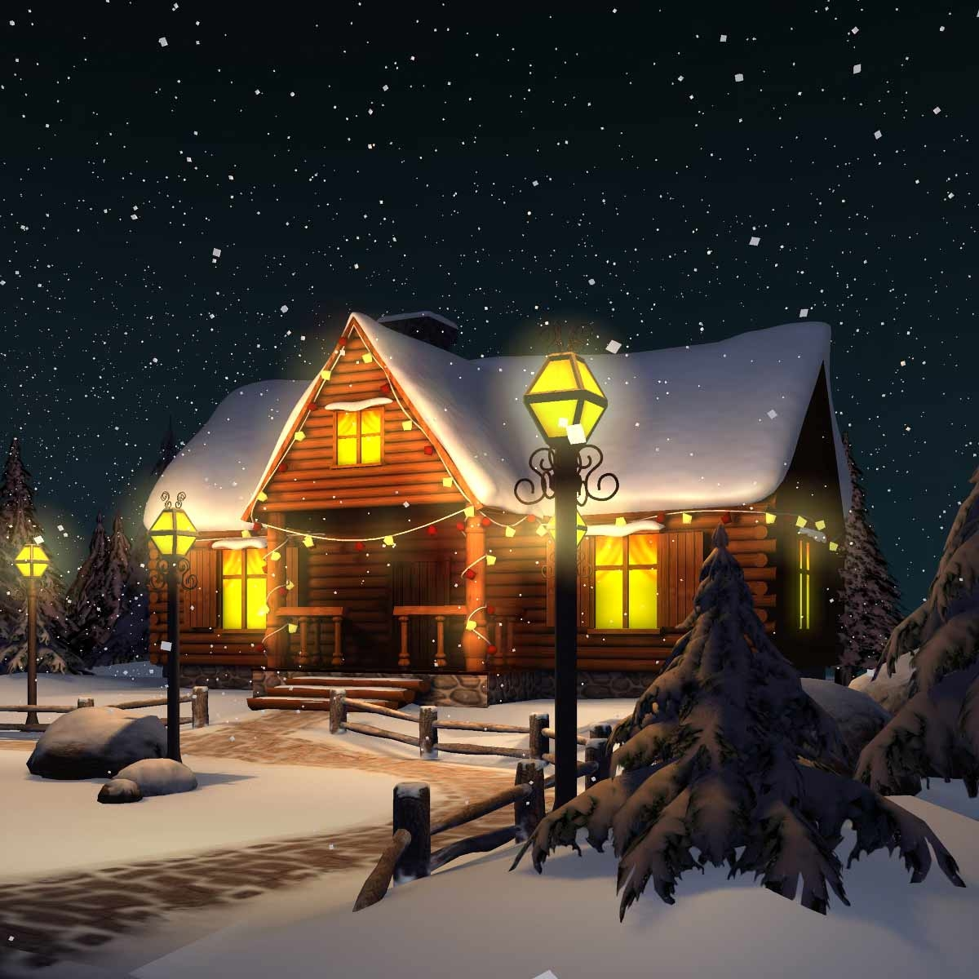
Notes:
Neighbours visiting

Slide 11
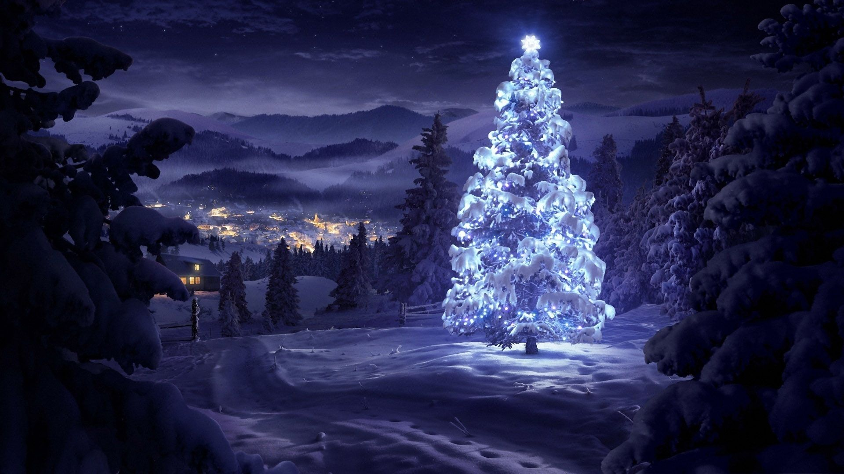

Slide 12
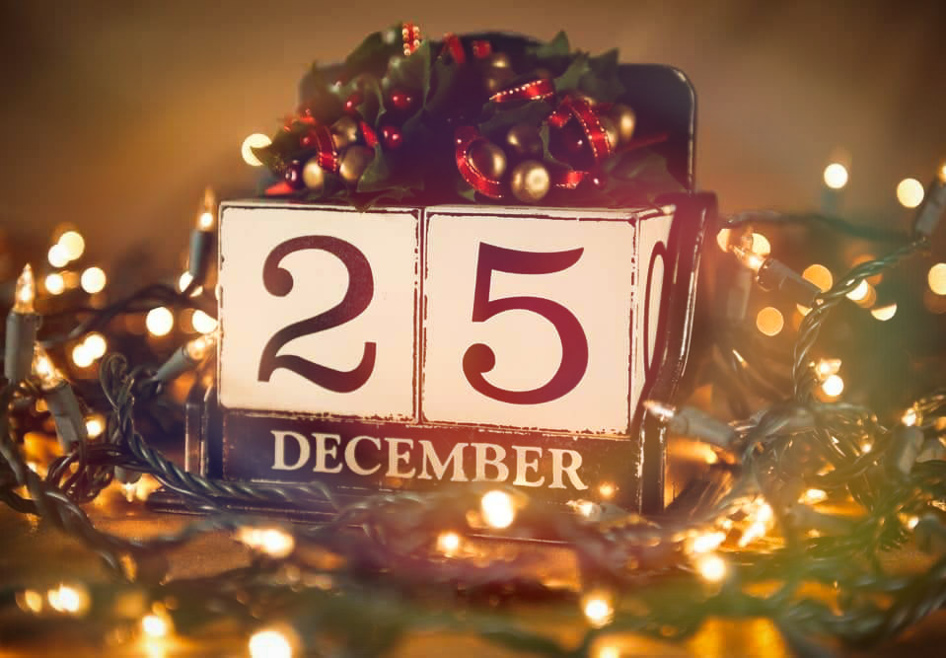

Slide 13
On the first day of Christmas, families should mostly stay together, they shouldn‘t go out anywhere and should wake up early in order to uncover the Christmas eve's table. Leftovers and straw left from the table are given to animals.

Slide 16
On the second day it was appropriate to have guest's to come over.
Often Christmas makers would show up dressed up as animals. They would sing some songs and ask for food and money which people had to invite inside and groom, though if they started talking and not sing, people would not let them in. After sharing your kindness people would wait for double the amount of it next year

